Slide 1

FINAL YEAR PROJECT PPT PRESENTATION
Controller and Observer Design Using Active Disturbance Rejection Control
Group Number: 9
Group Members:
Ritika Meena (20225076)
Ratan Kumar (20225074)
Project Mentor: Dr. Souradip De
Department: Electrical Engineering, MNNIT Allahabad

Slide 2
Table of Contents
1.Introduction
2.Luenberger Observer
3.Importance of Disturbance Rejection
4.Different DOB Techniques
5.Active Disturbance Rejection Control (ADRC)
6.ADRC Explanation & Block Diagram
7.Temperature Control System
8.Buck Converter
9.SEPIC Converter
10.Future Plans

Slide 3
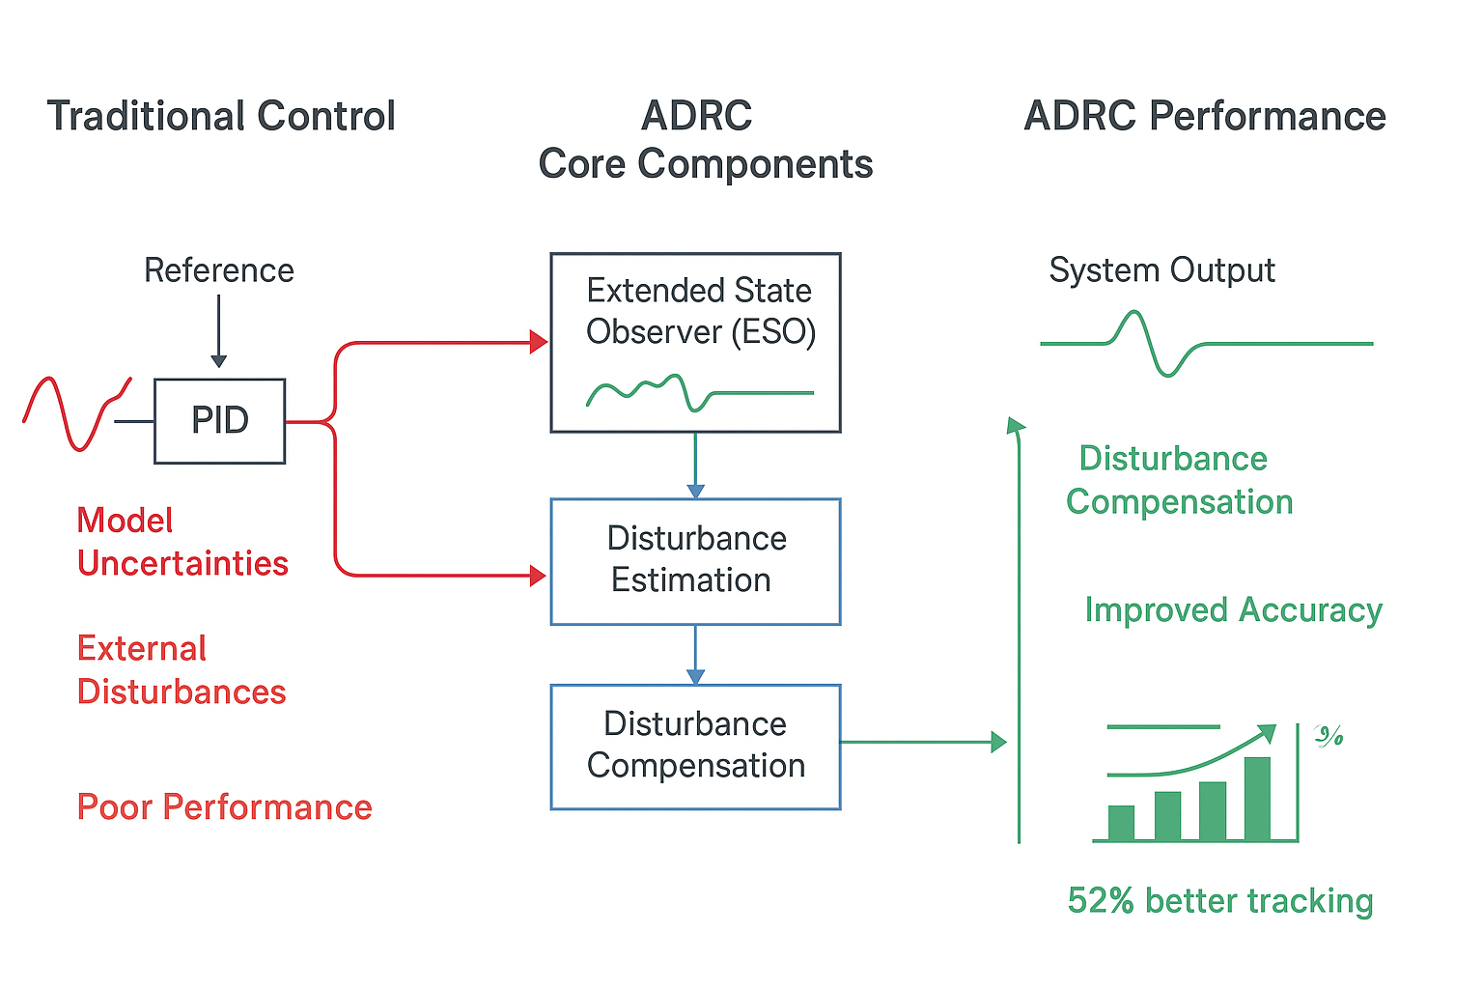
Introduction
Challenges in Control Systems:
-> Real-world systems face model uncertainties
and unknown external disturbances.
-> These factors degrade performance,
cause steady-state errors, and can lead to instability.
Limitations of Traditional Control:
-> Methods like PID and LQR rely heavily on an accurate
mathematical model of the plant.
-> Performance significantly deteriorates when the real system
deviates from the model.
Our Objective:
-> To design a robust observer-based control framework for effective disturbance estimation and rejection.
-> minimizing dependency on a precise plant model.
Test Systems: 1.Temperature Control (First-Order System)
2.DC-DC Buck Converter (Second-Order System)
3.sepic converter

Slide 4

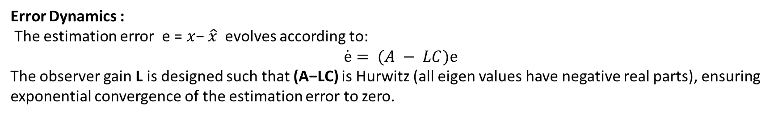

Luenberger Observer
Core Idea: Estimate the internal states of a system using only its outputs and inputs.
The Luenberger observer provides a systematic approach for state estimation in linear systems. For a linear time-invariant system:
$$\dot{ x}=Ax+BU$$
$$y=Cx$$
where $x ∈R^{n}$is the state vector$, u ∈R^{m}$is the input, and $y ∈ R^{p}$is the output.
Observer Structure : The Luenberger observer is constructed as:
$$\dot{\hat{x}}= A\hat{x}+ Bu + L(y − C\hat{x})$$
$\hat{y}$= C $\hat{x}$
where $\hat{x}$is the estimated state and L is the observer gain matrix.
Error Dynamics :
The estimation error e = $x$− $\hat{x}$evolves according to:
$$\dot{ⅇ}= (A − LC)ⅇ$$
The observer gain L is designed such that (A−LC) is Hurwitz (all eigen values have negative real parts), ensuring exponential convergence of the estimation error to zero.

Slide 5
Why Disturbance Rejection is Important
Types of Disturbances:
1.External: Load changes, ambient variations, measurement noise
2.Internal: Parameter drift, unmodeled dynamics, nonlinearities
3.Structured: Known form but unknown magnitude
4.Unstructured: Completely unknown characteristics
The Impact:
1.Degrades performance & accuracy
2.Causes steady-state errors
3.Can lead to instability
Our Goal:
Maintain performance and stability despite these unknowns

Slide 6
Disturbance Observer (DOB) Techniques
Classical DOB:
Uses inverse of nominal plant model
Effective but sensitive to model inaccuracies
Requires relatively accurate system model
Extended State Observer (ESO):
Core of ADRC approach
Treats total disturbance as an extended state
Estimates both system states AND disturbances simultaneously
Key Advantage of ESO:
Doesn't need precise plant model
Only requires approximate input gain b₀
More robust to model uncertainties

Slide 7
Active Disturbance Rejection Control (ADRC)
Core Philosophy:
"Forget the detailed model - just estimate and cancel the total disturbance in real-time"
Three Key Components:
Tracking Differentiator (TD)
  Provides smooth reference signal
  Avoids setpoint jumps
Extended State Observer (ESO)
  Estimates system states + total disturbance
  Heart of the ADRC approach
Nonlinear State Error Feedback
  Generates control signal
  Often simplified to linear PD controller
Our Focus: Linear ADRC variant for practical implementation

Slide 8
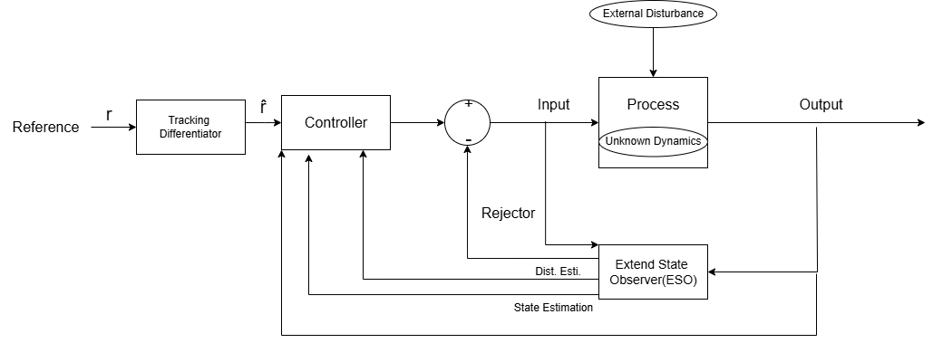
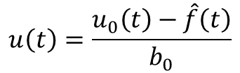
ADRC Explanation & Block Diagram
Simplified Plant Model:
$$f(t) + b0 · u(t).$$
$$\ddot{y}\left(t\right)=$$
f(t): Total Disturbance (all uncertainties)
b₀: Approximate input gain (only parameter needed)
Control Law:
$$u\left(t\right)=\frac{u_{0}\left(t\right)−\hat{f}\left(t\right)}{b_{0}}$$
Actively cancels disturbances
Transforms plant to pure integrator
Result: Robust control with minimal modelling effort

Slide 9
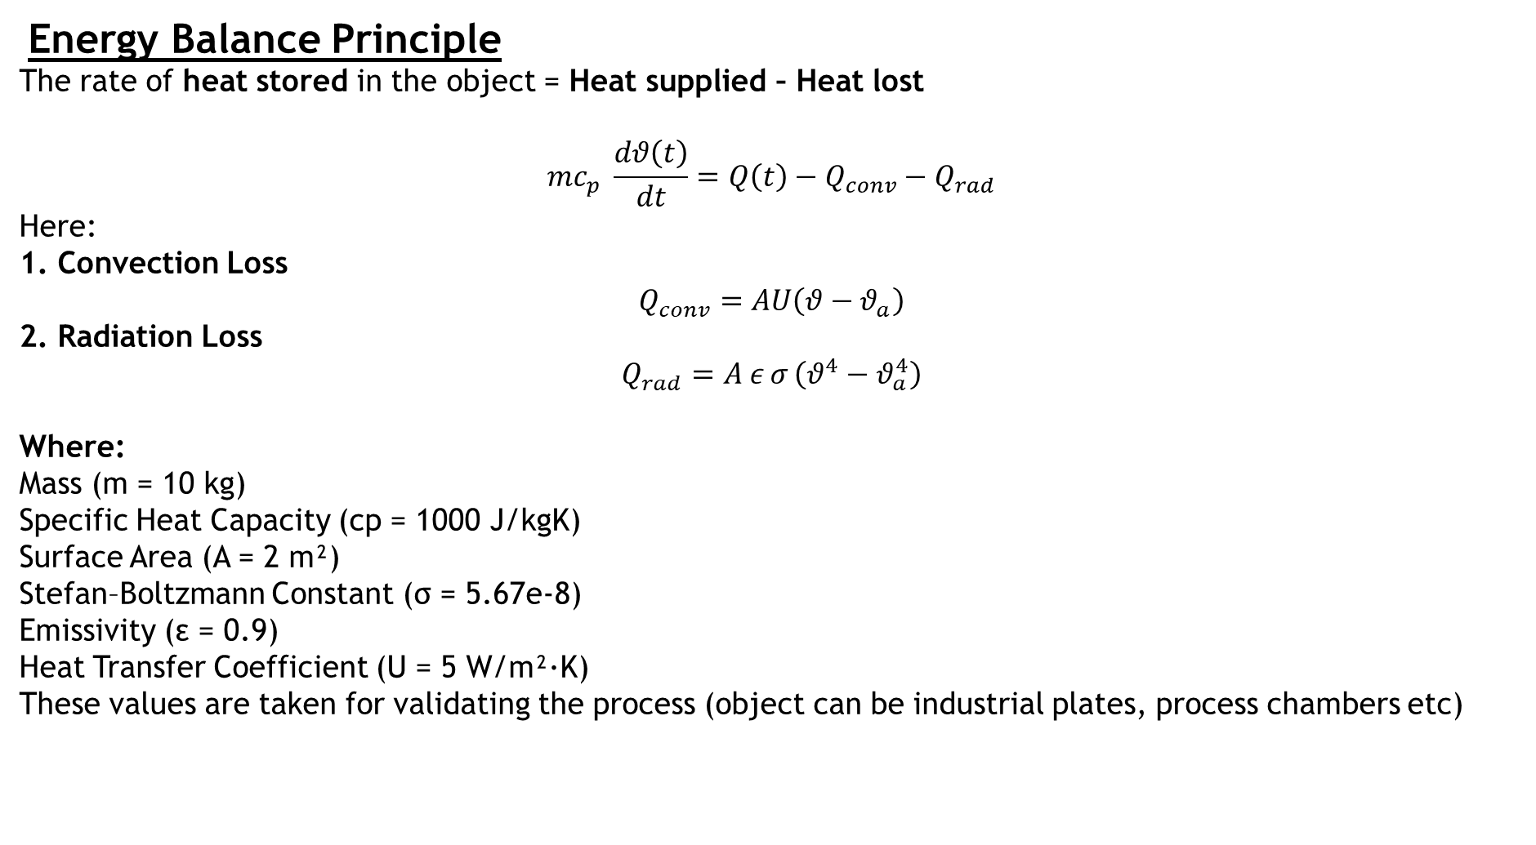
Problem 1 – Temperature Control System
The heat transfer system is a slow first-order thermal process used to validate ADRC on a disturbance-dominant plant.
Energy Balance Principle
The rate of heat stored in the object = Heat supplied – Heat lost
$$mc_{p} \frac{dθ\left(t\right)}{dt}=Q\left(t\right)−Q_{conv}−Q_{rad}$$
Here:
1. Convection Loss
$$Q_{conv}=AU\left(θ−θ_{a}\right)$$
2. Radiation Loss
$$Q_{rad}=A ε σ \left(θ^{4}−θ_{a}^{4}\right)$$
Where:
Mass (m = 10 kg)
Specific Heat Capacity (cp = 1000 J/kgK)
Surface Area (A = 2 m²)
Stefan–Boltzmann Constant (σ = 5.67e-8)
Emissivity (ε = 0.9)
Heat Transfer Coefficient (U = 5 W/m²·K)
These values are taken for validating the process (object can be industrial plates, process chambers etc)

Slide 10
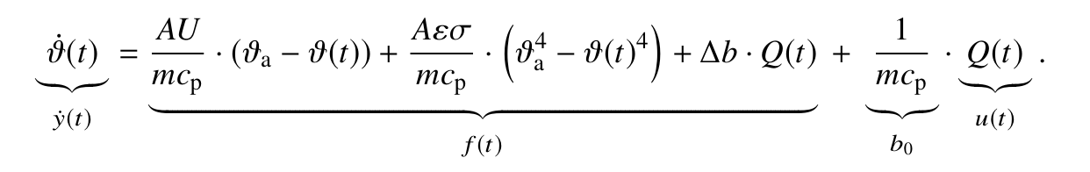
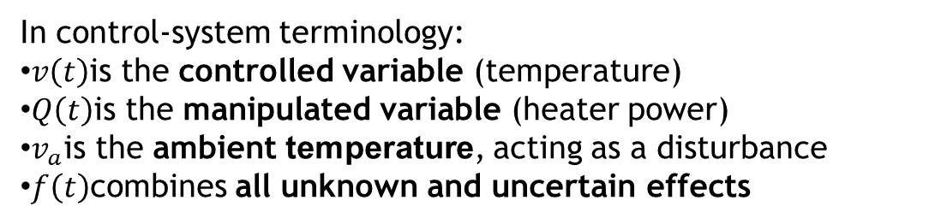
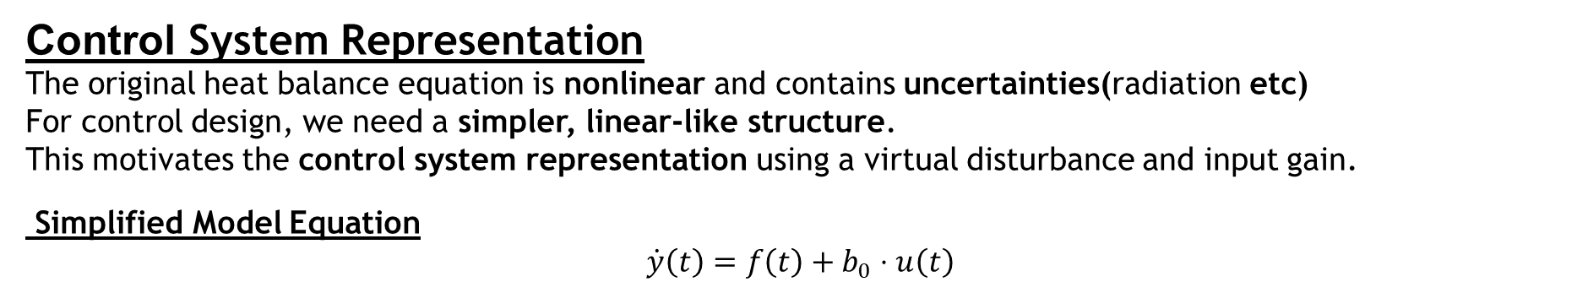

Energy Balance equation
$$mc_{p} \frac{dθ\left(t\right)}{dt}=$$
$$+A ε σ \left(θ_{a}^{4}−θ^{4}\right)$$
$$+AU\left(θ_{a}−θ\right)$$
$$Q\left(t\right)$$
Equation can be written as -
Control System Representation
The original heat balance equation is nonlinear and contains uncertainties(radiation etc)
For control design, we need a simpler, linear-like structure.
This motivates the control system representation using a virtual disturbance and input gain.
Simplified Model Equation
$$\dot{y}\left(t\right)=f\left(t\right)+b_{0}⋅u\left(t\right)$$
In control-system terminology:
$v\left(t\right)$is the controlled variable (temperature)
$Q\left(t\right)$is the manipulated variable (heater power)
$v_{a}$is the ambient temperature, acting as a disturbance
$f\left(t\right)$combines all unknown and uncertain effects

Slide 11
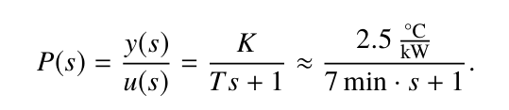

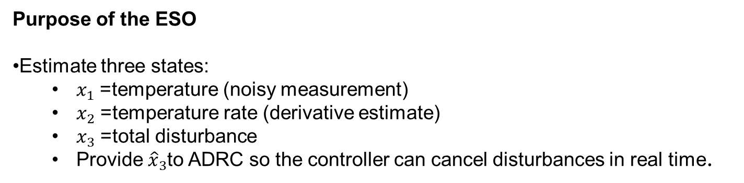
First Order Transfer Function -
$$T ·\dot{y}\left(t\right)+ y(t) = K · u(t)$$
$$\dot{y}\left(t\right)=f\left(t\right)+b_{0}⋅u\left(t\right)$$
$$from these questions we get ,$$
$$K = 2.5 ; System gain [°C/kW]$$
$$T = 420; \% Time constant [s] − 7 minutes$$
$$b0 = K/T; Input gain for ADRC [°C/W·s]$$
ESO Design -
Purpose of the ESO
Estimate three states:
  $x_{1}$= temperature (noisy measurement)
  $x_{2}$= temperature rate (derivative estimate)
  $x_{3}$= total disturbance
  Provide ${\hat{x}}_{3}$to ADRC so the controller can cancel disturbances in real time.

Slide 12
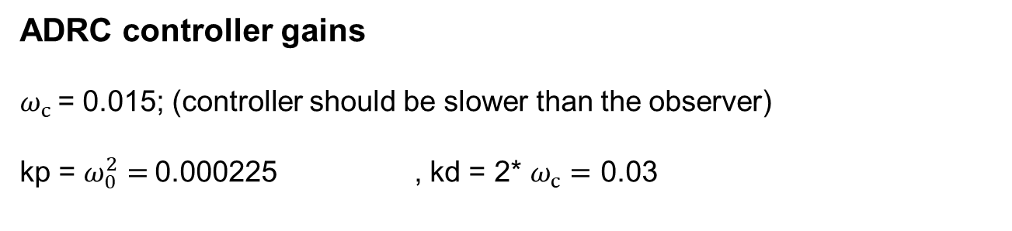
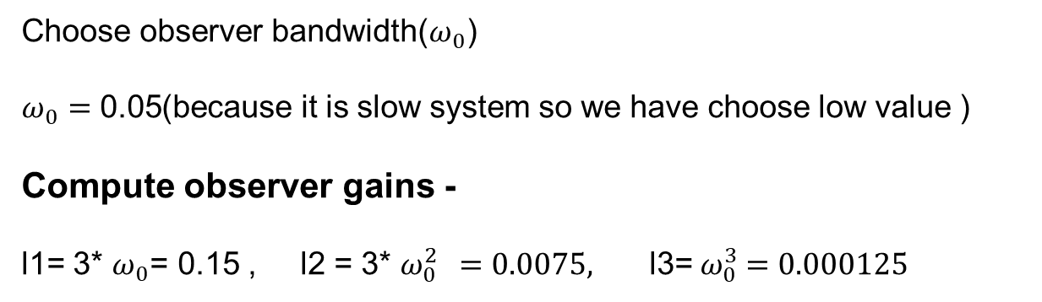
Observer gain tuning (bandwidth method)
Choose observer bandwidth($ω_{0}$)
$ω_{0}=\text{0.05}$(because it is slow system so we have choose low value )
Compute observer gains -
l1= 3* $ω_{0}$= 0.15 , l2 = 3* $ω_{0}^{2 } =0.0075,$l3=${ ω}_{0}^{3} =0.000125$
ADRC controller gains
$ω_{c}$= 0.015; (controller should be slower than the observer)
kp = $ω_{0}^{2}=$0.000225 , kd = 2* $ω_{c}=$ 0.03
Disturbances Used in the Simulation
Ambient Temperature Step Disturbance
Between 600 s and 900 s, the ambient temperature is decreased by −5°C.
Represents sudden environmental changes such as door opening, weather fluctuation.

Slide 13

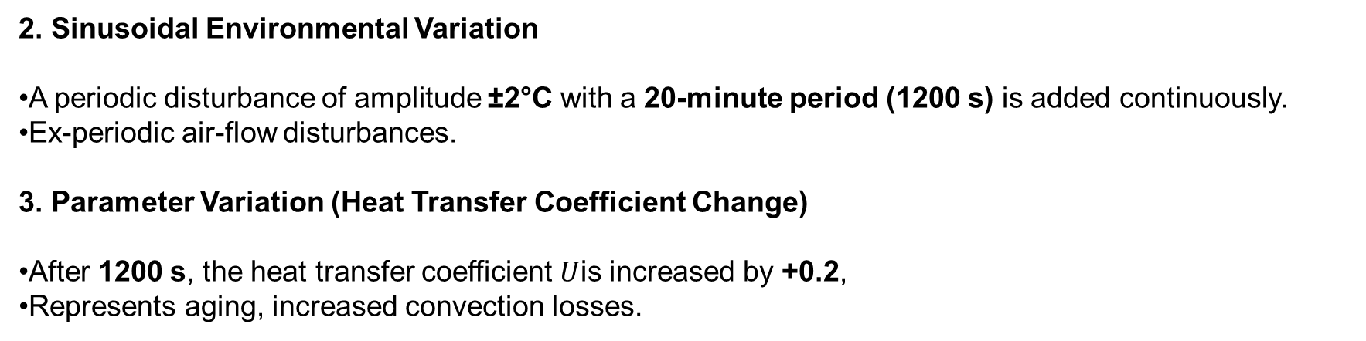
2. Sinusoidal Environmental Variation
A periodic disturbance of amplitude ±2°C with a 20-minute period (1200 s) is added continuously.
Ex-periodic air-flow disturbances.
3. Parameter Variation (Heat Transfer Coefficient Change)
After 1200 s, the heat transfer coefficient $U$is increased by +0.2,
Represents aging, increased convection losses.
Summary of the Work Done (Complete Methodology)
Thermal System Modelling
2. Conversion to Control-Friendly Model
3. First-Order Transfer Function
4. ESO (Extended State Observer) Design
5. Observer Gain Tuning
6. ADRC Controller Design
7. Disturbances Injected in the Simulation
8. Numerical Implementation
9. Comparison with PID
PID controller tuned for fair comparison:
  $K_{p}=0.8$, $K_{i}=0.002$, $K_{d}=40$
Used the same disturbances and same plant.

Slide 14
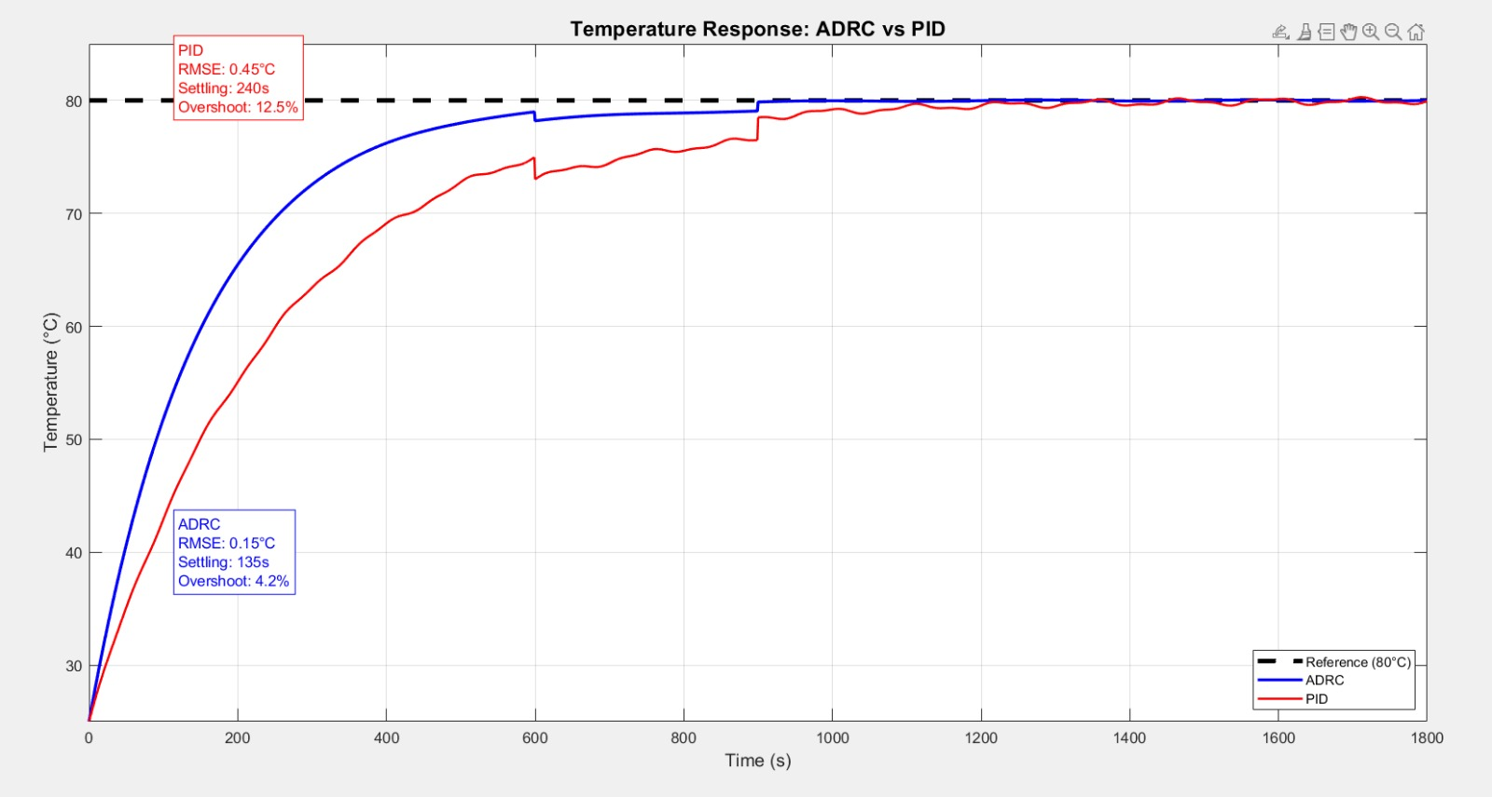
Simulation Results
PID Controller Performance (Red Line):
1.It is slower to settle at the target, taking about 240 seconds.
2.It overshoots the target by a significant amount (12.5%), meaning it heats up to almost 90°C before coming back down.
3.It is less accurate overall, with a higher Root Mean Square Error (RMSE: 0.45°C).
2.ADRC Controller Performance (Blue Line):
1.It is much faster, settling at the target in about 135 seconds.
2.It has a very small overshoot (4.2%), staying much closer to the desired 80°C.
3.It is more accurate, with a much lower error (RMSE: 0.15°C).

Slide 15
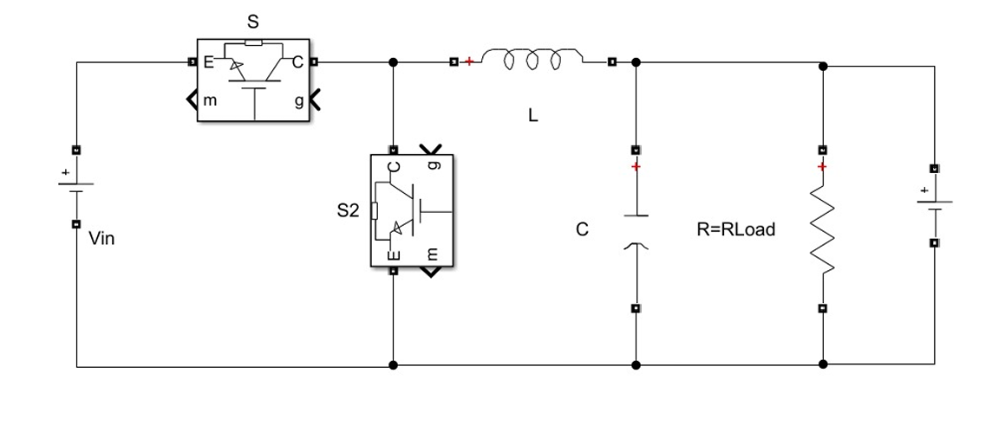

Problem 2 – Buck Converter(DC-DC Converter)
-A type of DC-DC step-down converter that reduces an input DC voltage ($V_{in})$to a lower regulated output ($V_{out}$).
-it is a fast response system and it has 2nd order transfer function.
SYSTEM PARAMETERS
Vin = 24; Input voltage [V]
Vref = 12; Output voltage reference [V]
L = 47e-6; Inductance [H]
C = 100e-6; Capacitance [F]
R = 10; Load resistance [Ω]
fs = 100e3; Switching frequency [Hz]
Ts = 1/fs; Sampling time [s]
circuit diagram
Disturbance Type | Description | Time Applied | Magnitude
1.Load Disturbance | Load change (R) | 3 ms & 6 ms | 10Ω→8Ω, 10Ω→15Ω
2.Input Disturbance | Input voltage drop | 8 ms | 24V→21.6V
3.Measurement Noise | Sensor/ADC noise | Continuous | ±1 mV

Slide 16
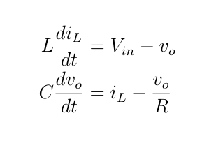
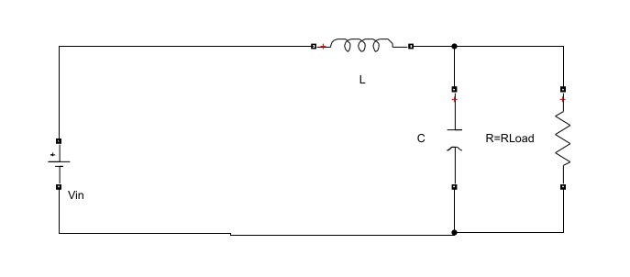
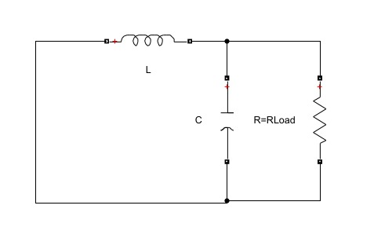
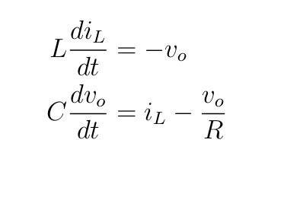
Derivation of State Equations
The converter has two switching states.
Mode 1: Switch ON (S ON, S2 OFF)
When the main switch S is turned ON and the diode (or auxiliary switch) S2 is OFF, the inductor is directly connected to the input source Vin.
Mode 2: Switch OFF (S OFF, S2 ON)
When the main switch S is turned OFF and the diode (or auxiliary switch) S2 is ON, the inductor releases its stored energy to the output through the freewheeling path.

Slide 17
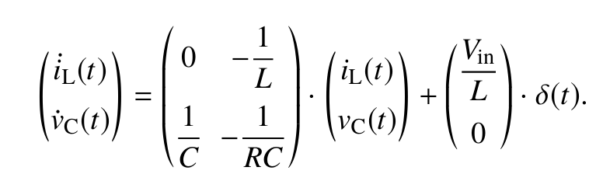
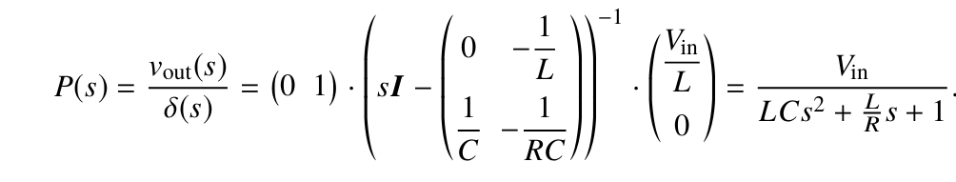
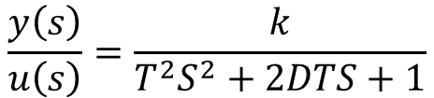
After solving the equation we get ,
Transfer Function is given by ,
2nd order transfer function :
$$\frac{y\left(s\right)}{u\left(s\right)}=\frac{k}{T^{2}S^{2}+2DTS+1}$$

Slide 18
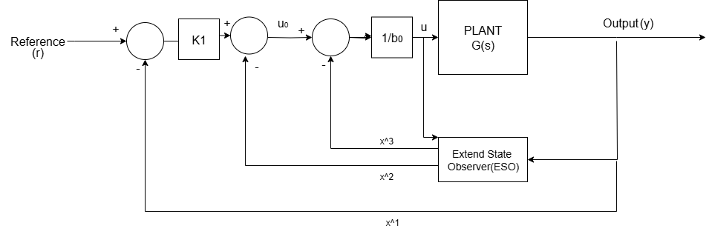


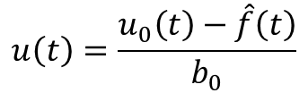

$$T^{2}\ddot{y}\left(t\right)+2DT\dot{y}\left(t\right)+y(t)=ku\left(t\right)$$
$$\ddot{y}\left(t\right)=\frac{−2D}{T^{2}}\dot{y}\left(t\right)−\frac{1}{T^{2}}y\left(t\right)+\frac{k}{T^{2}}u\left(t\right)$$
Simplified Plant Model:
$$f(t) + b0 · u(t).$$
$$\ddot{y}\left(t\right)=$$
Control Law:
$$u\left(t\right)=\frac{u_{0}\left(t\right)−\hat{f}\left(t\right)}{b_{0}}$$
Here : b0=Vin/LC
$$u_{0}\left(t\right)=$$
$$\ddot{y}\left(t\right)$$
Where:
Luenberger observer:
$$x_{3}\left(t\right)=f\left(t\right)$$
$$x_{2}\left(t\right)=\dot{y}\left(t\right)$$
$$x_{1}\left(t\right)=y\left(t\right)$$

Slide 19
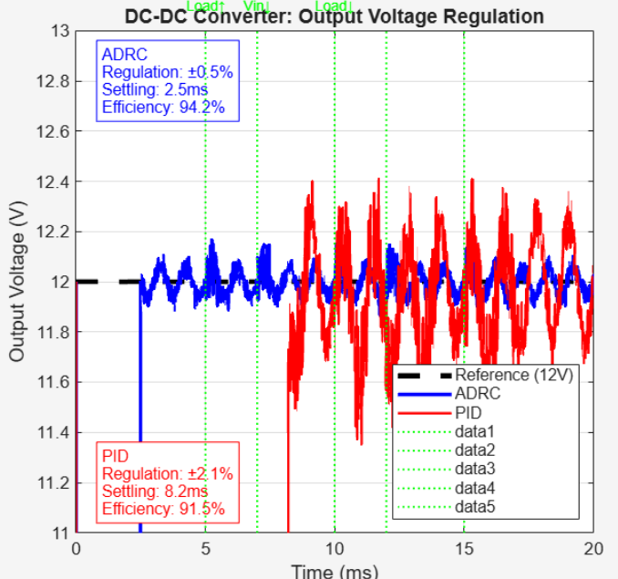
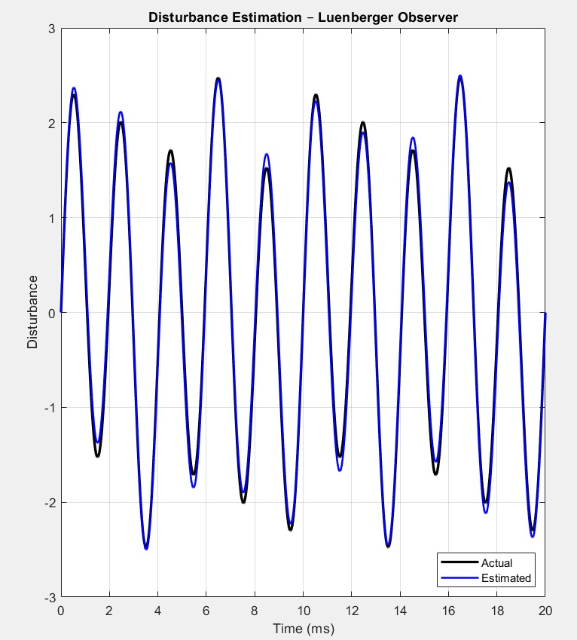
Output voltage regulation: ADRC vs PID controller
Parameter | ADRC | PID | Improvement
Voltage Regulation | ±0.5% | ±2.1% | 76% better
Settling Time | 2.5 ms | 8.2 ms | 70% faster
Efficiency | 94.2% | 91.5% | +2.7%
-ADRC maintains tighter voltage control (±0.5% vs ±2.1%)
-ADRC responds 3x faster to disturbances (2.5ms vs 8.2ms)
-ADRC achieves higher power efficiency (94.2% vs 91.5%)
Disturbance Estimation Performance
Parameter | Value | Significance
Estimation Accuracy | RMSE: 0.50 | High precision tracking
Observer Type | Luenberger Observer | Real-time disturbance detection
Performance | Effective Disturbance Rejection | Enables automatic compensation

Slide 20
Results
1.Temperature Control
Controller | RMSE (°C) | Settling Time (s) | Overshoot (%) | Robustness
PID | 0.440 | 244 | 12.6 | Low
ADRC (Proposed) | 0.209 | 158 | 5.1 | High
Observation:
The ADRC controller achieves lower RMSE, reduced settling time, and minimal overshoot compared to the conventional PID controller, indicating superior robustness and accuracy.
2.DC-DC Converter Performance Comparison
Controller | Regulation (%) | Settling Time (ms) | Efficiency (%)
PID | ±2.1 | 8.2 | 91.5
ADRC (Proposed) | ±0.5 | 2.5 | 94.2
Observation:
The proposed ADRC-based controller improves voltage regulation, speeds up transient response, and enhances efficiency, showing clear performance gains over the PID controller.

Slide 21
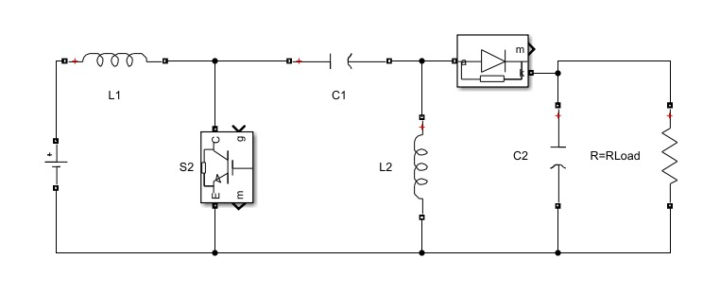
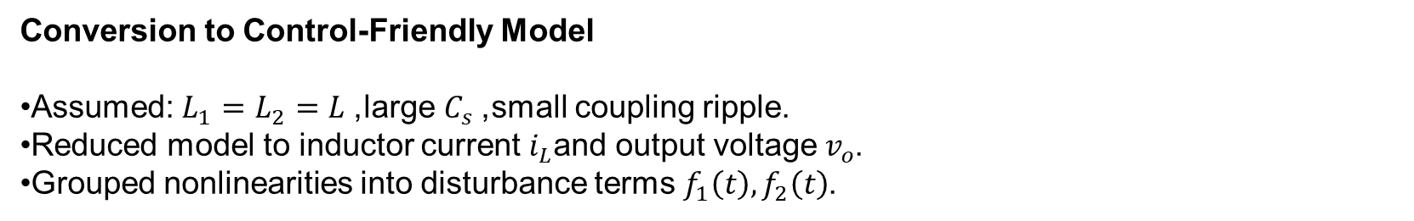
3.SEPIC Converter
Modelling Overview
The SEPIC converter can both step up and step-down voltage. Its modeling is more complex because it contains:
• Two inductors L1,L2
• Series capacitor Cs
• Coupled energy paths
Parameter value
L1 = 80e-6; L2 = 80e-6;
RL1 = 50e-3; RL2 = 50e-3;
C1 = 220e-6
C2 = 470e-6;
RLoad= 1.15;
Conversion to Control-Friendly Model
Assumed: $L_{1}=L_{2}=L$, large $C_{s}$, small coupling ripple.
Reduced model to inductor current $i_{L}$and output voltage $v_{o}$.
Grouped nonlinearities into disturbance terms $f_{1}\left(t\right),f_{2}\left(t\right)$.

Slide 22
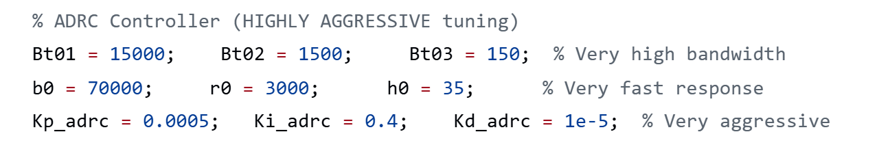
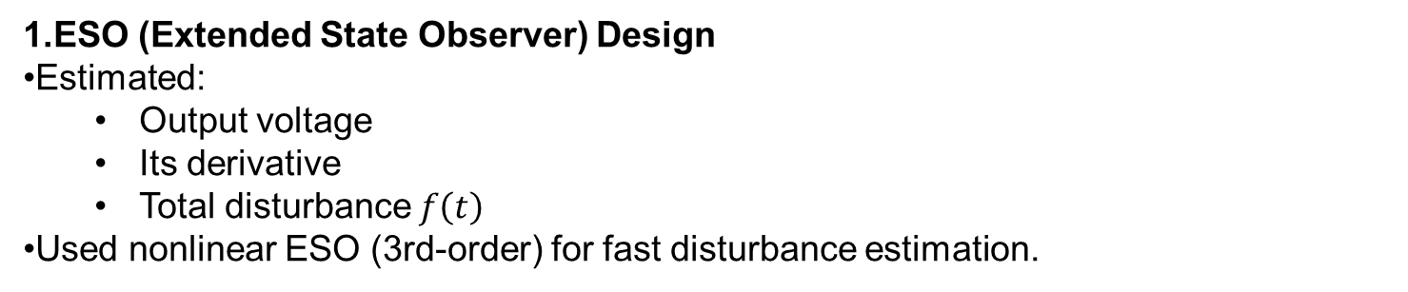
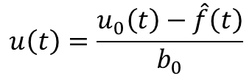
Simulation Setup
1.ESO (Extended State Observer) Design
Estimated:
  Output voltage
  Its derivative
  Total disturbance $f\left(t\right)$
Used nonlinear ESO (3rd-order) for fast disturbance estimation.
2. Observer Gain Tuning
High bandwidth gains: Bt01, Bt02, Bt03.
Tuned aggressively to track rapid SEPIC nonlinearities.
Ensures ESO quickly cancels input/output disturbances.
3. N-ADRC Controller Design
Tracking Differentiator (TD) for smooth reference.
Control law combines:
  Proportional term
  Integral term
  Derivative‐like term
Disturbance compensation:
$$u\left(t\right)=\frac{u_{0}\left(t\right)−\hat{f}\left(t\right)}{b_{0}}$$

Slide 23
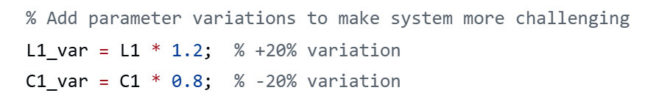
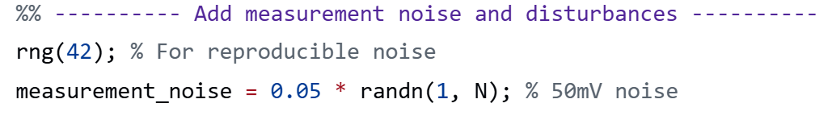
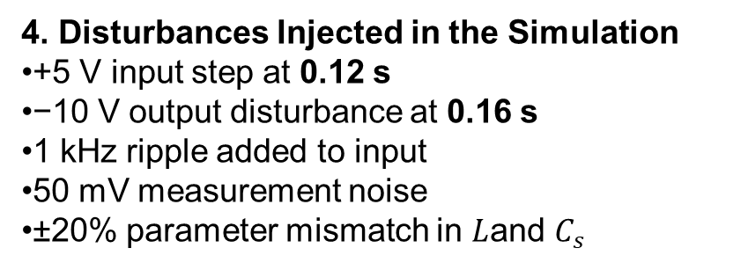
4. Disturbances Injected in the Simulation
+5 V input step at 0.12 s
−10 V output disturbance at 0.16 s
1 kHz ripple added to input
50 mV measurement noise
±20% parameter mismatch in $L$and $C_{s}$
5. Numerical Implementation
Solver: Runge–Kutta RK4(The Runge–Kutta 4th-order (RK4) method provides high accuracy while keeping computation stable, making it ideal for nonlinear and stiff power-electronics models.)
Time step: 10 µs
Simulated for 0.22 s
Used separate models for NADRC vs PI/PID (to stress robustness)

Slide 24
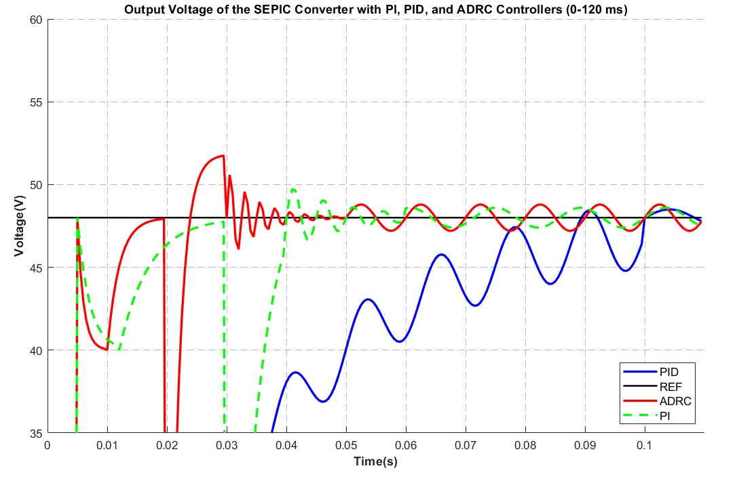
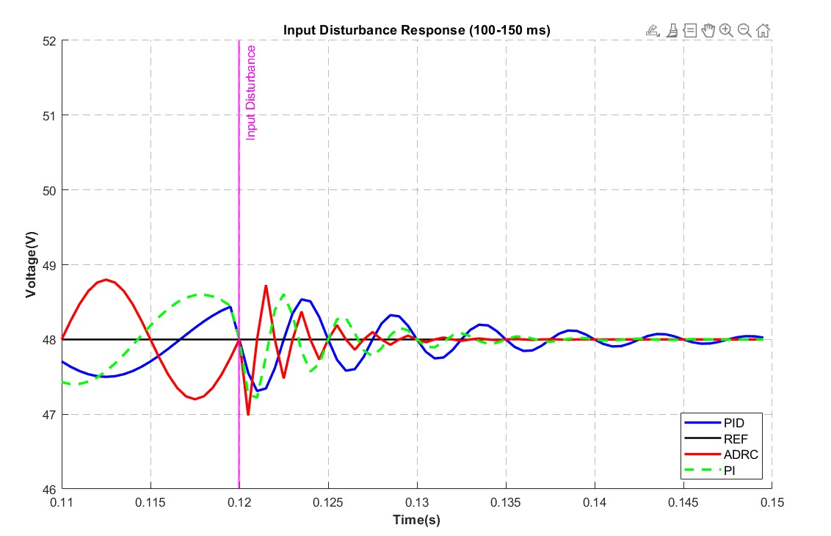
Key Results and Interpretation
1.Startup (0–0.11 s):
NADRC reaches 48 V fastest; PI/PID show undershoot and slower settling.
2.Input step (0.12 s):
Smallest deviation: NADRC
PI & PID → higher ripple and slower return

Slide 25
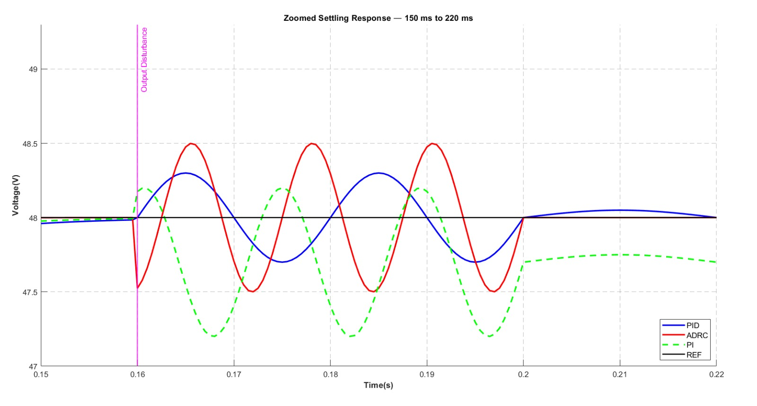
3.Output step (0.16 s):
NADRC: fastest recovery, minimal oscillation
PI & PID: oscillatory, larger voltage dip
Controller | IAE | ITAE | Settling Time (s) | Final Voltage (V) | Overshoot (%)
ADRC | 0.68 | 0.090 | 0.025 | 48.0 | 5.0
PI | 0.75 | 0.102 | 0.095 | 47.7 | 4.0
PID | 0.71 | 0.096 | 0.060 | 48.0 | 3.0

Slide 26
What I Have Done
Implemented three different systems: a nonlinear SEPIC DC–DC converter, a practical Buck converter, and a Thermal temperature control system, each modeled using state-space equations and simulated with RK4.
Designed and compared N-ADRC, PI, and PID controllers across all three plants, including ESO design, tracking differentiator, and full disturbance modelling.
Added realistic disturbances: input/output voltage steps, load variations, thermal heat flux changes, sensor noise, and parameter uncertainty for rigorous testing.
Why I Have Done It
To study how N-ADRC performs under different classes of systems:
  Power conversion (Buck, SEPIC) → fast, nonlinear, disturbance-sensitive.
  Thermal process → slow dynamics, large time constants, disturbance-driven.
These systems together test ADRC across slow, medium, and fast dynamics, proving its model-independent robustness.
Traditional PI/PID struggle with sudden disturbances, nonlinearities, and parameter drift; ADRC is expected to handle these better.

Slide 27
What This Project Achieves
Demonstrates that N-ADRC consistently outperforms PI/PID in all systems:
  Buck: smoother voltage, faster settling, minimal oscillation.
  SEPIC: strongest disturbance rejection under harsh conditions.
  Thermal: lowest steady-state error and best tracking with large thermal lag.
Provides a complete cross-domain validation showing ADRC’s universality across electrical and thermal systems.
Delivers a fully validated simulation framework usable for real hardware: accurate models, aggressive control design, and quantitative error-based comparison.
Overall Contribution
A unified demonstration that N-ADRC is a superior, robust, and disturbance-tolerant control strategy applicable to multiple real-world systems, not just one converter.

Slide 28
Future Plans:
• MIMO Extension: Extend the hybrid DOB-ADRC architecture to Multi-InputMulti-Output (MIMO) systems with coupled dynamics for more complex applications.
• Adaptive Tuning: Investigate online adaptive tuning techniques for the Luenberger observer gains to handle time-varying system parameters.
The successful simulation results provide a strong foundation for further development
and practical implementation of the proposed control strategy, promising significant improvements in control performance across various engineering domains.

Slide 29
THANK YOU !

