Slide 1
GameEngine
Structure
ver. 2.0.0 dev

Slide 2
Root folder
bin
resource
src
document
map
library
test
main
interface
target
resource
text
java
java
src
texture
Engine folder
Pom.xml
model
README.md
other

Slide 3
GameEngine components
src
main
game
engine
java
editor
physic
source

Slide 4
Game component
game
your package
your package
main
your package
your main class
Settings.xml

Slide 5
Game component
Your main class
your main class
Extends “game.game.Game” class from Engine component
Overrides method __onStart() - [add “super.__onStart()” before code]
Overrides method __onUpdate()
Overrides method __onUpdateWithPause() - [optional]

Slide 6
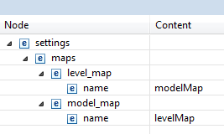
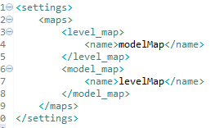
Game component
Settings.xml
Settings.xml
modelMap.xml
resource
map
levelMap.xml

Slide 7
Game component
Usable services

Slide 8
Engine component
engine
1
2
3
4
5
6
core
game
object
renderer
shader
tool

