Slide 1
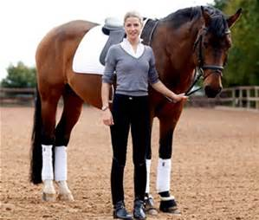
Goal: Find the Perfect Pony
This stage can last a year or more. Our customers are quite deliberate.
Contact
(email,
phone)
Decision to consider Gotlands specifically
Age/
Height
w?
how?
Show?
Young
Rider
Pony
how?
Gotlands
Famous
Breed?
Pure-
bred
Price
Perform
how?
how?
Lease or
Buy?
Jumping/
Driving
Sport
Kathleen
“Convince me that this pony is worth the asking price.”
Must address these criteria on our site, through text, images and video!

