Slide 1
Spot Pet Insurance: GEO Prompt Analysis
AI Search Visibility & Opportunity Assessment
October 27, 2025

Slide 2

Executive Summary
We Tested 452 Prompts Across 6 AI Platforms
The Reality: We're Invisible on 85% of Queries
452
384
61
6
Prompts Analyzed
Zero Visibility
Low Visibility
Strong Visibility
Across ChatGPT, Gemini, Perplexity, Copilot, Google AI, and Claude
85% of prompts where competitors dominate completely
16% visibility, ready to scale with focused effort
33% visibility on proven winners to replicate
Bottom Line: Only 68 prompts (15%) show any Spot visibility. Competitors own 85% of the AI search conversation—representing roughly 343 prompts daily where we're completely absent while competitors appear.

Slide 3
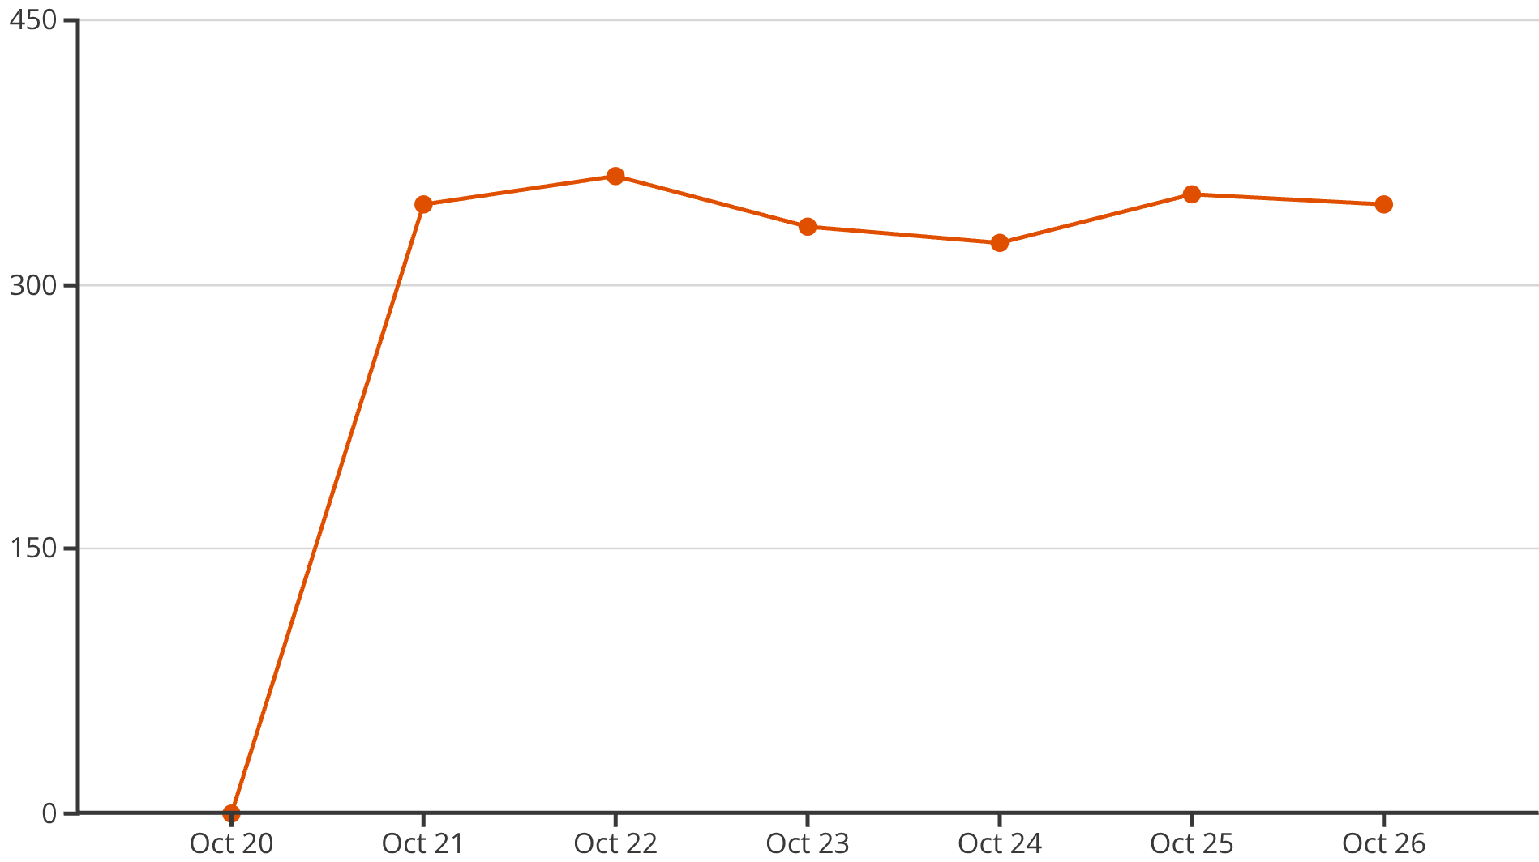
The Problem: We're Missing While Competitors Show Up
Visibility Gap Tracking (Started Oct 21st)
Average Daily Gap: 343 Prompts
The gap fluctuates between 324-361 prompts daily, representing 76% of all prompts tested where competitors are mentioned but Spot is not.
Key Insight: This visibility gap is where we're losing market share in AI search. Every day, potential customers receive AI recommendations without ever hearing about Spot.

Slide 4

What's Working: Our 33% Visibility Winners
6 Prompts Where We're Winning (Learn & Replicate)
Perks & Discounts
Wellness Care
"pet insurance companies with member discounts and extra perks"
"compare pet insurance wellness plans which ones cheapest with good preventive care benefits"
33% visibility, +8% growth momentum
33% visibility, +33% growth momentum
Fast Claims Processing
Branded Search
"best pet insurance fastest claims processing"
"most affordable dog insurance options under 50 dollars monthly budget"
33% visibility, +33% growth momentum
33% visibility, +33% growth momentum
Winning Pattern Identified: Wellness care, affordability messaging, discount transparency, and fast claims processing drive our strongest AI visibility. These themes resonate with AI recommendation algorithms and should inform all content strategy.

Slide 5
Biggest Opportunity Topics
Where We Need to Win (Top 9 by Volume)
Rank
Topic
Prompts
Current Performance
1
Fast Claims Processing
46
Mixed (6 at 16%, rest at 0%)
2
Employer Benefits
46
Mostly 0% visibility
3
Hereditary/Chronic Conditions
45
Mostly 0% visibility
4
No Network Restrictions
45
Mixed performance
5
Puppy & Kitten Insurance
45
Mostly 0% visibility
6
Multi-Pet Insurance
45
3 at 16%, rest at 0%
7
Dogs & Cats General
45
Mostly 0% visibility
8
Wellness & Preventive Care
44
Some 33% winners
9
Accident & Illness Coverage
44
Mostly 0% visibility

Slide 6
High-Value Opportunities: 5 Prompts to Prioritize
1
Multi-Pet Coverage
2
Fast Claims Processing
3
Budget Multi-Pet
"affordable pet insurance that covers both dogs and cats under one plan"
"best pet insurance fastest claims processing"
"cheapest pet insurance for household with multiple dogs and cats"
Current: 16% visibility (+16% growth)
Current: 33% visibility (+33% growth) ✓ Top Tier
Current: 16% visibility (stable, not growing)
Why It Matters: Directly aligns with Priority #1 Add-a-Pet initiative. Multi-pet households represent high lifetime value customers. We lead ChatGPT at 72% share of voice.
Why It Matters: Already winning with strong upward momentum. Our 2-3 day processing time is a competitive advantage that resonates in AI recommendations.
Why It Matters: Combines affordability messaging with multi-pet targeting—the largest addressable market segment for cost-conscious pet parents with multiple animals.
Action: Amplify multi-pet discount content, create side-by-side comparison guides, and actively target high-authority review sites with our multi-pet value proposition.
Action: Protect and amplify this strength. Position as "speed + vet freedom" versus Trupanion's direct pay model which limits provider choice.
Action: Develop transparent pricing content, interactive cost calculators, and comprehensive multi-pet savings guides that demonstrate cumulative discount value.

Slide 7
High-Value Opportunities
Continued
4
Employer Benefits Programs
5
Wellness & Preventive Care
"best companies offering pet insurance employee benefits"
"pet insurance with preventative care add on features"
Current: 16% visibility (+11% growth)
Current: 16% visibility (+16% growth)
Why It Matters: Represents 46 prompts in this category alone, optimizing this content now can aid us as open enrollment period begins.
Why It Matters: Related wellness prompts already achieving 33% visibility prove this is a winning pattern. Wellness add-ons increase per-policy value and demonstrate comprehensive care commitment.
Action: Publish and prominently showcase current partnership success stories, with specific enrollment metrics and data, to optimize for both HR reps doing research, and potential employer policies.
Action: Create comprehensive wellness guides, detailed cost-benefit analyses, and comparison content that positions our preventive care options against competitors.
Common Success Thread: All 5 identified opportunities show existing growth momentum or proven success patterns in related queries. They represent winnable territory with focused content investment and strategic positioning.

Slide 8
Recommended Action Plan
90-Day Sprint to Close the Gap
Primary Goal: Reduce visibility gap from 343 prompts → <250 prompts (27% improvement)
Immediate Actions
Next 30 Days
Multi-Pet Blitz: Create 5-7 high-quality content pieces targeting 16% visibility multi-pet prompts
Target Review Sites: Place content on high-DR platforms (NerdWallet, CNBC, Bankrate) for maximum AI visibility
Protect Winners: Audit all claims content to ensure "2-3 day processing" is prominently featured
Position vs Competition: Establish "speed + vet freedom" narrative against Trupanion's restrictive model
Quick Wins: Identify and create targeted content for 10-15 high-volume 0% visibility prompts
1
2
Short-Term Initiatives
60-90 Days
Employer Benefits Hub: Launch dedicated landing pages with HR resources, partnership case studies, and enrollment tools
Wellness Expansion: Develop interactive cost calculators, comprehensive care guides, and preventive care positioning
Scale Success Patterns: Replicate our 33% visibility strategies across the 61 prompts currently at 16% visibility
Content Partnerships: Establish ongoing relationships with top-tier review and comparison sites

Slide 9
Success Metrics
How We'll Measure Progress
Metric
Baseline
30-Day Target
90-Day Target
Prompts with >0% Visibility
67 (15%)
80 (18%)
100+ (22%)
Prompts at 16%+ Visibility
61
70
85+
Prompts at 33%+ Visibility
6
10
15+
Daily Visibility Gap
343 prompts
310 prompts
<250 prompts
Gap Reduction
0%
10%
27%
Investment Focus Areas
Expected Outcome
High-DR review site content partnerships
Double our AI search visibility footprint in 90 days while establishing defensible content moats in our strongest performing categories and winning back branded search territory.
Educational content for informational queries
Multi-pet and wellness topic authority
Employer benefits B2B content development

