Slide 1
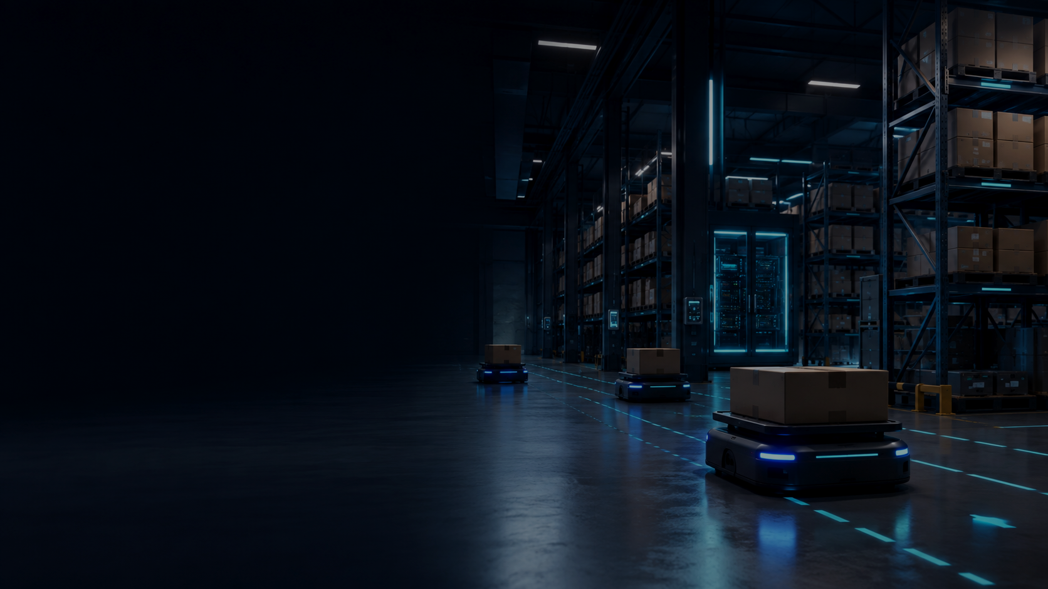
BUSINESS CONTEXT
Warehouses are becoming automated — but the world stays messy.
Robots fail when operations change faster than their scripted workflows can adapt.
Pitch: simulate real-world incidents before robots meet them.
Reality
Problem
Need
boxes fall, aisles block, layouts change
automation is brittle without event practice
local AI that can reason + control safely
01

Slide 2
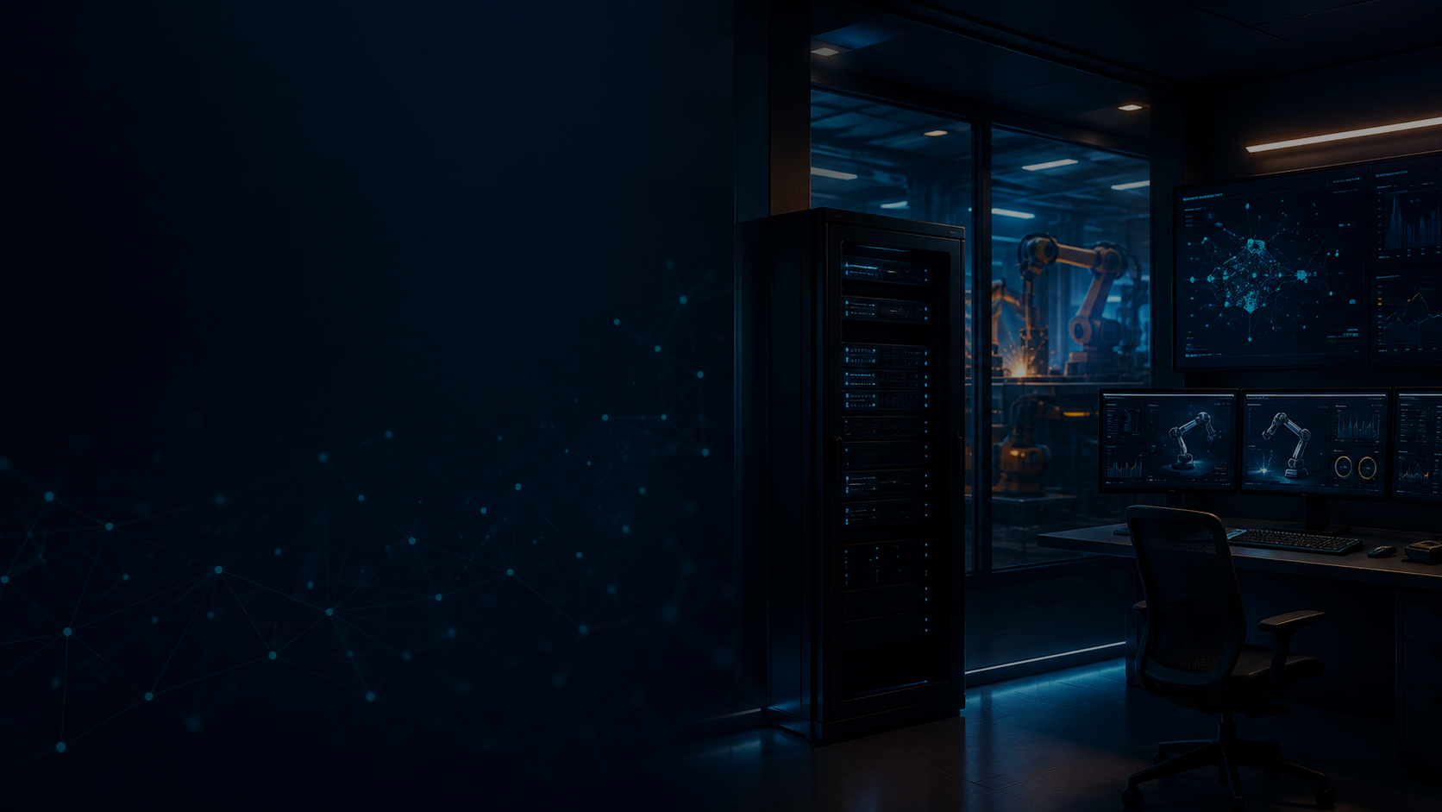
WHY IT MATTERS
Local AI + automation control is the missing layer.
Industrial teams need AI that works near the machine: private, low-latency, inspectable, and safe to test.
Local-first: keeps operational data and safety logic inside the facility.
Control-aware: converts goals into validated ROS 2 / simulation actions, not just text.
Simulation loop: prove behavior under random events before physical rollout.
02

Slide 3
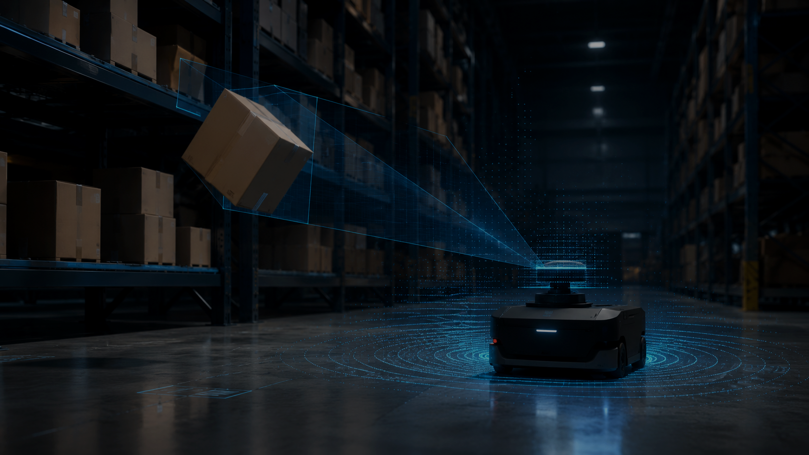
WHAT WE ARE BUILDING
A Physical AI testbed for dynamic warehouse events.
NVIDIA Isaac Sim becomes a controllable training ground where mobile robots practice higher-level missions.
Event library: box_fall, pallet_tip, aisle_blocked, object_moved
Robot task: “Find the fallen boxes in the warehouse.”
03

Slide 4
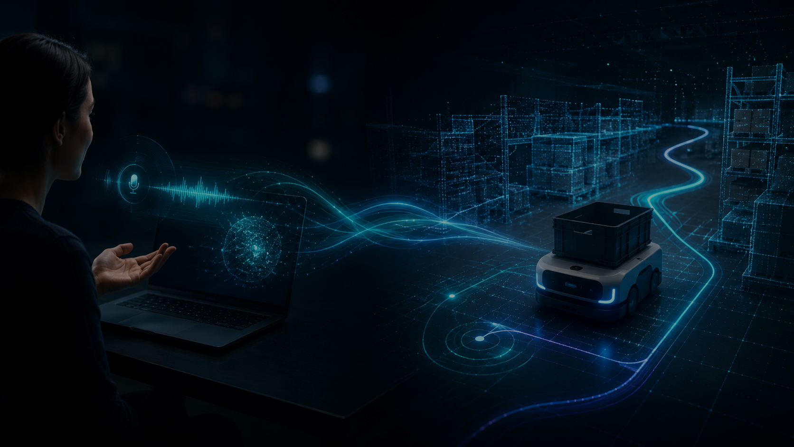
SYSTEM LOOP
From human intent to ROS 2 actions.
A simple end-to-end loop connects conversation, task planning, command mapping, simulation, and robot feedback.
Human goal
→
Task plan
→
ROS 2 map
→
Isaac Sim
→
Feedback
natural language
mission + constraints
topics/actions
robot + physics
video/status
04

Slide 5
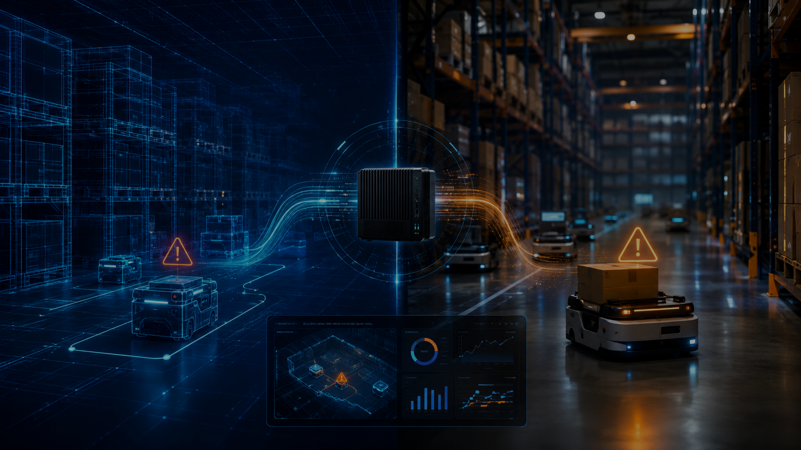
HACKATHON OUTCOME
A demo that shows the future of physical operations.
Local AI watches the world change, controls automation through ROS 2, and learns safer procedures in simulation first.
Local Physical AI: reliable automation for messy facilities.
Demo
Platform
Path
mobile robot finds fallen boxes
event simulation + ROS 2 mapping
digital twin → real robot → operations copilot
05

