Slide 1

Member:
Ho Minh Cuong
Le Hoang Phuc
Mentor:
Ms. Ly Dang
EVENT PLANNING
Assignment Presentation
March 19, 2018

Slide 2

OVERVIEW
I. Technologies
II. Features
III. UI
IV. Demo

Slide 3







TECHNOLOGIES

Slide 4
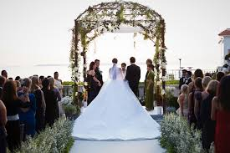


FEATURES

Slide 5
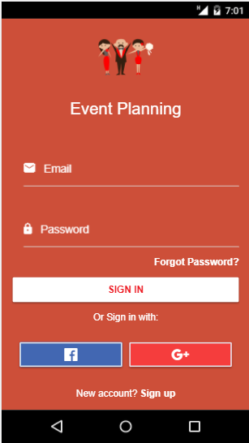
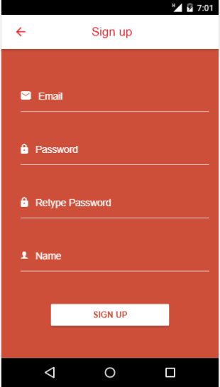
UI
Login
Sign up

Slide 6
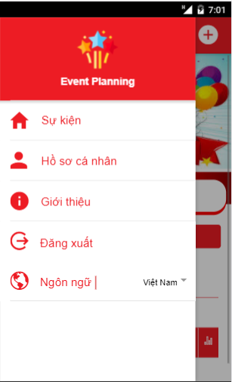
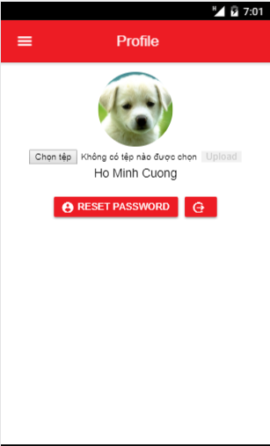
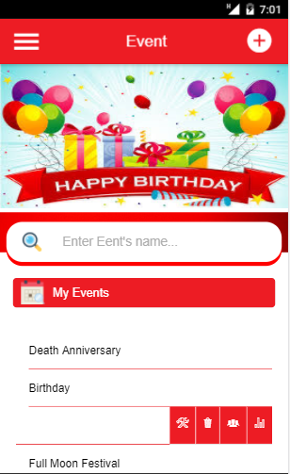
UI

Slide 7
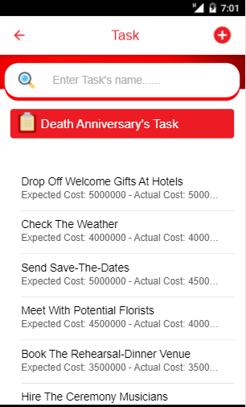
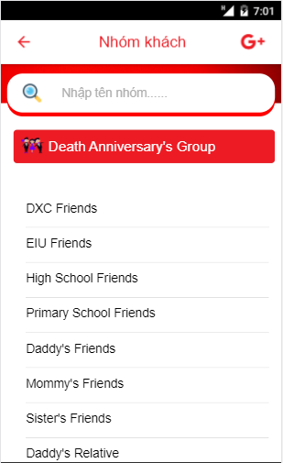
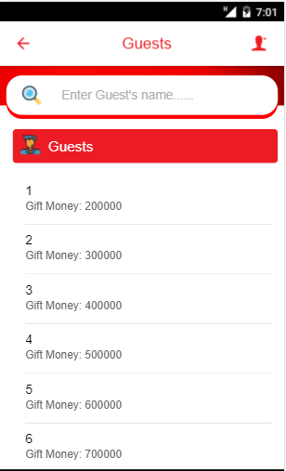
UI

Slide 8
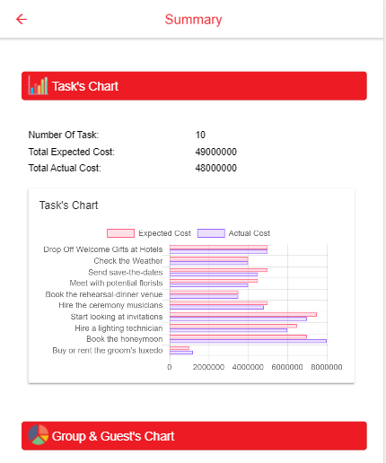
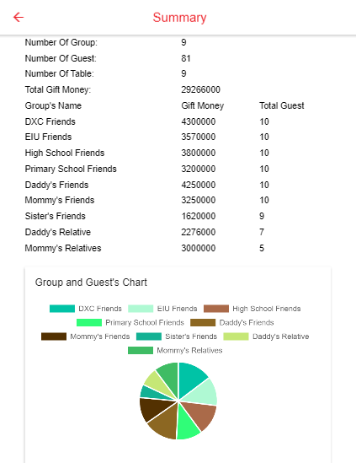
UI

Slide 9
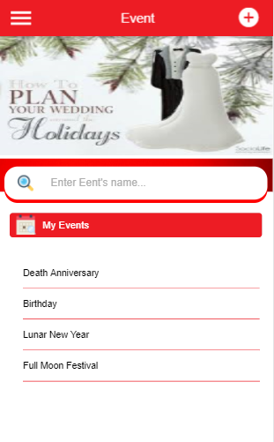
DEMO

Slide 10
THANKS FOR YOUR ATTENTION
Assignment Presentation
March 19, 2018

