Slide 1
Lecture 2: MapReduce and Frequent Itemsets
ENGG5108/CSCI5510 Big Data Analytics
Prof. Michael R. Lyu
Computer Science & Engineering Dept.
The Chinese University of Hong Kong

Slide 2
Outline
Introduction
The Hadoop Distributed File System (HDFS)
MapReduce
Hadoop
Hadoop Streaming
Problems Suited for MapReduce
Frequent Itemsets
Conclusion

Slide 3
Outline
Introduction
The Hadoop Distributed File System (HDFS)
MapReduce
Hadoop
Hadoop Streaming
Problems Suited for MapReduce
Frequent Itemsets
Conclusion

Slide 4


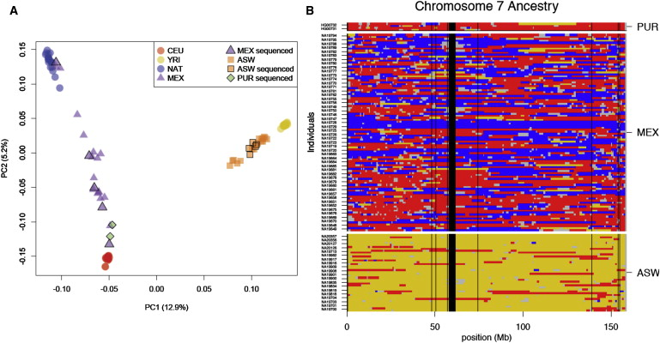

Introduction
Much of the course will be devoted to learning with big data
Twitter
Facebook
Netflix
Bioinformatics

Slide 5
Introduction
Challenges:
  How to distribute computation?
  Distributed/parallel programming is hard
MapReduce addresses all of the above
  Google’s computational/data manipulation model
  Elegant way to work with Big Data

Slide 6

Motivation: Data Volume Now
The scale of data today and tomorrow:
2008: Google processes 20 PB a day
2009: Facebook has 2.5 PB user data + 15 TB/day
2009: eBay has 6.5 PB user data + 50 TB/day
2011: Yahoo! has 180-200 PB of data
2012: 2.5 exabytes (EB) created everyday
2013: Estimated size of digital world is 2.7 ZB
By 2020: 540ZB will be produced (200 GB for every person)

Slide 7

Motivation: Google Example
20+ billion web pages x 20KB = 400+ TB
1 computer reads 30-35 MB/sec from disk
  ~4 months to read the web
~1,000 hard drives to store the web (mainly text data)
Takes even more resources to do useful work with the data
Today, a standard architecture for such problem is emerging:
  Cluster of commodity Linux nodes
  Commodity network (ethernet) to connect them
  It was estimated that Google had over 2.5M machines in 12 data centers worldwide

Slide 8
Large-scale Computing
Large-scale computing for data mining problems on commodity hardware
Challenges:
  How do you distribute computation?
  How can we make it easy to write distributed programs?
  How can you handle machine failures?
    One server may stay up 3 years (1,000 days)
    If you have 1,000 servers, expect to lose 1/day
    It is estimated that Google had 2.5M machines in 2016
      2,500 machine fails every day!

Slide 9
Idea and Solution
Issue: Copying data over a network takes time
Idea:
  Bring computation close to the data
  Store files multiple times for reliability
MapReduce addresses these problems
  Google’s computational/data manipulation model
  Elegant way to work with big data
  Storage Infrastructure – File system
    Google: GFS; Hadoop: HDFS
  Programming model
    Map-reduce

Slide 10
Relationship
Hardware & OS
HDFS
MapReduce
HBase
Hive
Mahout
Pig
ZooKeeper
Hadoop
Projects
Hadoop

Slide 11
Outline
Introduction
The Hadoop Distributed File System (HDFS)
MapReduce
Hadoop
Hadoop Streaming
Problems Suited for MapReduce
Frequent Itemsets
Conclusion

Slide 12
The Hadoop Distributed File System (HDFS)
With hundreds of machines at hand, failure is the norm rather than exception
Traditional file storage system cannot cope with the scale and failure faced by large clusters
The Hadoop Distributed File System (HDFS) is a natural solution to this problem
  Distributed File System
  Provides global file namespace
  Replica to ensure data recovery

Slide 13
The Hadoop Distributed File System (HDFS)
A HDFS instance may consist of thousands of server machines, each storing part of the file system’s data.
Since we have huge number of components, and each component has non-trivial probability of failure, it means that there is always some component that is non-functional.
Detection of faults and quick, automatic recovery from them are a core architectural goal of HDFS.

Slide 14
Data Characteristics
Streaming data access
Batch processing rather than interactive user access
Write-once-read-many: a file, once created, written and closed, need not be changed
This assumption simplifies coherency in concurrent accesses
Notes:
Other characteristics:
Applications need streaming access to data
Large data sets and files: gigabytes to terabytes size
High aggregate data bandwidth
Scale to hundreds of nodes in a cluster
Tens of millions of files in a single instance
Batch processing without user interaction
Write-once-read-many: order of concurrent accesses does not matter
This assumption simplifies coherency of concurrent accesses
A map-reduce application or web-crawler application fits perfectly with this model.

Slide 15
HDFS Architecture
Master/slave architecture
  Master: NameNode
  Slave: DataNode
HDFS exposes a file system namespace (NameNode) and allows user data to be stored in files.
A file is split into one or more blocks and set of blocks are stored in DataNodes.
Notes:
HDFS cluster consists of a single NameNode, a master server that manages the file system namespace and regulates access to files by clients.
There are a number of DataNodes usually one per node in a cluster.
The DataNodes manage storage attached to the nodes that they run on.
DataNodes: serves read, write requests, performs block creation, deletion, and replication upon instruction from NameNode.

Slide 16
HDFS Architecture
Namenode
Metadata(Name, replicas..)
(/home/foo/data,6. ..
Metadata ops
Client
Block ops
Read
Datanodes
Datanodes
B
replication
Blocks
Rack1
Write
Rack2
Client

Slide 17
File System Namespace
Namenode maintains the file system.
  Hierarchical file system with directories and files.
  Create, remove, move, rename, etc.
  Any meta information changes to the file system is recorded by the Namenode.
An application can specify the number of replicas of the file needed: replication factor of the file. This information is stored in the Namenode.

Slide 18
Data Replication
HDFS is designed to store very large files across machines in a large cluster.
  Each file is a sequence of blocks.
  All blocks in the file except the last are of the same size.
Blocks are replicated for fault tolerance.
Block size and replicas are configurable per file.
The NameNode receives a Heartbeat and a BlockReport from each DataNode in the cluster.
BlockReport contains all the blocks on a DataNode.

Slide 19
Replica Selection
Replica selection for read operation: HDFS tries to minimize the bandwidth consumption and latency.
If there is a replica on the Reader node then that is preferred.
HDFS cluster may span multiple data centers: replica in the local data center is preferred over the remote one.

Slide 20
Safemode Startup
Each DataNode checks in with Heartbeat and BlockReport.
NameNode verifies that each block has acceptable number of replicas.
After a configurable percentage of safely replicated blocks check in with the NameNode, NameNode exits Safemode.
It then makes the list of blocks that need to be replicated.
NameNode then proceeds to replicate these blocks to other DataNodes.
Notes:
On startup NameNode enters Safemode.
Replication of data blocks do not occur in Safemode.

Slide 21
Filesystem Metadata
The HDFS namespace is stored by NameNode.
NameNode uses a transaction log called the EditLog to record every change that occurs to the filesystem meta data.
  For example, creating a new file
  Change replication factor of a file
  EditLog is stored in the NameNode’s local filesystem
Notes:
Entire filesystem namespace including mapping of blocks to files and file system properties is stored in a file FsImage. Stored in Namenode’s local filesystem.

Slide 22
NameNode
Keeps image of entire file system namespace.
When the Namenode starts up
  Gets the FsImage and Editlog.
  Update FsImage with EditLog information.
  Stores a copy of the FsImage as a checkpoint.
In case of crash
  Last checkpoint is recovered.
Notes:
4GB of local RAM is sufficient to support the above data structures that represent the huge number of files and directories.

Slide 23
DataNode
A DataNode stores data in files in its local file system.
  Each block of HDFS is a separate file.
  These files are placed in different directories.
  Creation of new directory is determined by heuristics.
When the filesystem starts up:
  Generates Blockreport.
  Sends this report to NameNode.
Notes:
DataNode has no knowledge about HDFS filesystem
DataNode does not create all files in the same directory.

Slide 24
HDFS Summary
Reliable distributed file system
Data kept in “chunks” spread across machines
Each chunk replicated on different machine and racks
  Seamless recovery from disk or machine failure
C0
C1
D0
D1
C2
C1
C0
E1
….
C2
D6
C3
C6
D0
C6
A2
B6

Slide 25
Outline
Introduction
The Hadoop Distributed File System (HDFS)
MapReduce
Hadoop
Hadoop Streaming
Problems Suited for MapReduce
Frequent Itemsets
Conclusion

Slide 26
MapReduce
Warm-up task
  We have a huge text document
  Count the number of times each distinct word appears in the file
Sample application
  Analyze web server logs to find popular URLs

Slide 27
Task: Word Count
Using Unix tool chain, we can count the occurrences of words:
  words (doc.txt) | sort | uniq –c
    Where words takes a file and outputs the words in it, one per line
This way of counting captures the essence of MapReduce
  Mapper (done by words)
  Group by keys and sort (done by sort)
  Reducer (done by uniq)
  Hadoop handles the partition and parallelization

Slide 28
MapReduce: Overview
Sequentially read a lot of data
Map:
  Extract something you care about
Group by key: Sort and Shuffle
Reduce:
  Aggregate, summarize, filter or transform
Write the result

Slide 29
MapReduce
Input: a set of key-value paris
Programmer must specifies two methods:
  Map(k,v) -> <k’, v’>
    Takes a key-value pair and outputs a set of key-value pairs
    There is one Map call for every (k,v) pair
  Reduce (k’, <v’>) -> <k’, v’’>
    All values v’ with the same key k’ are reduced together and processed in v’ order
    There is one Reduce function call per unique key k’

Slide 30
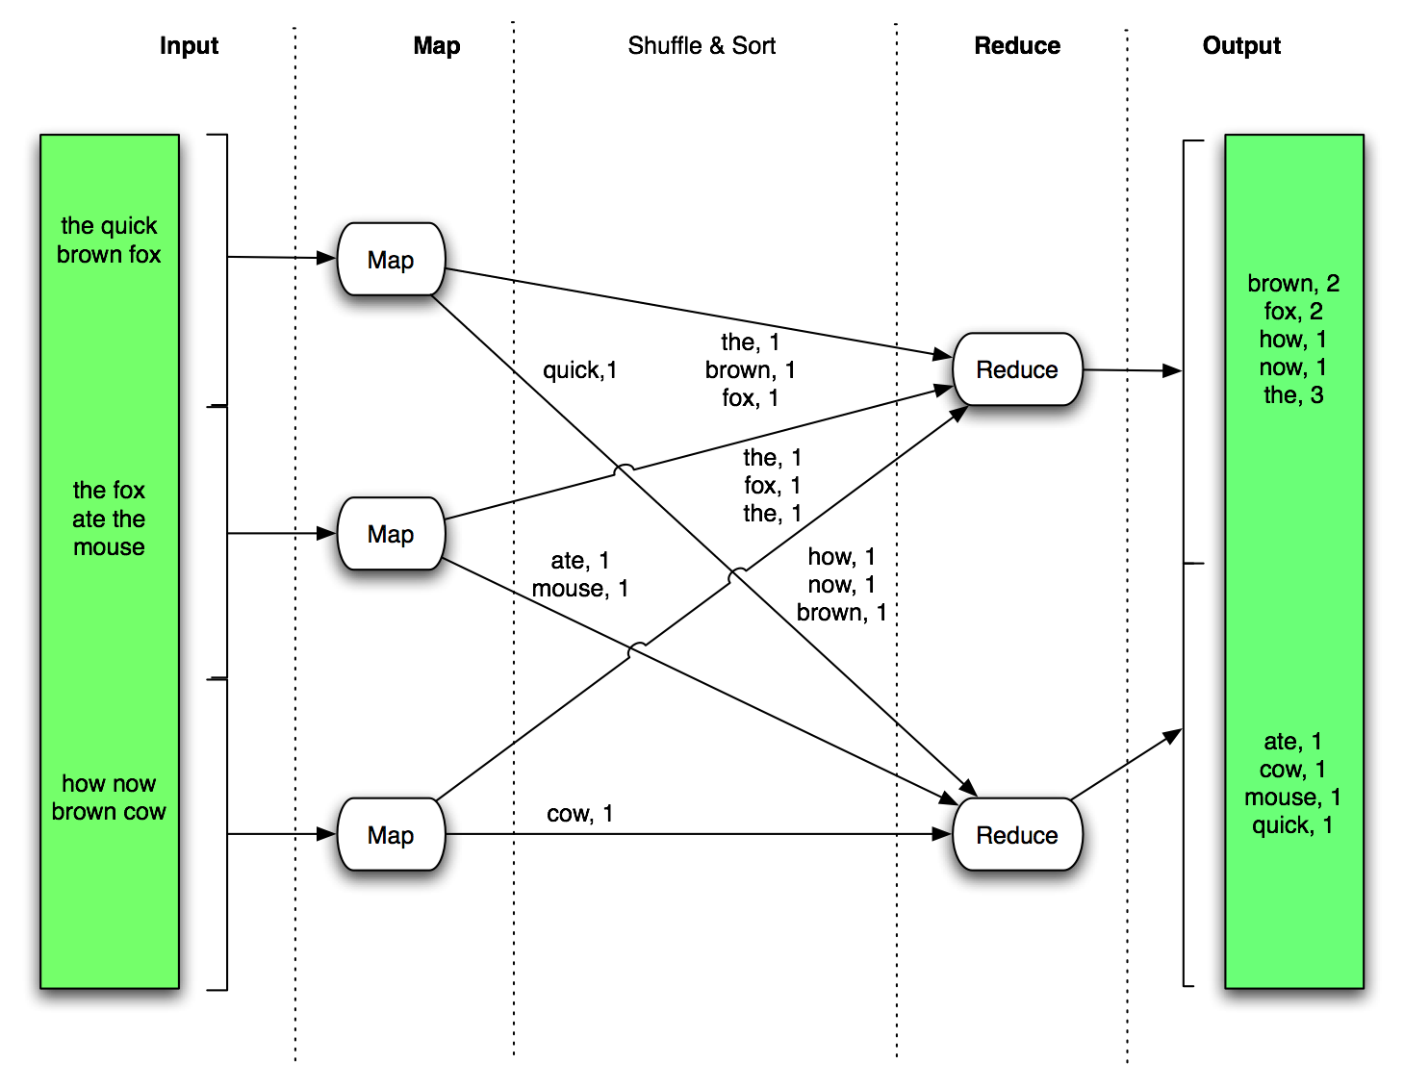
MapReduce: Word Count Example
Now that one document changes to a large corpus of documents

Slide 31
MapReduce: Word Count Example
// key: document name; value: text of the document
Map(key, value):
for each word w in value:
emit(w, 1)
// key: a word; value: an iterator over counts
Reduce(key, values):
result = 0
for each count v in values:
results += v
emit(key, result)

Slide 32
In-class Practice
Go to practice

Slide 33
MapReduce: Environment
MapReduce environment takes care of:
  Partitioning the input data
  Scheduling the program’s execution across a set of machines
  Performing the “group by key” step
  Handling machine failures
  Managing required inter-machine communication

Slide 34
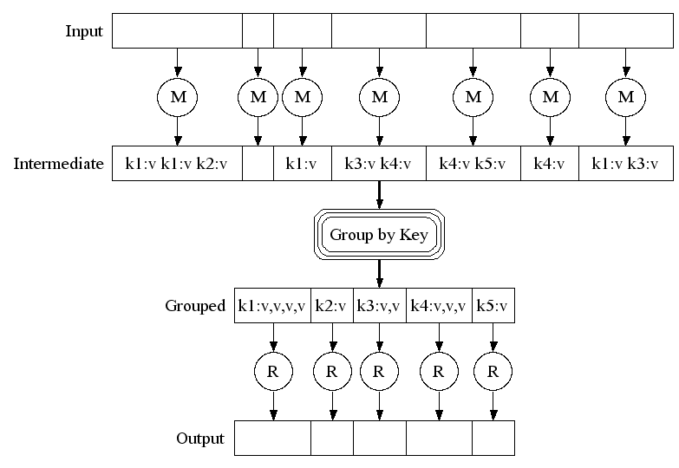
MapReduce
Map:
Read input and produces a set of key-value pairs
Group by key:
Collect all pairs with the same key
Reduce:
Collect all values belonging to the key and output

Slide 35
MapReduce
Move computation to the data
C0
C1
D0
D1
C2
C1
C3
E1
….
C2
D6
C3
C6
D0
C6
A2
B6
DataNode
DataNode
DataNode
DataNode
TaskTracker
TaskTracker
TaskTracker
TaskTracker
Bring computation directly to the data!
DataNode also serve as compute servers

Slide 36
Data Flow
Input and final output are stored on a distributed file system (FS):
  Scheduler tries to schedule map tasks “close” to physical storage location of input data
Intermediate results are stored on local FS of Map and Reduce workers
Output is often input to another MapReduce task

Slide 37
Coordination: Master
Master node takes care of coordination:
  Task status: (idle, in-progress, completed)
  Idle tasks get scheduled as workers become available
  When a map task completes, it sends the master the location and sizes of its R intermediate files, one for each reducer
  Master pushes this info to reducers
Master pings workers periodically to detect failures

Slide 38
Dealing with Failures
Map worker failure
  Map tasks completed or in-progress at worker are reset to idle
  Reduce workers are notified when task is rescheduled on another worker
Reduce worker failure
  Only in-progress tasks are reset to idle
  Reduce task is restarted
Master failure
  MapReduce task is aborted and client is notified.

Slide 39
How Many Map and Reduce Jobs?
M map tasks, R reduce tasks
Rule of a thumb:
  Make M much larger than the number of nodes in the cluster
  One chunk per map is common
  Improves dynamic load balancing and speeds up recovery from worker failures
Usually R is smaller than M
  Output is spread across R files

Slide 40
Refinement: Combiners
Often a Map task will produce many pairs of the form (k,v1), (k,v2), … for the same key k
  E.g., popular words in the word count example
Can save network time by pre-aggregating values in the mapper:
  Combine(k, list(v)) -> v2
  Combiner is usually the same as the reduce function
Works only if reduce function is commutative and associative

Slide 41
Refinement: Partition Function
Want to control how keys get partitioned
  Inputs to map tasks are created by contiguous splits of input file
  Reduce needs to ensure that records with the same intermediate key end up at the same worker
System uses a default partition function:
  Hash(key) mod R
Sometimes useful to override the hash function:
  E.g., hash(hostname(URL)) mod R ensures URLs from a host end up in the same output file

Slide 42
Outline
Introduction
The Hadoop Distributed File System (HDFS)
MapReduce
Hadoop
Hadoop Streaming
Problems Suited for MapReduce
Frequent Itemsets
Conclusion

Slide 43
Hadoop
Hadoop is an open source implementation of MapReduce framework
  Hadoop Distributed File System (HDFS) as storage
  Hadoop handles the task split, task distribution, task monitoring and failure recovery
  All you need to do is to write two Java classes
    Mapper
    Reducer

Slide 44
Hadoop
Follow the MapReduce architecture, the Hadoop has a master/slave design
 | master | slave
MapReduce | jobtracker | tasktracker
HDFS | namenode | datanode

Slide 45
Word Count in Hadoop
Mapper
public static class MapClass extends MapReduceBase
implements Mapper {
private final static IntWritable one = new IntWritable(1);
private Text word = new Text();
public void map(WritableComparable key, Writable value,
OutputCollector output, Reporter reporter)
throws IOException {
String line = ((Text)value).toString();
StringTokenizer itr = new StringTokenizer(line);
while (itr.hasMoreTokens()) {
word.set(itr.nextToken());
output.collect(word, one);
}
}
}

Slide 46
Word Count in Hadoop
Reducer
public static class Reduce extends MapReduceBase implements Reducer {
public void reduce(WritableComparable key, Iterator
values, OutputCollector output, Reporter reporter)
throws IOException {
int sum = 0;
while (values.hasNext()) {
sum += ((IntWritable) values.next()).get();
}
output.collect(key, new IntWritable(sum));
}
}

Slide 47
Word Count in Hadoop
Main
public static void main(String[] args) throws IOException {
//checking goes here
JobConf conf = new JobConf();
conf.setOutputKeyClass(Text.class);
conf.setOutputValueClass(IntWritable.class);
conf.setMapperClass(MapClass.class);
conf.setCombinerClass(Reduce.class);
conf.setReducerClass(Reduce.class);
conf.setInputPath(new Path(args[0]));
conf.setOutputPath(new Path(args[1]));
JobClient.runJob(conf);
}

Slide 48
Outline
Introduction
The Hadoop Distributed File System (HDFS)
MapReduce
Hadoop
Hadoop Streaming
Problems Suited for MapReduce
Frequent Itemsets
Conclusion

Slide 49
Hadoop Streaming
To enjoy the convenience brought by Hadoop, one has to implement mapper and reducer in Java
  Hadoop defines a lot of data types and complex class hierarchy
  There is a learning curve
Hadoop streaming allows you to use any language to write the mapper and reducer

Slide 50
Hadoop Streaming
Using Hadoop Streaming, you need to write
  Mapper
    Read input from standard input (STDIN)
    Write map result to standard output (STDOUT)
      Key value are separated using tab
  Group by key
    Done by Hadoop
  Reducer
    Read input (Mapper’s output) from standard input (STDIN)
    Write output (Final result) to standard output (STDOUT)

Slide 51
Hadoop Streaming
Allows you to start writing MapReduce application that can be readily deployed without having to learn Hadoop class structure and data types
Speed up development
Utilize rich features and handy libraries from other languages (Python, Ruby)
Efficiency critical application can be implemented in efficient language (C, C++)

Slide 52
Hadoop Streaming: Word Count Mapper
#!/usr/bin/env python
import sys
# input comes from STDIN (standard input)
for line in sys.stdin:
# remove leading and trailing whitespace
line = line.strip()
# split the line into words
words = line.split()
# increase counters
for word in words:
# write the results to STDOUT (standard output);
# what we output here will be the input for the
# Reduce step, i.e. the input for reducer.py
#
# tab-delimited; the trivial word count is 1
print '%s\t%s' % (word, 1)

Slide 53
Hadoop Streaming: Word Count Reducer
#!/usr/bin/env python
from operator import itemgetter
import sys
current_word = None
current_count = 0
word = None
for line in sys.stdin:
line = line.strip()
word, count = line.split('\t', 1)
try:
count = int(count)
except ValueError:
continue
if current_word == word:
current_count += count
else:
if current_word:
print '%s\t%s' % (current_word, current_count)
current_count = count
current_word = word
if current_word == word:
print '%s\t%s' % (current_word, current_count)

Slide 54
Hadoop Streaming: How to Run?
To run the sample code
-file caches the argument to every tasktracker
The above command distribute the mapper.py and reducer.py to every tasktracker
$HADOOP_HOME/bin/hadoop jar $HADOOP_HOME/hadoop-streaming.jar \
-input inputPathonHDFS \
-output outputPathonHDFS \
-file pathToMapper.py \
-mapper mapper.py \
-file pathToReducer.py \
-reducer reducer.py

Slide 55
Hadoop Streaming: Word Count
#!/usr/bin/env python
"""A more advanced Mapper, using Python iterators and generators."""
import sys
def read_input(file):
for line in file:
yield line.split()
def main(separator='\t'):
# input comes from STDIN (standard input)
data = read_input(sys.stdin)
for words in data:
# write the results to STDOUT (standard output);
# what we output here will be the input for the
# Reduce step, i.e. the input for reducer.py
#
# tab-delimited; the trivial word count is 1
for word in words:
print '%s%s%d' % (word, separator, 1)
if __name__ == "__main__":
main()

Slide 56
Hadoop Streaming: Word Count
#!/usr/bin/env python
"""A more advanced Reducer, using Python iterators and generators."""
from itertools import groupby
from operator import itemgetter
import sys
def read_mapper_output(file, separator='\t'):
for line in file:
yield line.rstrip().split(separator, 1)
def main(separator='\t'):
# input comes from STDIN (standard input)
data = read_mapper_output(sys.stdin, separator=separator)
# groupby groups multiple word-count pairs by word,
# and creates an iterator that returns consecutive keys and their group:
# current_word - string containing a word (the key)
# group - iterator yielding all ["&lt;current_word&gt;", "&lt;count&gt;"] items
for current_word, group in groupby(data, itemgetter(0)):
try:
total_count = sum(int(count) for current_word, count in group)
print "%s%s%d" % (current_word, separator, total_count)
except ValueError:
# count was not a number, so silently discard this item
pass
if __name__ == "__main__":
main()

Slide 57
Demo
Given a list of academic paper authors and their papers, we try to output:
  The most used non-trivial words in the title for each author
We use a python based MapReduce framework implementation called mincemeat.

Slide 58
Demo
Input Data
  Books, Ph.D. Thesis, web pages, academic papers
  Input format
    Publication type
    Affiliation
    Abbreviation code
    Authors
    Title
tr/gte/TM-0014-06-88-165:::Frank Manola:::Distributed Object Management Technology.
tr/ibm/IWBS94:::Christoph Beierle::Udo Pletat:::The Algebra of Feature Graph Specifications

Slide 59
Demo
To run the demo:
  In terminal 1, type:
    python demo.py
    This set the mapper, reducer and start the main program
  In terminal 2, type:
    python mincemeat.py -p changeme 127.0.0.1
    “changeme” is the authentication password
    127.0.0.1 is the server address
    This starts the Map-Reduce framework

Slide 60
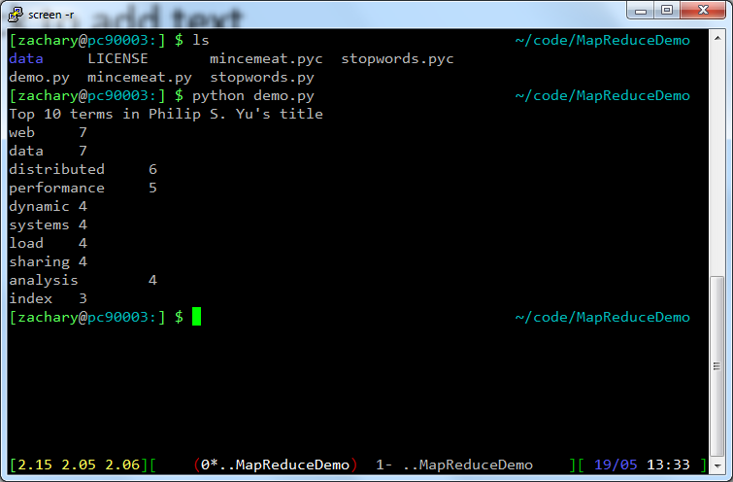
Demo

Slide 61
Outline
Introduction
The Hadoop Distributed File System (HDFS)
MapReduce
Hadoop
Hadoop Streaming
Problems Suited for MapReduce
Frequent Itemsets
Conclusion

Slide 62
Example: Host Size
Suppose we have a large web corpus
Look at the metadata file
  Lines of the form: (URL, size, date, …)
For each host, find the total number of bytes
  That is, the sum of the page sizes for all URLs from that particular host
Other examples:
  Link analysis and graph processing
  Machine learning algorithms

Slide 63
Example: Language Model
Statistical machine translation:
  Need to count number of times every 5-word sequence occurs in a large corpus of documents
Very easy with MapReduce
  Map:
    Extract (5-word sequence, count) from document
  Reduce:
    Combine the counts

Slide 64
Example: Join By MapReduce
Compute the natural join R(A,B) x S(B,C)
R and S are each stored in files
Tuples are pairs (a, b) or (b,c)
A | B
a1 | b1
a2 | b1
a3 | b2
a4 | b3
B | C
b2 | c1
b2 | c2
b3 | c3
A | C
a3 | c1
a3 | c2
a4 | c3
X
=
Note – Other relational-algebra operations: Selection, Projection,
Union/Interaction/Difference, Grouping/Aggregation

Slide 65
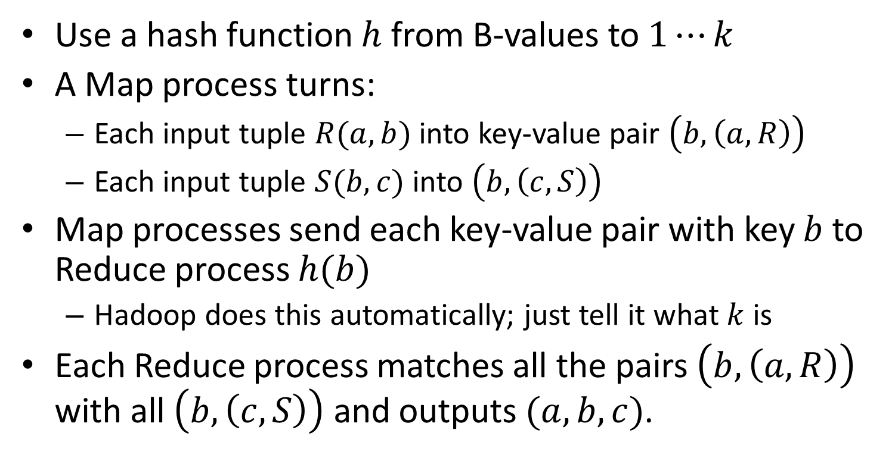
MapReduce Join
Use a hash function $h$ from B-values to $1⋯k$
A Map process turns:
  Each input tuple $R(a,b)$ into key-value pair $\left(b, \left(a,R\right)\right)$
  Each input tuple $S(b,c)$ into $\left(b, \left(c, S\right)\right)$
Map processes send each key-value pair with key $b$ to Reduce process $h(b)$
  Hadoop does this automatically; just tell it what $k$ is
Each Reduce process matches all the pairs $\left(b, \left(a, R\right)\right)$ with all $\left(b,\left(c,S\right)\right)$ and outputs $(a,b,c)$.

Slide 66
Cost Measures for Algorithms
In MapReduce we quantify the cost of an algorithm using
  Communication cost
    total I/O of all processes
  Elapsed communication cost
    Max of I/O alone any path
  (Elapsed) computation cost
    Analogous, but count only running time of processes
  Note that here the big-O notation is not the most useful (adding more machines is always an option)

Slide 67
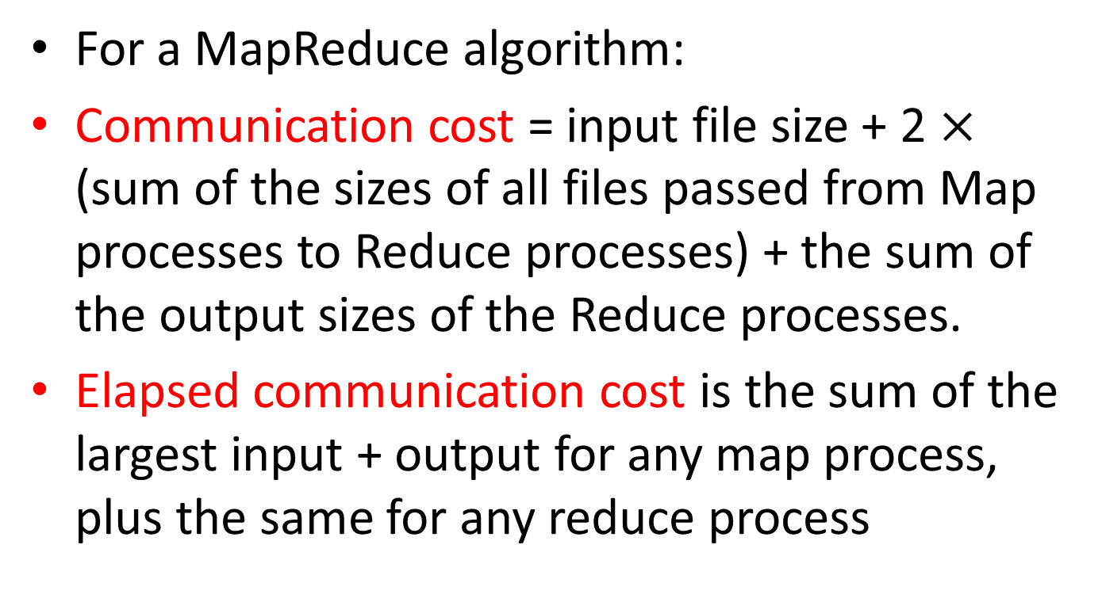
Example: Cost Measures
For a MapReduce algorithm:
Communication cost = input file size + 2 $×$ (sum of the sizes of all files passed from Map processes to Reduce processes) + the sum of the output sizes of the Reduce processes.
Elapsed communication cost is the sum of the largest input + output for any map process, plus the same for any reduce process

Slide 68
What Cost Measures Mean
Either the I/O (communication) or processing (computation) cost dominates
  Ignore one or the other
Total cost tells what you pay in rent from your friendly neighborhood cloud
Elapsed cost is wall-clock time using parallelism

Slide 69
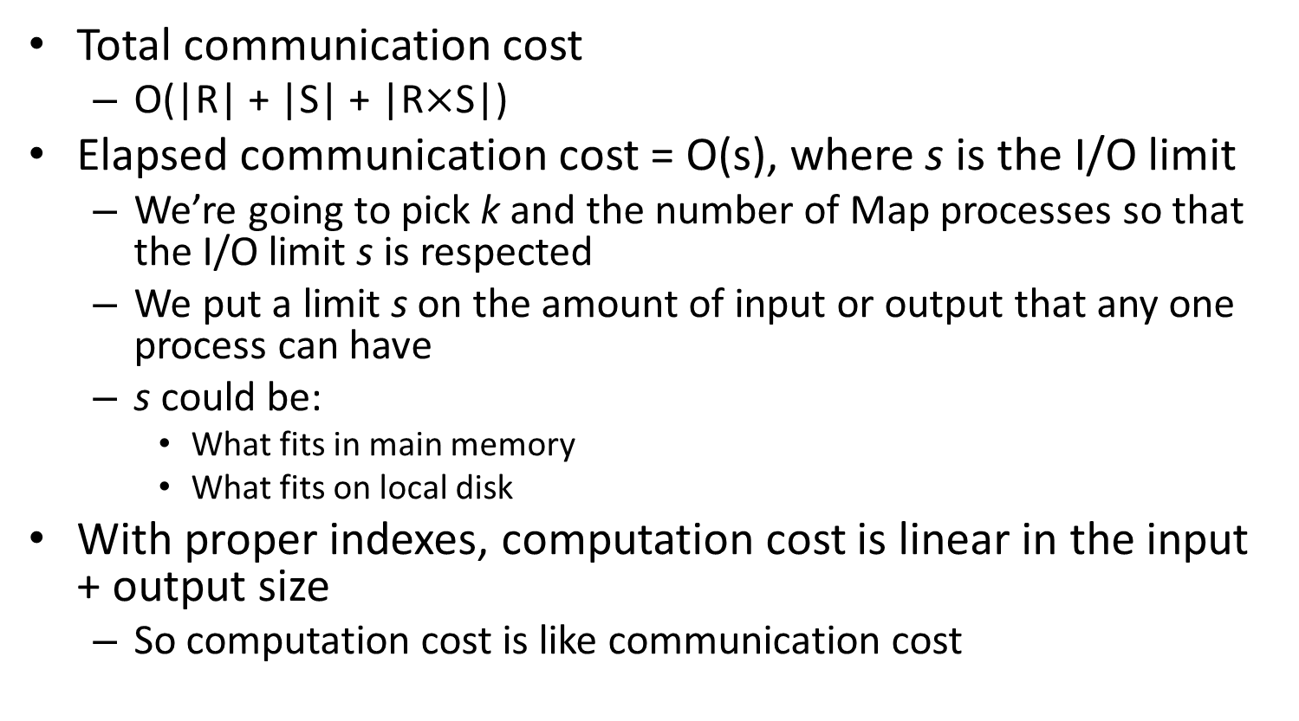
Cost of MapReduce Join
Total communication cost
  O(|R| + |S| + |R$×$S|)
Elapsed communication cost = O(s), where s is the I/O limit
  We’re going to pick k and the number of Map processes so that the I/O limit s is respected
  We put a limit s on the amount of input or output that any one process can have
  s could be:
    What fits in main memory
    What fits on local disk
With proper indexes, computation cost is linear in the input + output size
  So computation cost is like communication cost

Slide 70
Outline
Introduction
The Hadoop Distributed File System (HDFS)
MapReduce
Hadoop
Hadoop Streaming
Problems Suited for MapReduce
Frequent Itemsets
Conclusion

Slide 71
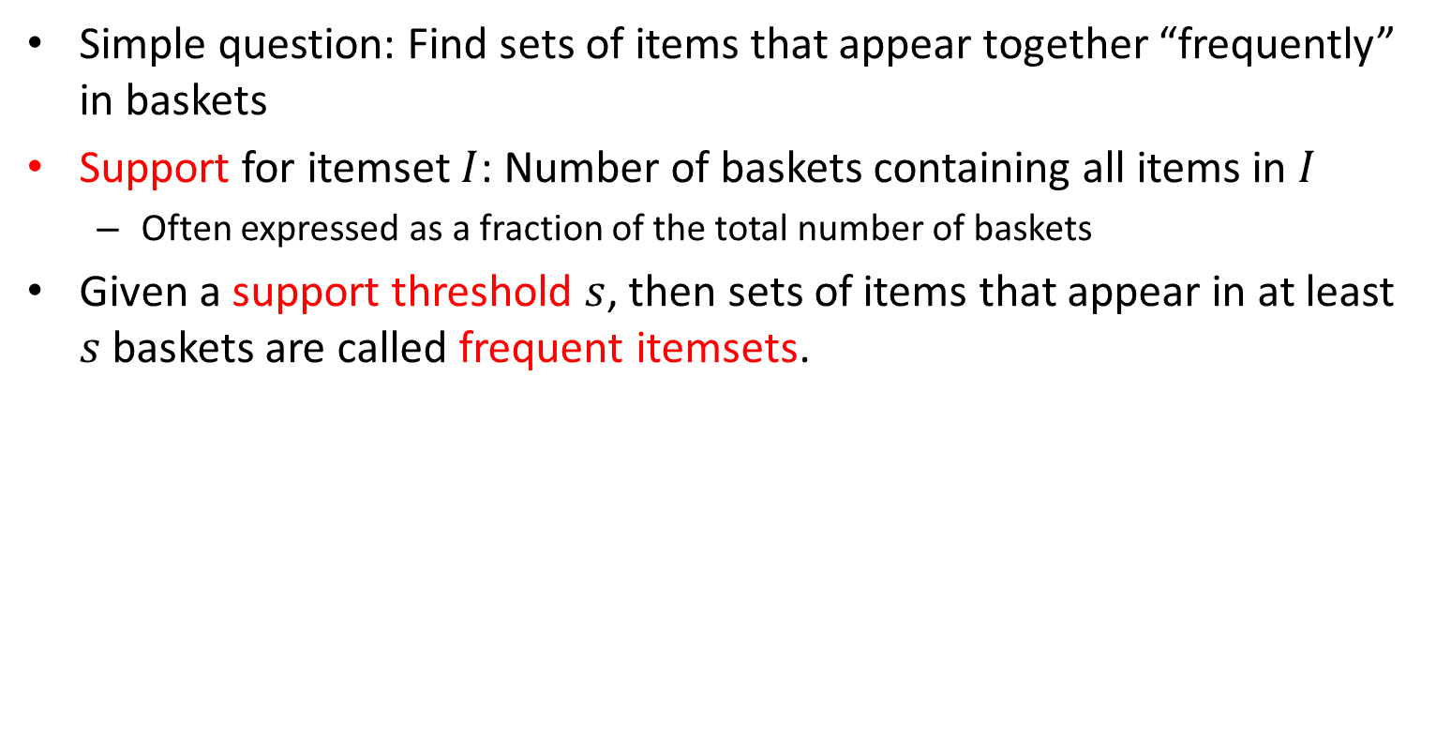
Frequent Itemsets
Simple question: Find sets of items that appear together “frequently” in baskets
Support for itemset $I$: Number of baskets containing all items in $I$
  Often expressed as a fraction of the total number of baskets
Given a support threshold $s$, then sets of items that appear in at least $s$ baskets are called frequent itemsets.
TID | Items
1 | Bread, Coke, Milk
2 | Beer, Bread
3 | Beer, Coke, Diaper, Milk
4 | Beer, Bread, Diaper, Milk
5 | Coke, Diaper, Milk
Support of {Beer, Bread} = 2

Slide 72
Example: Frequent Itemsets
Items = {milk, coke, pepsi, beer, juice}
Minimum support = 3 baskets
Frequent itemsets: {m}, {c}, {b}, {j},
  {m,b}, {b,c}, {c,j}
B1 = {m,c,b} | B2 = {m,p,j}
B3 = {m,b} | B4 = {c,j}
B5 = {m,p,b} | B6 = {m,c,b,j}
B7 = {c,b,j} | B8 = {b,c}

Slide 73
Itemsets: Computation Model
Typically, data is kept in flat files rather than in a database system:
  Stored on disk
  Stored basket-by-basket
  Baskets are small but we have many baskets and many items
    Expand baskets into pairs, triples, etc. as you read baskets
    Use k nested loops to generate all sets of size k
Items are positive integers,
and boundaries between
baskets are –1.

Slide 74
Computation Model
The true cost of mining disk-resident data is usually the number of disk I/O’s
In practice, association-rule algorithms read the data in passes – all baskets read in turn
We measure the cost by the number of passes an algorithm makes over the data

Slide 75
Main-Memory Bottleneck
For many frequent-itemset algorithms, main-memory is the critical resource
  As we read baskets, we need to count something, e.g., occurrences of pairs of items
  The number of different things we can count is limited by main memory
  Swapping counts in/out is a disaster

Slide 76
Naïve Algorithm to Count Pairs
Read file once, counting in main memory the occurrences of each pair:
  From each basket of n items, generate its n(n-1)/2 pairs by two nested loops
Fails if (#items)² exceeds main memory
  Remember: #items can be 100K (Wal-Mart) or 10B (Web pages)
    Suppose 10⁵ items, counts are 4-byte integers
    Number of pairs of items: 10⁵(10⁵-1)/2 = 5*10⁹
    Therefore, 2*10¹⁰ (20 gigabytes) of memory needed

Slide 77
A-Priori Algorithm
A two-pass approach called a-priori limits the need for main memory
Key idea: monotonicity
  If a set of items I appears at least s times, so does every subset J of I.
Contrapositive for pairs:
  If item i does not appear in s baskets, then no pair including i can appear in s baskets

Slide 78
A-Priori Algorithm
Pass 1: Read baskets and count in main memory the occurrences of each individual item
  Requires only memory proportional to #items
Items that appear at least s times are the frequent items
Pass 2: Read baskets again and count in main memory only those pairs where both elements are frequent (from Pass 1)
  Requires memory proportional to square of frequent items only (for counts)
  Plus a list of the frequent items (so you know what must be counted)

Slide 79
Main-Memory: Picture of A-Priori

Slide 80
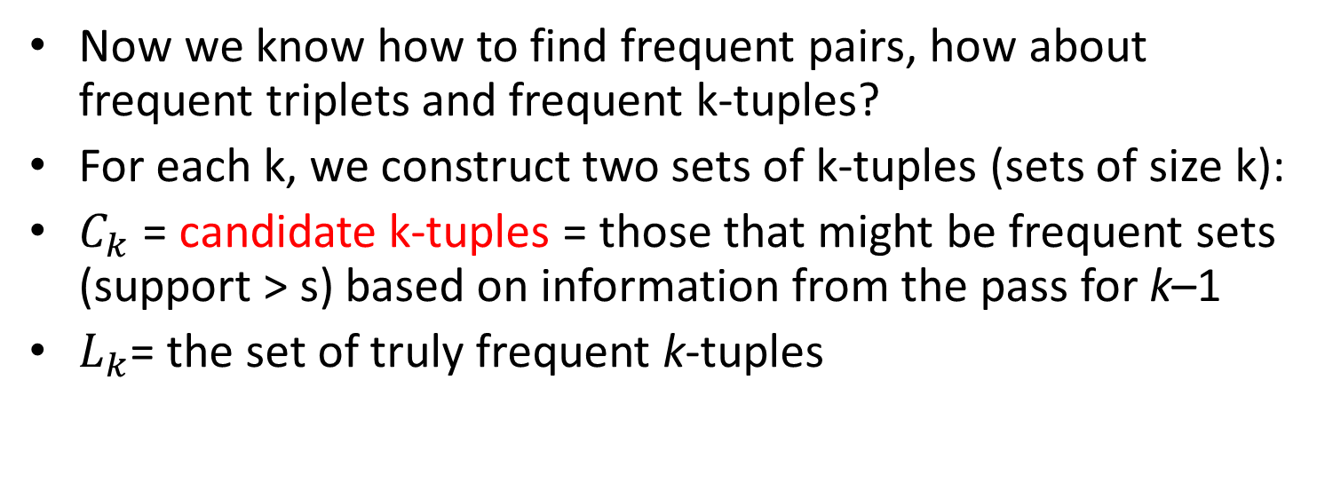
Frequent Triplets, Etc.
Now we know how to find frequent pairs, how about frequent triplets and frequent k-tuples?
For each k, we construct two sets of k-tuples (sets of size k):
$C_{k}$ = candidate k-tuples = those that might be frequent sets (support > s) based on information from the pass for k–1
$L_{k}$= the set of truly frequent k-tuples

Slide 81
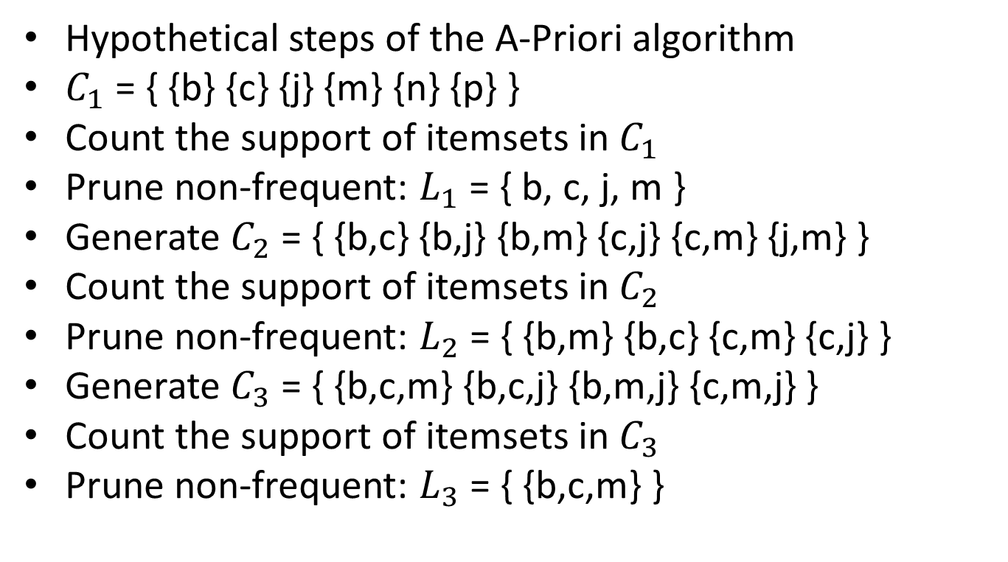
Example
Hypothetical steps of the A-Priori algorithm
$C_{1}$ = { {b} {c} {j} {m} {n} {p} }
Count the support of itemsets in $C_{1}$
Prune non-frequent: $L_{1}$ = { b, c, j, m }
Generate $C_{2}$ = { {b,c} {b,j} {b,m} {c,j} {c,m} {j,m} }
Count the support of itemsets in $C_{2}$
Prune non-frequent: $L_{2}$ = { {b,m} {b,c} {c,m} {c,j} }
Generate $C_{3}$ = { {b,c,m} {b,c,j} {b,m,j} {c,m,j} }
Count the support of itemsets in $C_{3}$
Prune non-frequent: $L_{3}$ = { {b,c,m} }
Notes:
In this slide, C₃ is conservation; it can directly be {{b,c,m}}. However, it would take additional effort to find out.

Slide 82
A-Priori for All Frequent Itemsets
One pass for each k (itemset size)
Needs room in main memory to count each candidate k-tuple
For typical market-basket data and reasonable support (e.g., 1%), k = 2 requires the most memory
Many possible extensions: Lower the support s as itemset gets bigger
  Association rules with intervals:
    For example: Men over 65 have 2 cars
  Association rules when items are in a taxonomy
    Bread, Butter → FruitJam
    BakedGoods, MilkProduct → PreservedGoods

Slide 83
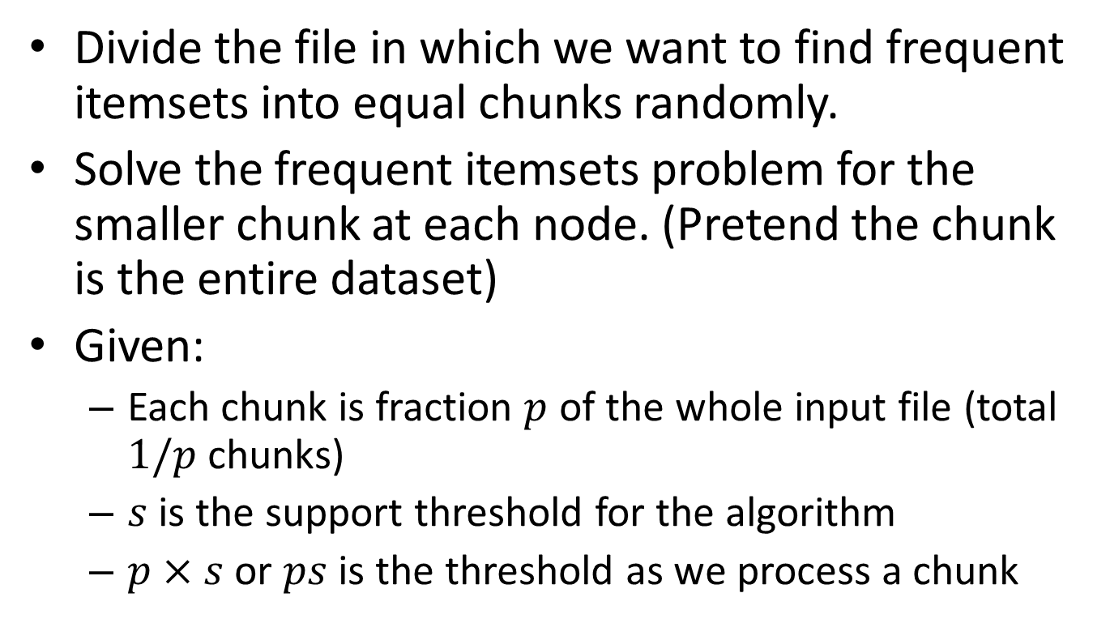
Map-Reduce Implementation
Divide the file in which we want to find frequent itemsets into equal chunks randomly.
Solve the frequent itemsets problem for the smaller chunk at each node. (Pretend the chunk is the entire dataset)
Given:
  Each chunk is fraction $p$ of the whole input file (total $1/p$ chunks)
  $s$ is the support threshold for the algorithm
  $p×s$ or $ps$ is the threshold as we process a chunk

Slide 84
Map-Reduce Implementation
At each node, we can use A-Priori algorithm to solve the smaller problem
Take the group of all the itemsets that have been found frequent for one or more chunks.
  Every itemset that is frequent in the whole file is frequent in at least one chunk
  All the true frequent itemsets are among the candidates

Slide 85
Map-Reduce Implementation
We can arrange the aforementioned algorithm in a two-pass Map-Reduce framework
  First Map-Reduce cycle to produce the candidate itemsets
  Second Map-Reduce cycle to calculate the true frequent itemsets.

Slide 86
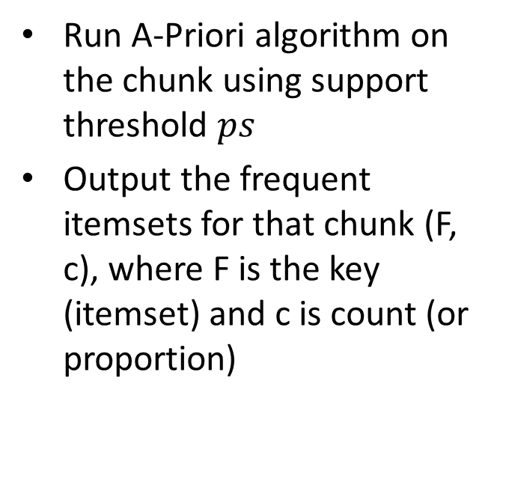
Map-Reduce Implementation
First Mapper
First Reducer
Run A-Priori algorithm on the chunk using support threshold $ps$
Output the frequent itemsets for that chunk (F, c), where F is the key (itemset) and c is count (or proportion)
Output the candidate itemsets to verify in the second pass
Given (F,c), discard c and output all candidate itemsets Fs

Slide 87
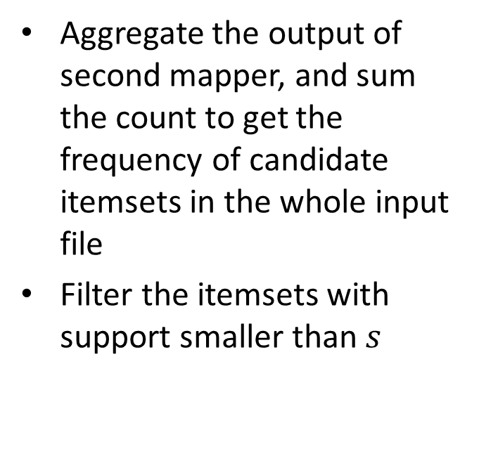
Map-Reduce Implementation
Second Mapper
Second Reducer
For all the candidate itemsets produced by first reducer, count the frequency in local chunk
Aggregate the output of second mapper, and sum the count to get the frequency of candidate itemsets in the whole input file
Filter the itemsets with support smaller than $s$

Slide 88
Outline
Introduction
The Hadoop Distributed File System (HDFS)
MapReduce
Hadoop
Hadoop Streaming
Problems Suited for MapReduce
Frequent Itemsets
Conclusion

Slide 89
Conclusion
HDFS is a reliable distributed file system
MapReduce is a distributed computing environment
  Hadoop is an open-source implementation of MapReduce
  Hadoop Streaming allow you to use any language to write MapReduce code
Frequent Itemsets problem can be solved efficiently using its monotonicity property
  A-Priori algorithm

Slide 90
One-Slide Takeaway
HDFS is a distributed file system built with robust in mind
MapReduce is a convenient paradigm to implement parallel program
Hadoop is an open source implementation of MapReduce
Hadoop streaming allows you to use any language to program mapper and reducer
Monotonicity property enable efficient algorithms for Frequent Itemsets problem

Slide 91
References
MapReduce: Simplified Data Processing on Large Clusters, Jeffrey Dean and Sanjay Ghemawat
The Hadoop Distributed File System: Architecture and Design by Apache Foundation Inc
Hadoop in Action, Chuck Lam
Hadoop File System, ppt by B. Ramamurthy
Intro & MapReduce, pdf by Jure Leskovec
Association Rules, pdf by Jure Leskovec
Writing an Hadoop MapReduce Program in Python, http://www.michael-noll.com/tutorials/writing-an-hadoop-mapreduce-program-in-python/

Slide 92
In-Class Practice
Given the following input:
I spent long spells at sea on all types of vessel; I followed officer training with the Surface Fleet and with the Royal Marines.
1. Write the output of the word count mapper’s output for the above input.
2. Write the output of the word count mapper’s output after the shuffle process.
3. Write the output of the word count reducer’s output for the above input.

