Slide 1
Lecture 3: Locality Sensitive Hashing
ENGG5108/CSCI5510 Big Data Analytics
Prof. Michael R. Lyu
Computer Science & Engineering Dept.
The Chinese University of Hong Kong

Slide 2
A Motivating Example
[Hays and Efros, SIGGRAPH 2007]
Scene Completion Problem
Target: ﬁlling in or replacing an image region with new image data such that the modiﬁcation can not be detected.
Main problem: how to find candidate images which are similar with the original image so that we can use them to replace.

Slide 3
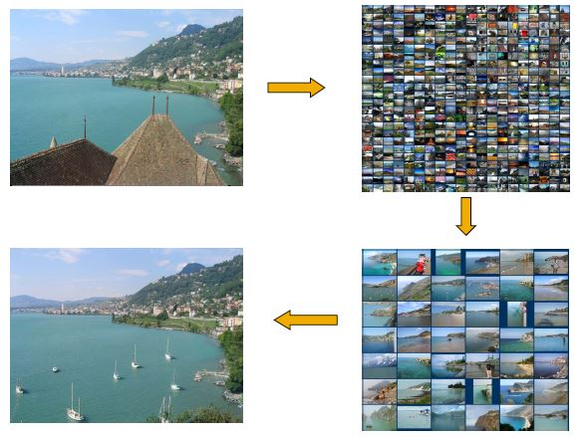
Scene Completion Problem

Slide 4
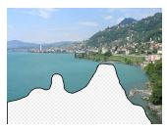
Scene Completion Problem

Slide 5
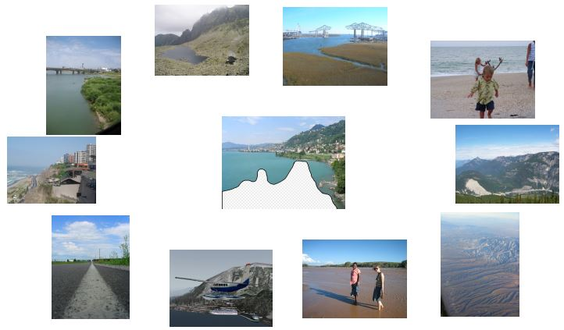
Scene Completion Problem

Slide 6
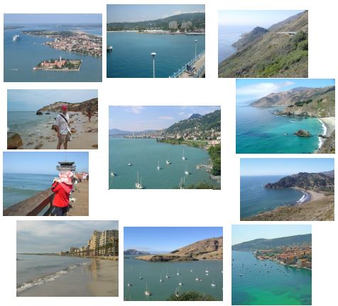
Scene Completion Problem

Slide 7
A Common Metaphor
Many problems can be expressed as finding “similar” sets:
Find near-neighbors in high-dimensional space
Examples:
Pages with similar words
Customers who purchased similar products
Images with similar features
Users who visited the similar websites

Slide 8
Outline
Finding Similar Documents
Shingling
Min Hashing
Locality-Sensitive Hashing
Other Applications of LSH
Appendix: Theory of LSH

Slide 9
Outline
Finding Similar Documents
Shingling
Min Hashing
Locality-Sensitive Hashing
Other Applications of LSH
Appendix: Theory of LSH

Slide 10
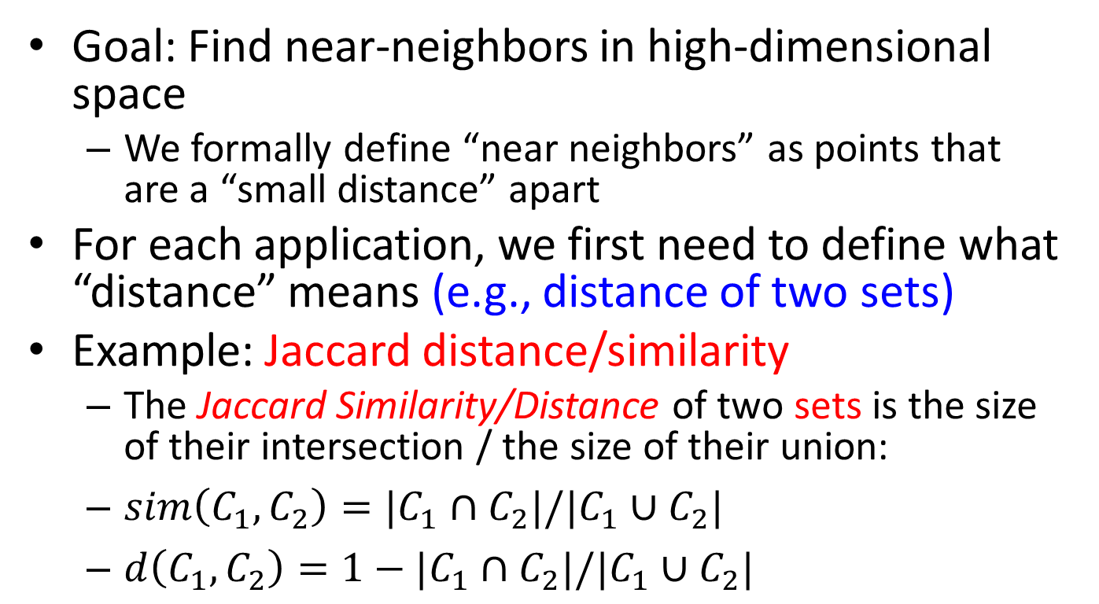
Distance Measures
Goal: Find near-neighbors in high-dimensional space
We formally define “near neighbors” as points that are a “small distance” apart
For each application, we first need to define what “distance” means (e.g., distance of two sets)
Example: Jaccard distance/similarity
The Jaccard Similarity/Distance of two sets is the size of their intersection / the size of their union:
$sim\left(C_{1},C_{2}\right)=|C_{1}∩C_{2}|/|C_{1}∪C_{2}|$
$d\left(C_{1},C_{2}\right)=1−|C_{1}∩C_{2}|/|C_{1}∪C_{2}|$

Slide 11
Distance Measures
3 in intersection
8 in union
Jaccard similarity = 3/8
Jaccard distance = 5/8

Slide 12
Finding Similar Documents
Goal: Given a large number (N in the millions or billions) of text documents, find pairs that are “near duplicates”
Applications:
Mirror websites, or approximate mirrors
Don’t want to show both in a search
Similar news articles at many news sites
Cluster articles by “same story”

Slide 13
Finding Similar Documents
Problems we face:
Many pieces of one document can appear out of order in another
Too many documents to compare all pairs
Documents are so large or so many that they cannot fit in main memory

Slide 14
3 Essential Steps for Similar Docs
Shingling: Convert documents to sets
Minhashing: Convert large sets to short signatures, while preserving similarity
Locality-sensitive hashing: Focus on pairs of signatures likely to be from similar documents
Candidate pairs!

Slide 15
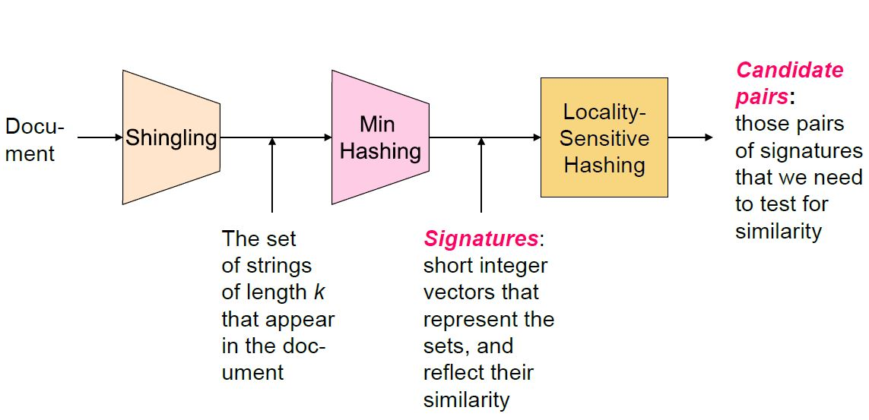
The Big Picture

Slide 16
Step 1 - Shingling
Convert documents to sets

Slide 17
Documents as High-Dim Data
Simple approaches:
Document = set of words appearing in document
Document = set of “important” words
Don’t work well for this application. Why?
Need to account for ordering of words!
A different way: Shingles!

Slide 18
Shingles: Definition
A k-shingle (or k-gram) for a document is a sequence of k tokens that appears in the doc
Tokens can be characters, words or something else, depending on the application
Assume tokens = characters for examples
Example: k = 2; document D₁ = abcab
Set of 2-shingles: S(D₁)={ab, bc, ca}
Option: Shingles as a bag (multiset), count ab twice: S’(D₁)={ab, bc, ca, ab}

Slide 19
Compressing Shingles
To compress long shingles, we can hash them to (say) 4 bytes
Represent a doc by the set of hash values of its k-shingles
Idea: Two documents could (rarely) appear to have singles in common, when in fact only the hash-values were shared
Example: k = 2; document D₁ = abcab
Set of 2-shingles: S(D₁)={ab, bc, ca}
Hash the shingles: h(D₁)={1, 5, 7}

Slide 20
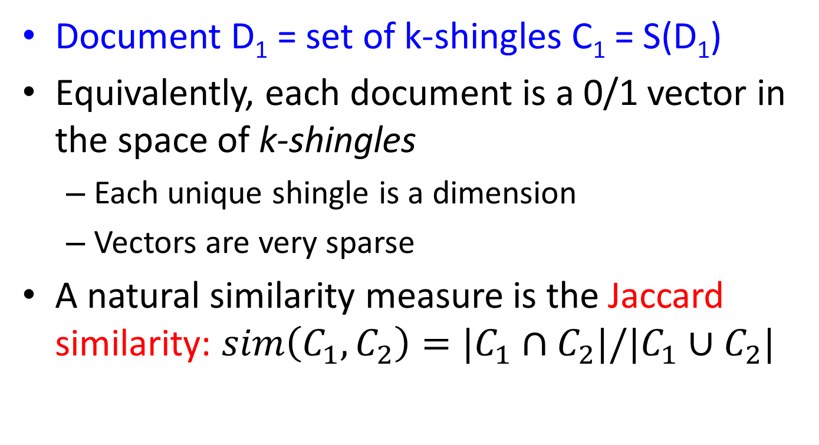
Similarity Metric for Shingles
Document D₁ = set of k-shingles C₁ = S(D₁)
Equivalently, each document is a 0/1 vector in the space of k-shingles
Each unique shingle is a dimension
Vectors are very sparse
A natural similarity measure is the Jaccard similarity: $sim\left(C_{1},C_{2}\right)=|C_{1}∩C_{2}|/|C_{1}∪C_{2}|$

Slide 21
Working Assumption
Documents that have lots of shingles in common have similar text, even if the text appears in different order
Caveat: You must pick k large enough, or most documents will have most shingles
k = 5 is OK for short documents
k = 10 is better for long documents

Slide 22
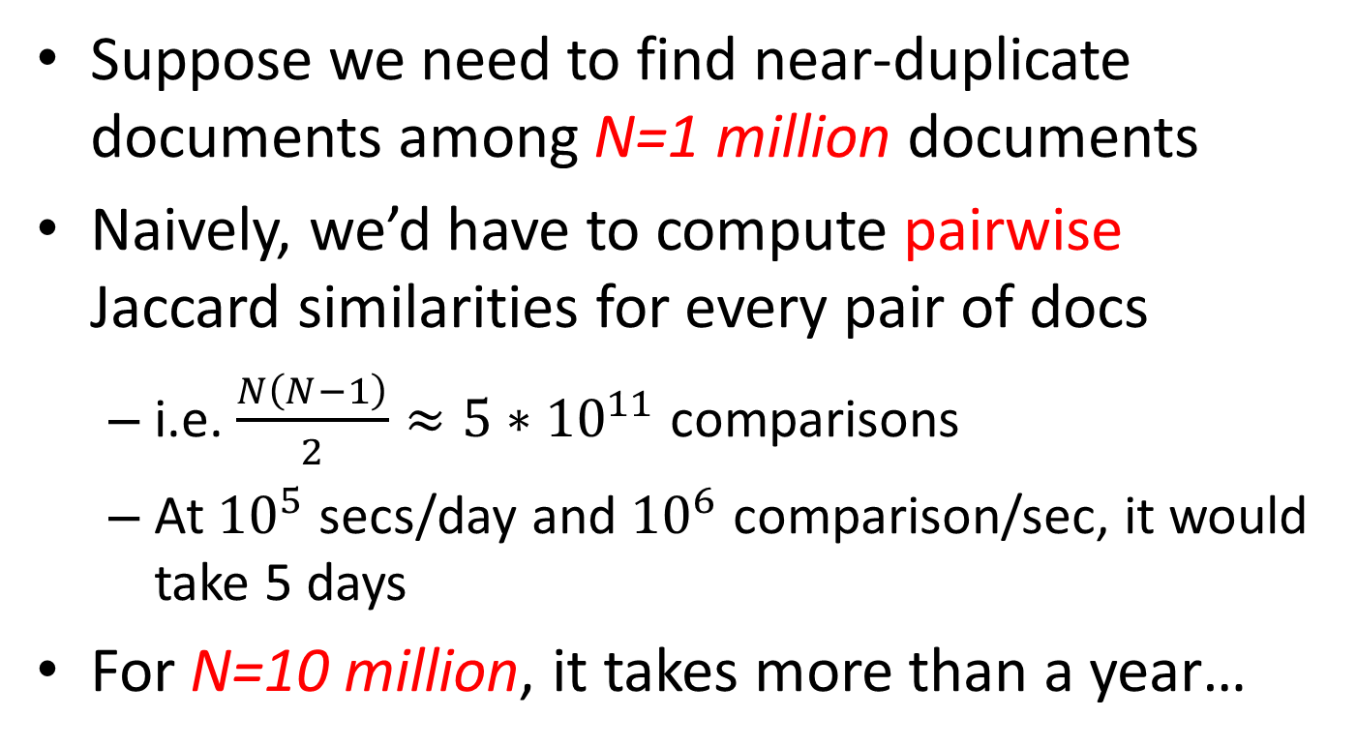
Motivation for Minhash/LSH
Suppose we need to find near-duplicate documents among N=1 million documents
Naively, we’d have to compute pairwise Jaccard similarities for every pair of docs
i.e. $\frac{N\left(N−1\right)}{2}≈5∗{10}^{11}$ comparisons
At ${10}^{5}$ secs/day and ${10}^{6}$ comparison/sec, it would take 5 days
For N=10 million, it takes more than a year…

Slide 23
Step 2 - MinHashing
Convert large sets to short signatures, while preserving similarity

Slide 24
Encoding Sets as Bit Vectors
Many similarity problems can be formalized as finding subsets that have significant intersection
Encode sets using 0/1 vectors
One dimension per element in the universal set
Interpret set intersection as bitwise AND, and set union as bitwise OR

Slide 25

Encoding Sets as Bit Vectors
Example: $C_{1}=10111;C_{2}=10011$
Size of intersection = 3; size of union = 4,
Jaccard similarity = 3/4
$d\left(C_{1},C_{2}\right)=$ 1 – (Jaccard similarity) = 1/4

Slide 26
From Sets to Boolean Matrices
Rows = elements (shingles)
Columns = sets (documents)
1 in row e and column s if and only if e is a member of s
Column similarity is the Jaccard similarity of the corresponding sets (rows with value 1)
Typical matrix is sparse!
Each document is a column!

Slide 27
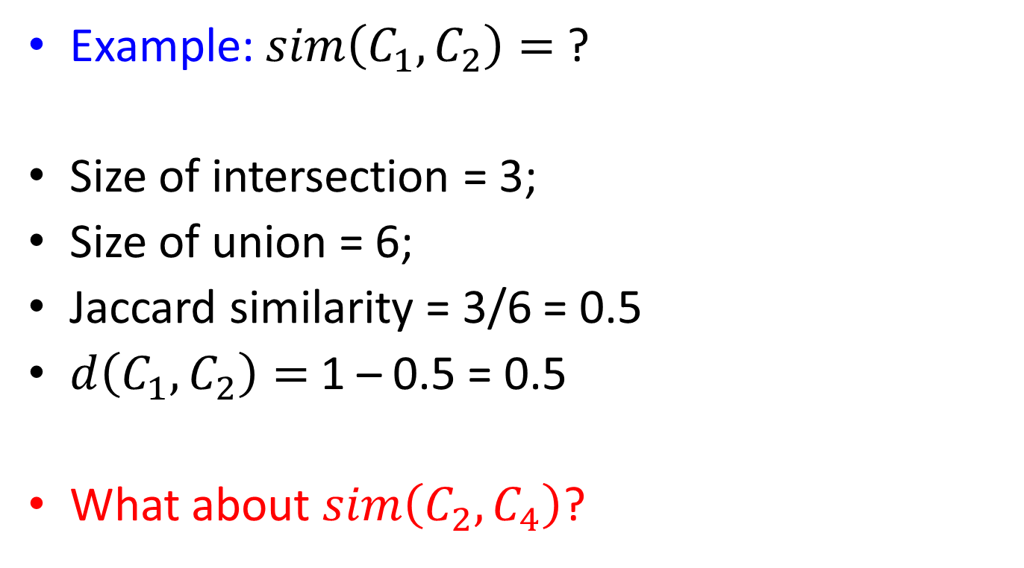

From Sets to Boolean Matrices
$$C_{1}{ C}_{2}{ C}_{3}{ C}_{4}$$
Example: $sim\left(C_{1},C_{2}\right)=$?
Size of intersection = 3;
Size of union = 6;
Jaccard similarity = 3/6 = 0.5
$d\left(C_{1},C_{2}\right)=$ 1 – 0.5 = 0.5
What about $sim\left(C_{2},C_{4}\right)$?
1 | 1 | 1 | 0
1 | 1 | 0 | 1
0 | 1 | 0 | 1
0 | 0 | 0 | 1
1 | 0 | 0 | 1
1 | 1 | 1 | 0
1 | 0 | 1 | 0
Notes:
Sim(C2, C4) = 2 / 6

Slide 28
Finding Similar Columns
So far:
Documents → Sets of shingles
Represent sets as boolean vectors in a matrix
Next Goal: Find similar columns
Challenges: too many long columns to compare
Approach:
1) Signatures of columns: small summaries of columns
2) Examine pairs of signatures to find similar columns
Comparing all pairs may take too much time – Job for LSH
3) Optional: Check whether columns with similar signatures are really similar

Slide 29
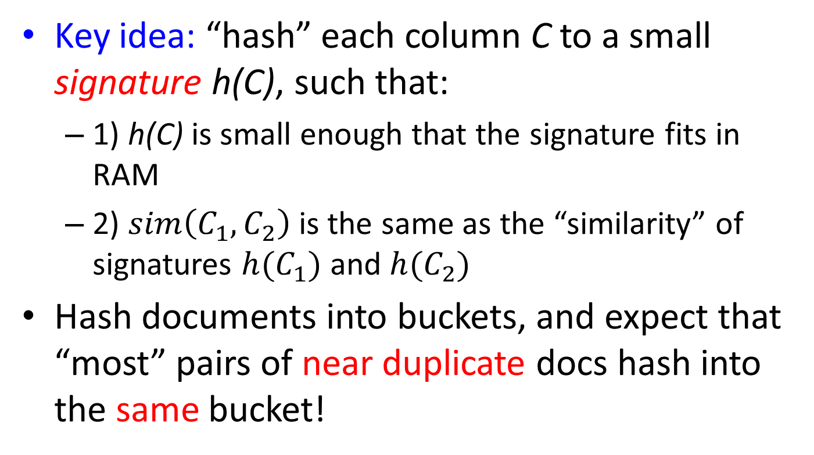
Hashing Columns (Signatures)
Key idea: “hash” each column C to a small signature h(C), such that:
1) h(C) is small enough that the signature fits in RAM
2) $sim\left(C_{1},C_{2}\right)$ is the same as the “similarity” of signatures $h(C_{1})$ and $h(C_{2})$
Hash documents into buckets, and expect that “most” pairs of near duplicate docs hash into the same bucket!

Slide 30
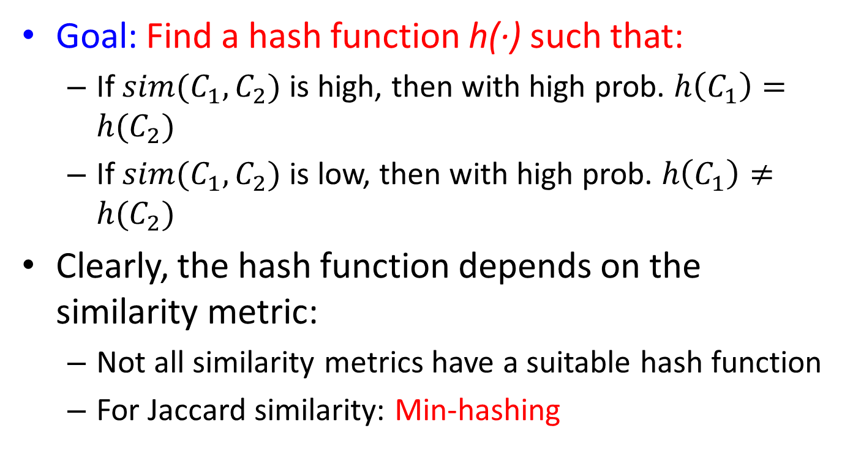
Min-Hashing
Goal: Find a hash function h(·) such that:
If $sim(C_{1},C_{2})$ is high, then with high prob. $h\left(C_{1}\right)=h(C_{2})$
If $sim(C_{1},C_{2})$ is low, then with high prob. $h\left(C_{1}\right)≠h(C_{2})$
Clearly, the hash function depends on the similarity metric:
Not all similarity metrics have a suitable hash function
For Jaccard similarity: Min-hashing

Slide 31
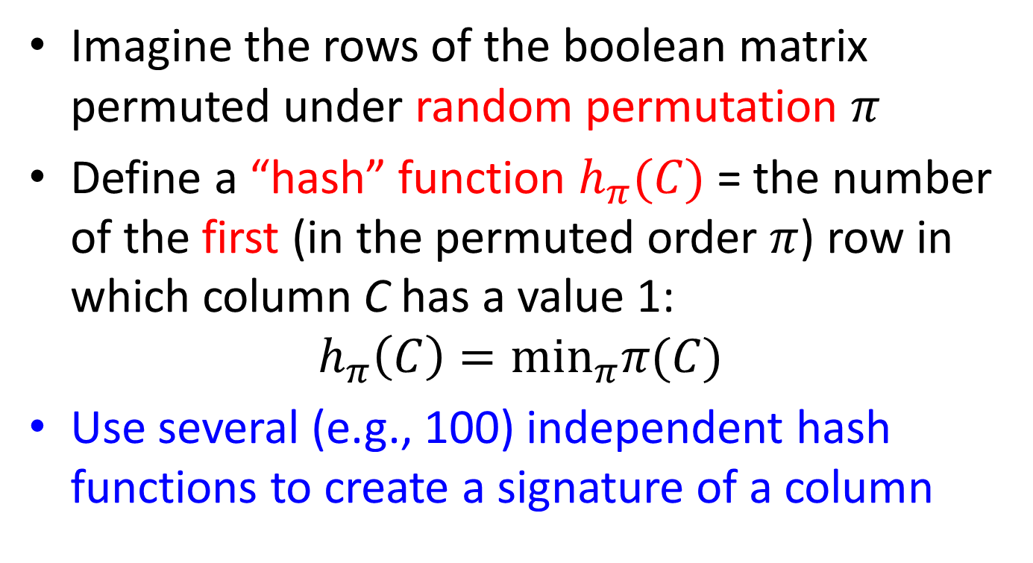
Min-Hashing
Imagine the rows of the boolean matrix permuted under random permutation $π$
Define a “hash” function $h_{π}(C)$ = the number of the first (in the permuted order $π$) row in which column C has a value 1:
$$h_{π}\left(C\right)=\min_{π}π(C)$$
Use several (e.g., 100) independent hash functions to create a signature of a column

Slide 32
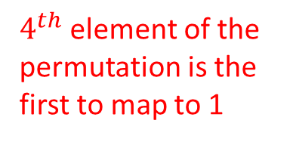

Min-Hashing Example
Permutation $π$
Input matrix (Shingles*Documents)
Signature matrix M
2
3
7
6
1
5
4
4
2
1
3
6
7
5
3
4
7
2
6
1
5
1 | 0 | 1 | 0
1 | 0 | 0 | 1
0 | 1 | 0 | 1
0 | 1 | 0 | 1
0 | 1 | 0 | 1
1 | 0 | 1 | 0
1 | 0 | 1 | 0
2 | 1 | 2 | 1
2 | 1 | 4 | 1
1 | 2 | 1 | 2
$4^{th}$ element of the permutation is the first to map to 1

Slide 33

Surprising Property
Choose a random permutation $π$
Claim: Pr[$h_{π}\left(C_{1}\right)=h_{π}\left(C_{2}\right)$] = $sim(C_{1},C_{2})$
Why?

Slide 34
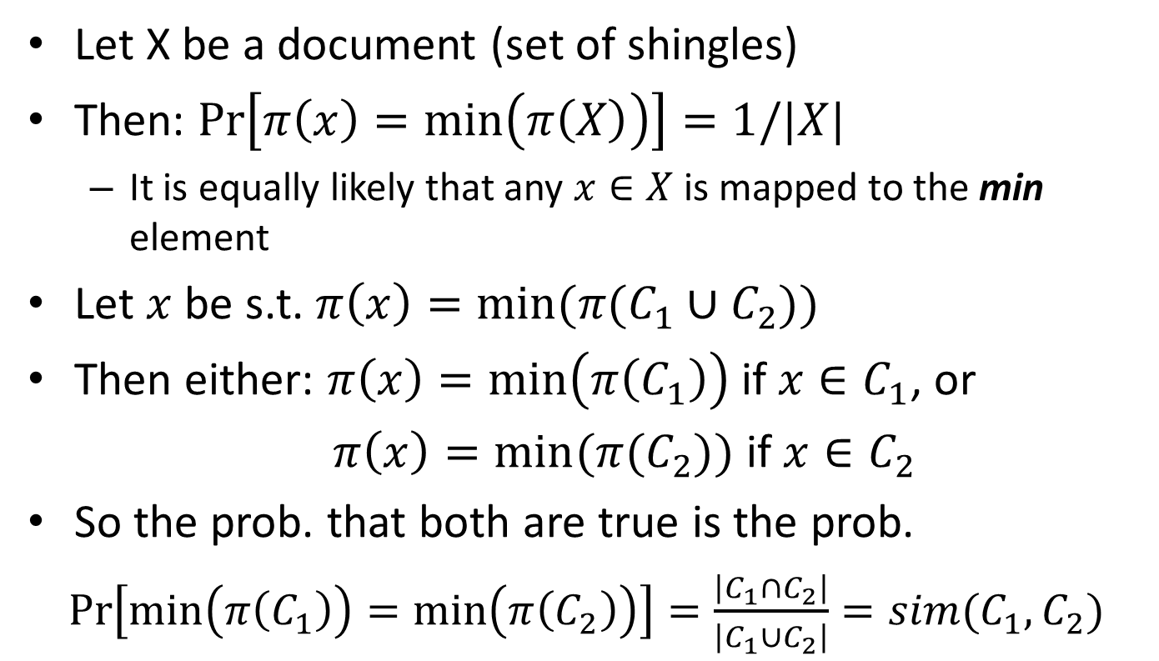
The Proof
Let X be a document (set of shingles)
Then: $Pr\left[π\left(x\right)=\min\left(π\left(X\right)\right)\right]=1/|X|$
It is equally likely that any $x∈X$ is mapped to the min element
Let $x$ be s.t. $π\left(x\right)=min⁡(π(C_{1}∪C_{2}))$
Then either: $π\left(x\right)=\min\left(π\left(C_{1}\right)\right)$ if $x∈C_{1}$, or
$π\left(x\right)=min⁡(π(C_{2}))$ if $x∈C_{2}$
So the prob. that both are true is the prob.
$Pr\left[\min\left(π\left(C_{1}\right)\right)=\min\left(π\left(C_{2}\right)\right)\right]=\frac{\left|C_{1}∩C_{2}\right|}{\left|C_{1}∪C_{2}\right|}=sim(C_{1},C_{2})$

Slide 35
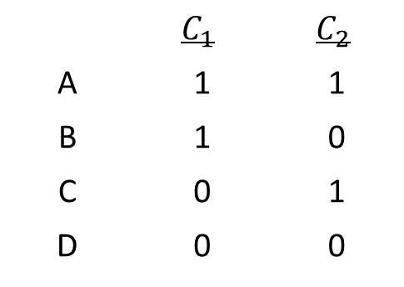
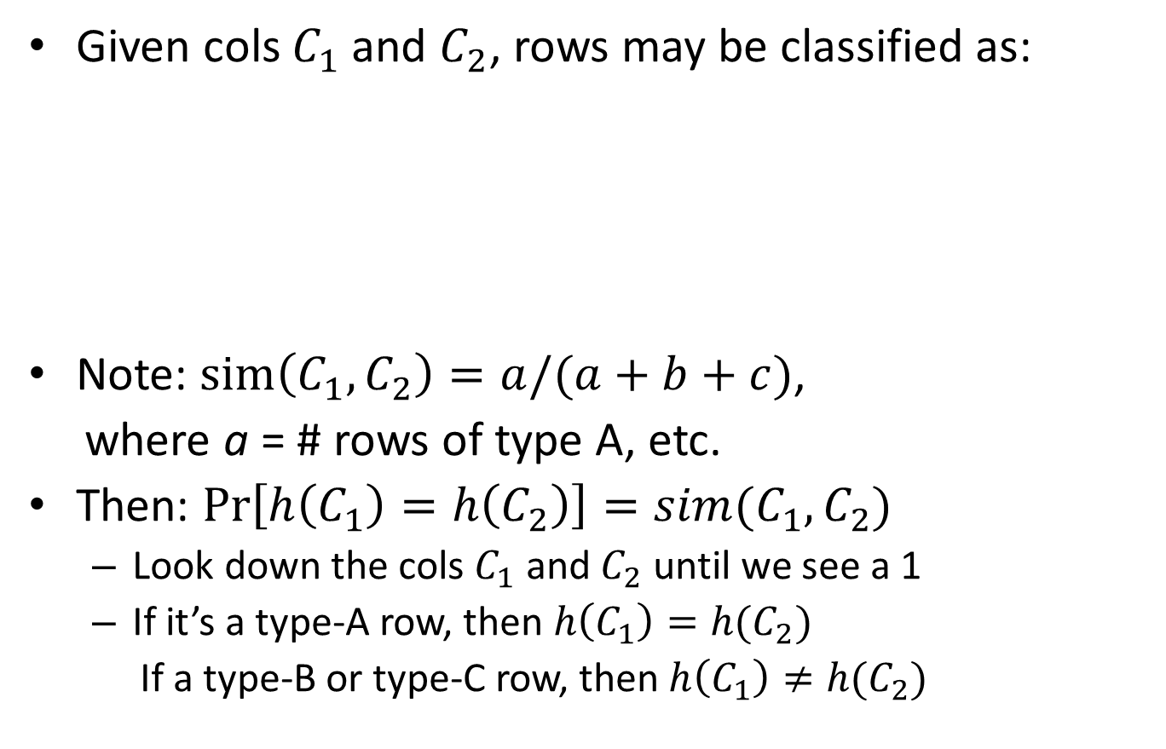
Four Types of Rows
Given cols $C_{1}$ and $C_{2}$, rows may be classified as:
Note: $sim\left(C_{1},C_{2}\right)=a/(a+b+c)$,
where a = # rows of type A, etc.
Then: $\operatorname{Pr}\left[h\left(C_{1}\right)=h\left(C_{2}\right)\right]=sim(C_{1},C_{2})$
Look down the cols $C_{1}$ and $C_{2}$ until we see a 1
If it’s a type-A row, then $h\left(C_{1}\right)=h(C_{2})$
If a type-B or type-C row, then $h\left(C_{1}\right)≠h(C_{2})$
 | $$C_{1}$$ | $$C_{2}$$
A | 1 | 1
B | 1 | 0
C | 0 | 1
D | 0 | 0

Slide 36
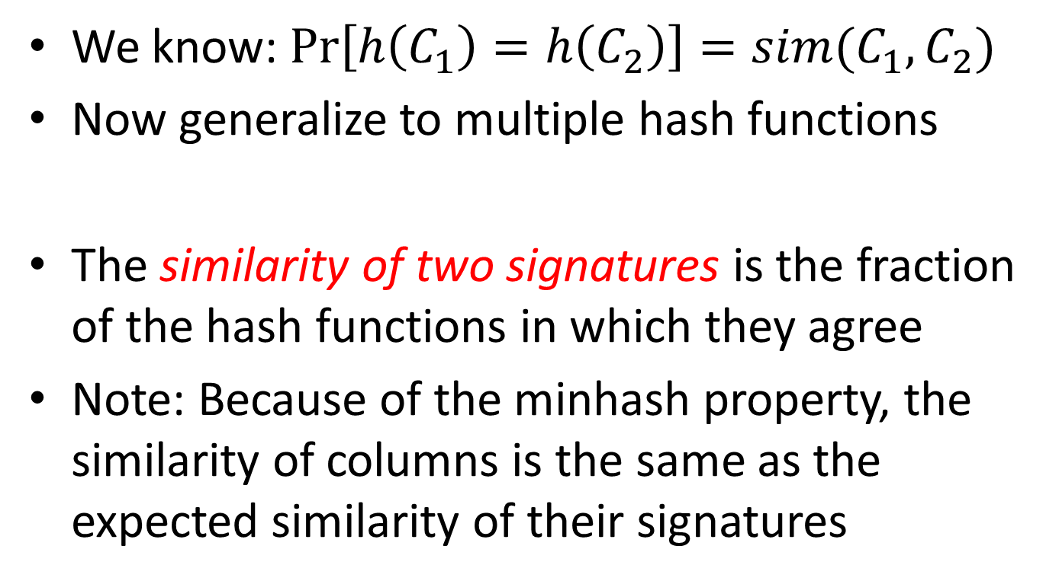
Similarity for Signatures
We know: $\operatorname{Pr}\left[h\left(C_{1}\right)=h\left(C_{2}\right)\right]=sim(C_{1},C_{2})$
Now generalize to multiple hash functions
The similarity of two signatures is the fraction of the hash functions in which they agree
Note: Because of the minhash property, the similarity of columns is the same as the expected similarity of their signatures

Slide 37

Min-Hashing Example
Permutation $π$
Input matrix (Shingles*Documents)
Signature matrix M
2
3
7
6
1
5
4
4
2
1
3
6
7
5
3
4
7
2
6
1
5
1 | 0 | 1 | 0
1 | 0 | 0 | 1
0 | 1 | 0 | 1
0 | 1 | 0 | 1
0 | 1 | 0 | 1
1 | 0 | 1 | 0
1 | 0 | 1 | 0
2 | 1 | 2 | 1
2 | 1 | 4 | 1
1 | 2 | 1 | 2
Similarities:
 | 1-3 | 2-4 | 1-2 | 3-4
Col/Col | 0.75 | 0.75 | 0 | 0
Sig/Sig | 0.67 | 1.00 | 0 | 0

Slide 38
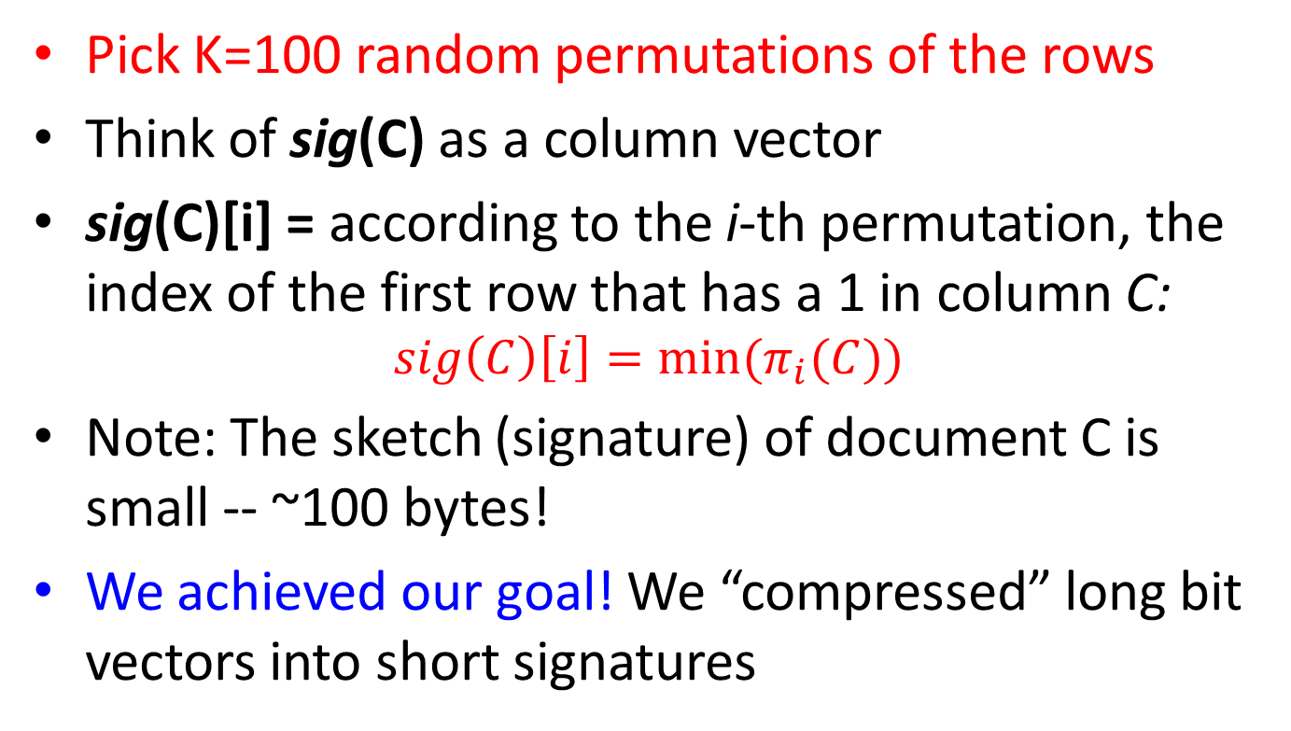
MinHash Signatures
Pick K=100 random permutations of the rows
Think of sig(C) as a column vector
sig(C)[i] = according to the i-th permutation, the index of the first row that has a 1 in column C:
$$sig\left(C\right)\left[i\right]=min⁡(π_{i}(C))$$
Note: The sketch (signature) of document C is small -- ~100 bytes!
We achieved our goal! We “compressed” long bit vectors into short signatures

Slide 39
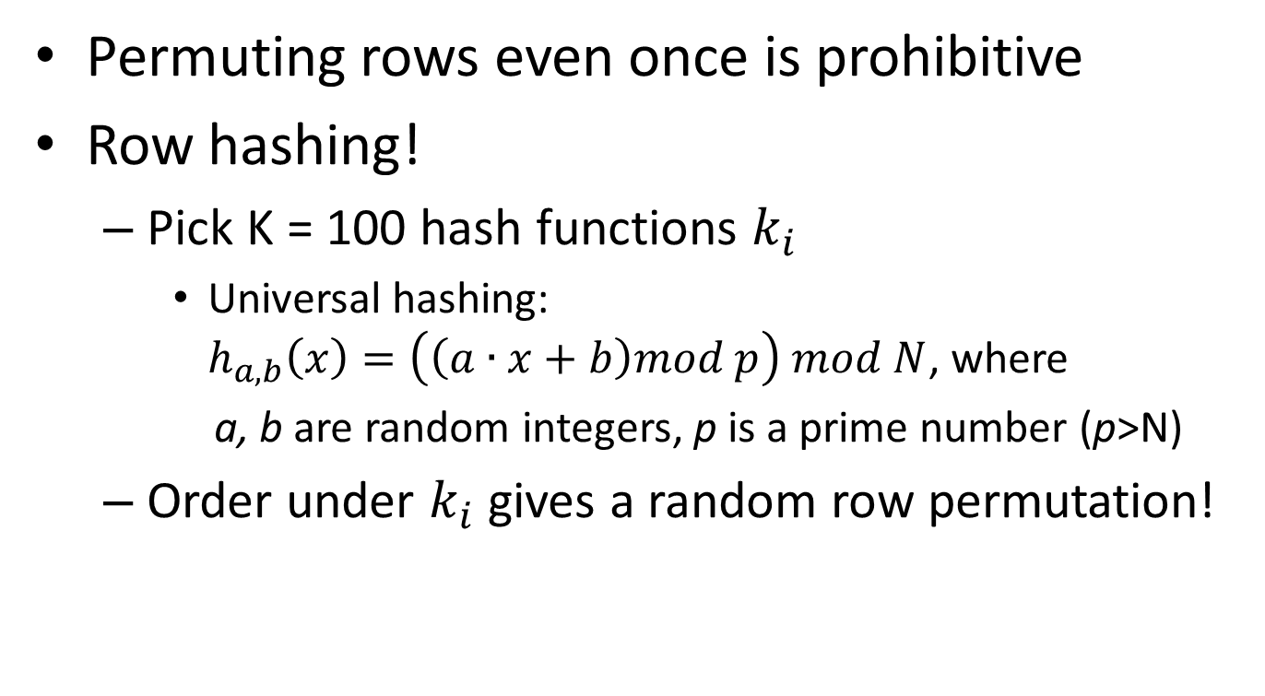
Implementational Trick
Permuting rows even once is prohibitive
Row hashing!
Pick K = 100 hash functions $k_{i}$
Universal hashing: $h_{a,b}\left(x\right)=\left(\left(a∙x+b\right)mod p\right) mod N$, where
a, b are random integers, p is a prime number (p>N)
Order under $k_{i}$ gives a random row permutation!

Slide 40
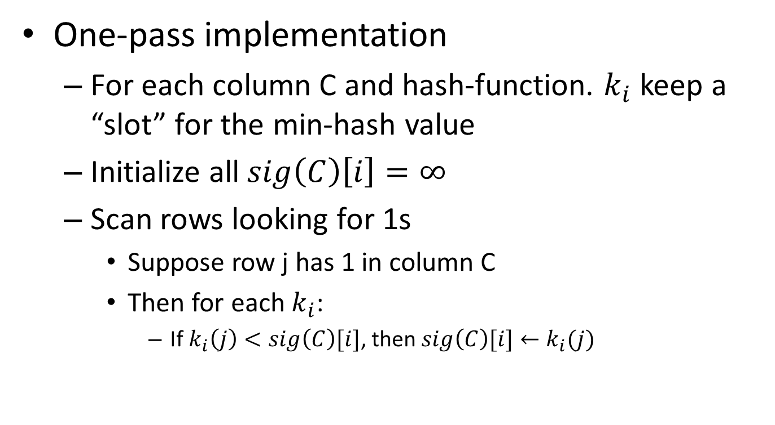
Implementational Trick
One-pass implementation
For each column C and hash-function. $k_{i}$ keep a “slot” for the min-hash value
Initialize all $sig\left(C\right)\left[i\right]=∞$
Scan rows looking for 1s
Suppose row j has 1 in column C
Then for each $k_{i}$:
If $k_{i}\left(j\right)<sig\left(C\right)[i]$, then $sig\left(C\right)[i]←k_{i}(j)$

Slide 41
In-Class Practice
Go to practice

Slide 42
Step 3 – Locality Sensitive Hashing
Focus on pairs of signatures likely to be from similar documents

Slide 43
LSH: First Cut
Goal: Find documents with Jaccard similarity at least s (for some similarity threshold)
General idea: Use a (hash) function f(x,y) that tells whether x and y is a candidate pair: a pair of elements whose similarity must be evaluated
For minhash matrices:
Hash columns of signature matrix to many buckets
Each pair of documents that hashes into the same bucket is a candidate pair (for further examination)

Slide 44
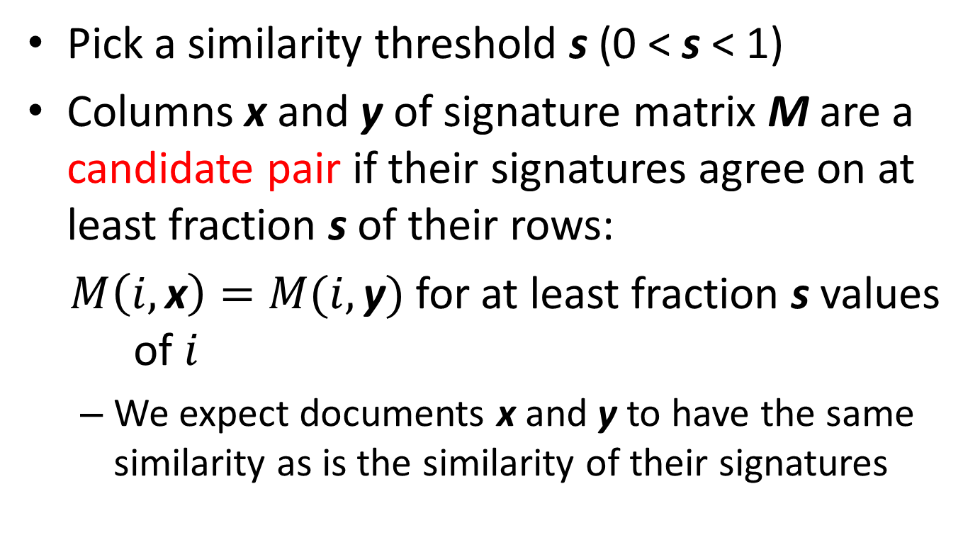
Candidates from Minhash
Pick a similarity threshold s (0 < s < 1)
Columns x and y of signature matrix M are a candidate pair if their signatures agree on at least fraction s of their rows:
$M\left(i,\text{x}\right)=M(i,\text{y})$ for at least fraction s values of $i$
We expect documents x and y to have the same similarity as is the similarity of their signatures

Slide 45
LSH for Minhash
Big idea: Hash columns of signature matrix M several times
Arrange that (only) similar columns are likely to hash to the same bucket, with high probability
Candidate pairs are those that hash to the same bucket
Banding Technique
Divide the signature matrix into b bands consisting of r rows each

Slide 46

Partition M into b Bands
r rows
per band
b bands
One signature
Signature matrix $M$

Slide 47
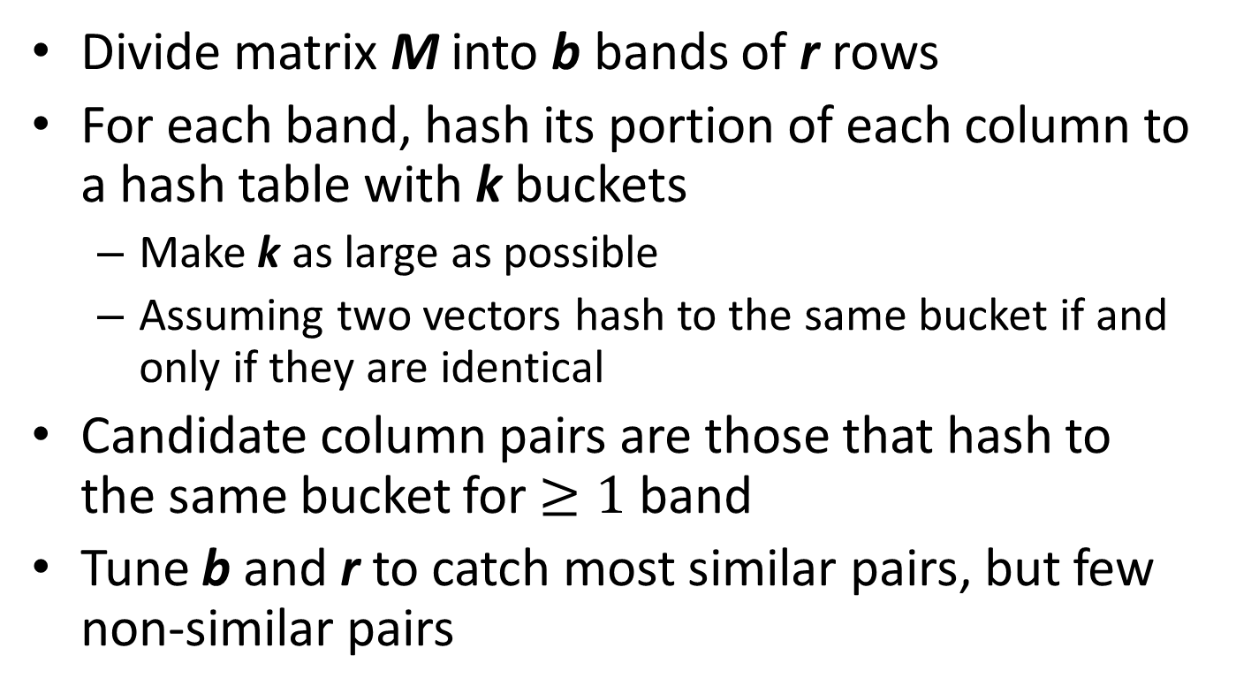
Partition M into b Bands
Divide matrix M into b bands of r rows
For each band, hash its portion of each column to a hash table with k buckets
Make k as large as possible
Assuming two vectors hash to the same bucket if and only if they are identical
Candidate column pairs are those that hash to the same bucket for $≥1$ band
Tune b and r to catch most similar pairs, but few non-similar pairs

Slide 48
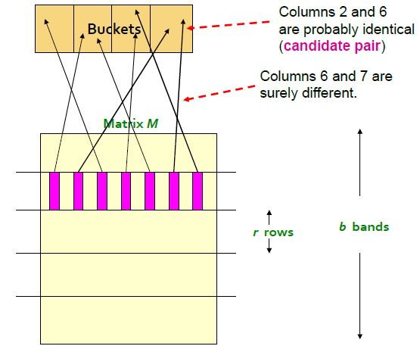
Hashing Bands

Slide 49
Simplifying Assumption
There are enough buckets that columns are unlikely to hash to the same bucket unless they are identical in a particular band
Hereafter, we assume that “same bucket” means “identical in that band”
Assumption needed only to simplify analysis, not for correctness of algorithm

Slide 50
Example of Bands
Assume the following case:
Suppose 100,000 columns of M (100k docs)
Signatures of 100 integers (rows)
Therefore, signatures take 40Mb
Choose b = 20 bands of r = 5 integers/band
Goal: Find pairs of documents that are at least s = 0.8 similar
Notes:
An integer takes 4 byes to represent. Total signature = 4 bytes x 100 x 100K = 40 Mb.

Slide 51
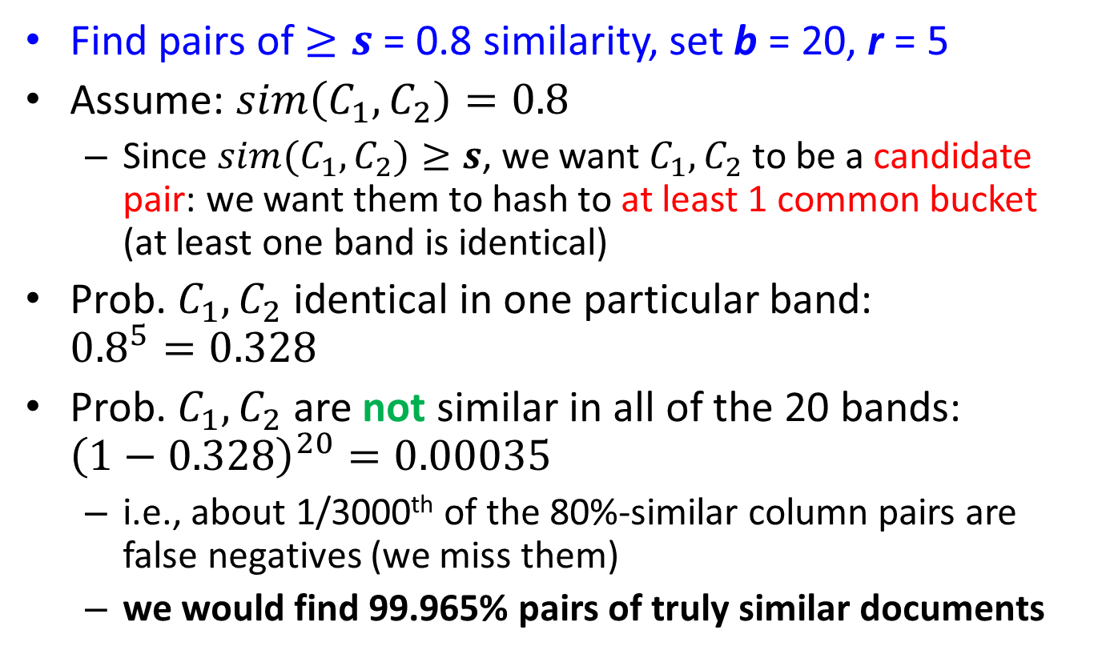

$C_{1},C_{2}$ are 80% Similar
Find pairs of $≥s$ = 0.8 similarity, set b = 20, r = 5
Assume: $sim\left(C_{1}, C_{2}\right)=0.8$
Since $sim(C_{1},C_{2})≥s$, we want $C_{1},C_{2}$ to be a candidate pair: we want them to hash to at least 1 common bucket (at least one band is identical)
Prob. $C_{1},C_{2}$ identical in one particular band: ${0.8}^{5}=0.328$
Prob. $C_{1},C_{2}$ are not similar in all of the 20 bands: ${\left(1−0.328\right)}^{20}=0.00035$
i.e., about 1/3000th of the 80%-similar column pairs are false negatives (we miss them)
we would find 99.965% pairs of truly similar documents

Slide 52
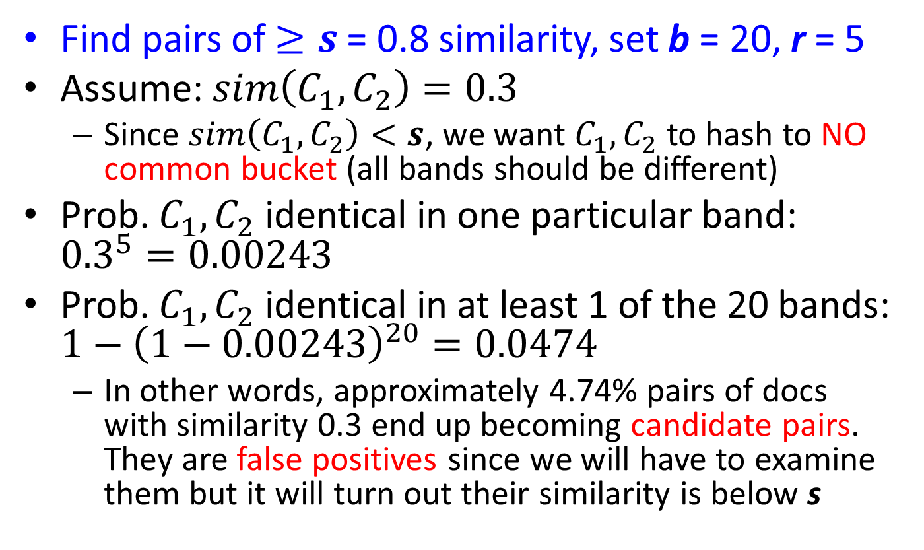

$C_{1},C_{2}$ are 30% Similar
Find pairs of $≥s$ = 0.8 similarity, set b = 20, r = 5
Assume: $sim\left(C_{1}, C_{2}\right)=0.3$
Since $sim\left(C_{1},C_{2}\right)<s$, we want $C_{1},C_{2}$ to hash to NO common bucket (all bands should be different)
Prob. $C_{1},C_{2}$ identical in one particular band: ${0.3}^{5}=0.00243$
Prob. $C_{1},C_{2}$ identical in at least 1 of the 20 bands: ${1−\left(1−0.00243\right)}^{20}=0.0474$
In other words, approximately 4.74% pairs of docs with similarity 0.3 end up becoming candidate pairs. They are false positives since we will have to examine them but it will turn out their similarity is below s

Slide 53
LSH Involves a Tradeoff
Pick:
the number of minhashes (rows of M)
the number of bands b, and
the number of rows r per band
to balance false positives/negatives
Example: if we had only 15 bands of 5 rows, the number of false positives would go down, but the number of false negatives would go up

Slide 54
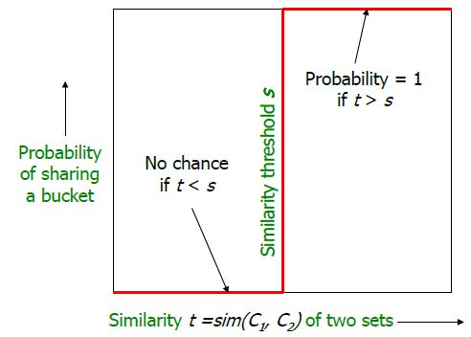
Analysis of LSH – What We Want

Slide 55
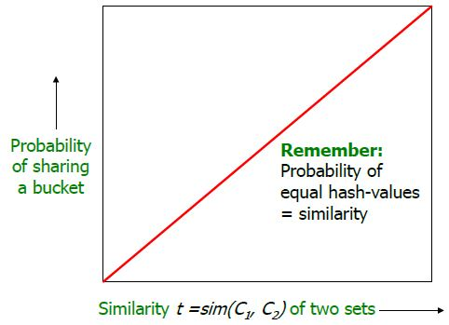
What 1 Band of 1 Row Gives You

Slide 56
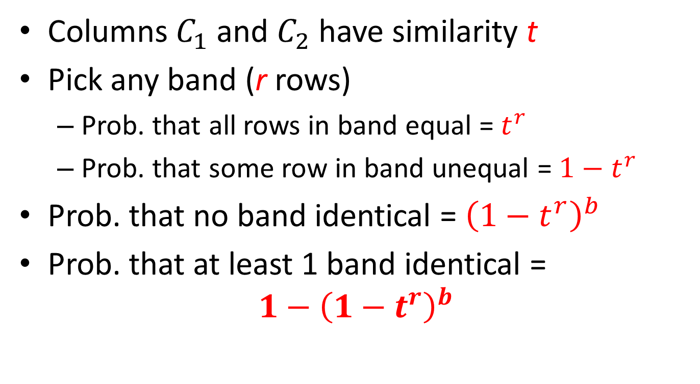
b bands, r rows/band
Columns $C_{1}$ and $C_{2}$ have similarity t
Pick any band (r rows)
Prob. that all rows in band equal = $t^{r}$
Prob. that some row in band unequal = $1−t^{r}$
Prob. that no band identical = ${\left(1−t^{r}\right)}^{b}$
Prob. that at least 1 band identical =
$$1−{\left(1−t^{r}\right)}^{b}$$

Slide 57
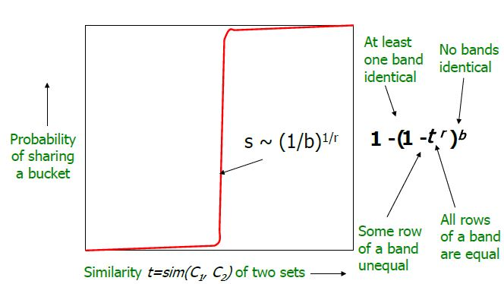
What b Bands of r Rows Gives You

Slide 58
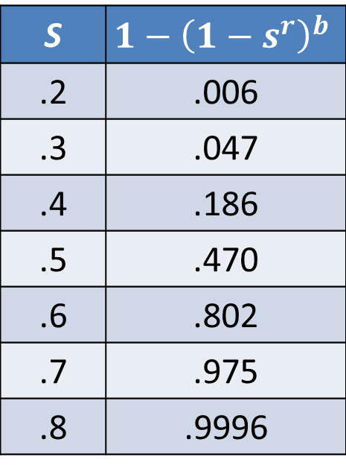
Example: b =20; r = 5
Similarity threshold s
Prob. that at least 1 band is identical:
S | $$1−{\left(1−s^{r}\right)}^{b}$$
.2 | .006
.3 | .047
.4 | .186
.5 | .470
.6 | .802
.7 | .975
.8 | .9996

Slide 59
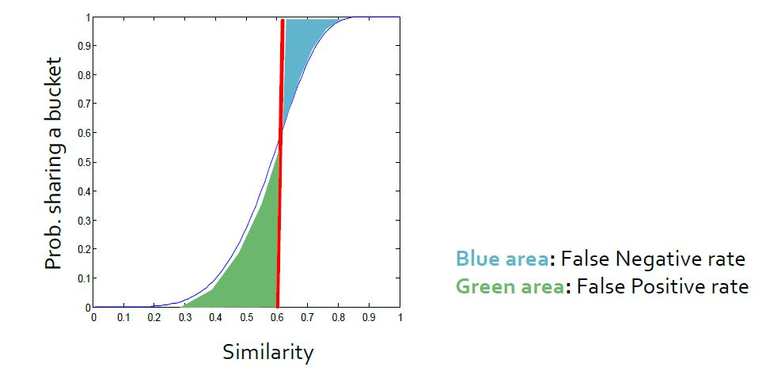
Picking r and b: The S-curve
Picking r and b to get the best S-curve
50 hash-functions (r=5, b=10)

Slide 60
LSH Summary
Tune M, b, r to get almost all pairs with similar signatures, but eliminate most pairs that do not have similar signatures
Check in main memory that candidate pairs really do have similar signatures
Optional: In another pass through data, check that the remaining candidate pairs really represent similar documents

Slide 61
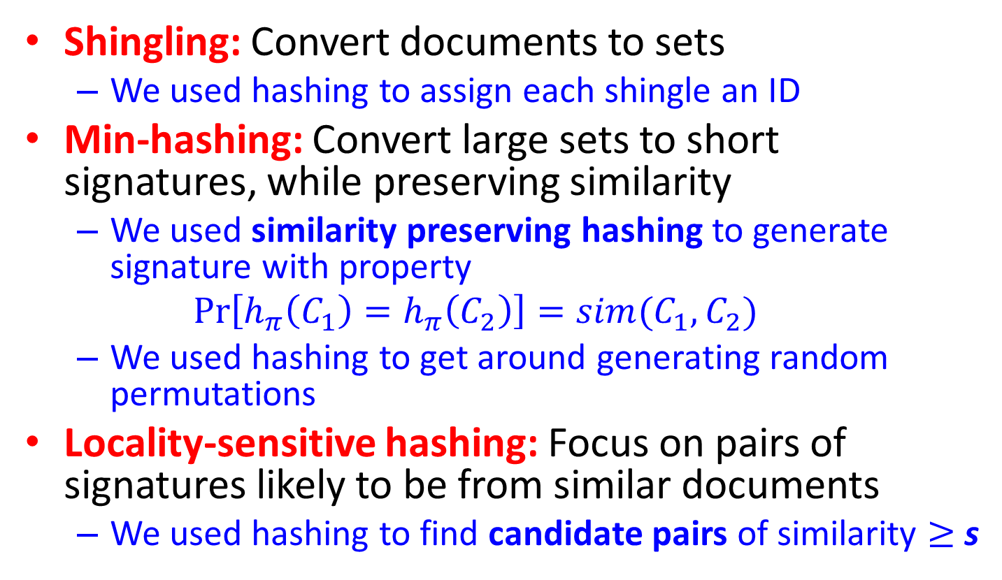
Finding Similar Documents: Summary
Shingling: Convert documents to sets
We used hashing to assign each shingle an ID
Min-hashing: Convert large sets to short signatures, while preserving similarity
We used similarity preserving hashing to generate signature with property
$$\operatorname{Pr}\left[h_{π}\left(C_{1}\right)=h_{π}\left(C_{2}\right)\right]=sim(C_{1},C_{2})$$
We used hashing to get around generating random permutations
Locality-sensitive hashing: Focus on pairs of signatures likely to be from similar documents
We used hashing to find candidate pairs of similarity $≥$ s

Slide 62
Outline
Finding Similar Documents
Shingling
Min Hashing
Locality-Sensitive Hashing
Other Applications of LSH
Theory of LSH

Slide 63
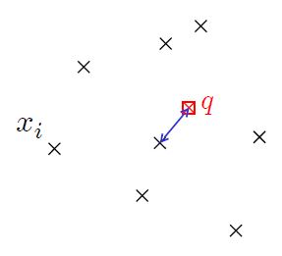
Finding Similar Docs: Review
Goal: Given one document, find similar documents in a very large repository
Generalized: Given one query, find near-neighbors / nearest neighbors in high-dimensional space

Slide 64
Other Applications of LSH
LSH has been applied to other problem domains including:
Near-duplicate detection
Hierarchical clustering
Image/audio/video similarity identification
Bioinformatics
……

Slide 65
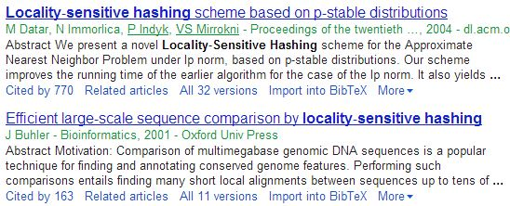
Near-duplicate Detection
How does Google scholar merge the same paper with different copies?
Near-duplicate detection!

Slide 66
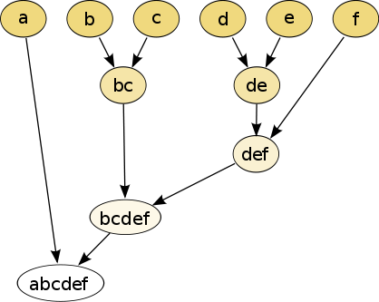
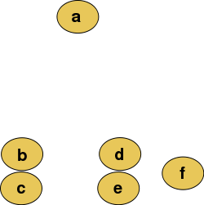
Hierarchical Clustering
A method of cluster analysis which seeks to build a hierarchy of clusters
The role of LSH: find similar items so that they can be merged into the same cluster

Slide 67
Image/Audio/Video Similarity Identification
Theoretically, they are all problems of near-neighbors search.
Unlike document similarity identification, a huge amount of pre-processing work needs to be done in order to map each file into a high-dimensional vector.

Slide 68
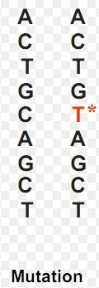
Bioinformatics
Example 1: Genome-wide association study
An examination of many common genetic variants in different individuals to see if any variant is associated with a trait
Example 2: Gene expression similarity identification
Still one task of near-neighbors search

Slide 69
One-Slide Takeaway
Finding similar documents:
Shingling
Min Hashing
Locality-Sensitive Hashing
Other LSH applications
Appendix: How to construct locality-sensitive hash functions

Slide 70
Outline
Finding Similar Documents
Shingling
Min Hashing
Locality-Sensitive Hashing
Other Applications of LSH
Appendix: Theory of LSH

Slide 71
Families of Hash Functions
For Minhashing signatures, we got a Minhash function for each permutation of rows
An example of a family of hash functions:
A “hash function” is any function that takes two elements and says whether or not they are “equal”
A family of hash functions is any set of hash functions from which we can pick one at random efficiently
Example: the set of Minhash functions generated from permutations of rows

Slide 72
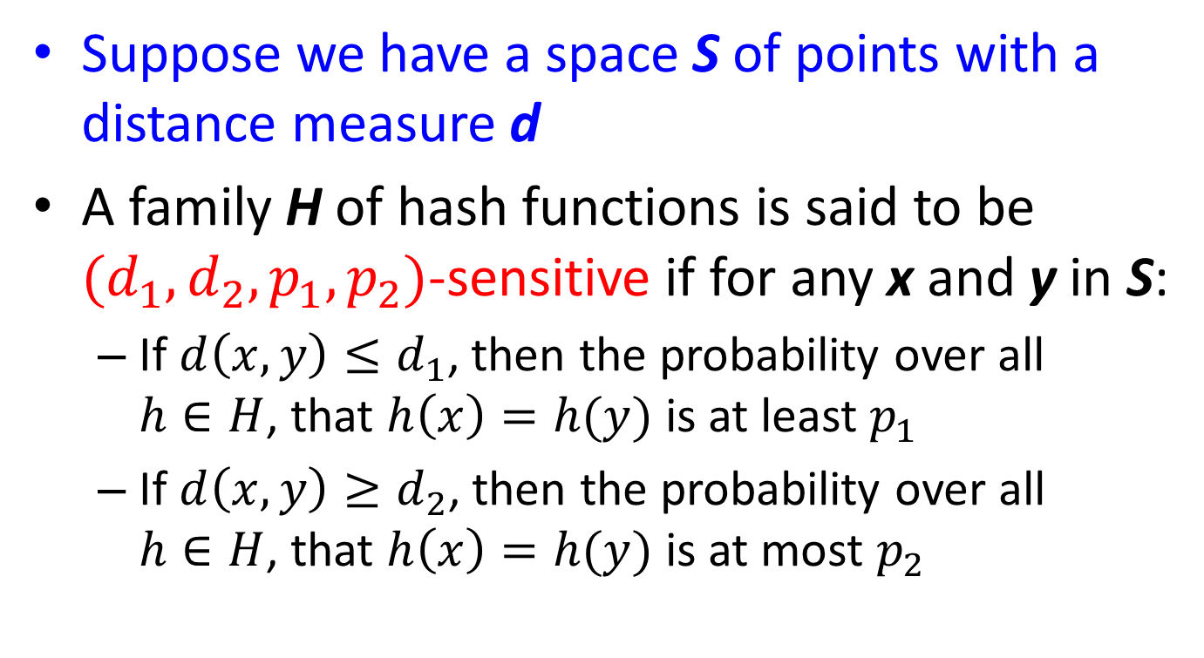
Locality-Sensitive (LS) Families
Suppose we have a space S of points with a distance measure d
A family H of hash functions is said to be $(d_{1},d_{2},p_{1},p_{2})$-sensitive if for any x and y in S:
If $d\left(x,y\right)≤d_{1}$, then the probability over all $h∈H$, that $h\left(x\right)=h(y)$ is at least $p_{1}$
If $d\left(x,y\right)≥d_{2}$, then the probability over all $h∈H$, that $h\left(x\right)=h(y)$ is at most $p_{2}$

Slide 73
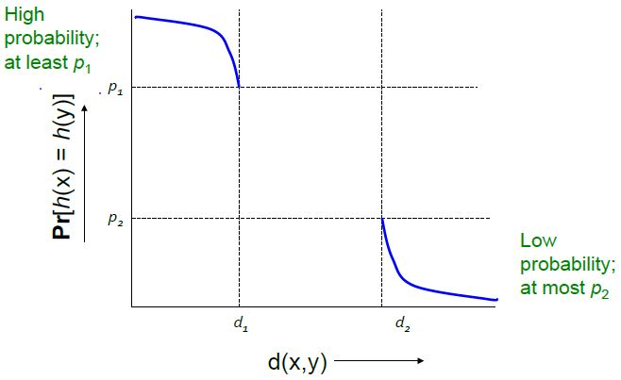
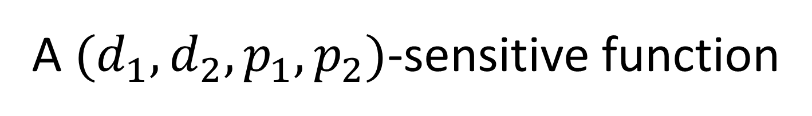
A $(d_{1},d_{2},p_{1},p_{2})$-sensitive function

Slide 74
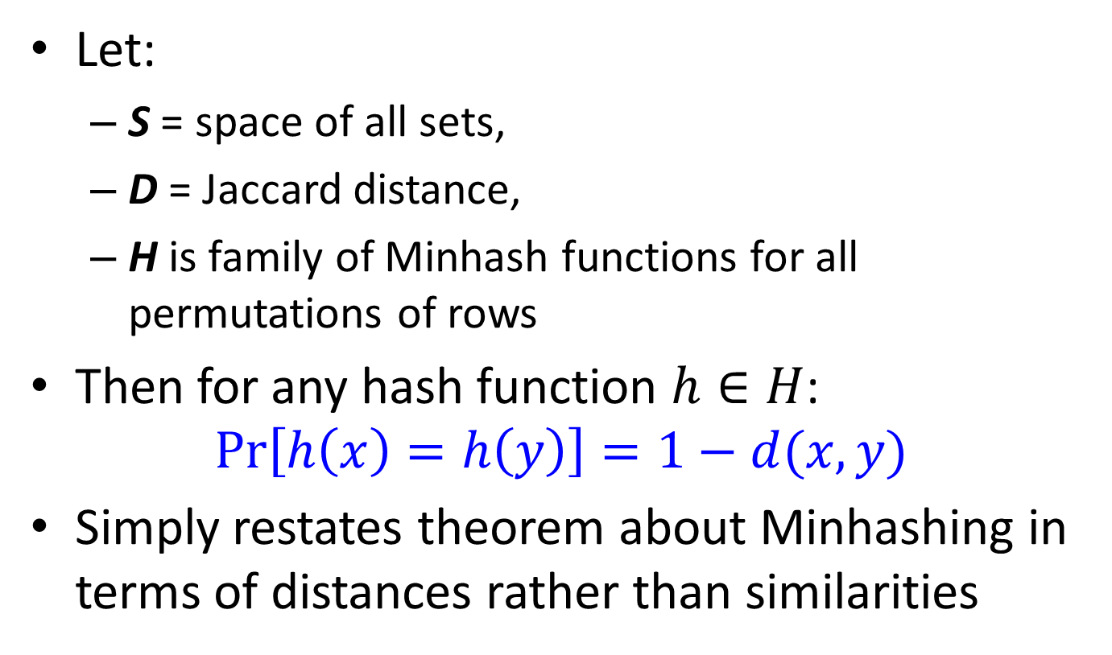
Example of LS Family: Minhash
Let:
S = space of all sets,
D = Jaccard distance,
H is family of Minhash functions for all permutations of rows
Then for any hash function $h∈H$:
$$\operatorname{Pr}\left[h\left(x\right)=h\left(y\right)\right]=1−d(x,y)$$
Simply restates theorem about Minhashing in terms of distances rather than similarities

Slide 75
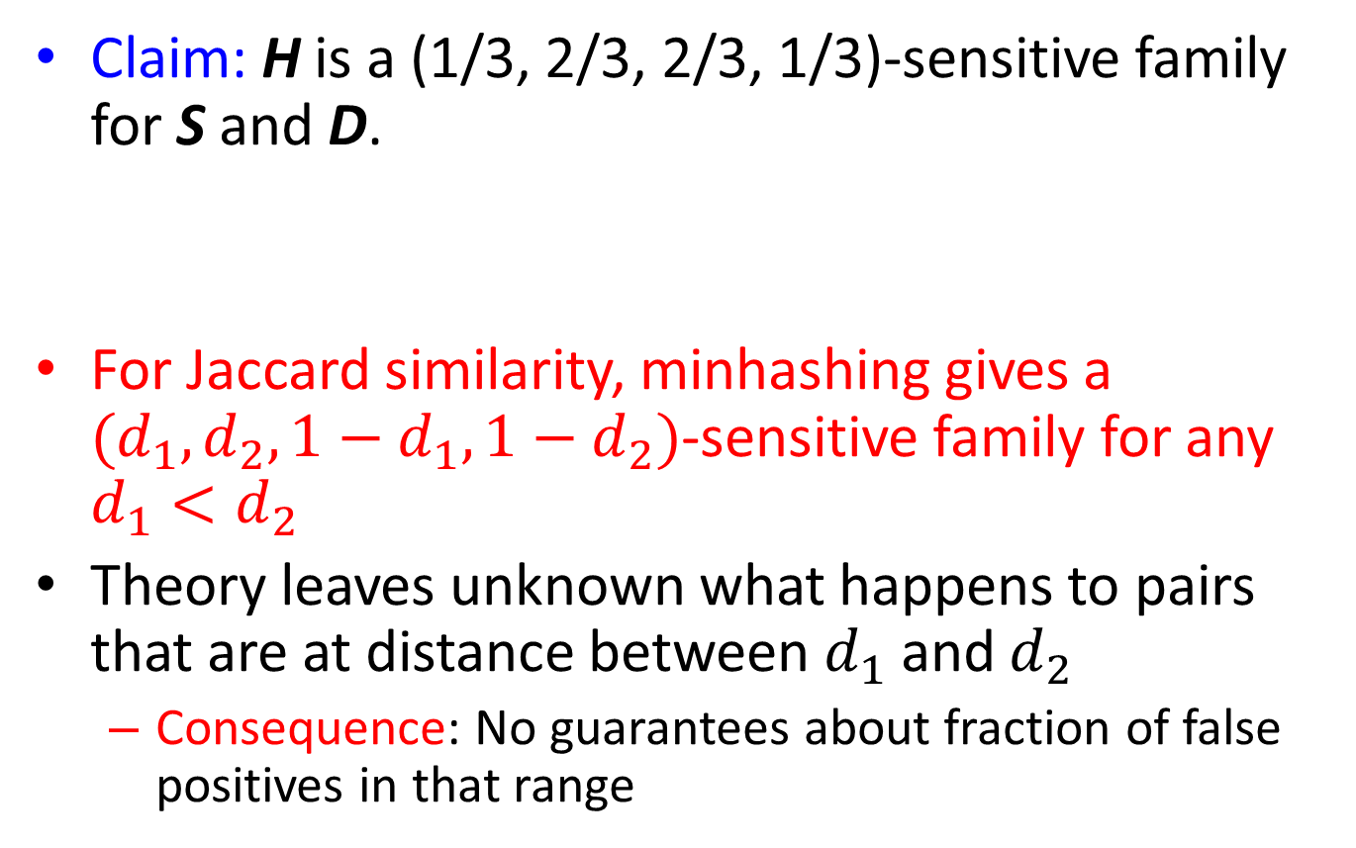
Example: LS Family – (2)
Claim: H is a (1/3, 2/3, 2/3, 1/3)-sensitive family for S and D.
For Jaccard similarity, minhashing gives a $(d_{1},d_{2},1−d_{1},1−d_{2})$-sensitive family for any $d_{1}<d_{2}$
Theory leaves unknown what happens to pairs that are at distance between $d_{1}$ and $d_{2}$
Consequence: No guarantees about fraction of false positives in that range

Slide 76
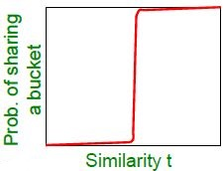
Amplifying a LS-Family
Can we reproduce the “S-curve” effect we saw before for any LS family?
The “bands” technique we learned for signature matrices carries over to this more general setting
Two constructions:
AND construction like “rows in a band”
OR construction like “many bands”

Slide 77
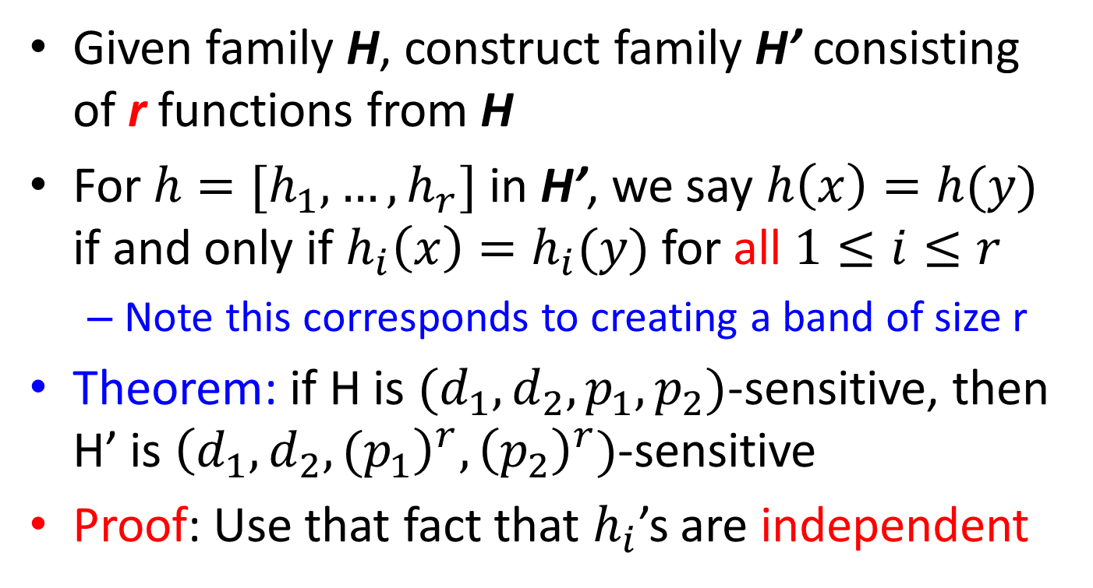
AND of Hash Functions
Given family H, construct family H’ consisting of r functions from H
For $h=[h_{1},…,h_{r}]$ in H’, we say $h\left(x\right)=h(y)$ if and only if $h_{i}\left(x\right)=h_{i}(y)$ for all $1≤i≤r$
Note this corresponds to creating a band of size r
Theorem: if H is $(d_{1},d_{2},p_{1},p_{2})$-sensitive, then H’ is ${\left(d_{1},d_{2},{(p}_{1}\right)}^{r},{\left(p_{2}\right)}^{r})$-sensitive
Proof: Use that fact that $h_{i}$’s are independent

Slide 78
Subtlety Regarding Independence
Independence of hash functions (HFs) really means that the prob. of two HFs saying “yes” is the product of each saying “yes”
But two Minhash functions (e.g.) could be highly correlated
For example, if permutations agree in the first one million entries
However, the probabilities in the 4-tuples are over all possible members of H, H’
OK for Minhash, others, but must be part of LSH-family definition

Slide 79
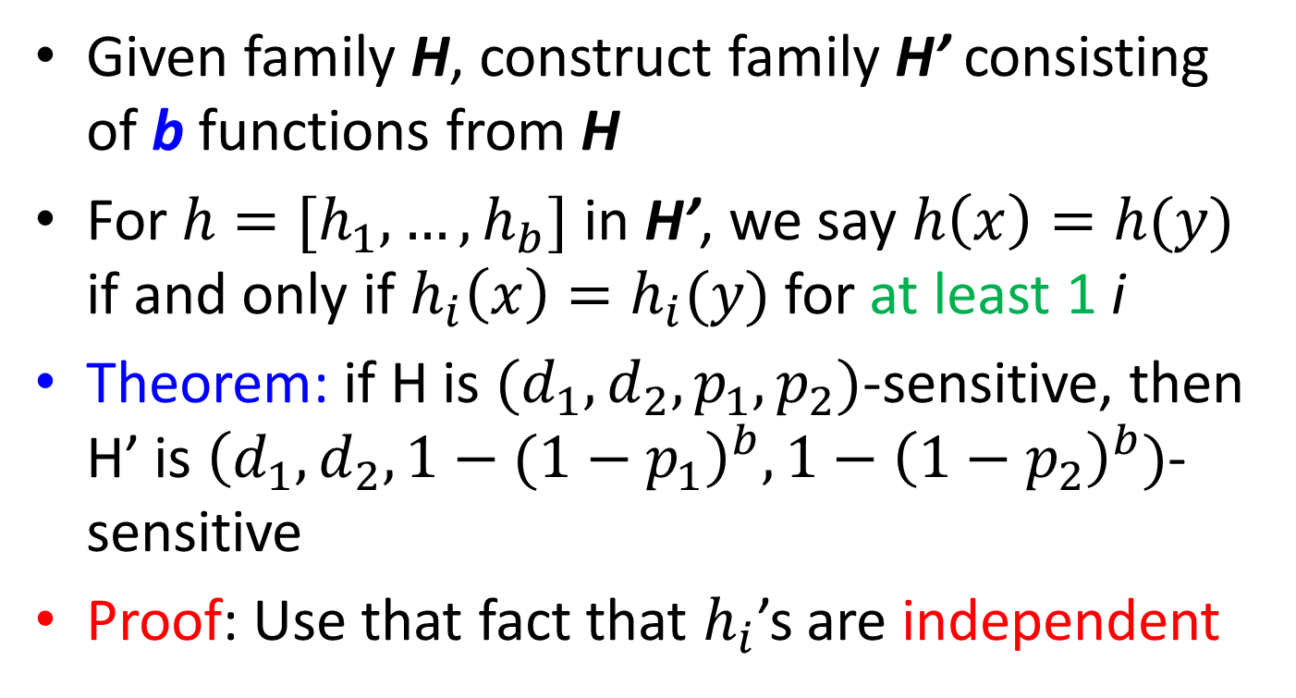
OR of Hash Functions
Given family H, construct family H’ consisting of b functions from H
For $h=[h_{1},…,h_{b}]$ in H’, we say $h\left(x\right)=h(y)$ if and only if $h_{i}\left(x\right)=h_{i}(y)$ for at least 1 i
Theorem: if H is $(d_{1},d_{2},p_{1},p_{2})$-sensitive, then H’ is ${\left(d_{1},d_{2},{1−(1−p}_{1}\right)}^{b},1−{\left(1−p_{2}\right)}^{b})$-sensitive
Proof: Use that fact that $h_{i}$’s are independent

Slide 80
Effect of AND and OR Constructions
AND makes all probs. shrink, but by choosing r correctly, we can make the lower prob. approach 0 while the higher does not
OR makes all probs. grow, but by choosing b correctly, we can make the upper prob. approach 1 while the lower does not

Slide 81
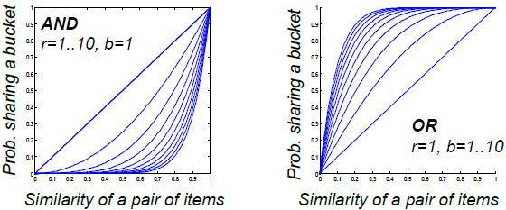
Effect of AND and OR Constructions

Slide 82
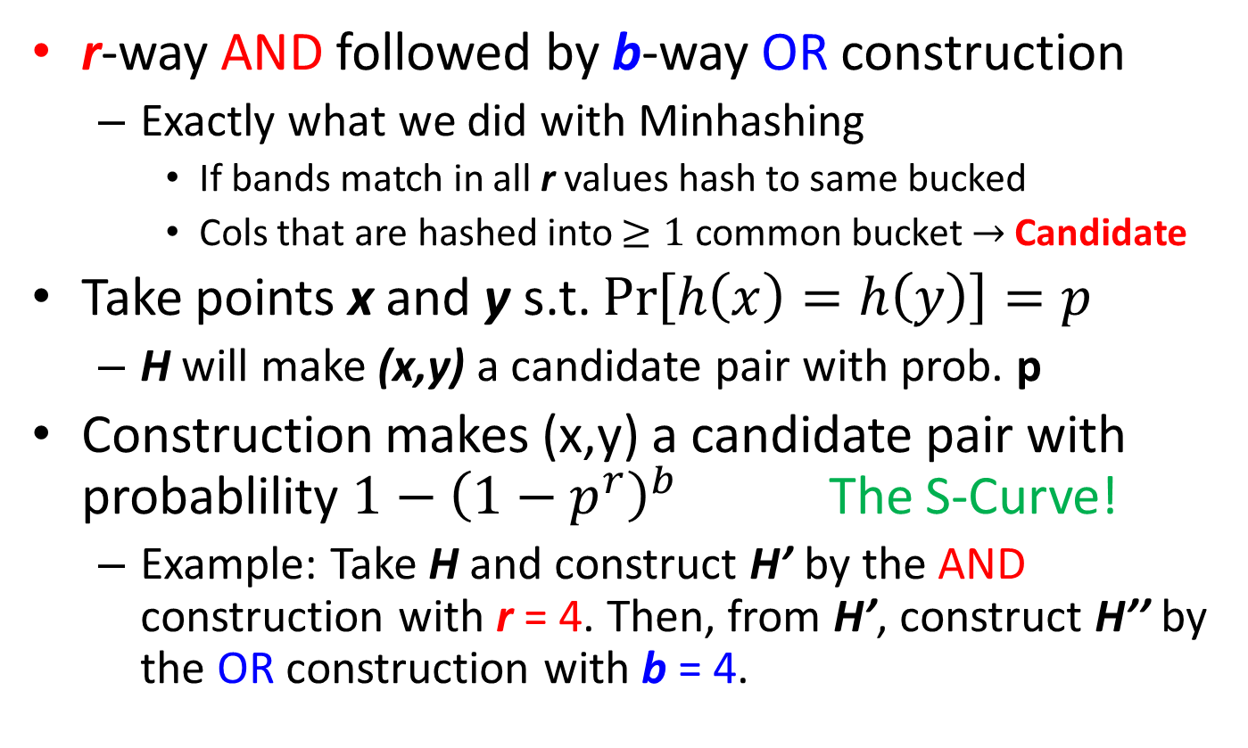
Composing Constructions
r-way AND followed by b-way OR construction
Exactly what we did with Minhashing
If bands match in all r values hash to same bucked
Cols that are hashed into $≥1$ common bucket $→$ Candidate
Take points x and y s.t. $\operatorname{Pr}\left[h\left(x\right)=h\left(y\right)\right]=p$
H will make (x,y) a candidate pair with prob. p
Construction makes (x,y) a candidate pair with probablility $1−{\left(1−p^{r}\right)}^{b}$ The S-Curve!
Example: Take H and construct H’ by the AND construction with r = 4. Then, from H’, construct H’’ by the OR construction with b = 4.

Slide 83
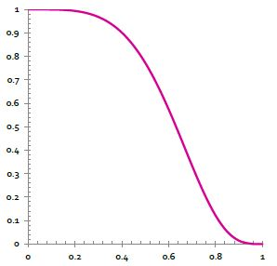

Table for Function $1−{\left(1−p^{4}\right)}^{4}$
p | 1-(1-p⁴)⁴
.2 | .0064
.3 | .0320
.4 | .0985
.5 | .2275
.6 | .4260
.7 | .6666
.8 | .8785
.9 | .9860
r = 4, b = 4 transforms a (.2,.8,.8,.2)-sensitive family into a (.2,.8,.8785,.0064)-sensitive family.

Slide 84

Picking r and b: The S-curve
Picking r and b to get desired performance
50 hash-functions (r * b = 50)
Blue area X: False Negative rate
These are pairs with sim > s but the X fraction won’t share a band and then will never becomes candidates. This means we will never consider these pairs for (slow/exact) similarity calculation!
Green area Y: False Positive rate
These are pairs with sim < s but we will consider theme as candidates. This is not too bad, we will consider them for (slow/exact) similarity computation and discard them.

Slide 85

Picking r and b: The S-curve
Picking r and b to get desired performance
50 hash-functions (r * b = 50)

Slide 86

OR-AND Composition
Apply a b-way OR construction followed by an r-way AND construction
Transforms probability p into ${\left(1−{\left(1−p\right)}^{b}\right)}^{r}$
The same S-curve, mirrored horizontally and vertically
Example: Take H and construct H’ by the OR construction with b = 4. Then, from H’, construct H’’ by the AND construction with r = 4.

Slide 87


Table for Function ${\left(1−{\left(1−p\right)}^{4}\right)}^{4}$
p | (1-(1-p)⁴)⁴
.2 | .0140
.3 | .1215
.4 | .3334
.5 | .5740
.6 | .7725
.7 | .9015
.8 | .9680
.9 | .9936
The example transforms a (.2,.8,.8,.2)-sensitive family into a (.2,.8,.9936,.1215)-sensitive family.

Slide 88
Cascading Constructions
Example: Apply the (4,4) OR-AND construction followed by the (4,4) AND-OR construction
Transforms a (.2, .8, .8, .2)-sensitive family into a (.2, .8, .9999996, .0008715)-sensitive family
Note this family uses 256 (=4*4*4*4) of the original hash functions

Slide 89
Summary
Pick any two distances x < y
Start with a (x, y, (1-x), (1-y))-sensitive family
Apply constructions to amplify (x, y, p, q)-sensitive family, where p is almost 1 and q is almost 0
The closer to 0 and 1 we get, the more hash functions must be used

Slide 90


In-Class Practice
Element | $$S_{1}$$ | $$S_{2}$$ | $$S_{3}$$ | $$S_{4}$$
1 | 0 | 1 | 0 | 1
2 | 0 | 1 | 0 | 0
3 | 1 | 0 | 0 | 1
4 | 0 | 0 | 1 | 0
5 | 0 | 0 | 1 | 1
6 | 1 | 0 | 0 | 0
Compute the minhash signature for each column if we use the following three hash functions: $h_{1}\left(x\right)=2x+1$ mod 6; $h_{2}\left(x\right)=3x+2$ mod 6; $h_{3}\left(x\right)=5x+2$ mod 6.
Which of these hash functions are true permutations?
How close are estimated Jaccard similarities for the six pairs of columns to the true Jaccard similarities?
Notes:
Elements can start from 0 or 1. When starting from 1, the range of mod 6 result is 1 to 6 (instead of 0 to 5).

