Slide 1
NLP and Text Mining
Project: Mental Health Issue Classification
Tim Graf & Yanis Schärer
20.12.2022

Slide 2
Project: Mental Health Issue Classification
NLP and Text Mining
Table of Contents
Task 1: Data Exploration and Processing
Task 2: Sentiment Analysis using TF-IDF
Task 3: NER
Task 4: Sentiment Analysis using BERT

Slide 3
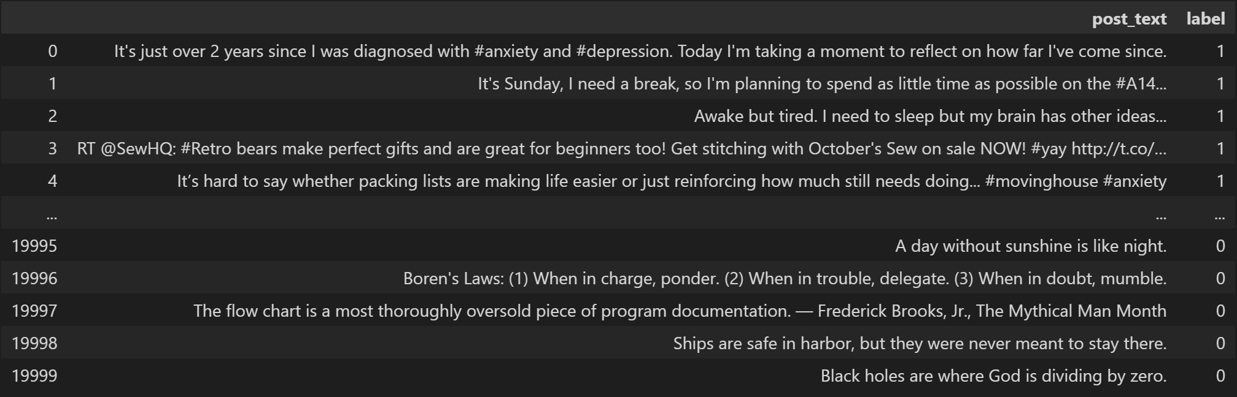
Task 1: Data Exploration and Processing
NLP and Text Mining – Project: Mental Health Issue Classification
Dataset and Basic Statistics
20’000 labeled tweets from (only) 72 unique users (0 = non-depressed, 1 = depressed) 🡪 Possible problem: Model could learn to classify users (instead of the actual text) based on their style of writing
Balanced dataset, i.e. 10’000 tweets with each label
All tweets are (more or less) in English
Lengths:
 | Min | Average | Max
Characters | 4 | 82 | 169
Words | 1 | 17 | 65
Notes:
Spellchecker

Slide 4
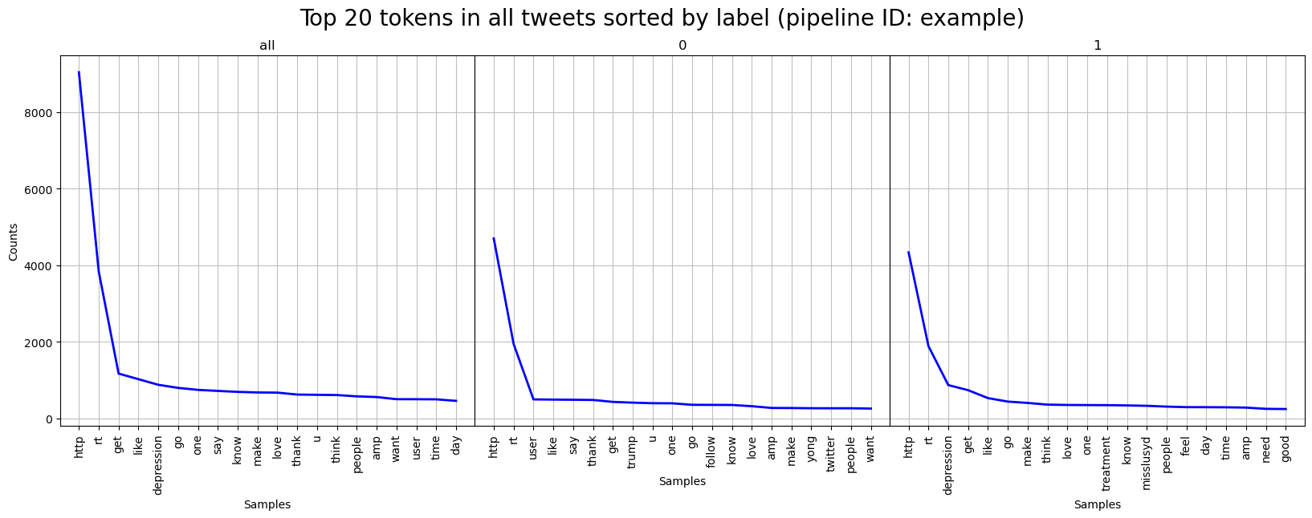
Task 1: Data Exploration and Processing
NLP and Text Mining – Project: Mental Health Issue Classification
Pipeline and TFD for different variants
Pipeline with data, tokenizer, lemmatizer, stopwords as initialization arguments (plus some optional arguments like a unique ID for the pipeline)
Important functions: process(): Processes the data based on the chosen tokenizer, lemmatizer/stemmer and stopwords. Steps can be individually left out. tfd(): Calculates the TFD for the complete processed data and additionally for the individual labels. Can optionally plot the TFD.
We tried 8 different tokenizer-lemmatizer/stemmer combinations (always with the NLTK stopwords corpus). Performance has to be checked in the next step.

Slide 5
Task 2: Sentiment Analysis using TF-IDF
NLP and Text Mining – Project: Mental Health Issue Classification
Improved and Extended Pipeline
Pipeline has to be extended with functions train_test_split(), fit(), predict(), score() for sentiment classification. The pipeline has two new arguments vec and clf (optional, in case the user only wants to output the TFD). → The new functions are only wrappers for existing sklearn-functions.
Trying out the different pipelines, the TweetTokenizer turned out to yield the best performance.
Notes:
Problems with tokenizers: WordPunct cannot distinguish URLs from normal text, TreeBank split don’t and can’t. TweetTokenizer seems to be the most promising one.

Slide 6


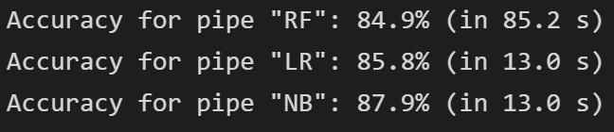
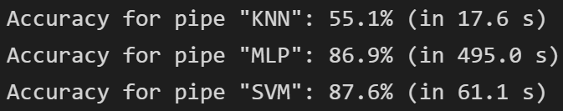
Task 2: Sentiment Analysis using TF-IDF
NLP and Text Mining – Project: Mental Health Issue Classification
Results (1)
Experiment 1: Difference between lemmatizing and stemming
Lemmatizing
Stemming
Experiment 2: Different classifiers (RF = Random Forest, LR = Logistic Regression, NB = Multinomial Naive Bayes, KNN = k-Nearest-Neighbor, MLP = Multilayer Perceptron, SVM = Support Vector Machine)
Notes:
1: Stemming slower but slightly more accurate
2: NB and LR are the fastest, but NB is more accurate. MLP is not bad but very slow. SVM is good but slow. → we stick with NB.

Slide 7

Task 2: Sentiment Analysis using TF-IDF
NLP and Text Mining – Project: Mental Health Issue Classification
Results (2)
Experiment 3: Importance of pre-processing
Notes:
3: We thought the difference would be higher.

Slide 8
Task 3: NER
NLP and Text Mining – Project: Mental Health Issue Classification
NER on Raw Data
NER Annotations by hand, using only spaCy base NER-labels:
TP | 34
FP | 59
FN | 20
Precision | 36.6%
Recall | 53.1%

Slide 9
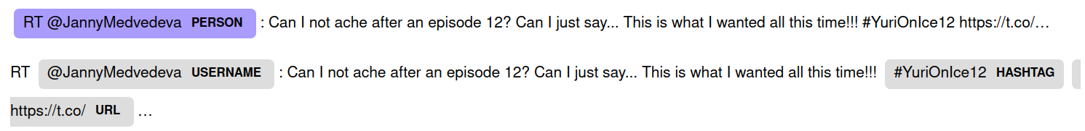
Task 3: NER
NLP and Text Mining – Project: Mental Health Issue Classification
Custom NER
Added Patterns to detect:
URLs
Usernames
Hashtags
Standard NER did not have these categories.
Debatable whether Twitter handles should be PERSON

Slide 10
Task 3: NER
NLP and Text Mining – Project: Mental Health Issue Classification
Comparison
Vanilla spaCy Custom NER rules
TP | 34
FP | 59
FN | 20
TP | 115
FP | 39
FN | 32
Precision | 36.6%
Recall | 53.1%
Precision | 74.6%
Recall | 78.2%

Slide 11
Task 4: Sentiment Analysis using BERT
NLP and Text Mining – Project: Mental Health Issue Classification
Approach
We used a pre-trained BERT model from huggingface (bert-base-uncased)
Then used BertForSequenceClassification (linear layer on CLS output)
No Finetuning of BERT itself
Training and evaluation on Ubelix

Slide 12
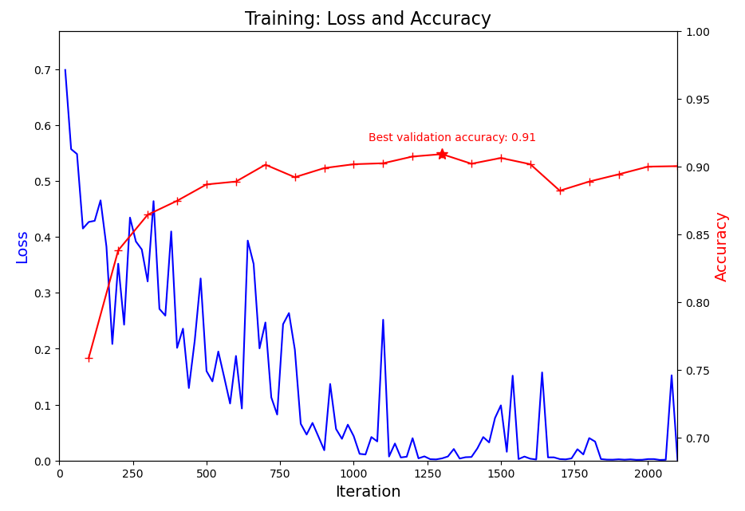
Task 4: Sentiment Analysis using BERT
NLP and Text Mining – Project: Mental Health Issue Classification
Training & Results
Learning Rate: 1e-5 (higher learning rates fluctuated)
Accuracy | 90.7%
Precision | 91.6%
Recall | 89.5%
F1 | 90.2%

Slide 13

Thanks
For your (cross-)attention!
Tim Graf & Yanis Schärer
20.12.2022

