Slide 1
NLP and Text Mining
Project: Mental Health Issue Classification
Tim Graf & Yanis Schärer
20.12.2022

Slide 2
Project: Mental Health Issue Classification
NLP and Text Mining
Table of Contents
Task 1: Data Exploration and Processing
Task 2: Sentiment Analysis using TF-IDF
Task 3: NER
Task 4: Sentiment Analysis using BERT

Slide 3
Task 1: Data Exploration and Processing
NLP and Text Mining – Project: Mental Health Issue Classification
Dataset and Basic Statistics
20’000 labeled tweets from 72 unique users (0 → non-depressed, 1 → depressed)
Balanced dataset, i.e. 10’000 tweets with each label
All tweets are (more or less) in English
Lengths:
 | Min | Average | Max
Characters | 4 | 82 | 169
Words | 1 | 17 | 65

Slide 4
Task 1: Data Exploration and Processing
NLP and Text Mining – Project: Mental Health Issue Classification
Pipeline and TFD for different variants

Slide 5
Task 2: Sentiment Analysis using TF-IDF
NLP and Text Mining – Project: Mental Health Issue Classification
Improved and Extended Pipeline

Slide 6
Task 2: Sentiment Analysis using TF-IDF
NLP and Text Mining – Project: Mental Health Issue Classification
Results
TfidfVectorizer + mNB for lemm. And stem. & different clf & w, w/o pre-processing

Slide 7
Task 3: NER
NLP and Text Mining – Project: Mental Health Issue Classification
NER on Raw Data
Spacy

Slide 8
Task 3: NER
NLP and Text Mining – Project: Mental Health Issue Classification
Custom NER
Added Entities and Patterns
Show @timgraf!...

Slide 9
Task 3: NER
NLP and Text Mining – Project: Mental Health Issue Classification
Comparison
Show some tweets
Precision, Recall, Counts

Slide 10
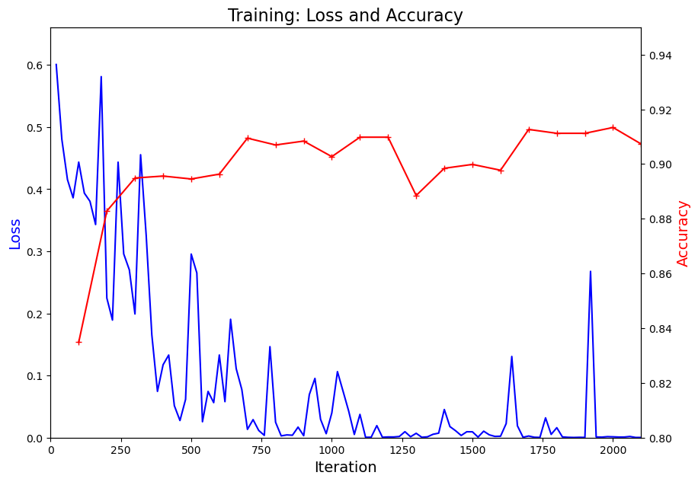
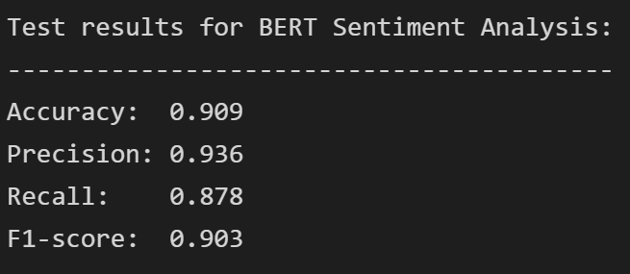
Task 4: Sentiment Analysis using BERT
NLP and Text Mining – Project: Mental Health Issue Classification
Model and Results
We used a pre-trained BERT model from huggingface (pip install transformers)
Fine-tuning and evaluation on Ubelix
Improvement of 3.0% in accuracy compared to Naive-Bayes classifier,
but computationally expensive
→ Trade-off

Slide 11

Thanks
For your (cross-)attention!
Tim Graf & Yanis Schärer
20.12.2022

