Slide 1


Lecture Autosummary —
conspect and quiz
A grounded conspect and an adaptive quiz from video and slides · Shamil Arslanov · Harbour Space · 2026

Slide 2
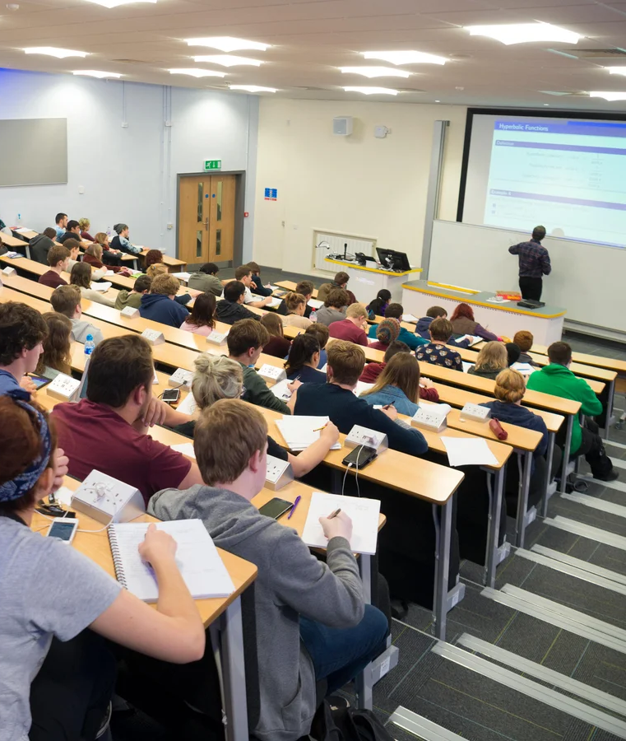

photo​
Problem: both artifacts fall short
01
A lecture recording runs 2–3.5 hours — too long to rewatch before an exam
02
Slides lose the spoken channel: examples, caveats, intuition, and “this will be on the exam”
334 facts exist only in speech, not on the slides

Slide 3
Solution: conspect + quiz
Video and PDF slides go through an STT → LLM → evaluation pipeline:
01
02
A conspect where every statement is tagged with its source: slide / speech / both — nothing spoken gets lost
A 5-question quiz per lecture that improves itself via psychometrics of real attempts
03
04
Course web app: conspect → quiz → results; attempts stored in SQLite
Thesis metric — the share of spoken facts that survive into the conspect; slides alone give 0 %

Slide 4
2026
Pipeline: from recording to self-check
MP4 video
9 lectures · 21.3 h
WAV audio
ffmpeg · 16 kHz mono
STT
whisper.cpp / Google STT
E2: WER, latency, cost
Raw transcript
46k words, fillers, off-topic
Reconstruction (LLM)
8.6k words, LaTeX math
PDF slides
beamer · 619 pages
Extraction
pypdf text + PNG renders
Conspect (LLM)
every fact: slide / transcript / both
E1: coverage · faithfulness
Quiz
5 questions, pydantic schema
Web app
Next.js · attempts in SQLite
E3: item analysis
difficulty p, discrimination r_pb
rejection and LLM regeneration of questions

Slide 5
2026
Data: a real course
•
“Deep Learning and Computer Vision” — Harbour Space 2026, S. Nikolenko
•
Dense math: formulas and terminology stress both STT and summarization
•
Manual labeling: a 19.5-min golden transcript for WER and 40 pairs for judge calibration
9
21.3 h
619
49
lectures: video + slides
of lecture video in 1080p
slide pages (PDF)
quiz attempts from 8 students

Slide 6
E1: evaluating facts, not words
Slides (reconstr.)
157 claims
Coverage (recall)
sources ⊑ conspect
LLM decomposition
atomic claims + salience: core / supporting / aside
entails(claim, text)
top-16 embedding retrieval + strict LLM judge
Transcript
526 claims
Faithfulness (precision)
conspect ⊑ sources
Conspect
208 claims
Transcript-only coverage
spoken but not on slides: the share surviving into the conspect
One entailment mechanism — three judged directions; judge validated manually: κ = 0.95 on 40 pairs, zero false positives

Slide 7
2026
E1: all metrics improve
Coverage
Means over the 8 held-out lectures — lecture 6, used for pipeline calibration, is excluded. The full pipeline wins on every metric on every lecture (including it shifts the means by ≤0.7 pp).
45.2
63.2
Faithfulness
66.4
baseline (raw ASR conspect)
81.1
full pipeline (reconstructed transcript)
F1
Zero proven hallucinations
Manual audit (lecture 1) of the 9 most suspicious “unsupported” claims (names, dates, history): all grounded in transcript or slides. Flags are retrieval misses on ASR-garbled speech (“Kasparov” → “Casper off”) — true faithfulness likely > 0.9.
53.4
70.9
Spoken-fact retention
37.5
49.0
F1: 53.4 → 70.9

Slide 8
2026
LLM judge calibrated: κ = 0.95 on 40 manual pairs. Zero false positives, one miss.

Slide 9
2026
E2: WER 7× lower than the cloud
Word error rate (WER) on the 19.5-min golden fragment — lower is better
whisper.cpp — local, free
Google STT — cloud, paid
2.3 %
16.3 %
scale 0–20 %
scale 0–20 %

Slide 10
E3: the quiz improves itself
Classical test theory over real student attempts — the loop is closed:
01
02
03
quiz.json — 5 live questions per lecture
Students answer in the web app; attempts are written to SQLite
Item analysis: difficulty p and discrimination r_pb for every question
04
05
Rejection: p ∉ [0.30, 0.85] or r_pb < 0.15 → the question is archived
The LLM writes a replacement, given the measured stats and typical mistakes

Slide 11
E3: results on live data
The web app collected 49 attempts from 8 respondents across all 9 quizzes (July 16–18, 2026); scores 0–5, mean 3.06, SD 1.54
33/45
0.61
+0.42
3/9
questions pass the rejection rule (73 %)
mean difficulty p — inside the target window [0.30, 0.85]
mean discrimination r_pb (7 questions below 0)
quizzes fully clean: lectures 04, 08, 09
01
02
03
Too easy (2): p = 1.00, everyone answers correctly, r_pb undefined — regenerate into a subtler probe of the same topic
Too hard (4): p = 0.20; two lecture-7 questions with r_pb = +0.71 and a shared distractor — manual answer-key check first
Non-discriminating (6): r_pb from −0.69 to −0.08 — strong respondents miss them; worst quiz — lecture 3
Sample-size caveat: 5–6 attempts per question — p granularity 0.17–0.20, a single respondent shifts r_pb by ±0.5; estimates are noisy

Slide 12
Status and plans
The pipeline runs end-to-end; experiments E1–E3 are set up and produced numbers:
Done
Done
End-to-end pipeline: STT → reconstruction → conspect → quiz → web; E1 engine and judge (κ = 0.95)
Numbers on the dev lecture: F1 72.6 %; WER 2.3 % vs 16.3 %; E3 in production: 49 attempts, 33/45 questions valid
Next
Next
Frozen pipeline on 8 held-out lectures; E2 latency and cost table
Regenerate the 12 rejected questions and re-measure; ablations: conspect quality and top-k

Slide 13
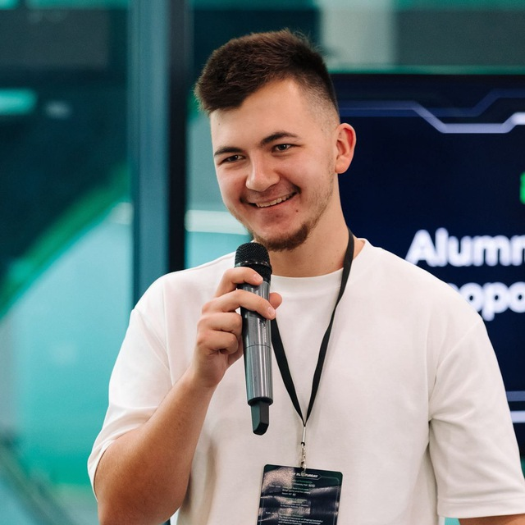
Thank you!
Shamil Arslanov
Data Science · Harbour Space
github.com/homomorfism/autosummary
shamil.arslanov@axialent.com

