Slide 1
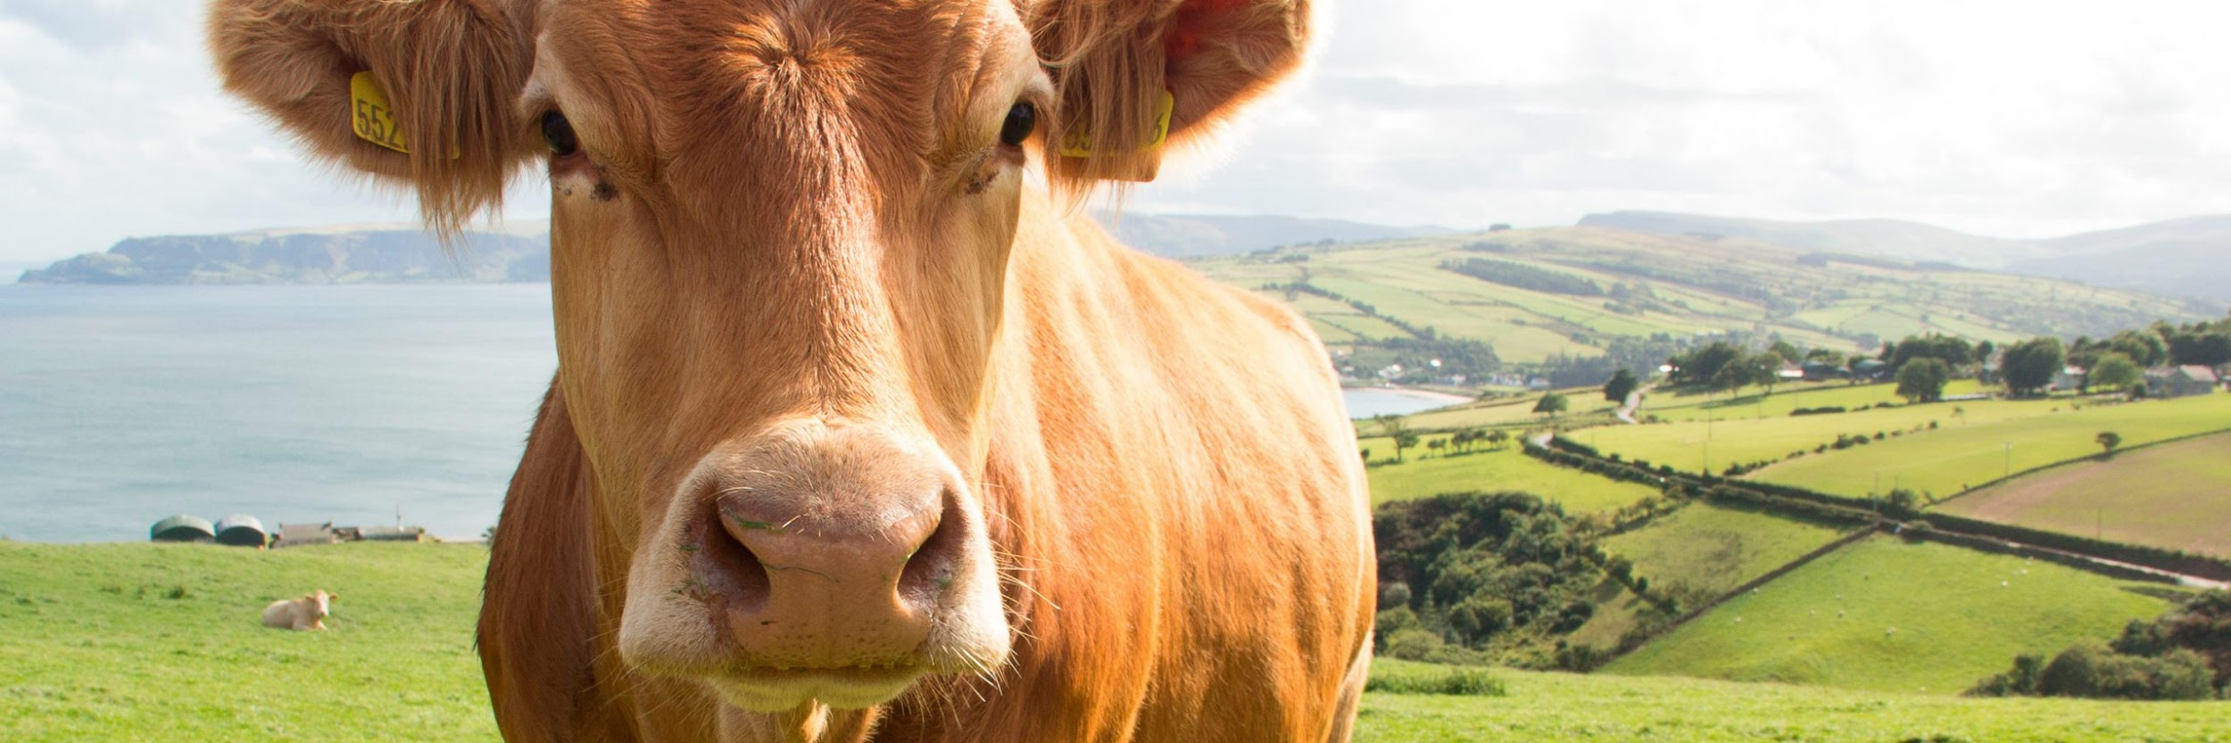

COMPRESSION ALGORITHMS TO OPTIMIZE BATTERY CONSUMPTION IN PRECISION LIVESTOCK FARMING

Slide 2



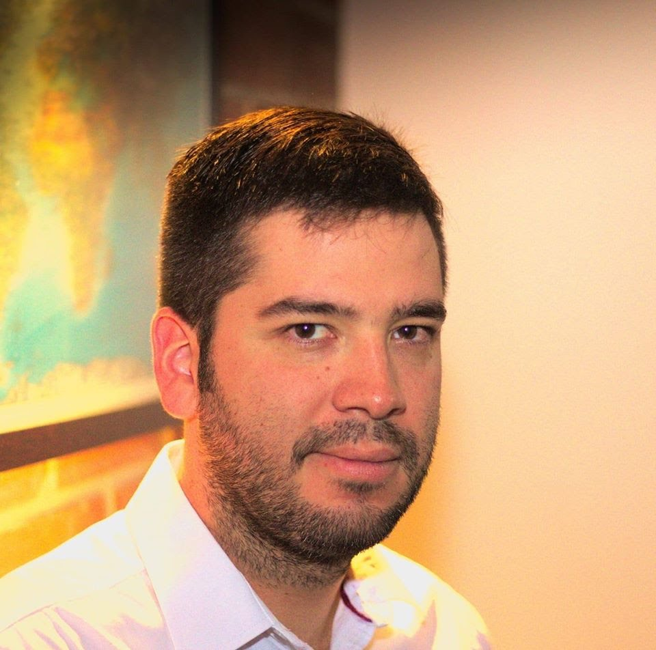

Team Presentation
Hernan
Moreno
Mariana
Yepes
Simón Marín
Mauricio
Toro
https://github.com/homorenom/ST0245-003/tree/master/proyecto/informe/entrega2

Slide 3
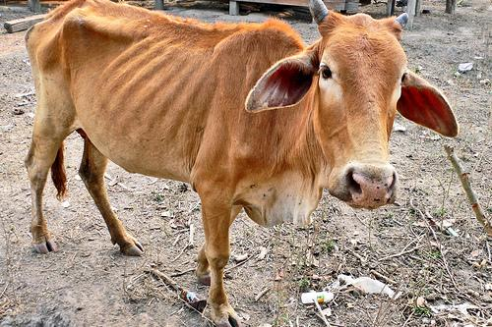
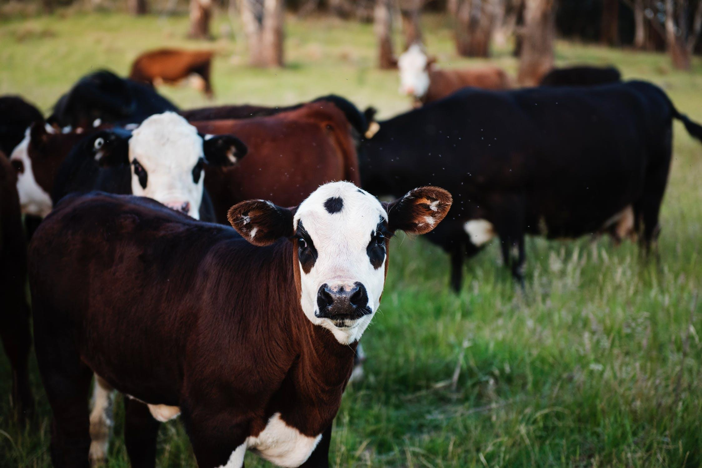
Training Process
Convolutional Neural Network
Sick-Cattle Images
Classification Algorithm
Classification Model
Healthy-Cattle Images

Slide 4
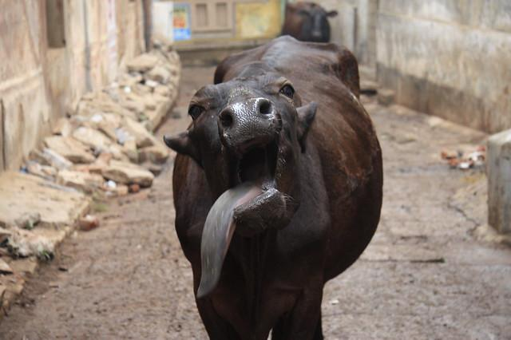
Testing Process
???
Is sick
Cattle Image
Seam carving
Classification Model
Output

Slide 5
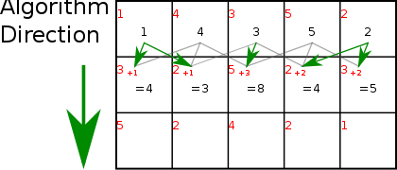
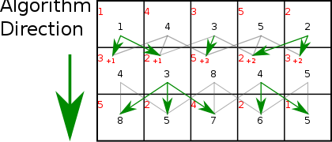
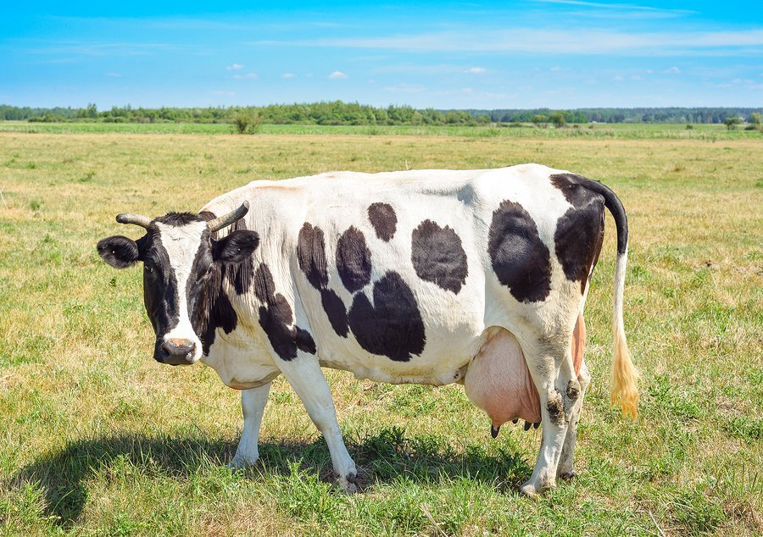
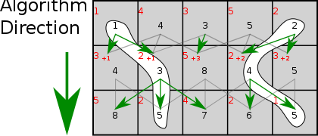
Compression Algorithm Design
Seam carving algorithm is an example of dynamic programming,, is a programming method that stores the results of sub-calculations in order to simplify a more complex result, and can be used to compute seams. If attempting to compute a vertical seam (or path) of lowest energy, the energy for each pixel in a row is computed, plus the energy of one of the three possible pixels above it.

Slide 6
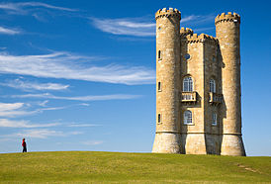
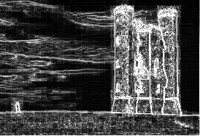
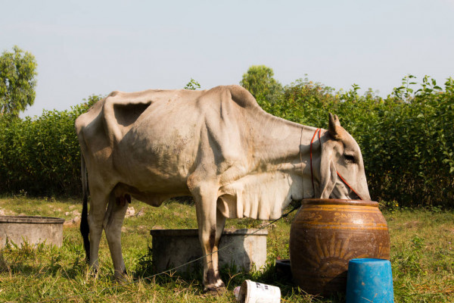
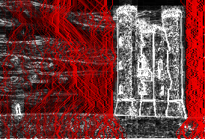
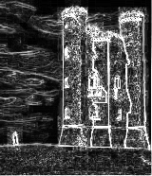

Compression Algorithm Design
3 parameters are calculated for each pixel in the original image : weight, density and energy, using different algorithms, as gradient magnitude, entropy, visual saliency or eye-gaze movement. In this example gradient magnitude was used. Low energy seams are removed and in the final image : low energy areas, to the right of the castle, and between the person and the castle, are removed from the image. The relevant image (the castle) is not touched.

Slide 7
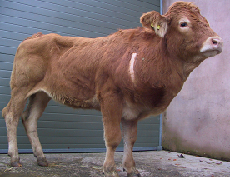
Compression Algorithm Complexity
 | Time Complexity | Memory Complexity
Image compression | O(N*M*2^{M}) | O(M*N)
Image decompression | O(N^2*M^2) | O(M*N)
Time and memory complexity using LZ77. Where N is the number of rows and M the number of columns of the matrix containing the image pixels.

Slide 8


Time and Memory Consumption
121 KB: 500 S
121 KB: 2 MB
Time Consumption:
on average
Memory Consumption:
On average

Slide 9
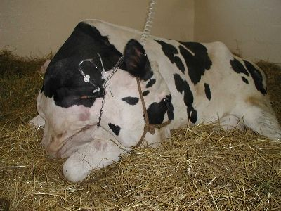
Average Compression Ratio
 | Healthy Cattle | Sick Cattle
Average compression ratio | 3:2 | 3:2
Average compression ratio for Healthy Cattle and Sick Cattle using both algorithms.
 | Healthy Cattle | Sick Cattle
Average compression ratio | 3:1 | 3:1
Average compression ratio for Healthy Cattle and Sick Cattle using seam carving.

Slide 10
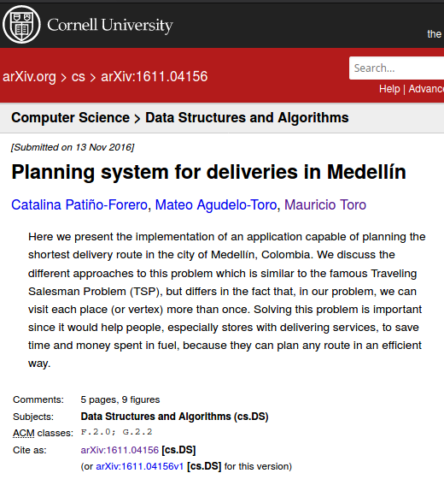
Report Accepted on arXiv
C. Patiño-Forero, M. Agudelo-Toro, and M. Toro. Planning system for deliveries in Medellín. ArXiv e-prints, Nov. 2016. Available at: https://arxiv.org/abs/1611.04156

Slide 11
THANK YOU!.

