Slide 1

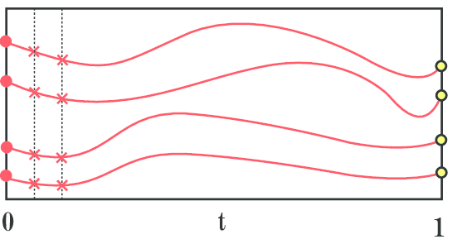
Homotopy Continuation Meets GPU
Hongyi Fan
Cognex

Slide 2









Motivation
Homotopy Continuation is simple
Numerical method: Homotopy Continuation (HC) e.g. PHCpack，MiNuS, Julia and others
Simple and able to solve all sizes of problems;
Not efficient
Problem | HC Time with CPU w/o optimization | Elimination Template Solver
P3P | 40ms | 0.063ms
5 Points Relative Pose Problem | 60ms | 0.035ms
P4P unknown focal length and distortion | 130ms | 9ms
Notes:
It relies on the simple and elegant idea to initially solve a simpler polynomial system (start system) and then deform its roots to the roots of the system we aim
to solve (target system) iteratively on the system parameter manifold

Slide 3
Motivation
Accelerate HC with parallelization
Multi-threading Path Tracking
PHCpack
Bertini
Julia
MiNuS
Multi-threading Polynomial Evaluation in GPU
PHCpack
Limited by number of CPU cores

Slide 4
GPU-HC
Why GPU?
GPU is becoming more and more powerful and available
Computation power: Highly parallelized structure
Portability: Jetson on micro aerial vehicles (drones)
GPU in multiview geometry tasks?
Classic visual odometry
Bundle Adjustment
learning-based Multiview framework
… and many others.
Jeon, Jinwoo, Sungwook Jung, Eungchang Lee, Duckyu Choi, and Hyun Myung. "Run your visual-inertial odometry on NVIDIA Jetson: Benchmark tests on a micro aerial vehicle." IEEE Robotics and Automation Letters 6, no. 3 (2021): 5332-5339.
Ren, Jie, et al. "MegBA: A GPU-based distributed library for large-scale bundle adjustment." European Conference on Computer Vision. Cham: Springer Nature Switzerland, 2022.
Zhang, Youmin, Fabio Tosi, Stefano Mattoccia, and Matteo Poggi. "Go-slam: Global optimization for consistent 3d instant reconstruction." In Proceedings of the IEEE/CVF International Conference on Computer Vision, pp. 3727-3737. 2023..

Slide 5

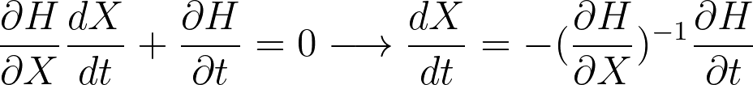
GPU-HC
How to parallelize HC?
What are the bottlenecks in HC?
Number of Solutions (homotopy paths)
In each homotopy path…
Prediction
Correction
Solving a linear system
Cost 80~90% of the total time
Jacobians and homotopy computation/evaluation

Slide 6
GPU-HC
How to parallelize HC?
Parallelization in different levels
Path tracking parallelization
Tracking simultaneously
Fast linear system solving
What GPU is good at
Evaluation of complicated Polynomial & Jacobian

Slide 7
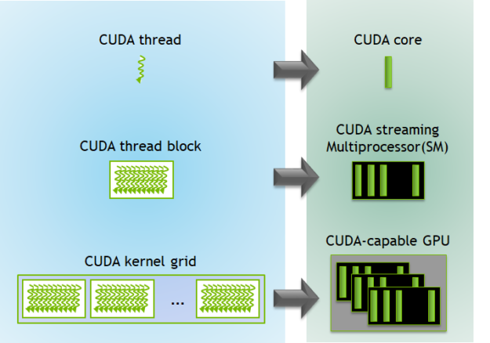
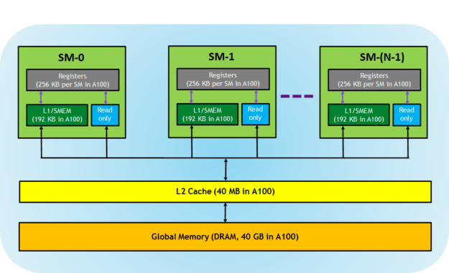
GPU-HC
How to parallelize HC?
Path Tracking Parallelization
Parallelize the “outer” part:
Solution Tracking
The parallelism is organized in terms of thread blocks (TBs)
Each TB is composed of multiple threads running in groups of 32 (a warp)
We need to assign 1 track to multiple threads for (1) lower level parallelization (2) always access to fast memories
Cannot assign a lot: thread synchronization takes time
Assign 1 track to 1 warp (32 threads)

Slide 8
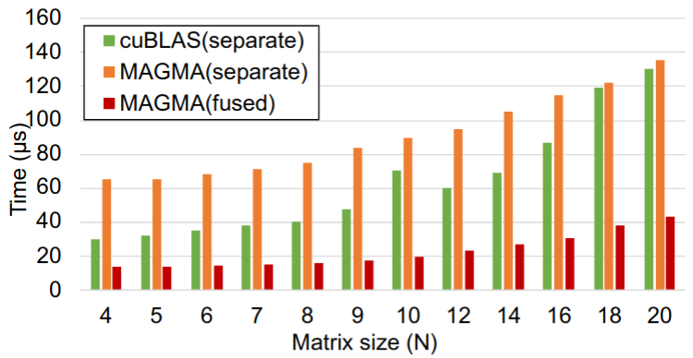
GPU-HC
What are the parallel computations in GPU-HC?
Parallelize the “inner part” of each track
cuBLAS, MAGMA
Collaborate with the MAGMA library Developers
High speed linear system solving for small matrix (dimension < 32x32)
Fused Kernel
Solving a linear system
Dong, Tingxing, Azzam Haidar, Piotr Luszczek, Stanimire Tomov, Ahmad Abdelfattah, and Jack Dongarra. Magma batched: A batched BLAS approach for small matrix factorizations and applications on gpus. Technical Report. Technical report, 2016.
Notes:
With the answers to the above two questions, we arrive at a nested parallelism for homotopy continuation.
In the fine level, we parallelize the inner part computation of each homotopy path. We tackle the two bottlenecks, namely, the linear system solver, and Jacobian/homotopy computation and evaluation.
Triangular solve of L portion is done in decomposition process

Slide 9




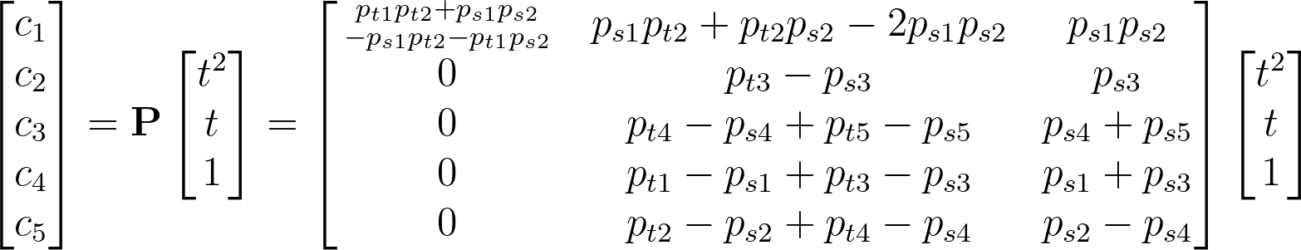
GPU-HC
What are the parallel computations in GPU-HC?
Fine level: Parallelize the “inner part” of each track
Jacobians and homotopy computation/evaluation
Parameter homotopy:
Constant in runtime
Compute the coefficients by
Notes:
For the computation and evaluation of the Jacobians and homotopy, we make use of the idea of single instruction multiple threads computation.
Here’s an example of two polynomial equations with two unknowns
What we need to do on the GPU side is to evaluate them

Slide 10
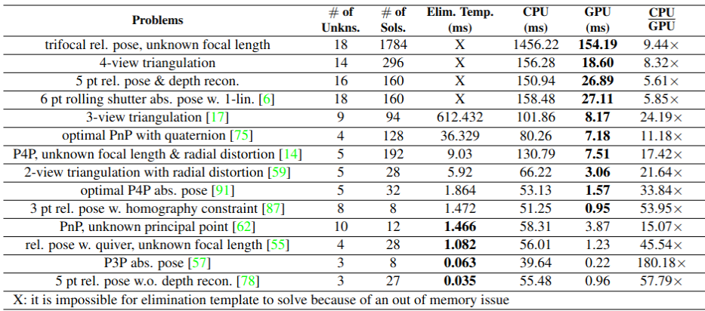
Comparisons on Other Problems

Slide 11

Take away messages
GPU-HC directly solving the original large, low-degree system efficiently.
GPU-HC opens a door for problems that were previously unsolvable or inefficient made practical in use.
Checkout our GitHub Repository!
Our publications:
Chien, Chiang-Heng, Hongyi Fan, Ahmad Abdelfattah, Elias Tsigaridas, Stanimire Tomov, and Benjamin Kimia. "GPU-based homotopy continuation for minimal problems in computer vision." In Proceedings of the IEEE/CVF Conference on Computer Vision and Pattern Recognition, pp. 15765-15776. 2022.
Chien, Chiang-Heng, Hongyi Fan, Ahmad Abdelfattah, Elias Tsigaridas, Stanimire Tomov, and Benjamin Kimia. "Parallel path tracking for homotopy continuation using GPU." In Proceedings of the International Symposium on Symbolic and Algebraic Computation. 2022.
Ding, Yaqing, Chiang-Heng Chien, Viktor Larsson, Karl Åström, and Benjamin Kimia. "Minimal Solutions to Generalized Three-View Relative Pose Problem." In Proceedings of the IEEE/CVF International Conference on Computer Vision, pp. 8156-8164. 2023.

Slide 12
Thanks for your attention

