Slide 1

Tour of solving polynomial systems in Computer Vision
Hongyi Fan
Cognex

Slide 2
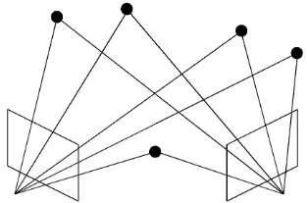
Goal
A brief overview of the existing techniques in solving polynomial systems, no algebraic geometry background needed
Analysis of their pros/cons and application scenarios

Slide 3
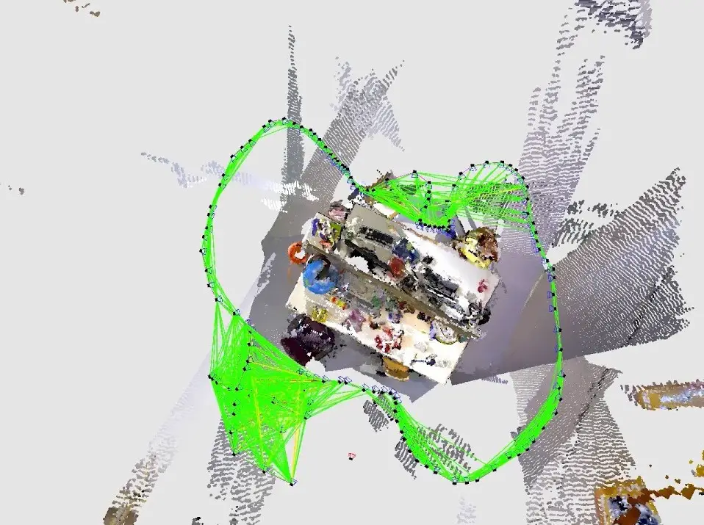
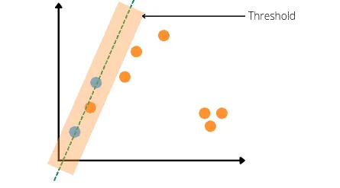
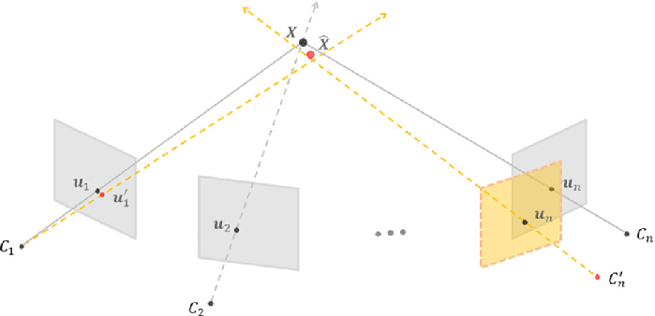
The requirements of an IDEAL polynomial solver
^{Stable and Accurate}
The solution needs to be accurate enough
The solution needs to be stable for different coefficients (both integer and floating numbers)
^{Fast}
^{Real-time applications}
^{Solving within RANSAC}
Large number of unknowns and equations

Slide 4
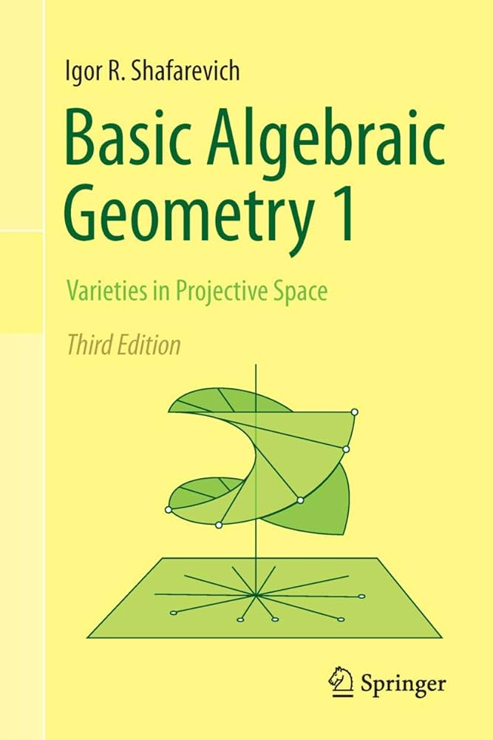

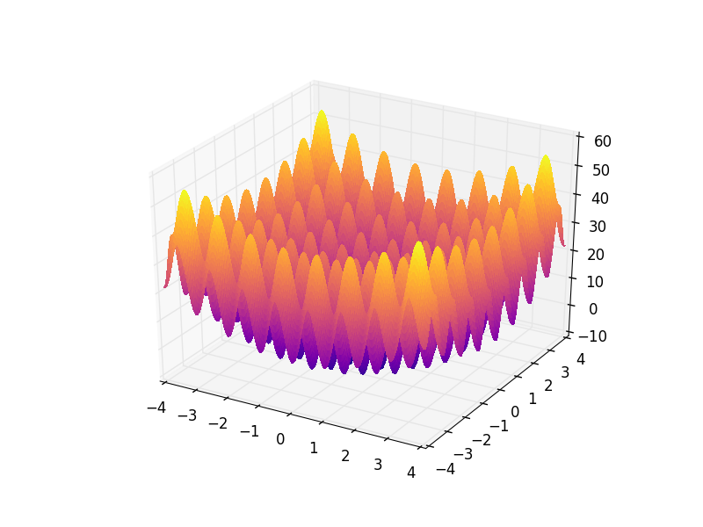
The requirements of an IDEAL polynomial solver
^{Easy to Access}
Solving without prior knowledge in algebraic geometry
Solving without doing manual research on the problem
^{Easy to initialize}
^{Low initialization effort}
^{Scalable}
Can solve large number of unknowns and equations
Opens the door of more problems and more applications
…..

Slide 5
The requirements of an IDEAL polynomial solver
 | Stable & Accurate | Fast | Easy to Access | Easy to Initialize | Scalable

Slide 6
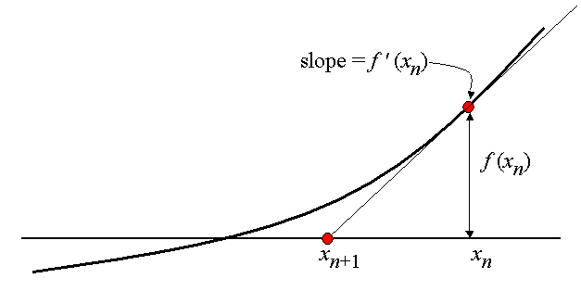
Newton’s method and its variant is still in use
^{Newton’s method}
^{Issues}
Relies heavily on initial guess
Fits for solution refinement or incremental solvers;
Problem | # of Unknowns | # of Solutions
trifocal rel. pose w/o f | 18 | 5344
trifocal rel. pose | 12 | 312
general trifocal rel. pose | 12 | 583

Slide 7

The requirements of an IDEAL polynomial solver
 | Stable & Accurate | Fast | Easy to Access | Easy to Initialize | Scalable
Newton-Raphson

Slide 8
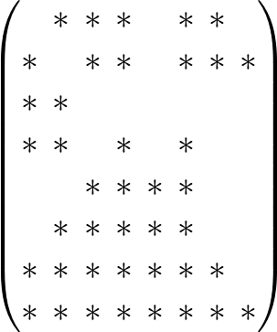
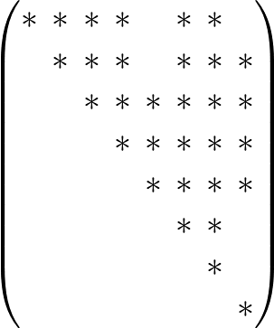

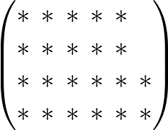
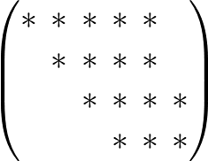
General Solvers：Variable Elimination
Extend the Gauss-Jordan elimination to multivariable polynomials
Ideally, general solvers suppose to solve any polynomial equations
Not Trivial: Two well known methods
^{Resultant}
^{Groebner basis}
Notes:
But not every system has this property

Slide 9




General Solvers: Resultant
^{Resultant:}
A polynomial expression that of their coefficients that is equal to 0 if and only if the polynomials has common roots.
Example: Five points algorithm with Hidden-Variable Resultant
10 equations and 3 unknowns
Resultant
Li, Hongdong. "A simple solution to the six-point two-view focal-length problem." Computer Vision–ECCV 2006: 9th European Conference on Computer Vision, Graz, Austria, May 7-13, 2006, Proceedings, Part IV 9. Springer Berlin Heidelberg, 2006.
Li, Hongdong, and Richard Hartley. "Five-point motion estimation made easy." 18th International Conference on Pattern Recognition (ICPR'06). Vol. 1. IEEE, 2006.
Notes:
But not every system has this property

Slide 10
General Solvers: Resultant
^{Resultant:}
Works well with simple problems
For general problems, it will generate really large symbolic resultants: Hard and slow to work with
Advanced resultant method can generate compact resultants, but one needs to pick manually and optimize manually
Example: Bezout-Cayley-Dixon method
Kasten, Yoni, Meirav Galun, and Ronen Basri. "Resultant based incremental recovery of camera pose from pairwise matches." 2019 IEEE Winter Conference on Applications of Computer Vision (WACV). IEEE, 2019.
Notes:
But not every system has this property

Slide 11
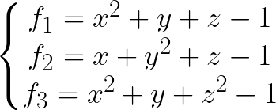
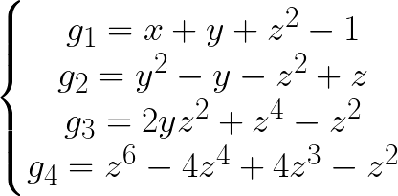

General Solvers: Groebner basis
^{Groebner basis:}
Convert a polynomial system to another system that shares the same roots but easier to solve
Finding the Groebner basis is not trivial, time consuming, and not unique
^{Buchberger Algorithm}
^{F4 Algorithm}
Multiple implementation in Maple/Matlab/Macaulay/Julia….
Notes:
But not every system has this property

Slide 12
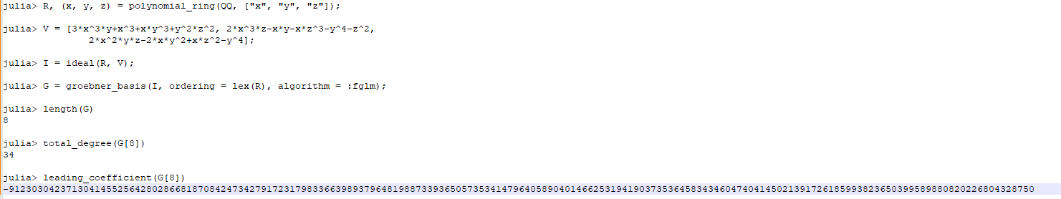
General Solvers: Groebner basis
^{Groebner basis:}
The coefficient may explode, generate some unstable behaviour if we use floating numbers.
^{A}
^{A}
^{A}
^{High complexity: Slow}
5 points relative problem: 0.5-1s
Notes:
But not every system has this property

Slide 13
The requirements of an IDEAL polynomial solver
 | Stable & Accurate | Fast | Easy to Access | Easy to Initialize | Scalable
Newton-Raphson
General Solvers (Resultant & Groebner basis)

Slide 14
Specific Solvers: Elimination Template
We are not solving any general polynomial
Same form, different coefficients
Automatically generate an efficient solver that can solve a particular problem
Offline Stage
Solve the Groebner basis on a finite field
Remember the “recipe” in eliminating variables
Forming an elimination template for coefficients
Online Stage
Insert the given coefficients
Solve the problem following the recipe
Kukelova, Zuzana, Martin Bujnak, and Tomas Pajdla. "Automatic generator of minimal problem solvers." In Computer Vision–ECCV 2008: 10th European Conference on Computer Vision, Marseille, France, October 12-18, 2008, Proceedings, Part III 10, pp. 302-315. Springer Berlin Heidelberg, 2008.
Larsson, Viktor, Kalle Astrom, and Magnus Oskarsson. "Efficient solvers for minimal problems by syzygy-based reduction." In Proceedings of the IEEE Conference on Computer Vision and Pattern Recognition, pp. 820-829. 2017.
Martyushev, Evgeniy, Jana Vrablikova, and Tomas Pajdla. "Optimizing elimination templates by greedy parameter search." In Proceedings of the IEEE/CVF Conference on Computer Vision and Pattern Recognition, pp. 15754-15764. 2022.
Notes:
But not every system has this property

Slide 15
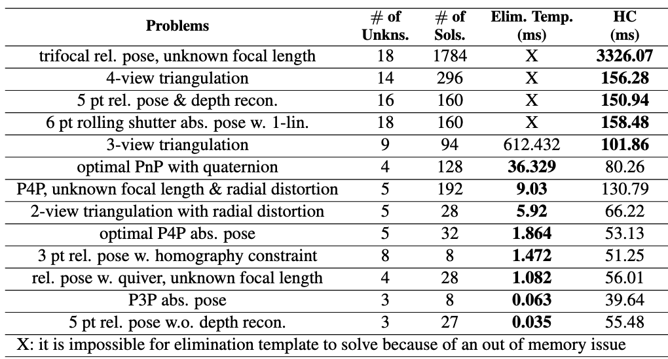
Specific Solvers: Elimination Template
A big leap in solving the polynomial problems in computer vision
The offline stage is an easy to access black box, the template generation is automatic
The online stage is an G-J elimination and linear system solving (Really Fast)
Notes:
But not every system has this property

Slide 16
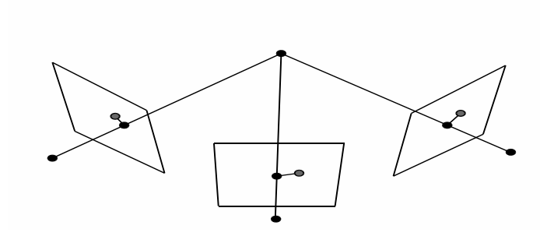
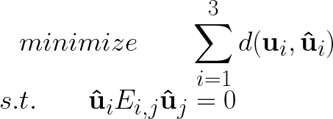




Specific Solvers: Elimination Template
There are problems cannot solve by elimination template
Offline stage still needs to solve Groebner basis: May not be achievable
The template size is not predictable and unstable sometimes
^{Example: 3-view triangulation}
The size of the elimination template is larger than 1000x1000
Notes:
But not every system has this property

Slide 17
The requirements of an IDEAL polynomial solver
 | Stable & Accurate | Fast | Easy to Access | Easy to Initialize | Scalable
Newton-Raphson
General Solvers (Resultant & Groebner basis)
Specific Solvers (Elimination Template)

Slide 18
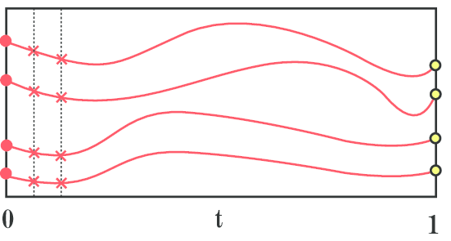
Homotopy Continuation (HC)
Solve the problem using another problem we know the root
Suppose we know the solution of an easier system G(x), i.e. start system, instead of F(x), i.e. target system
iteratively change the solutions of G(x) to that of F(x) via a homotopy H(x)
^{G(x)}
^{F(x)}
Notes:
But not every system has this property

Slide 19
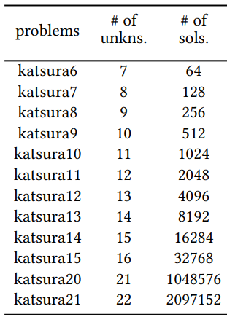
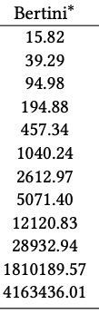
Homotopy Continuation
Tracking solution is simple and easy to implement (Will introduce in the next section)
Solving the system as it is (No transformation on the polynomial) -> Stable and General
Unit (ms)
HC method can solve these all in a fair amount of time.
Notes:
But not every system has this property

Slide 20
Homotopy Continuation: Compare with Elimination Template
The main issue is HC is not a fast method

Slide 21
The requirements of an IDEAL polynomial solver
 | Stable & Accurate | Fast | Easy to Access | Easy to Initialize | Scalable
Newton-Raphson
General Solvers (Resultant & Groebner basis)
Specific Solvers (Elimination Template)
Homotopy Continuation

Slide 22
The requirements of an IDEAL polynomial solver
 | Stable & Accurate | Fast | Easy to Access | Easy to Initialize | Scalable
Newton-Raphson
General Solvers (Resultant & Groebner basis)
Specific Solvers (Elimination Template)
Homotopy Continuation

Slide 23
Thanks for your attention

