Slide 1
Repeat-Until-Success Circuit on SliQSim
B10901008 張禾牧
B10901016 邱巖盛

Slide 2
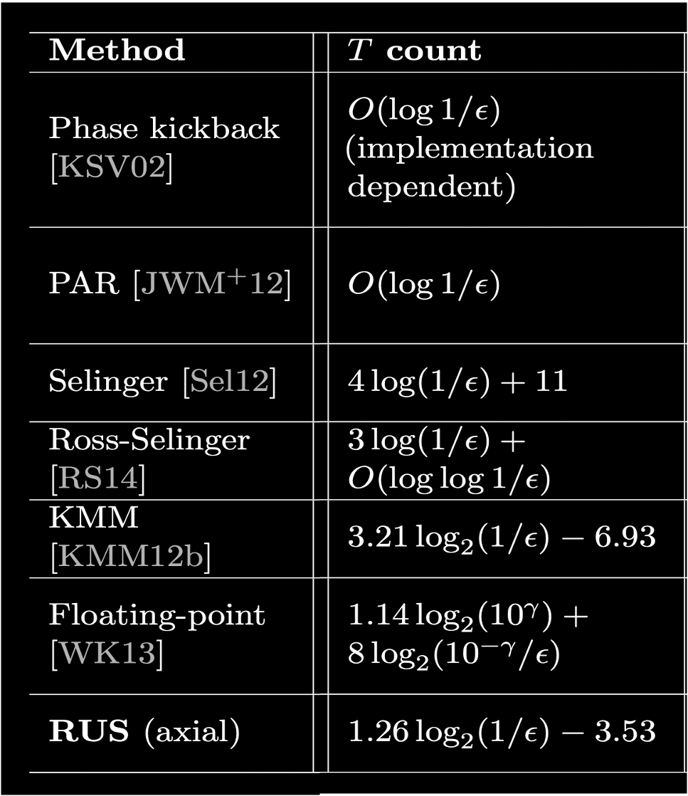
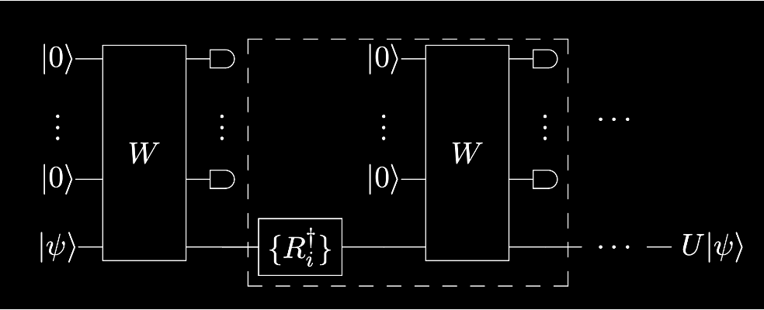
Repeat-Until-Success Circuit
Non-deterministic decomposition approach
Valid only when the measured ancilla in a specific state
With less (expected) cost compared to many other methods

Slide 3
RUS Ckt Simulating…
In our research:
We can manually decide the state into which the ancillae bits collapse.
Desired performance is determined by time / space cost, not T gate count.
Circuits can include Clifford + T gates, and beyond.
However, when concerning real physical computations, restrictions come into play.

Slide 4
RUS Implementation on SliQSim

Slide 5
Flow
Encountering RUS Gate
Build bigBDD
Collapse the states & Reset measured qubits
Reset the measured bits to |0⟩
Measure along the desired branch
Move the to-be-measured qubits to top

Slide 6
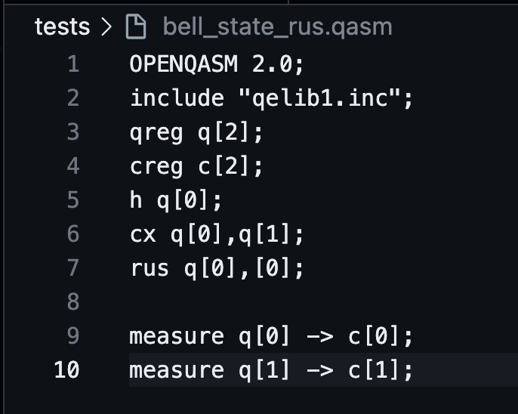
Encountering RUS gate
A notation similar gates in OPENQASM 2.0
rus q1, q2, …, [s1], [s2], …
s = (s1, s2, s3, …, sn) is the desired Z - measure value of q = (q1, q2, q3, …, qn).

Slide 7

Build bigBDD
Use Cudd_bddAnd and Cudd_bddOr to build the bigBDD F for the state vector.

Slide 8
Move the to-be-measured qubits to top
Use Cudd_ShuffleHeap to move to-be-measured qubits to top of F.
to-be-measured qubits
not to-be-measured qubits
others

Slide 9
Measure along the desired state branch
Trace along the branch with q = s
Record the final probability p
rus_normalize_factor /=
… ?

Slide 10
Collapse the state & Reset measured qubits
For each qubit, collapse it into its corresponding state, by Cudd_Cofactor
Set the measured qubits to 0
s₁
0

Slide 11
Experiments

Slide 12
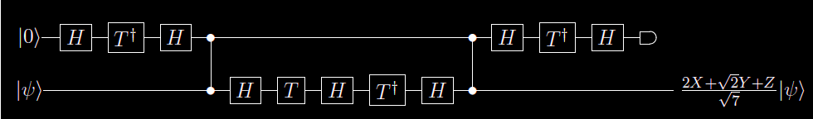
Exp1:
Compared with qiskit simulation result,
qiskit: [0.37796447+0.j , 0.75592895+0.53452248j]
SliQSim: [0.267261-0.267261i, 0.912487-0.156558i]
qiskit: [0.80178373-0.37796447j, 0.26726124+0.37796447j]
SliQSim: [0.299685-0.834208i, 0.456243+0.078279i]

Slide 13
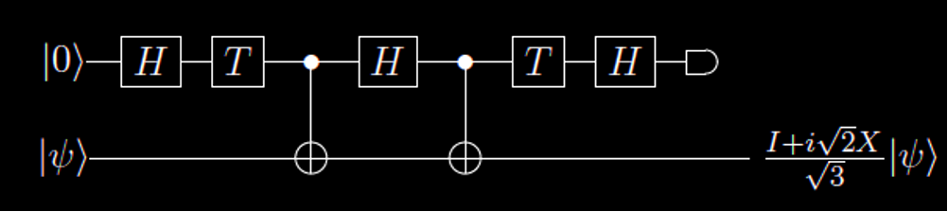
Exp2:
Execute 4096 times (to check the precision loss)
Compared with qiskit simulation result,
qiskit: [-0.35404678, -0.93522771i]
SliQSim: [-0.354047, -0.935228i]
qiskit: [-0.63285076-0.26213537j, 0.27880398-0.67309235j]
SliQSim: [-0.632851-0.262135j, 0.278804-0.673092j]

Slide 14
Future Work

Slide 15
RUS Circuit Synthesis
Adopt existing RUS Circuit Synthesis Algorithms to support small-angle rotation as well as other non - Clifford + T gates.
Design new RUS Synthesis Algorithm for further minimizing number of T counts if physical implementation is required.
3 D. V. Lindberg and H. K. H. Lee, “Optimization under constraints by applying an asymmetric entropy measure,” J. Comput. Graph. Statist., vol. 24, no. 2, pp. 379–393, Jun. 2015, doi: 10.1080/10618600.2014.901225. [Online]. Available: ³

Slide 16
Reference

Slide 17
1 Y.-H. Tsai, J.-H. R. Jiang, and C.-S. Jhang, “Bit-slicing the Hilbert space: Scaling up accurate quantum circuit simulation,” in Proc. ACM/IEEE Design Automation Conference (DAC), 2021. [Online]. Available: ¹
2 A. Bocharov, M. Roetteler, and K. M. Svore, “Efficient synthesis of universal repeat-until-success quantum circuits,” Phys. Rev. Lett., vol. 114, no. 8, p. 080502, Feb. 2015. [Online]. Available: ²
3 D. V. Lindberg and H. K. H. Lee, “Optimization under constraints by applying an asymmetric entropy measure,” J. Comput. Graph. Statist., vol. 24, no. 2, pp. 379–393, Jun. 2015, doi: 10.1080/10618600.2014.901225. [Online]. Available: ³
[4] A. Paetznick and K. M. Svore, “Repeat-Until-Success: Non-deterministic decomposition of single-qubit unitaries,” in Proc. IEEE International Conference on Quantum Computing and Engineering (QCE), 2014, pp. 146–152. [Online].

