Slide 1


2 Unity Raycast
Position (x,y,z)
Collision
Ray

Slide 2
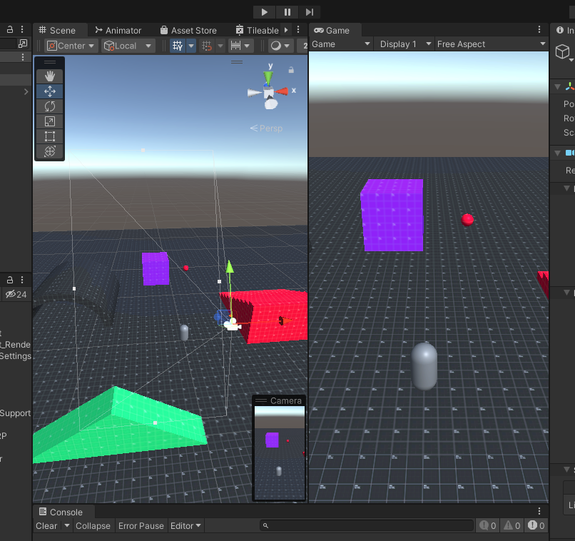
2 Unity Raycast
Position (x,y,z)
Ray
Ray

Slide 3
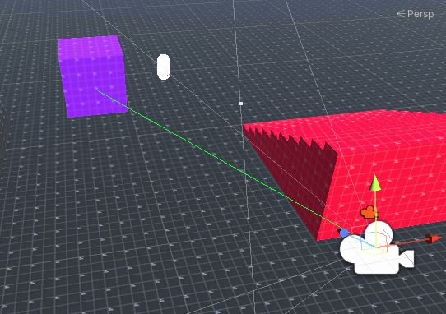
2 Unity Raycast
Click!!

Slide 4
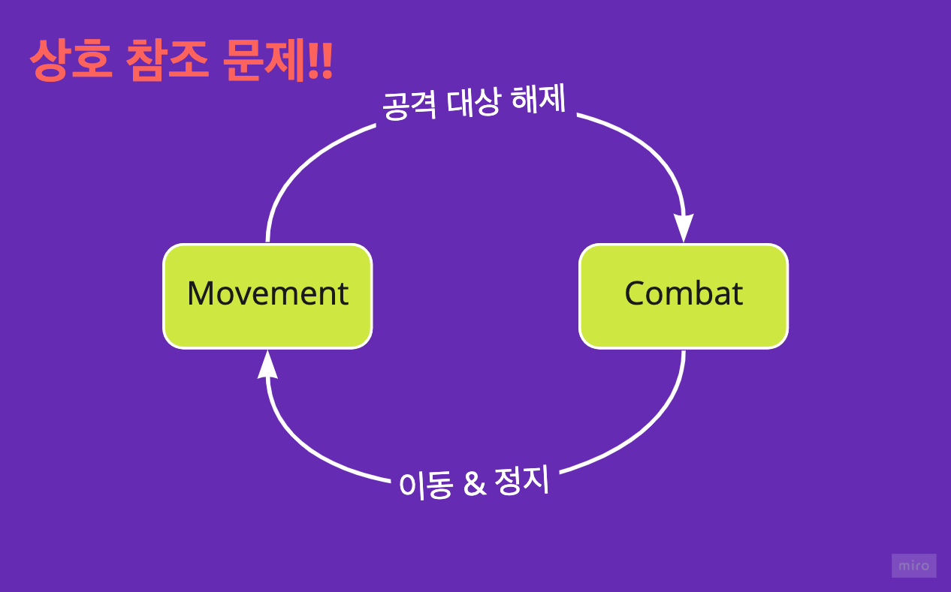
3 Unity Circular Dependency
Movement
Combat

Slide 5
3 Unity Circular Dependency
Movement
Combat

Slide 6
Z - Yaw
X - Roll
Y - Pitch

