Slide 1
DataRoot courses research project
Gender Recognition by Voice
Made by Honcharov Danylo

Slide 2
Tasks:
Explore the data
Choose 2 models and metrics for quality assurance.
Implement the models and compare them.
Make some conclusions and ways to improve result
Prepare iPython notebook and presentation.

Slide 3
Exploring data. Questions:
Is data balanced?
Statistical properties
of data.
Possible correlations?
Have we some features that more useful than others?
Graphical representation of data

Slide 4
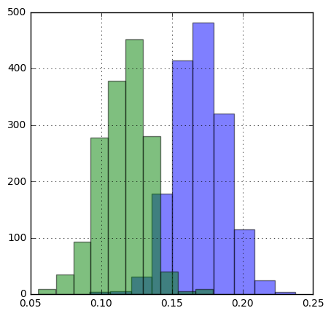
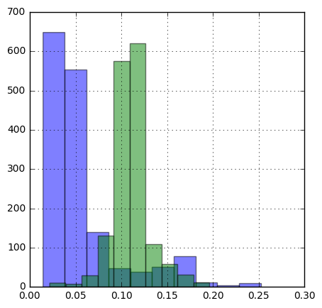
Exploring data. Illustrations:
Meanfun feature:
IRQ feature:

Slide 5
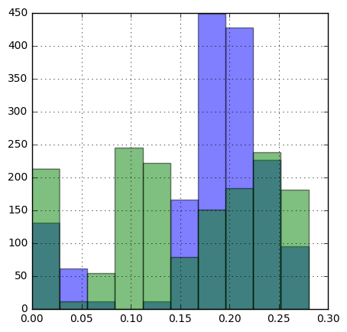
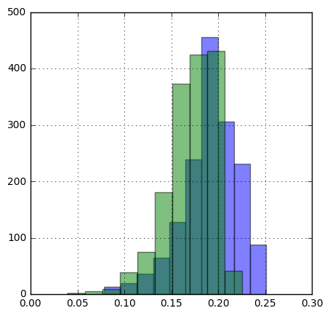
Exploring data. Illustrations:
Mode feature:
Meanfreq feature:

Slide 6
Researching models and metrics:
Logistic regression
Support Vector Machines

Slide 7
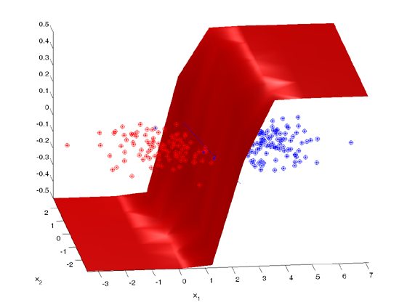
Logistic regression:

Slide 8
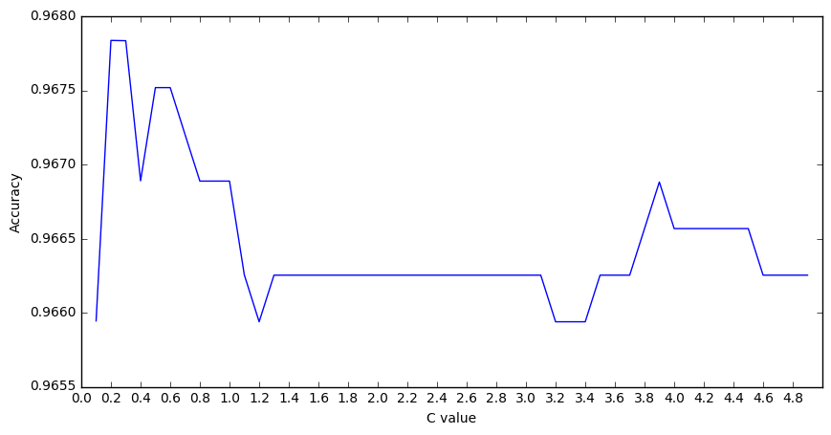
Finding best regularization for logistic regression in train set:

Slide 9
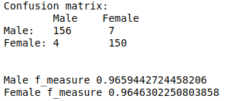
How evaluate quality of classification:
1. Precision
2. Recall
3. Accuracy
4. F-measure
5. Confusion matrix

Slide 10
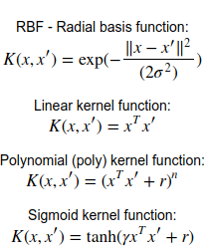
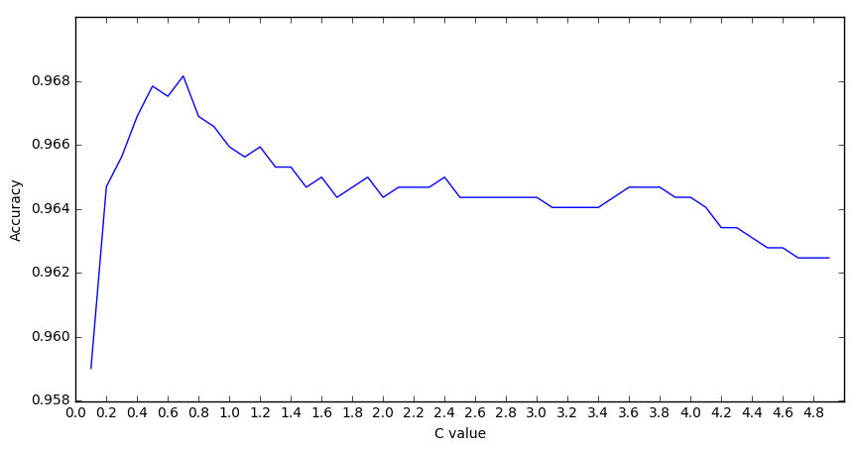

SVM. Default kernels:
Accuracy and regularization
for RBF kernel.

Slide 11
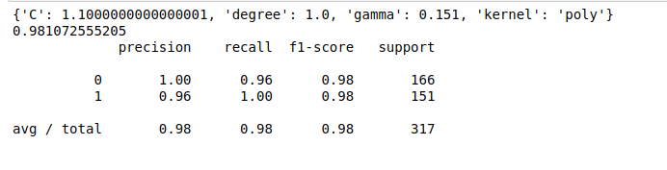
SVM. GridSearch:
Characteristics of best kernel,found by GrindSearch:

Slide 12
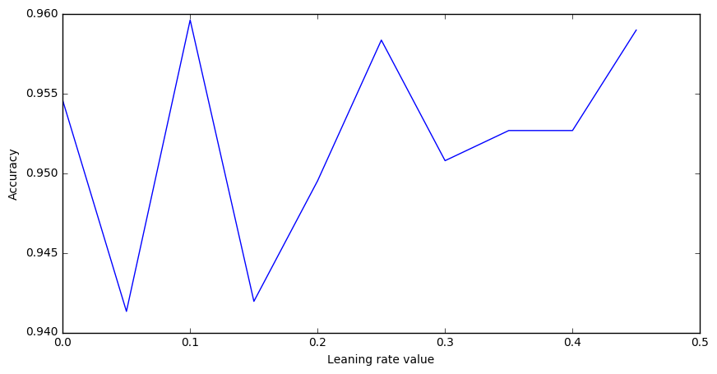
Simple perceptron.
Starting learning rate and accuracy for custom perceptron

Slide 13
Conslusions:
Exploring:
Data is balanced
Data have some useful features, that we can use
We have nice visualization of data
Data have some correlations between features.
SVM:
Best default kernels - linear and rbf
Best parametrized kernel,found by GridSearch - polynomial kernel
Parametres of svm was explored
Have some vizualization.
Logistic regression:
Worked well
Best C value - 0.2
Result of classification was explored
Global:
Numpy is lifesaver. Really.
Pandas - as cool, as pandas. 🐼
Scikit-learn - like a knife. Swiss knife.
Matplotlib. I thought, it can nothing. I was wrong. Easy in use,good-looking plots.
Simple perceptron:
This archaic thing worked
We even find starting learning rate (which not influence much, cause we adjust rate to epochs)

Slide 14
Ways to improve:
Logistic regression:
This model pretty simple, but have a good result. Nothing to improve, I think.
SVM:
Realize own version, that will be working with big dataset
Search widely in space of parameters
Simple perceptron:
Make more complicated version (or maybe versions, many of them) with backpropagation
Realize it with other libs, like Theano
Global:
Learn:
Theano
TensorFlow
OpenCV
xgboost

Slide 15

Thank you for attention.
Panda

