Slide 1
DataRoot courses research project
Gender Recognition by Voice
Made by Honcharov Danylo

Slide 2
Tasks:
Explore the data
Choose 2 models and metrics for quality assurance.
Implement the models and compare them.
Make some conclusions and ways to improve result
Prepare iPython notebook and presentation.

Slide 3
Exploring data. Questions:
Is data balanced?
Statistical properties
of data.
Possible correlations?
Have we some features that more useful than others?
Graphical representation of data

Slide 4
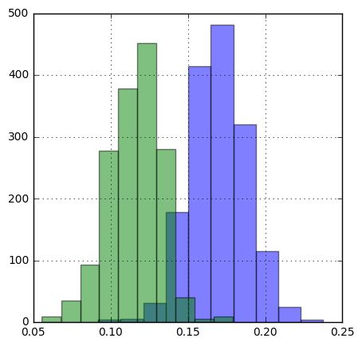
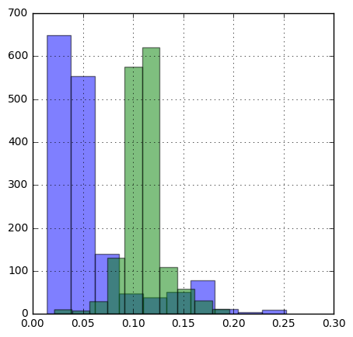
Exploring data. Illustrations:
Meanfun feature:
IRQ feature:

Slide 5
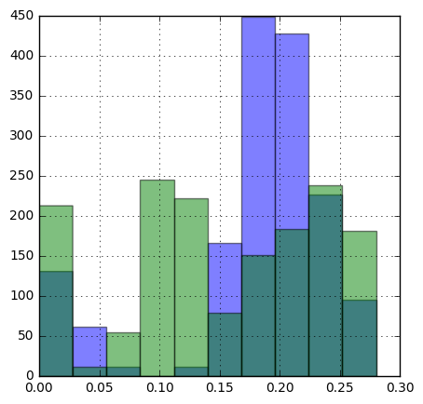
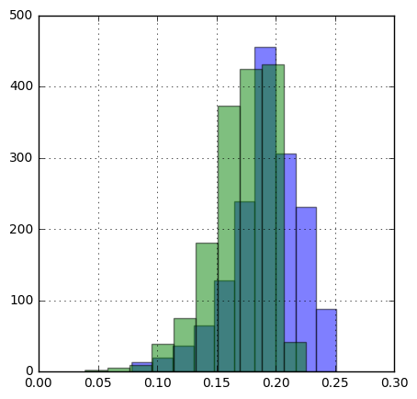
Exploring data. Illustrations:
Mode feature:
Meanfreq feature:

Slide 6
Researching models and metrics:
Logistic regression
Support Vector Machines

Slide 7
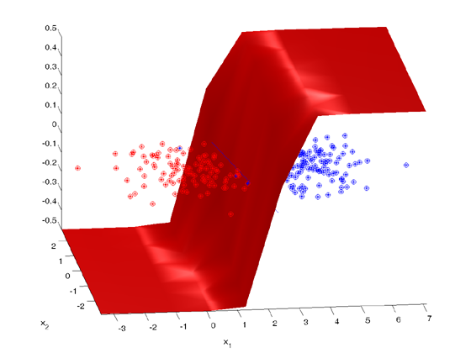
Logistic regression:

Slide 8
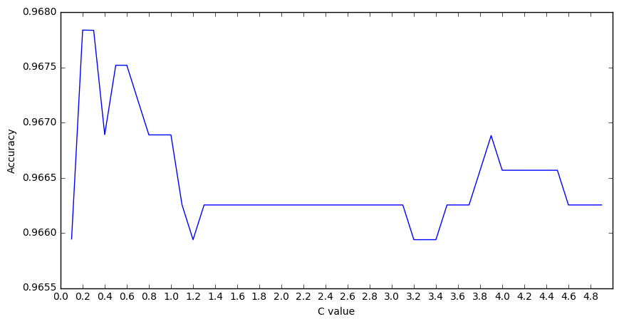

Finding best regularization for logistic regression in train set:

