Slide 1
SASE Technical Workshop
10/13/2021 1st Workshop Event
SASE_WebApplication_Calculator
(part 1)

Slide 2
Introduction
Basic logics and syntax, and how to compile our scripts (codes).
Working on a basic calculator code to get hands on experience.
Possibly go through a bit of basic web application process.

Slide 3
Compiler
Compiler is a program that is able to translate high-level language to a machine language that computer processors can use.
High-level languages are programming languages such as Java, Python, C, C++ that allow programmers to write program on.
High-level languages are closer to human languages so that’s why it’s considered high-level.
Machine language is language that computer reads, no need to worry about it.

Slide 4
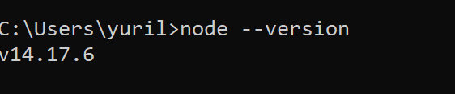
Nodejs
Nodejs uses a V8 JavaScript engine developed by google, it is able to compile JavaScript code.
We will be using Nodejs as our “compiler” throughout this event, we will be using this to build our web application. Programming language would be JavaScript within this workshop event.
Navigate to https://nodejs.org/en/download/ to download Nodejs Installer, and install it. (Demo)
To check if Nodejs successfully installed, type “node --version” into command prompt
For Mac users: go into Terminal
For Windows: go into Command Prompt

Slide 5
Basic commands for terminal
Before we proceed further to use compiler, we need to learn some basics terminal commands.
Terminal – text-based interface for typing commands.
“cd” – change directory command, use to change the current working directory.
“touch” – create, change and modify files command.
“cd <pathName>” – will navigate our working directory to the path name that we provided (Demo)
“touch <filename>” – if the files not already exists, we will be creating a new file.

Slide 6
Using compiler to run our scripts
To run our scripts (codes), we first type in the name of compiler than the name of the scripts into the terminal.
We will be creating our very first program to see how to run our scripts.
(Demo) “Hello.js” by creating a new scripts, and run the compiler to compile the scripts into terminal.
I will explain the codes in the following slides.

Slide 7
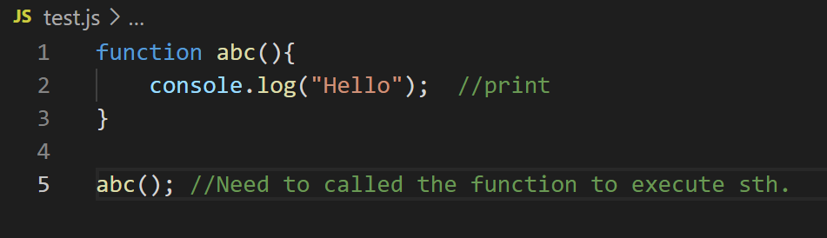
Functions
Functions are sets of instructions/statements that performs a task to achieve some outcomes.
Functions may vary a little bit across different languages. In Nodejs “function name_of_function(list of parameters){Statements}”
Eg.
The “abc” here is the name of the function. “()” things within the parenthesis the list of arguments. Things within “{}” brackets are the statements/instructions

Slide 8
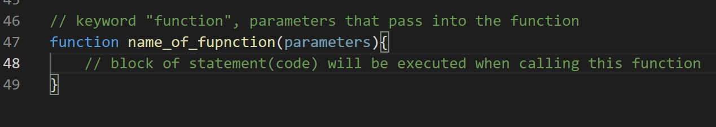
Syntax
Syntax – set of rules that correctly structure statements in a language such that the programming language can correctly compile.
JavaScript function syntax – first constructed with “function” keyword, (2nd) then function name after it
3rd parentheses () where parentheses may include several parameters.
(Demo) 4th curly brackets define the code to be executed.

Slide 9
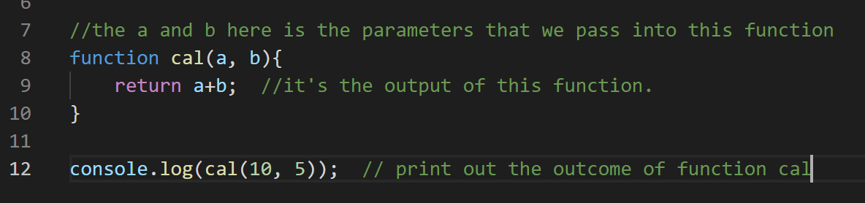
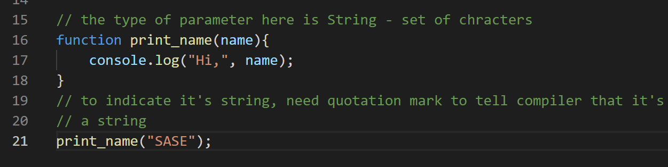
Demo functions
Programming Operators - https://www.tutorialspoint.com/computer_programming/computer_programming_operators.htm

Slide 10
Questions? (more demo if needed)

Slide 11
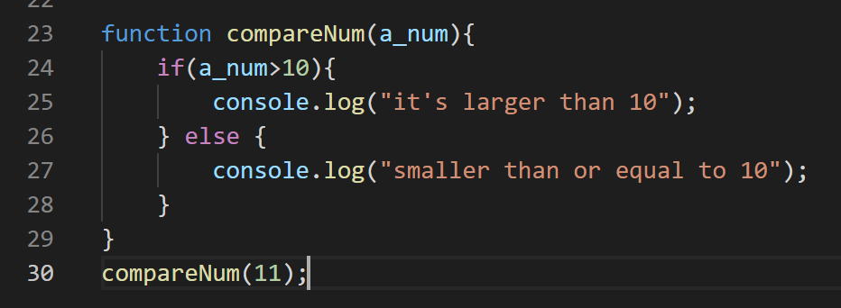
if statement
It’s a conditional statement. A decision making statement.
It specifies a block of code to be executed if the condition is satisfied/true.
Eg. If(condition){block of code.}
DEMO the following code

Slide 12
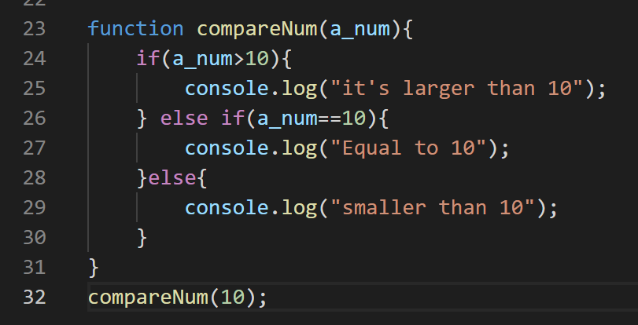
If, else if, else
“if” would execute a block of code if the condition is true
“else if” would setup a new condition, if the first “if” is false
“else” code within this block would execute, if the above conditions are not satisfied.
Demo

Slide 13
Questions? (more demo if needed)

Slide 14
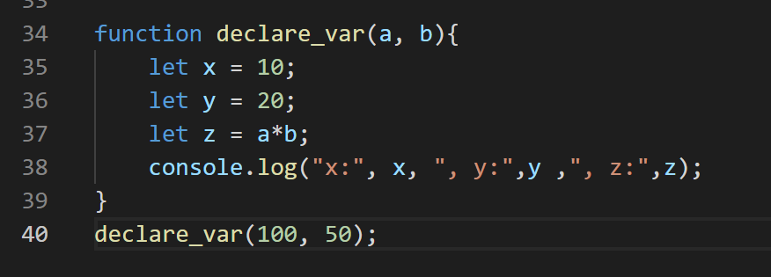
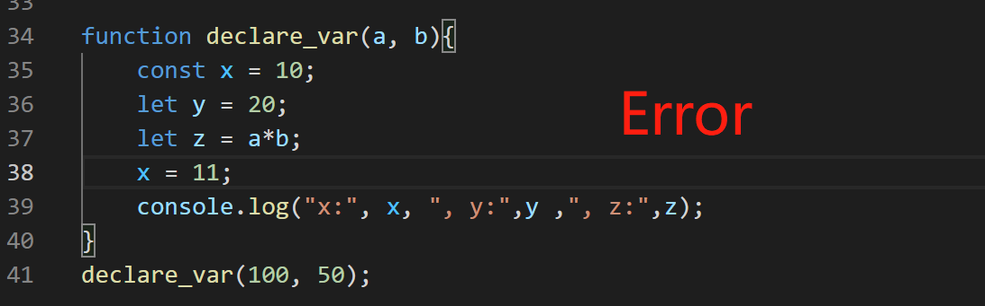
Variables
Variable is a container that stores value(s).
In JavaScript, there are 3 ways to declare a variable.
Var, let, const
Var and let are able to reassign the value within the variable. While const can’t
E.g. Demo

Slide 15
Basic calculator
We will be using Functions, conditional statements (if-else statements) and variables for our calculator.

Slide 16
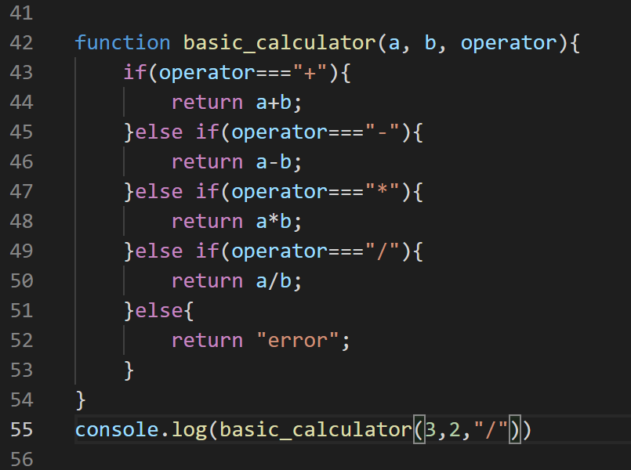
Demo the basic logics of a calculator

Slide 17
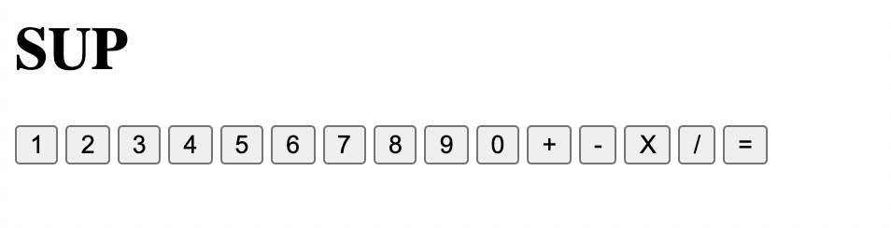
Demo Web Application
Using similar logics then we apply it to our web application.
Demo the calculator web app.

Slide 18
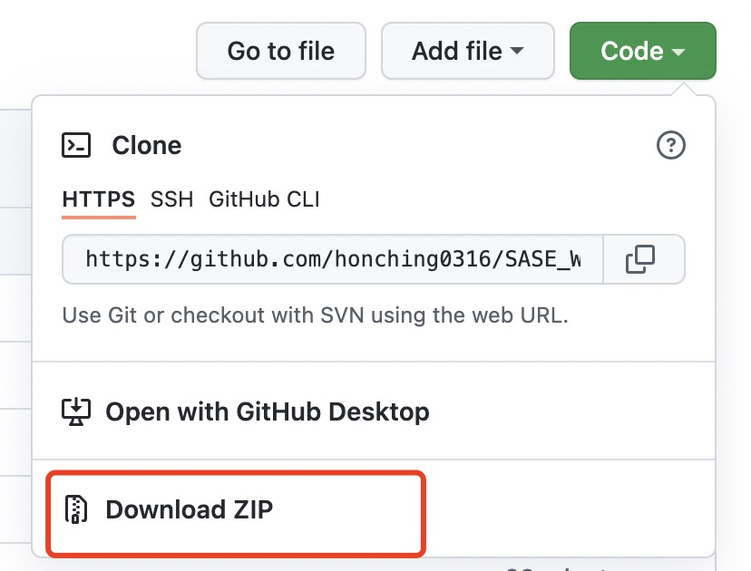
Resources
All the materials, including this ppt, all the demo codes, and the web application, under github.com/honching0316/SASE_WebApplication_Calculator
All the demo codes is written within the script demo.js
To download this workshop event’s materials (Demo)

Slide 19
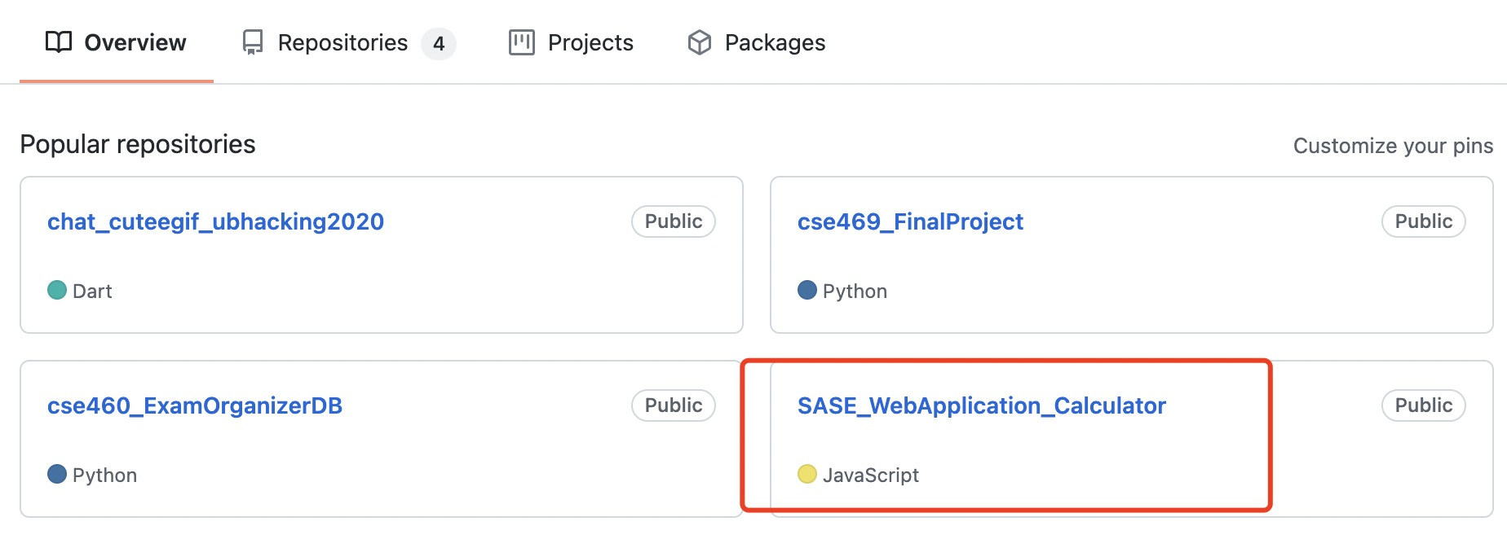
Or navigates to github.com/honching0316
Some of the future workshop events might be posted there as well (Demo)

Slide 20
End of today’s workshop event
Our next workshop event will be talking about introduction of ExpressJS. Back-end side when building a web application.
Basic concepts of ExpressJS, and how to use it to host a localhost website
Basic htmls, what’s html – basically the web page we see when browsing websites.
How to serve html file to our web application.

