Slide 1
Winning an Oscar
A Machine learning prediction model

Slide 2
Requirements
Multiple Data Sources
Multiple Libraries
Show our Analysis
Create a Predictive Model
Academy Requirements…

Slide 3
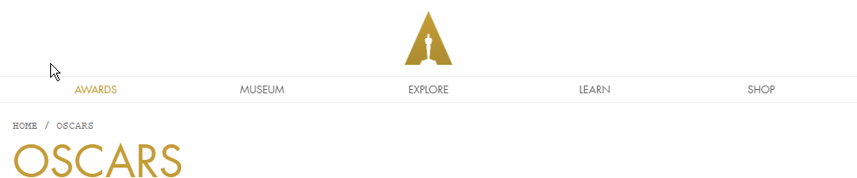
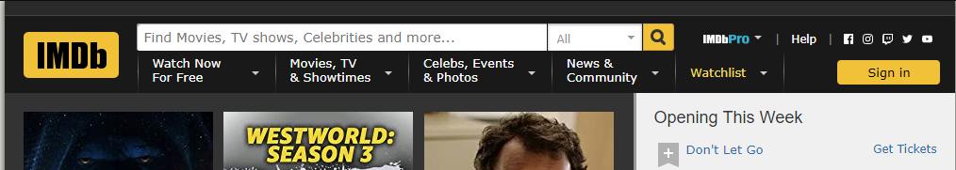
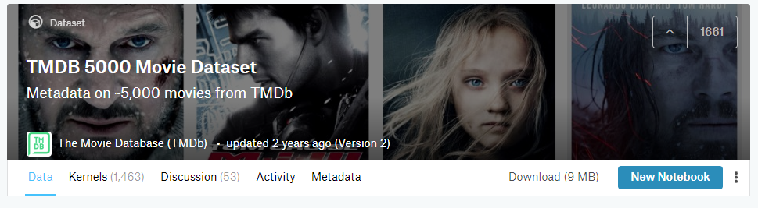
Gathering Data Sources
Academy Awards
IMDB
Kaggle

Slide 4
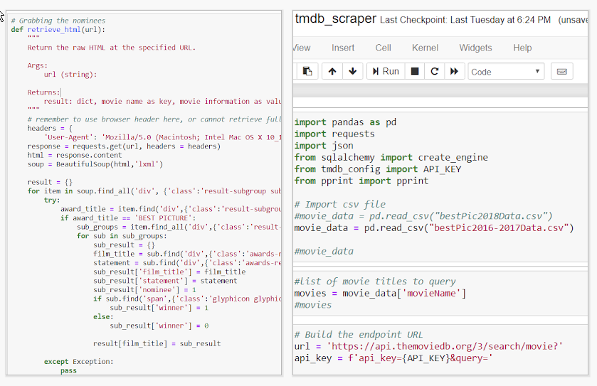
Web Scraping

Slide 5
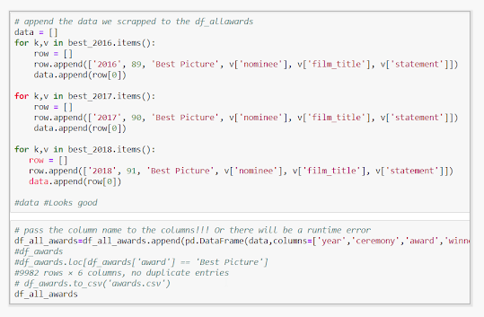
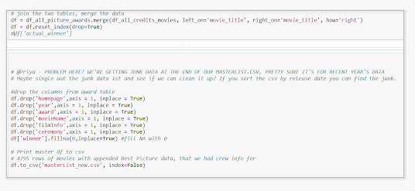
Cleaning the Data

Slide 6
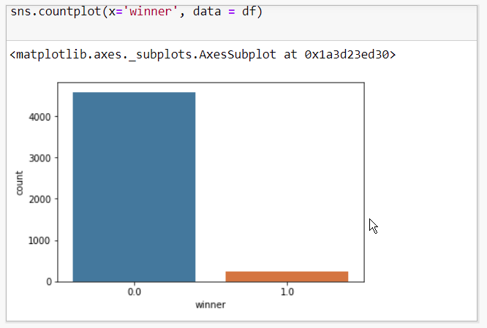
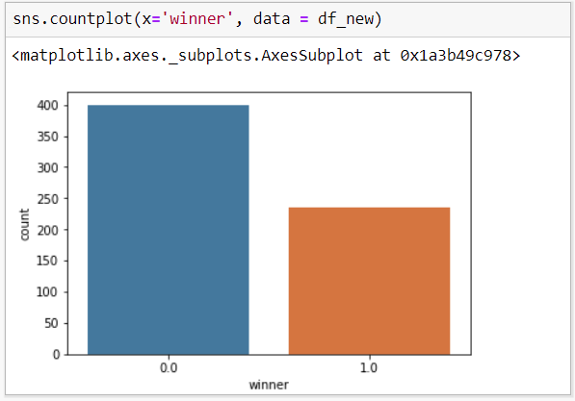
Normalization

Slide 7
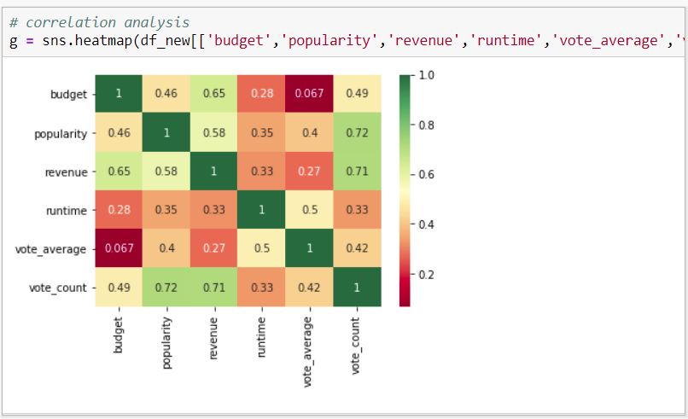
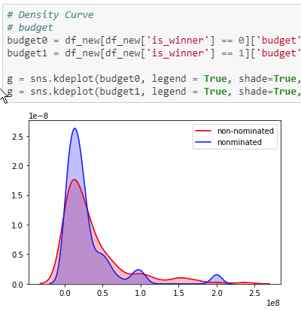
Analyzation
Heat Maps
Density Curves

Slide 8
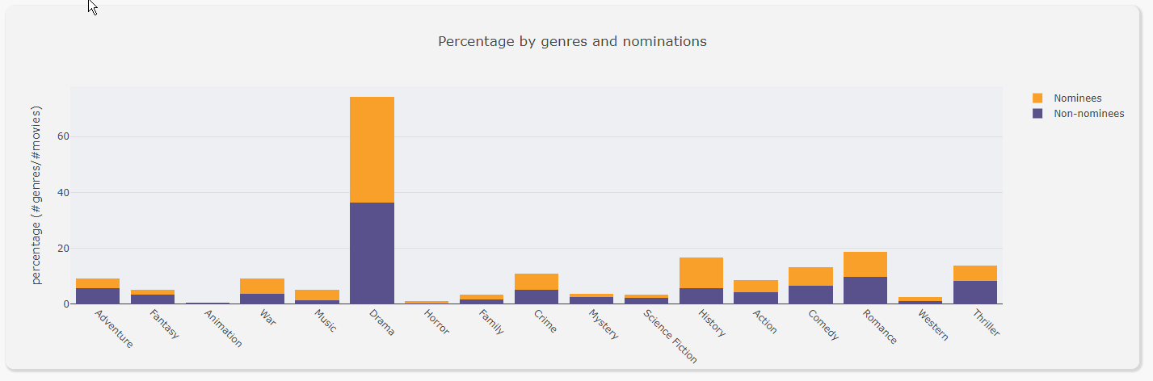
Analyzation II
Bar Graphs

Slide 9
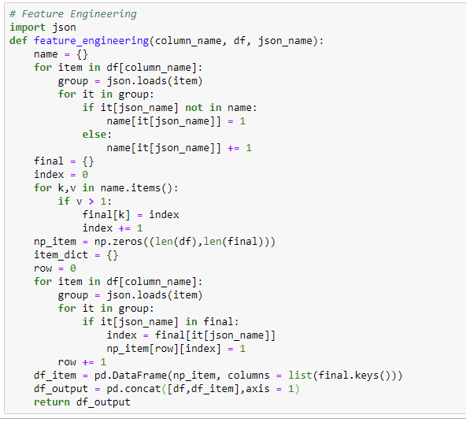
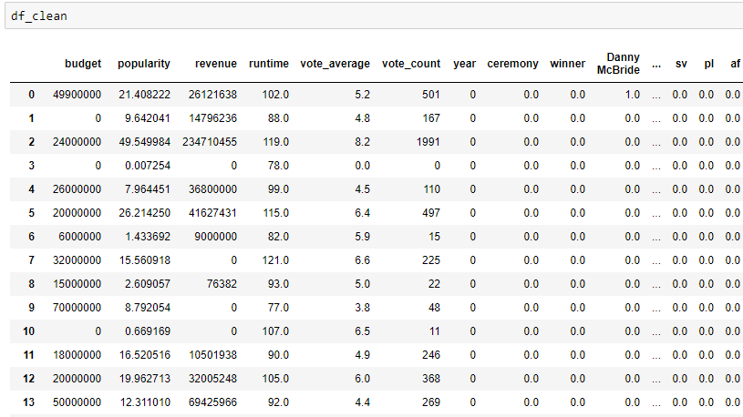
Feature Engineering: Cast and Crew

Slide 10

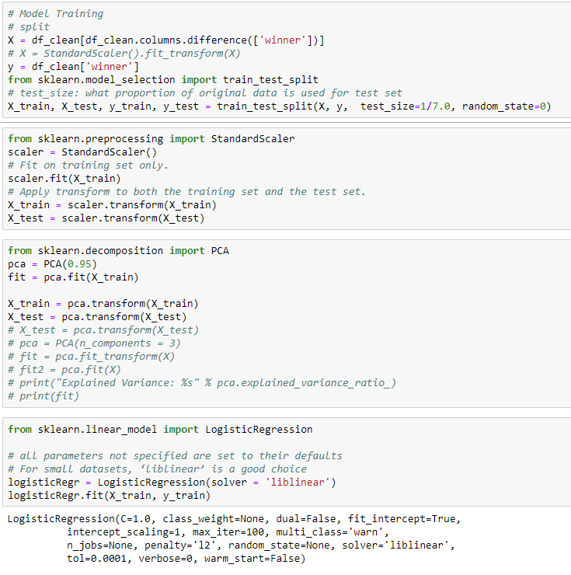
Training the Model
Using Sklearn

Slide 11
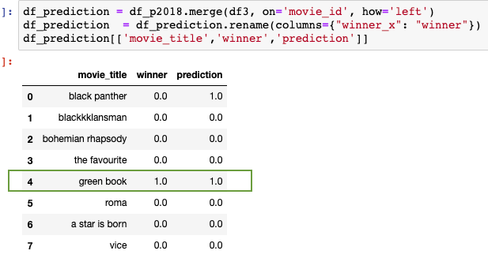
Prediction

Slide 12
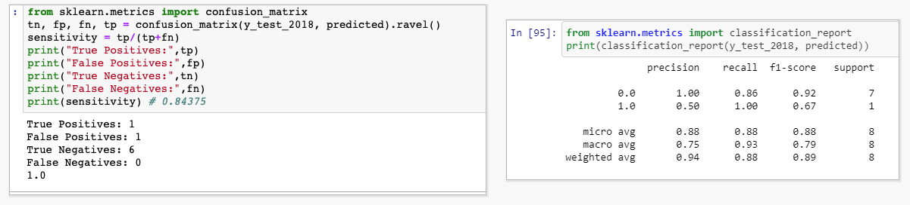
Certainty Analysis

Slide 13
Thank You!

