Slide 1
ECE3056A Architecture, Concurrency, and Energy Lecture: ISA Tradeoffs
Prof. Moinuddin K. Qureshi
NO OPEN LAPTOP OR TABLETS
Adapted from Slides of Prof. Mutlu (CMU)

Slide 2


Updates: Recitation Section
Sanjay Kariyappa
skariyappa3@gatech.edu
Ivan Walker
ivanwalker14@gmail.com
Tu & Th 10:30-11:30
(Next to KACB 2332)
M & W 3:00-4:00
(Next to KACB 2332)
Recitation Section
Tue 6-7, Mason111 Room 1113
Recitation Section
Tue 6-7, Mason 111 Room 2117
Vinson will be helping with development of Labs & Grading.
His office hours only during the week when labs are due.

Slide 3
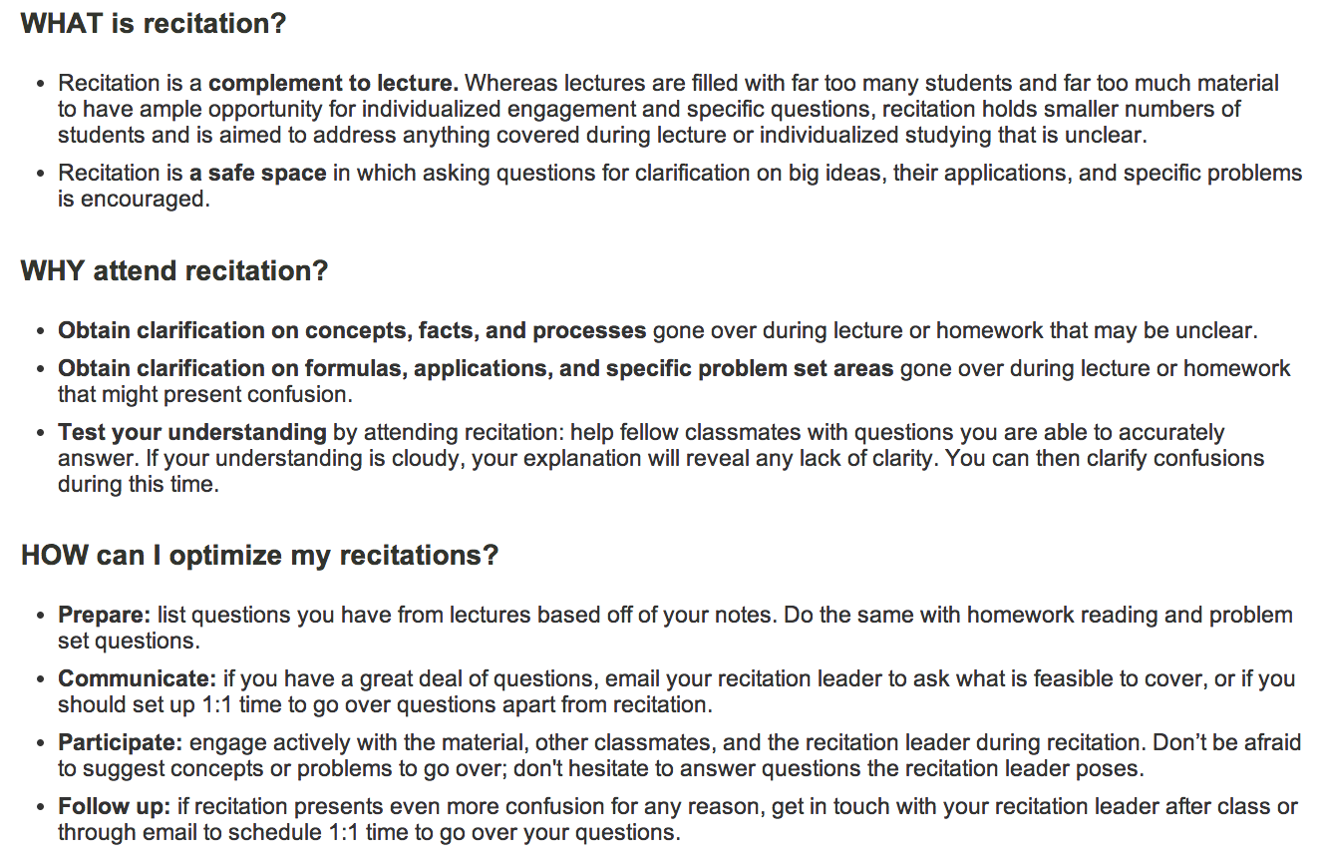
What is a Recitation Section Anyway?
Source:http://web.mit.edu/uaap/learning/lectures/recitations.html

Slide 4
Updates: Lab 1 Graded
Lab1 is graded, scores will released shortly.
We added extra test cases
For many students: All the test cases we provided pass, but
most of the new test cases fail ➔ Lower Score
Importance of testing your code: The test cases we provide are necessary but not sufficient to get the functionality right
There will be a regrade opportunity (more details soon) ➔
Score = Avg(OldScore,NewScore)

Slide 5
Extra Credit Problem (1% of grade)
Given that LC-3b does not have a MUL instruction we want to develop a routine that can perform MUL operations. The routine should take two operands of 8-bits each, available at locations 0x4000 and 0x4001 and should return the 16-bit resulting value at location 0x4002.

Slide 6
Extra Credit: Due on Sept 2, 11:59pm
You will need to test your MUL routine for the following ten test cases, and report the computed answer and number of instructions for each test case. You will get points ONLY IF your program computes the correct results for ALL the ten test cases. Submit your .asm file along with a text file with the following table and line filled out.
Val 0x4000 | 0xFF | 0x00 | 0x00 | 0xFF | 0xFF | 0x01 | 0x12 | 0x64 | 0xAA | 0x96
Val 0x4001 | 0xFF | 0x00 | 0xFF | 0x00 | 0x01 | 0xFF | 0x34 | 0x64 | 0x55 | 0x69
Result at 0x4002
Num Inst
The average number of instructions to perform MUL is: _____

Slide 7
ISA: Architecture State, Instruction Format, Processing Model, Memory Model, …

Slide 8
Many Different ISAs Over Decades
x86
PDP-x: Programmed Data Processor (PDP-11)
VAX
IBM 360
CDC 6600
SIMD ISAs: CRAY-1, Connection Machine
VLIW ISAs: Multiflow, Cydrome, IA-64 (EPIC)
PowerPC, POWER
RISC ISAs: Alpha, MIPS, SPARC, ARM
What are the fundamental differences?
E.g., how instructions are specified and what they do
E.g., how complex are the instructions

Slide 9
Element of ISA
Instruction sequencing model
Control flow vs. data flow
Instruction processing style
Specifies the number of “operands” an instruction “operates” on and how it does so
0, 1, 2, 3 address machines
0-address: stack machine (push A, pop A, op)
1-address: accumulator machine (ld A, st A, op A)
2-address: 2-operand machine (one is both source and dest)
3-address: 3-operand machine (source and dest are separate)
Tradeoffs?
Larger instructions vs. more executed operations
Code size vs. execution time

Slide 10
Examples
PDP-11: A 2-address machine
PDP-11 ADD: 4-bit opcode, 2 6-bit operand specifiers
Why? Limited bits to specify an instruction
Disadvantage: One source operand is always clobbered with the result of the instruction
How do you ensure you preserve the old value of the source?
X86: A 2-address (memory/memory) machine
Alpha: A 3-address (load/store) machine
MIPS? LC-3b?

Slide 11
What Are the Elements of An ISA?
Instructions
Opcode
Operand specifiers (addressing modes)
How to obtain the operand?
Data types
Definition: Representation of information for which there are instructions that operate on the representation
Integer, floating point, character, binary, decimal, BCD
Doubly linked list, queue, string, bit vector, stack
VAX: INSQUEUE and REMQUEUE instructions on a doubly linked list or queue; FINDFIRST
Digital Equipment Corp., “VAX11 780 Architecture Handbook,” 1977-78.
X86: SCAN opcode operates on character strings; PUSH/POP
Why are there different addressing modes?

Slide 12
Data Type Tradeoffs
What is the benefit of having more or high-level data types in the ISA?
What is the disadvantage?
Think compiler/programmer vs. microarchitect
Concept of semantic gap
Data types coupled tightly to the semantic level, or complexity of instructions
Early RISC architectures vs. Intel 432
Early RISC: Only integer data type
Intel 432: Object data type

Slide 13
What Are the Elements of An ISA?
Registers
How many
Size of each register
Why is having registers a good idea?
Concept of locality of data
A recently produced/accessed value is likely to be used more than once (temporal locality)
Storing that value in a register eliminate the need to go to memory each time that value is needed

Slide 14
ISA-level Tradeoffs: Number of Registers
Affects:
Number of bits used for encoding register address
Number of values kept in fast storage (register file)
(uarch) Size, access time, power consumption of register file
Large number of registers:
+ Enables better register allocation (and optimizations) by compiler → fewer saves/restores
-- Larger instruction size
-- Larger register file size

Slide 15
What Are the Elements of An ISA?
Memory organization
Address space: How many uniquely identifiable locations in memory
Addressability: How much data does each uniquely identifiable location store
Byte addressable: most ISAs, characters are 8 bits
Bit addressable: Burroughs 1700.
64-bit addressable: Some supercomputers. Why?
32-bit addressable: First Alpha
Food for thought
How do you add 2 32-bit numbers with only byte addressability?
How do you add 2 8-bit numbers with only 32-bit addressability?
Big endian vs. little endian? MSB at low or high byte.

Slide 16
Instruction Classes
Operate instructions
Process data: arithmetic and logical operations
Fetch operands, compute result, store result
Implicit sequential control flow
Data movement instructions
Move data between memory, registers, I/O devices
Implicit sequential control flow
Control flow instructions
Change the sequence of instructions that are executed

Slide 17
What Are the Elements of An ISA?
Load/store vs. memory/memory architectures
Load/store architecture: operate instructions operate only on registers
E.g., MIPS, ARM and many RISC ISAs
Memory/memory architecture: operate instructions can operate on memory locations
E.g., x86, VAX and many CISC ISAs

Slide 18
What Are the Elements of An ISA?
Addressing modes specify how to obtain the operands
Absolute LW rt, 10000
use immediate value as address
Register Indirect: LW rt, (r_{base})
use GPR[r_{base}] as address
Displaced or based: LW rt, offset(r_{base})
use offset+GPR[r_{base}] as address
Indexed: LW rt, (r_{base}, r_{index})
use GPR[r_{base}]+GPR[r_{index}] as address
Memory Indirect LW rt ((r_{base}))
use value at M[ GPR[ r_{base} ] ] as address
Auto inc/decrement LW Rt, (r_{base})
use GRP[r_{base}] as address, but inc. or dec. GPR[r_{base}] each time
Notes:
Indexed mode for gather scatter.

Slide 19
What Are the Benefits of Different Addressing Modes?
Another example of programmer vs. microarchitect tradeoff
Advantage of more addressing modes:
Enables better mapping of high-level constructs to the machine: some accesses are better expressed with a different mode → reduced number of instructions and code size
Think array accesses (autoincrement mode)
Think indirection (pointer chasing)
Sparse matrix accesses
Disadvantage:
More work for the compiler
More work for the microarchitect

Slide 20
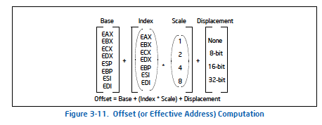
X86 SIB-D Addressing Mode
x86 Manual Vol. 1, page 3-31

Slide 21
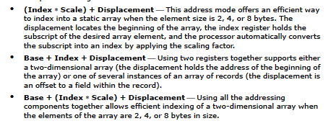
X86 Manual: Suggested Uses of Addressing Modes
x86 Manual Vol. 1, page 3-32

Slide 22
What Are the Elements of An ISA?
How to interface with I/O devices
Memory mapped I/O
A region of memory is mapped to I/O devices
I/O operations are loads and stores to those locations
Special I/O instructions
IN and OUT instructions in x86 deal with ports of the chip

Slide 23
What Are the Elements of An ISA?
Privilege modes
User vs supervisor
Who can execute what instructions?
Exception and interrupt handling
What procedure is followed when something goes wrong with an instruction?
What procedure is followed when an external device requests the processor?
Virtual memory
Each program has the illusion of the entire memory space, which is greater than physical memory
Access protection
We will talk about these later
Notes:
MIPS started out without having interrupt vectors… When an interrupt happens, SW figured out who interrupted… Costly in terms of time…

Slide 24
Complex vs. Simple ISA: Tradeoffs The (in)famous RISC vs CISC battle !

Slide 25
Complex vs. Simple Instructions
Complex instruction: An instruction does a lot of work, e.g. many operations
Insert in a doubly linked list
Compute FFT
String copy
Simple instruction: An instruction does small amount of work, it is a primitive
Add
XOR
Shift

Slide 26
Complex vs. Simple Instructions
Advantages of Complex instructions
+ Denser encoding → smaller code size → better memory utilization, saves off-chip bandwidth, better cache hit rate (better packing of instructions)
+ Simpler compiler: no need to optimize small instructions as much
Disadvantages of Complex Instructions
- Larger chunks of work → compiler has less opportunity to optimize
- More complex hardware → translation from a high level to control signals and optimization needs to be done by hardware
- Compiler is limited in fine-grained optimizations it can do

Slide 27
ISA-level Tradeoffs: Semantic Gap
Some tradeoffs (for you to think about)
Simple compiler, complex hardware vs. complex compiler, simple hardware
Caveat: Translation (indirection) can change the tradeoff!
Burden of backward compatibility
Performance?
Optimization opportunity: Example of VAX INDEX instruction: who (compiler vs. hardware) puts more effort into optimization?
Instruction size, code size

Slide 28
X86: Small Semantic Gap: String Operations
An instruction operates on a string
Move one string of arbitrary length to another location
Compare two strings
Enabled by the ability to specify repeated execution of an instruction (in the ISA)
Using a “prefix” called REP prefix
Example: REP MOVS instruction
Only two bytes: REP prefix byte and MOVS opcode byte (F2 A4)
Implicit source and destination registers pointing to the two strings (ESI, EDI)
Implicit count register (ECX) specifies how long the string is

Slide 29
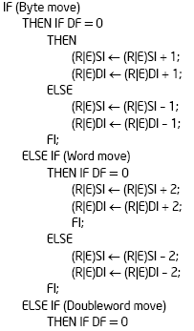
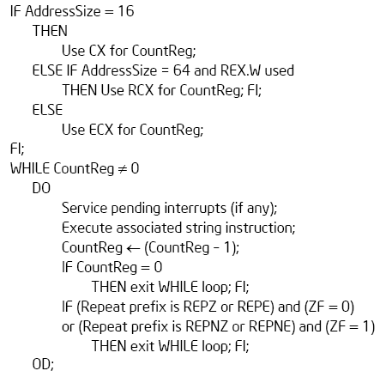
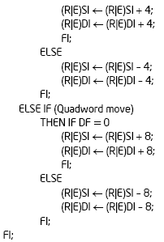
X86: Small Semantic Gap: String Operations
REP MOVS (DEST SRC)
How many instructions does this take in MIPS?

Slide 30
Small Semantic Gap Examples in VAX
FIND FIRST
Find the first set bit in a bit field
Helps OS resource allocation operations
SAVE CONTEXT, LOAD CONTEXT
Special context switching instructions
INSQUEUE, REMQUEUE
Operations on doubly linked list
INDEX
Array access with bounds checking
STRING Operations
Compare strings, find substrings, …
Cyclic Redundancy Check Instruction
EDITPC
Implements editing functions to display fixed format output
Digital Equipment Corp., “VAX11 780 Architecture Handbook,” 1977-78.

Slide 31
Announcements
Lab1 re-grade and “Part B” test cases
Lab1ExtraCredit
Check the Piazza announcement for byteadd example
We will support only ecelinsrv machines [no mac/ubuntu/etc.]
You can do MUL better than add N times (think!)
Top 5 submissions with lowest inst count: extra 1% grade Let the competition begin
3. Lab2 will be up tomorrow: go through microarch slides and PDF
4. If you have trouble with VPN/SSH, attend recitation section or see one of the TAs during their office hours

Slide 32
A Note on ISA Evolution
ISAs have evolved to reflect/satisfy the concerns of the day
Examples:
Limited memory size
Limited compiler optimization technology
Limited memory bandwidth
Need for specialization in important applications (e.g., MMX)

Slide 33
Effect of Translation
One can translate from one ISA to another ISA to change the semantic gap tradeoffs
Examples
Intel’s and AMD’s x86 implementations translate x86 instructions into programmer-invisible microoperations (simple instructions) in hardware
Transmeta’s x86 implementations translated x86 instructions into “secret” VLIW instructions in software (code morphing software)
Think about the tradeoffs

Slide 34
ISA-level Tradeoffs: Instruction Length
Fixed length: Length of all instructions the same
+ Easier to decode single instruction in hardware
+ Easier to decode multiple instructions concurrently
-- Wasted bits in instructions (Why is this bad?)
-- Harder-to-extend ISA (how to add new instructions?)
Variable length: Length of instructions different (determined by opcode and sub-opcode)
+ Compact encoding (Why is this good?)
Intel 432: Huffman encoding (sort of). 6 to 321 bit instructions. How?
-- More logic to decode a single instruction
-- Harder to decode multiple instructions concurrently
Tradeoffs
Code size (memory space, bandwidth, latency) vs. hardware complexity
ISA extensibility and expressiveness
Performance? Smaller code vs. imperfect decode
Notes:
Huffman encoding: shorter strings for more commonly occurring instructions

Slide 35
ISA-level Tradeoffs: Uniform Decode
Uniform decode: Same bits in each instruction correspond to the same meaning
Opcode is always in the same location
Ditto operand specifiers, immediate values, …
Many “RISC” ISAs: Alpha, MIPS, SPARC
+ Easier decode, simpler hardware
+ Enables parallelism: generate target address before knowing the instruction is a branch
-- Restricts instruction format (fewer instructions?) or wastes space
Non-uniform decode
E.g., opcode can be the 1st-7th byte in x86
+ More compact and powerful instruction format
-- More complex decode logic

Slide 36
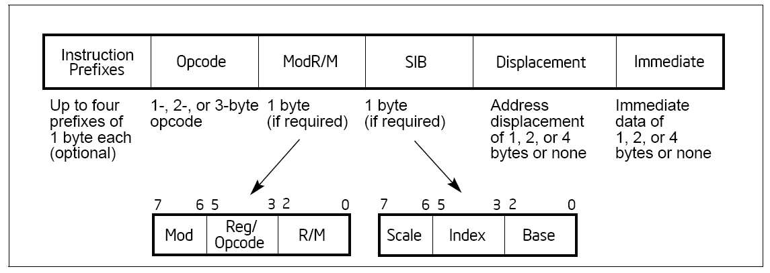
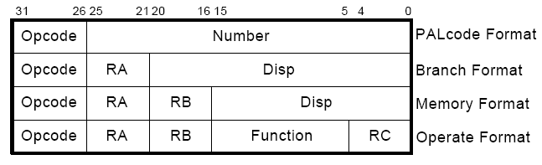
x86 vs. Alpha Instruction Formats
x86:
Alpha:

Slide 37
MIPS Instruction Format
R-type, 3 register operands
I-type, 2 register operands and 16-bit immediate operand
J-type, 26-bit immediate operand
Simple Decoding
4 bytes per instruction, regardless of format
must be 4-byte aligned (2 lsb of PC must be 2b’00)
format and fields easy to extract in hardware
0
6-bit
rs
5-bit
rt
5-bit
rd
5-bit
shamt
5-bit
funct
6-bit
R-type
opcode
6-bit
rs
5-bit
rt
5-bit
immediate
16-bit
I-type
opcode
6-bit
immediate
26-bit
J-type

Slide 38
MIPS: Aligned Access
MSB
byte-3
byte-2
byte-1
byte-0
LSB
LW/SW alignment restriction: 4-byte word-alignment
not designed to fetch memory bytes not within a word boundary
not designed to rotate unaligned bytes into registers
Need more instructions for the “infrequent” case
LWL/LWR is slower
Note LWL and LWR still fetch within word boundary
byte-7
byte-6
byte-5
byte-4
A
B
C
D
LWL rd 6(r0) →
byte-6
byte-5
byte-4
D
LWR rd 3(r0) →
byte-6
byte-5
byte-4
byte-3

Slide 39
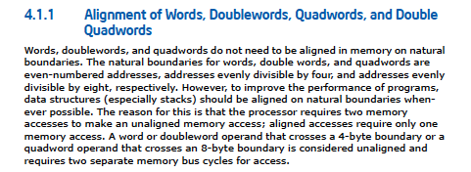
X86: Unaligned Access
LD/ST instructions automatically align data that spans a “word” boundary
Programmer/compiler does not need to worry about where data is stored (whether or not in a word-aligned location)

Slide 40
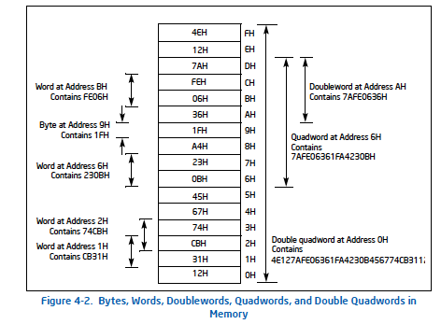
X86: Unaligned Access

Slide 41
Review: ISA Tradeoffs
Complex vs. simple instructions: concept of semantic gap
Use of translation to change the tradeoffs
Fixed vs. variable length, uniform vs. non-uniform decode
Number of registers, addressing modes
Unaligned memory access
What is the benefit of translating complex instructions to “simple instructions” before executing them?
In hardware (a la Intel, AMD)?
In software (a la Transmeta)?
Which ISA is easier to extend: fixed length or variable length?

Slide 42
A Note on Length and Uniformity
Uniform decode usually goes with fixed length
In a variable length ISA, uniform decode can be a property of instructions of the same length
It is hard to think of it as a property of instructions of different lengths

Slide 43
A Note on RISC vs. CISC
Usually, …
RISC
Simple instructions
Fixed length
Uniform decode
Few addressing modes
CISC
Complex instructions
Variable length
Non-uniform decode
Many addressing modes

