Slide 1
LC3b Assembly
Moinuddin K Qureshi

Slide 2
LC-3b Assembly Language
Instead of an instruction being 16 0s and 1s, as is the case in the LC-3b ISA, an instruction in assembly language consists of four parts, as shown below:
E.g.
MYLABEL ADD R1,R2,R3 ; A meaningful comment here

Slide 3
Example: SUM 1 to 10 (N in general)
; This program computes sum from 1 to N
.ORIG x3000
AND R2, R2, #0 ; Clear R2 for sum
LEA RO, NNN
LDW R1, R0, #0
LOOP ADD R2, R2, R1 ; Sum+=N
ADD R1,R1,#-1
BRp LOOP
HALT ; Decoded as TRAP x25
NNN .FILL x000A ; Ten in Hex, store N here
.END

Slide 4
Labels
Labels are symbolic names used to identify memory locations referred to explicitly in the program.
Labels: 1-20 alphanumeric characters, starting with letter
Two reasons:
Location of target of branch instruction
Location that contains a value that is loaded or stored

Slide 5
Opcode and Operands
An instruction must have an OPCODE: The thing the instruction is to do
Appropriate number of OPERAND, the things it is supposed to do it to
Opcodes are symbolic names: Easier to remember (ADD instead of 0001)
Number of operands depend on opcode:
RTI has zero
LEA has two (LEA R2, NUMBER)
ADD has three (ADD R1,R2,x0F)
Operand can be immediate value: #Decimal, xHex, bBinary (1000?)

Slide 6
Comments
Intended to enhance code readability
No effect on translation process (not acted on by LC-3b Assembler)
Identified by semicolons ;
If semicolon is first non blank character, entire line is ignored
Enhance visual presentation (separate pieces of program)
Increase readability and maintainability

Slide 7
Pseudo Ops (Assembler Directives)
Pseudo Ops are helpful to the assembler in performing translation
1 .ORIG: Tells the assembler where in memory to place the program
2 .END: Tells the assembler when program ends (after .END ignored)
3 .FILL: Set aside next location, and initialize it to <VALUE>
4 .BLKW: Tells the assembler to set aside N BLocK of Words in memory
5 .STRINGZ: Tells the assembler to initialize mem locations with a given string value (E.g. .STRINGZ “Hello, World!” ; x00 is sentinel)
Other pseudo ops too (but we won’t be using them)

Slide 8
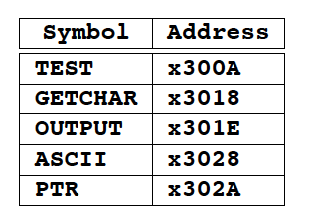
The Assembly Process
Two pass: Why?
First pass: Create the Symbol Table
2. The Second Pass: Generate the Machine Language Program

Slide 9
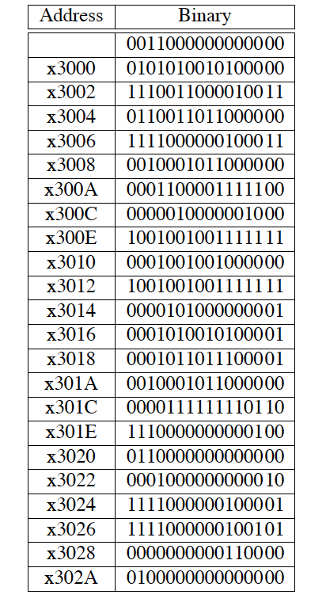
The Assembly Process (Pass Two)
What if LEA offset turns out
To be greater than 510, or < -512?
➔ Error Condition

Slide 10
Error Codes
Error Code 1: Undefined Label
Error Code 2: Invalid Opcode (MUL)
Error Code 3: Invalid Constant (.ORIG x1001, ADD R0,R1,#100)
Error Code 4: Other Error (Wrong Number of Operands)
e.g. ADD R0, R1

Slide 11
Problem (optional, for your benefit)
Given that LC-3b does not have a MUL instruction we want to develop a routine that can perform MUL operations. The routine should take two operands of 8-bits each, available at locations 0x4000 and 0x4001 and should return the 16-bit resulting value at location 0x4002.
TEST: If the value at 0x4000 is 0xF0 (#240) and at 0x4001 is 0x64 (#100),
Then what value gets stored at 0x4002?
TIME: How many instructions (dynamic) did you need to compute this
value? Can you do it in fewer instructions?

