Slide 1
LC3b ISA
Moinuddin K Qureshi
[REMINDER: No OPEN Laptops/Tablets/etc.]

Slide 2
What is A Computer?
We will cover all three components
Processing
Memory
(program
and data)
I/O
control
(sequencing)
datapath

Slide 3
The Von Neumann Model/Architecture
Also called stored program computer (instructions in memory). Two key properties:
Stored program
Instructions stored in a linear memory array
Memory is unified between instructions and data
The interpretation of a stored value depends on the control signals
Sequential instruction processing
One instruction processed (fetched, executed, and completed) at a time
Program counter (instruction pointer) identifies the current instr.
Program counter is advanced sequentially except for control transfer instructions
When is a value interpreted as an instruction?

Slide 4
The Von-Neumann Model
All major instruction set architectures today use this model
x86, MIPS, SPARC, Alpha, ARM, POWER
Underneath (at the microarchitecture level), the execution model of almost all implementations (or, microarchitectures) is very different
Pipelined instruction execution: Intel 80486 uarch
Multiple instructions at a time: Intel Pentium uarch
Out-of-order execution: Intel Pentium Pro uarch
Separate instruction and data caches
But, what happens underneath that is not consistent with the von Neumann model is not exposed to software
Difference between ISA and microarchitecture

Slide 5
ISA vs. Microarchitecture
ISA
Agreed upon interface between software and hardware
SW/compiler assumes, HW promises
What the software writer needs to know to write and debug system/user programs
Microarchitecture
Specific implementation of an ISA
Not visible to the software
Microprocessor
ISA, uarch, circuits
“Architecture” = ISA + microarchitecture
Problem
Algorithm
Program
ISA
Microarchitecture
Circuits
Electrons
Notes:
ISA is the interface between hardware and software… It is a contract that the hardware promises to satisfy.
Builder/user interface

Slide 6
ISA vs. Microarchitecture
What is part of ISA vs. Uarch?
Gas pedal: interface for “acceleration”
Internals of the engine: implements “acceleration”
Implementation (uarch) can be various as long as it satisfies the specification (ISA)
Add instruction vs. Adder implementation
Bit serial, ripple carry, carry lookahead adders are all part of microarchitecture
x86 ISA has many implementations: 286, 386, 486, Pentium, Pentium Pro, …
Microarchitecture usually changes faster than ISA
Few ISAs (x86, SPARC, MIPS, Alpha) but many uarchs
Why?

Slide 7
Property of ISA vs. Uarch?
ADD instruction’s opcode
Number of general purpose registers
Number of ports to the register file
Number of cycles to execute the MUL instruction
Whether or not the machine employs pipelined instruction execution
Remember
Microarchitecture: Implementation of the ISA under specific design constraints and goals

Slide 8
Overview of LC-3b ISA
Memory
2¹⁶ bytes
0x0000
To
0xFFFF
8 REGS
R0-R7
(16 bit wide)
PC
PSR
Condition codes
16-bit INSTRUCTIONS (4-bit opcode, 14 defined+ 2 reserved)

Slide 9
Arithmetic & Logic Instructions

Slide 10
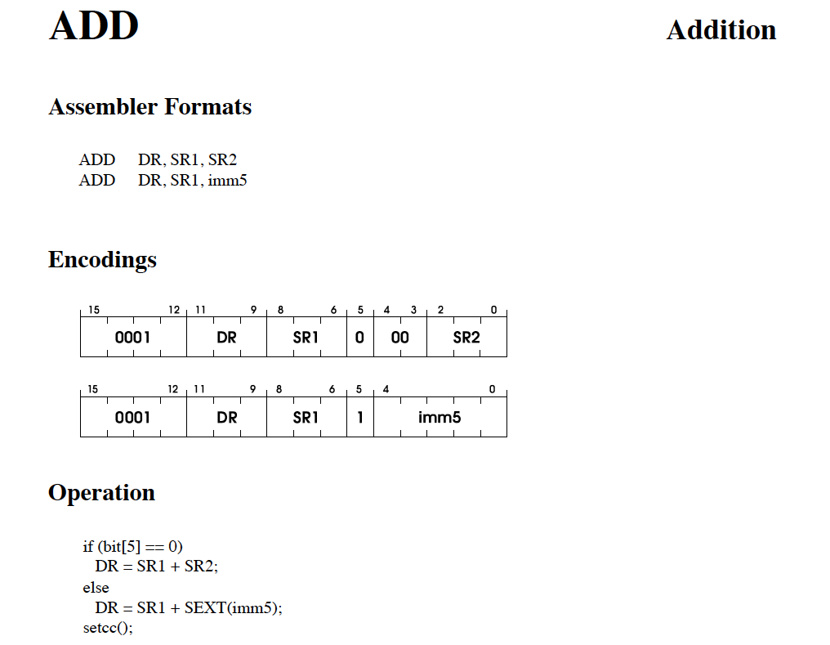

Slide 11
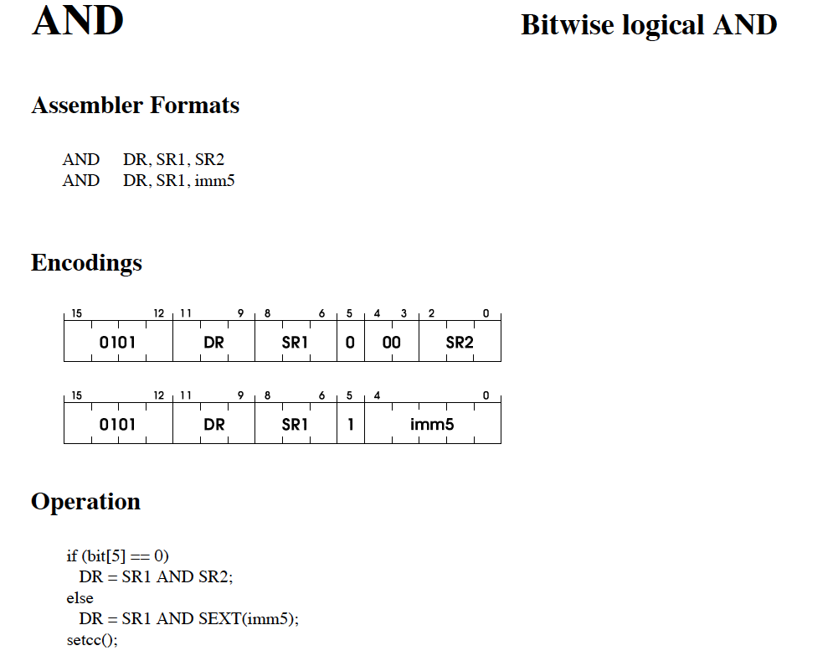

Slide 12
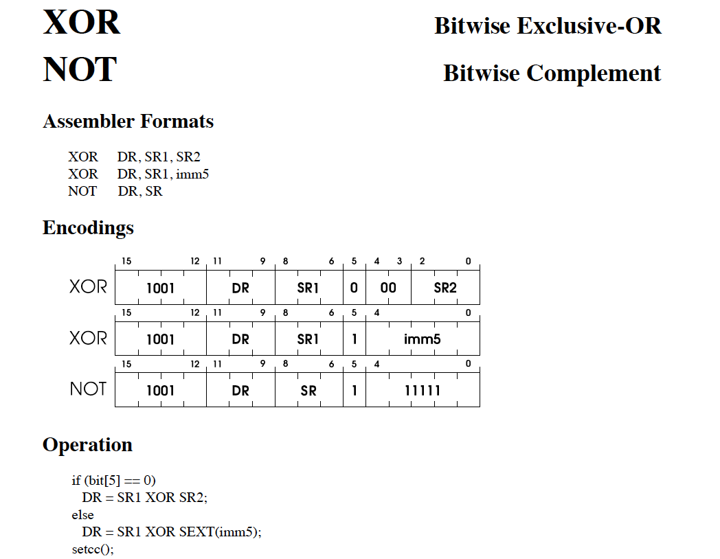

Slide 13
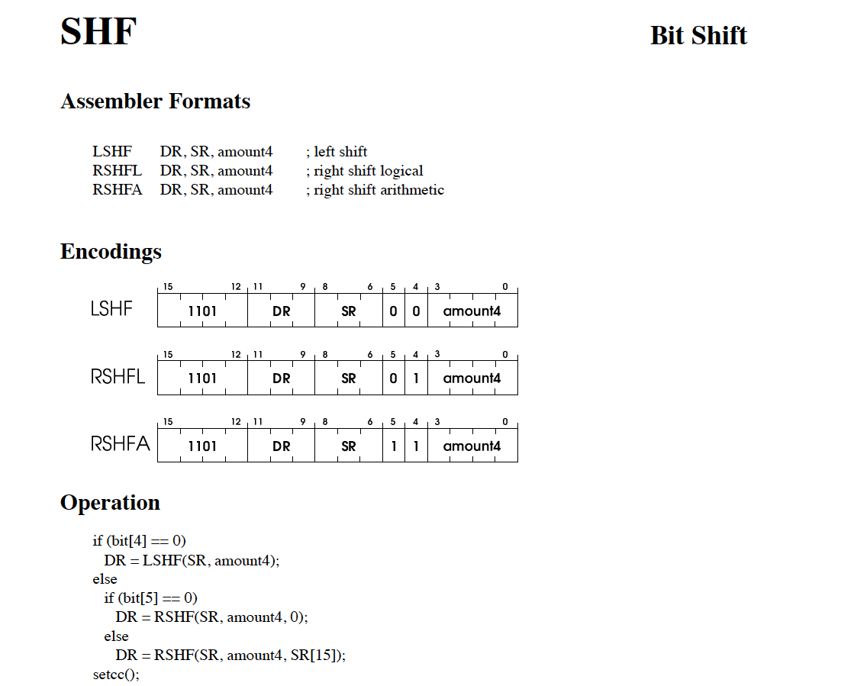

Slide 14
Memory Instructions

Slide 15
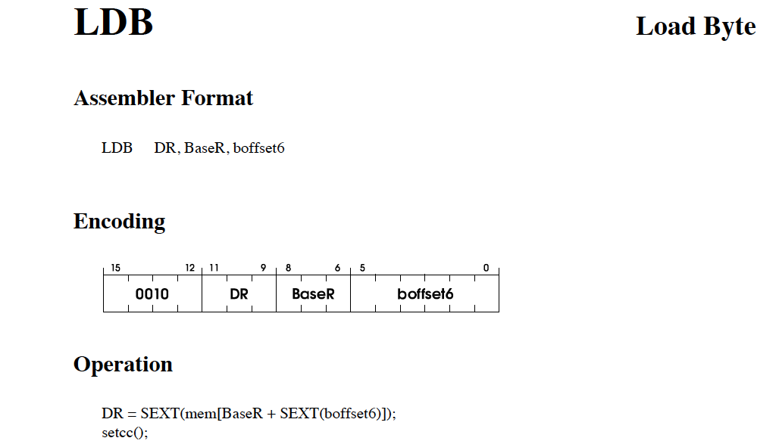

Slide 16
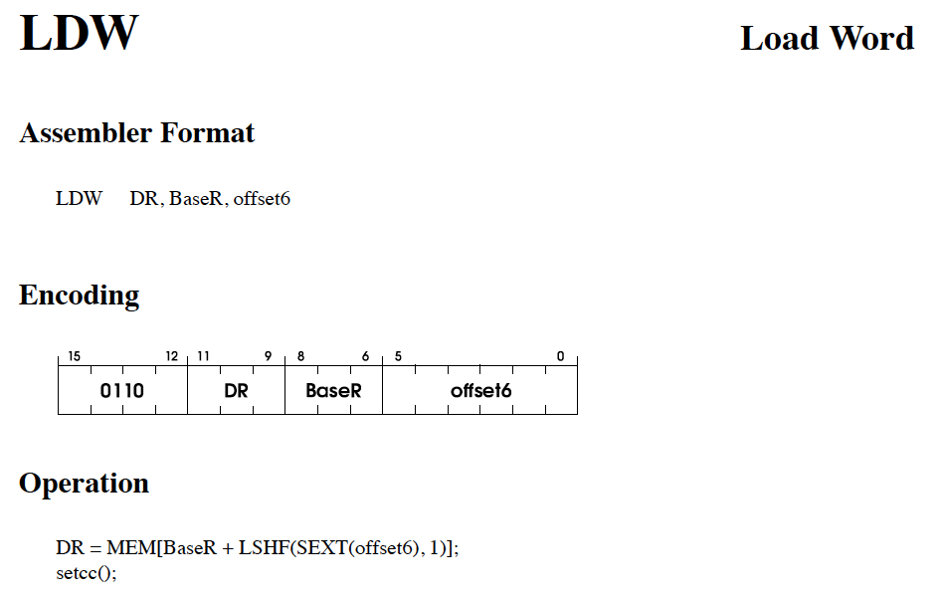

Slide 17
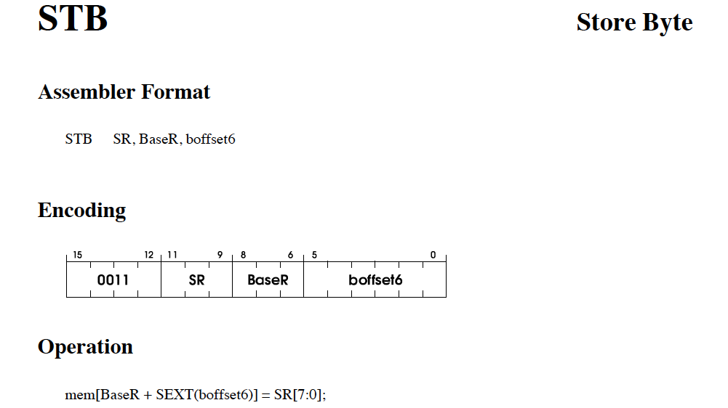

Slide 18
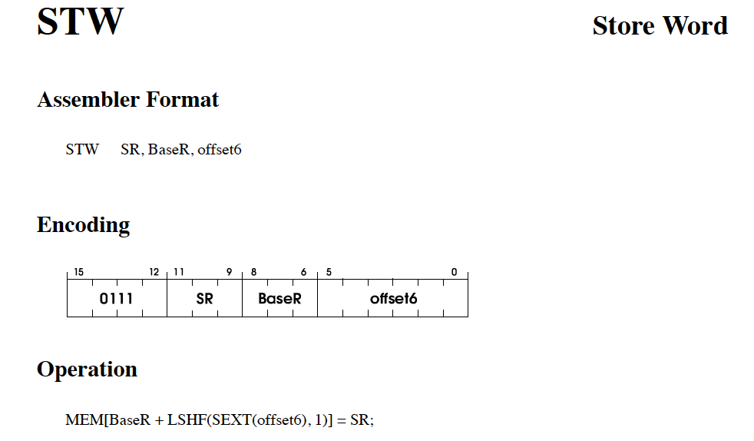

Slide 19
Control Flow Instructions

Slide 20
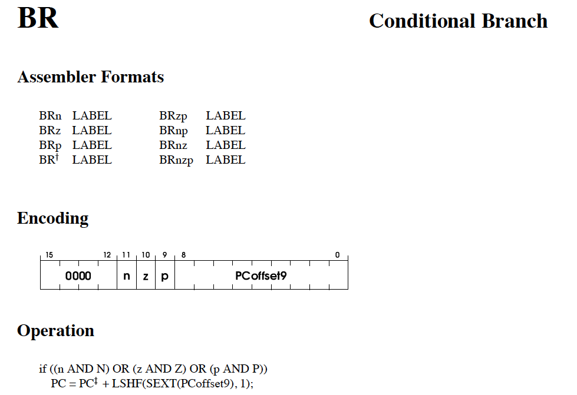

Slide 21
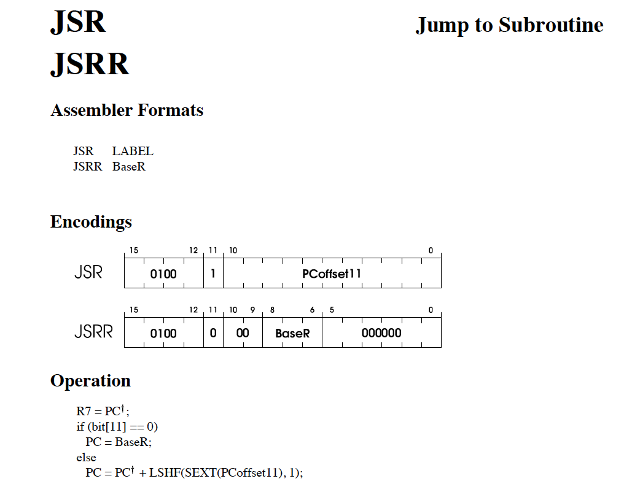

Slide 22
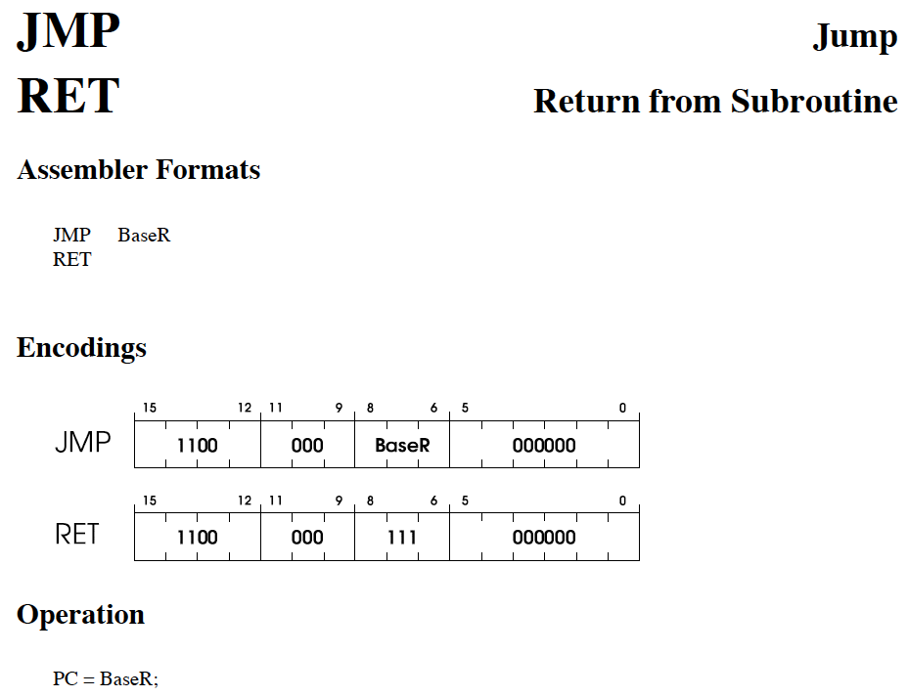

Slide 23
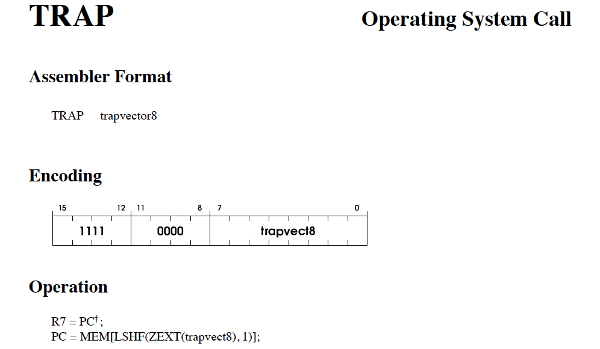

Slide 24
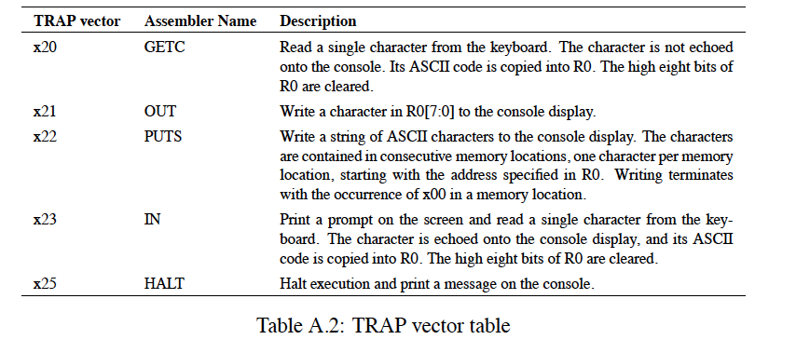

Slide 25
LEA: Get Address in Register

Slide 26
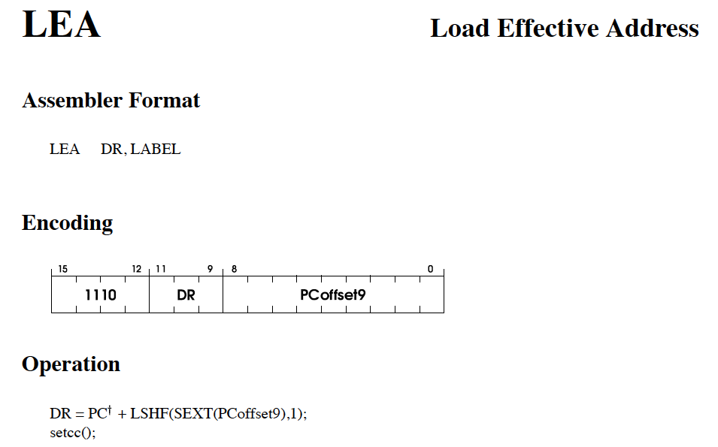
Note: this instruction does not access memory.
It is more like ALU op rather than memory op.

Slide 27
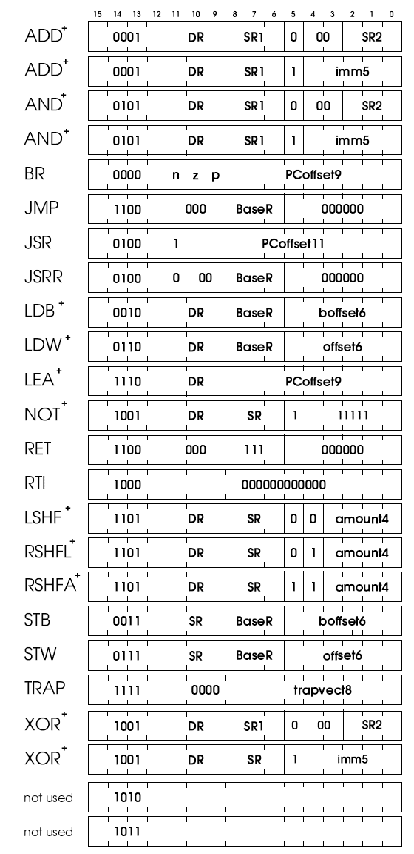
Concept of “Bit Steering”
A bit in the instruction determines
the interpretation of other bits.
Which instructions employ Bit steering?

Slide 28
A Day in the Life of an LC-3b Instruction
ooo
0x1234
0x42
R0
0x0000
0x1235
0x10
R1
0x1111
0x1236
0xFF
R2
0x2222
0x1237
0x1E
R3
0x3333
0x1238
0x7F
R4
0x4444
PC
0x1234
0x1239
0x92
R5
0x5555
0x123A
0x11
R6
0x6666
0x123B
0x11
R7
0x7777
0x123C
0x11
0x123D
0x11
0
1
0
0x123E
0x11
N
Z
P
0x123F
0x11
0x1240
0x11
ooo

Slide 29
1. What happens with this instruction ?
ooo
0x1234
0x42
R0
0x3333
0x0000
0x1235
0x10
R1
0x1111
0x1236
0xFF
R2
0x2222
0x1237
0x1E
R3
0x3333
0x1238
0x7F
PC
0x1234
R4
0x4444
0x1236
0x1239
0x92
R5
0x5555
0x123A
0x11
R6
0x6666
0x123B
0x11
R7
0x7777
Inst Fetched: 0x1042
0001 0000 0100 0010
0x123C
0x11
0x123D
0x11
0
0001 0000 0100 0010
0x123E
0x11
0
1
1
0
N
Z
P
0x123F
0x11
ADD R0, R1, R2
0x1240
0x11
ooo

Slide 30
2. What happens with this instruction ?
ooo
0x1234
0x42
R0
0x3333
0x1235
0x10
R1
0x1111
0x1236
0xFF
R2
0x2222
0x1237
0x1E
R3
0x3333
0x1238
0x7F
PC
0x1236
R4
0x4444
0x1238
0x1239
0x92
R5
0x5555
0x123A
0x11
R6
0x6666
0x123B
0x11
R7
0x7777
0x3332
Inst Fetched: 0x1EFF
0001 1110 1111 1111
0x123C
0x11
0x123D
0x11
0
0
1
0001 1110 1111 1111
0x123E
0x11
1
N
Z
P
0x123F
0x11
ADD R7, R3, #-1
0x1240
0x11
ooo

Slide 31
3. What happens with this instruction ?
ooo
0x1234
0x42
R0
0x3333
0x1235
0x10
R1
0x1111
0xEEEE
0x1236
0xFF
R2
0x2222
0x1237
0x1E
R3
0x3333
0x1238
0x7F
PC
0x1238
R4
0x4444
0x123A
0x1239
0x92
R5
0x5555
0x123A
0x11
R6
0x6666
0x123B
0x11
R7
0x3332
Inst Fetched: 0x927F
1001 0010 0111 1111
0x123C
0x11
0x123D
0x11
0
0
0
1001 0010 0111 1111
0x123E
0x11
1
1
N
Z
P
0x123F
0x11
XOR R1, R1, #-1
0x1240
0x11
ooo

