Slide 1
LC3b Microarchitecture
Moinuddin K Qureshi
[REMINDER: No OPEN Laptops/Tablets/etc.]

Slide 2
Lets Follow the ADD instruction
Read Memory[PC]
PC = PC+2
FETCH
IR=MEM[PC]
“DECODE” IR[15:12]
DECODE
EXECUTE
ADD
ooo
ooo
DR ⬅ SR1 + OP2
Set CC

Slide 3
Lets put the Datapath Together
ISA components first
REGFILE
MEMORY
PC
Condition Codes (CC)

Slide 4
REGFILE
DR.DATA
16
REGFILE
3
LD.REG
DR
3
3
SR2
SR1
16
16
SR2OUT
SR1OUT

Slide 5
Memory
MEMORY ADDR REG (MAR)
16
MEMORY
MEM.EN
READY (R)
MEM.WR
16
MEMORY DATA REG (MDR)

Slide 6
Reading from Multicycle Memory
MAR ⬅ ADDR
R=0
MDR ⬅ MEM
R=1
??? ⬅ MDR

Slide 7
PC
16
PROGRAM COUNTER (PC)
LD.PC
+2
16

Slide 8
Condition Codes
N
Z
P
LD.CC
LOGIC
16
Value

Slide 9
Now the Non-ISA Components
B
A
A
16
16
16
ALUK
ALU
IR[5:0]
Shamt
Dir, L/A
SHIFTER
00:ADD
01: AND
10: XOR
11: PASSA
16
16
OUTALU
OUTSHF

Slide 10
How Do We Connect All Components
BUS: Most simple interconnection network
Just a bunch of wires: Single writer, multiple reader (why?)
GateSHF
GatePC
GateMDR
GateALU
16
LD.IR
IR
LD.REG
LD.MAR
LD.MDR
REG
MAR
MDR

Slide 11
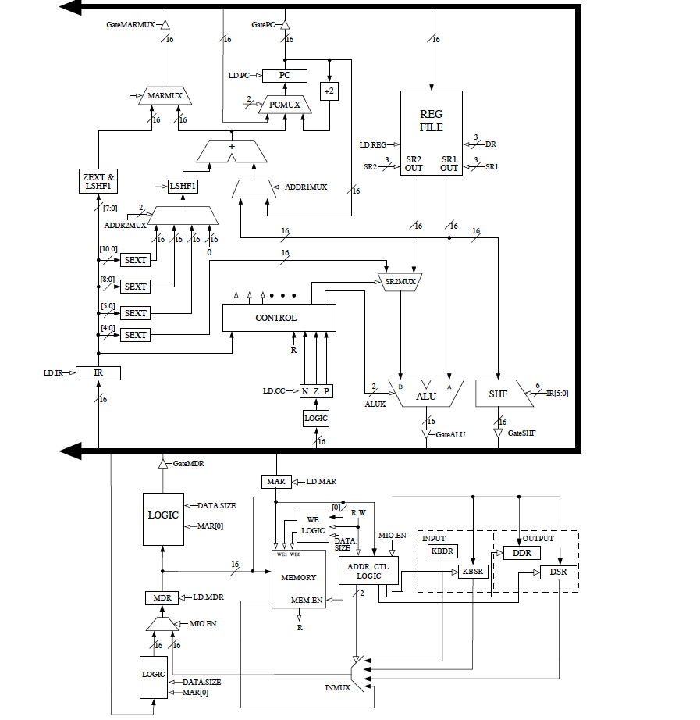
Tying it all together for ADD

Slide 12
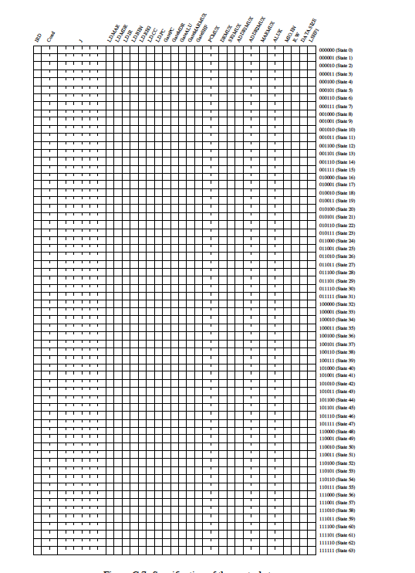
Control Store: Regulates Processor

Slide 13
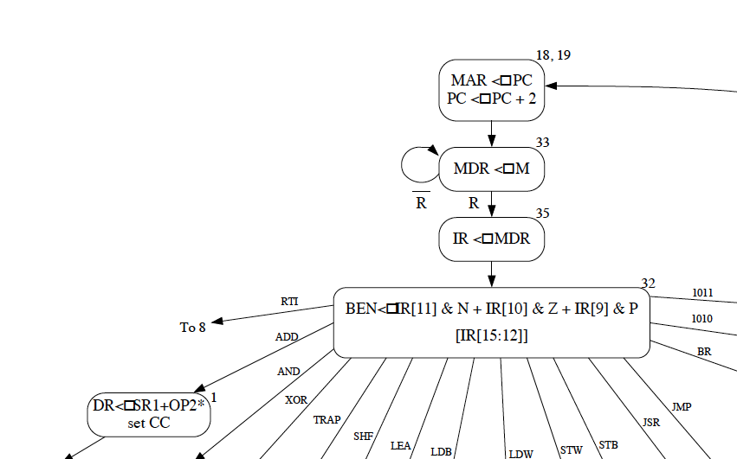
The State Diagram

Slide 14
State 18,19: MAR⬅ PC, PC ⬅ PC+2
Which signals must be asserted?
What is the next state?

Slide 15
The State Diagram

Slide 16
State 33: MDR gets M
Which signals must be asserted?
What is the next state? How?

Slide 17
The State Diagram

Slide 18
State 35: IR gets MDR
Which signals must be asserted?
What is the next state?

Slide 19
The State Diagram

Slide 20
State 32: DECODE, next state?

Slide 21
The State Diagram

Slide 22
State 1: DR=ADD (SR1,Op2)
Which signals must be asserted?
What is the next state?

Slide 23
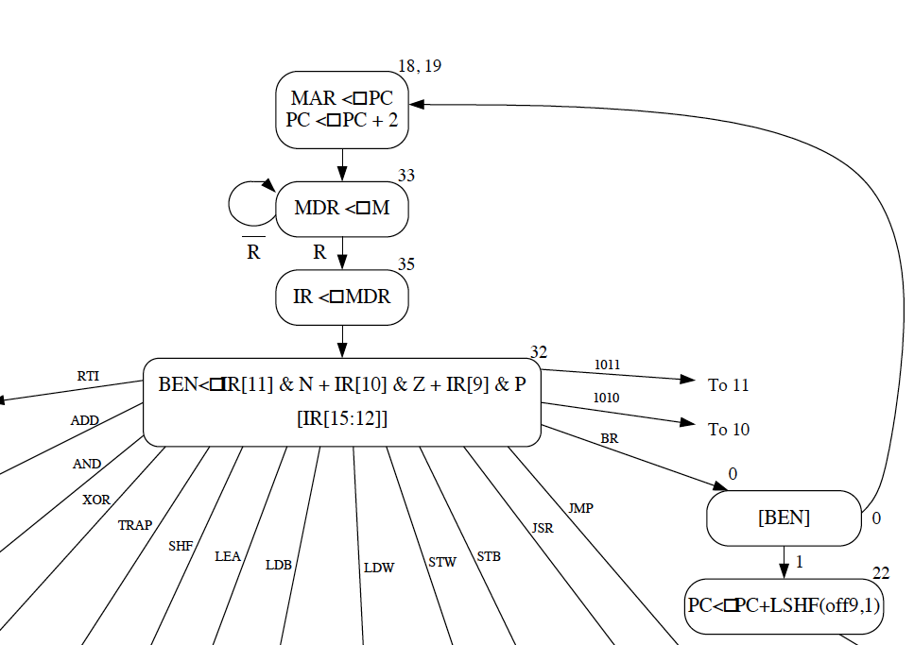
How about a BR instruction?
Fetch states are
the same

Slide 24
State 32: BEN and next state?

Slide 25
State 0: What is the next state?

Slide 26
State 22: PC ⬅ PC + LSHF(off9,1)

Slide 27
State 22: PC ⬅ PC + LSHF(off9,1)
Which signals must be asserted?
What is the next state?

Slide 28
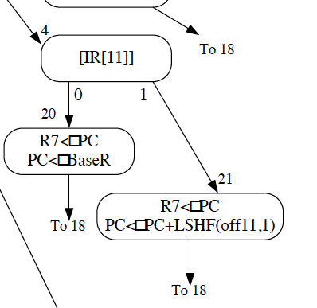
How about JSRR ?
Fetch & Decode
states are same
What is the next state?

Slide 29
Consider IR[11]=1
Fetch & Decode
states are same

Slide 30
State 21: R7⬅ PC, PC ⬅ PC + LSHF(off11,1)
111
Which signals must be asserted?
What is the next state?

Slide 31
Consider IR[11]=0
Fetch & Decode
states are same
What is the next state?

Slide 32
State 21: R7⬅ PC, PC ⬅ BaseR
111
Which signals must be asserted?
Why not do PC⬅BaseR using Bus?

Slide 33
MICROPROGRAMMING the LC-3b

Slide 34
MICROSEQUENCER

