Slide 1
ECE3056
Computer Architecture
Lecture: Microarchitecture
Moinuddin Qureshi, Georgia Tech
Slides adapted from Prof. Mutlu (CMU)

Slide 2
How Does a Machine Process Instructions?
What does processing an instruction mean?
Remember the von Neumann model
AS = Architectural (programmer visible) state before an instruction is processed
Process instruction
AS’ = Architectural (programmer visible) state after an instruction is processed
Processing an instruction: Transforming A to A’ according to the ISA specification of the instruction

Slide 3
The “Process instruction” Step
ISA specifies abstractly what A’ should be, given an instruction and A
  It defines an abstract finite state machine where
    State = programmer-visible state
    Next-state logic = instruction execution specification
  From ISA point of view, there are no “intermediate states” between A and A’ during instruction execution
    One state transition per instruction
Microarchitecture implements how A is transformed to A’
  There are many choices in implementation
  We can have programmer-invisible state to optimize the speed of instruction execution: multiple state transitions per instruction
    Choice 1: AS → AS’ (transform A to A’ in a single clock cycle)
    Choice 2: AS → AS+MS1 → AS+MS2 → AS+MS3 → AS’ (take multiple clock cycles to transform AS to AS’)

Slide 4
A Very Basic Instruction Processing Engine
Each instruction takes a single clock cycle to execute
Only combinational logic is used to implement instruction execution
  No intermediate, programmer-invisible state updates
AS = Architectural (programmer visible) state
at the beginning of a clock cycle
Process instruction in one clock cycle
AS’ = Architectural (programmer visible) state
at the end of a clock cycle

Slide 5
A Very Basic Instruction Processing Engine
Single-cycle machine
What is the clock cycle time determined by?
What is the critical path of the combinational logic determined by?
AS_{Next}
AS
Sequential
Logic
(State)
Combinational
Logic

Slide 6
Remember: Programmer Visible (Architectural) State
M[0]
M[1]
M[2]
M[3]
Registers
- given special names in the ISA
(as opposed to addresses)
- general vs. special purpose
M[4]
M[N-1]
Memory
array of storage locations
indexed by an address
Program Counter
memory address
of the current instruction
Instructions (and programs) specify how to transform
the values of programmer visible state

Slide 7
Single-cycle vs. Multi-cycle Machines
Single-cycle machines
  Each instruction takes a single clock cycle
  All state updates made at the end of an instruction’s execution
  Big disadvantage: The slowest instruction determines cycle time → long clock cycle time
Multi-cycle machines
  Instruction processing broken into multiple cycles/stages
  State updates can be made during an instruction’s execution
  Architectural state updates made only at the end of an instruction’s execution
  Advantage over single-cycle: The slowest “stage” determines cycle time
  Both single-cycle and multi-cycle machines literally follow the von Neumann model at the microarchitecture level

Slide 8
Instruction Processing “Cycle”
Instructions are processed under the direction of a “control unit” step by step.
Instruction cycle: Sequence of steps to process an instruction
Fundamentally, there are six phases:
Fetch
Decode
Address Generation (AGEN)
Fetch Operands
Execute
Store Result
Not all instructions require all six stages

Slide 9
Instruction Processing “Cycle” vs. Machine Clock Cycle
Single-cycle machine:
  All six phases of the instruction processing cycle take a single machine clock cycle to complete
Multi-cycle machine:
  All six phases of the instruction processing cycle can take multiple machine clock cycles to complete
  In fact, each phase can take multiple clock cycles to complete

Slide 10
A Single-Cycle Microarchitecture
A Closer Look

Slide 11
Remember…
Single-cycle machine
AS_{Next}
AS
Sequential
Logic
(State)
Combinational
Logic

Slide 12
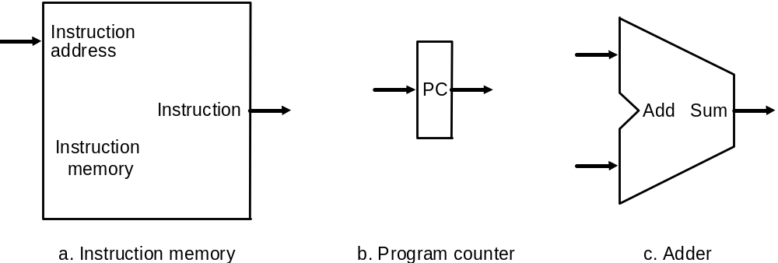
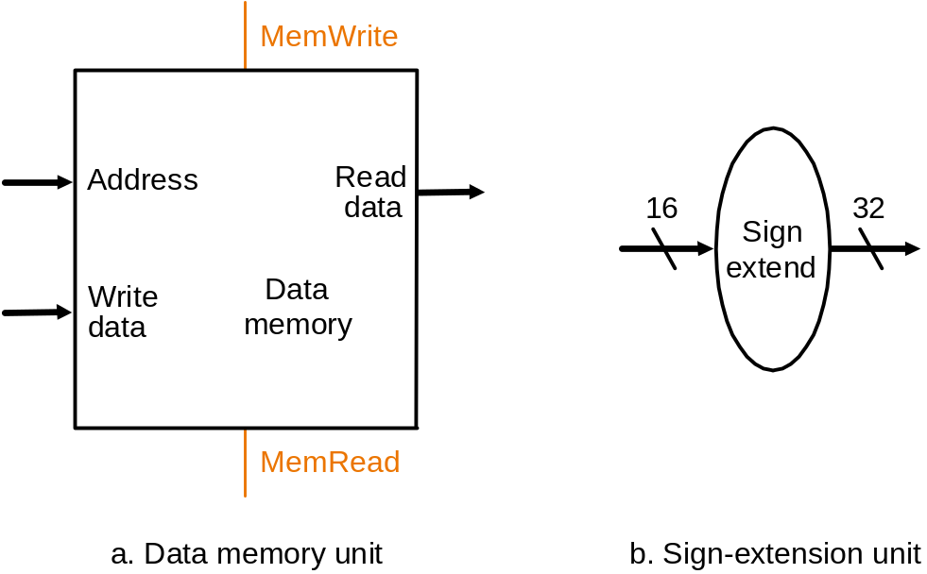
Let’s Start with the State Elements
Data and control inputs
Rd1.Regid
REGISTER
FILE
Rd1.Data
Rd2.Regid
Rd2.Data
WR
wr.Regid
Wr.Data
**Based on original figure from [P&H CO&D, COPYRIGHT 2004 Elsevier. ALL RIGHTS RESERVED.]

Slide 13
For Now, We Will Assume
“Magic” memory and register file
Combinational read
  output of the read data port is a combinational function of the register file contents and the corresponding read select port
Synchronous write
  the selected register is updated on the positive edge clock transition when write enable is asserted
    Cannot affect read output in between clock edges
Single-cycle, synchronous memory
  Contrast this with memory that tells when the data is ready
  i.e., Ready bit: indicating the read or write is done

Slide 14
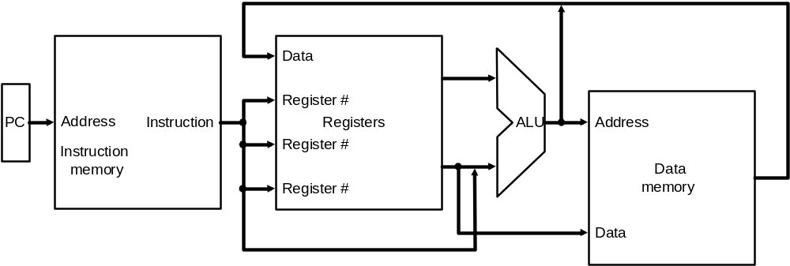
Instruction Processing
5 generic steps
  Instruction fetch (IF)
  Instruction decode and register operand fetch (ID/RF)
  Execute/Evaluate memory address (EX/AG)
  Memory operand fetch (MEM)
  Store/writeback result (WB)
WB
IF
ID/RF
EX/AG
MEM
**Based on original figure from [P&H CO&D, COPYRIGHT 2004 Elsevier. ALL RIGHTS RESERVED.]

Slide 15
Single-Cycle Datapath for
Arithmetic and Logical Instructions

Slide 16
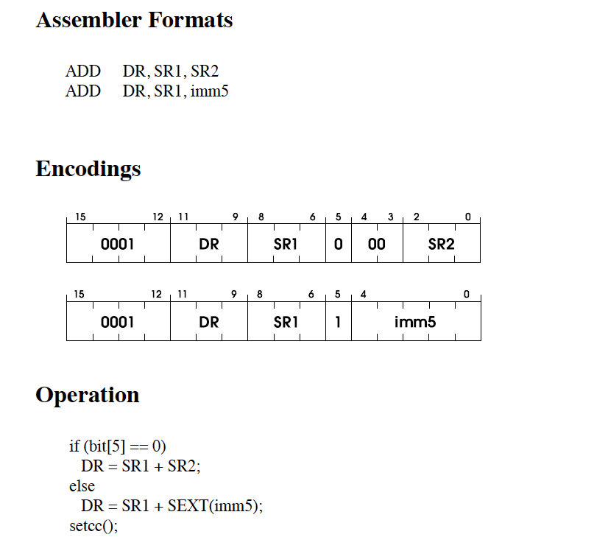
Lets Implement ADD Instruction

Slide 17
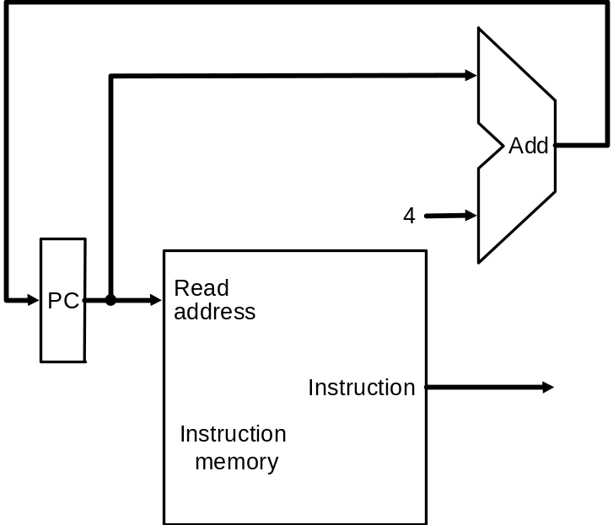
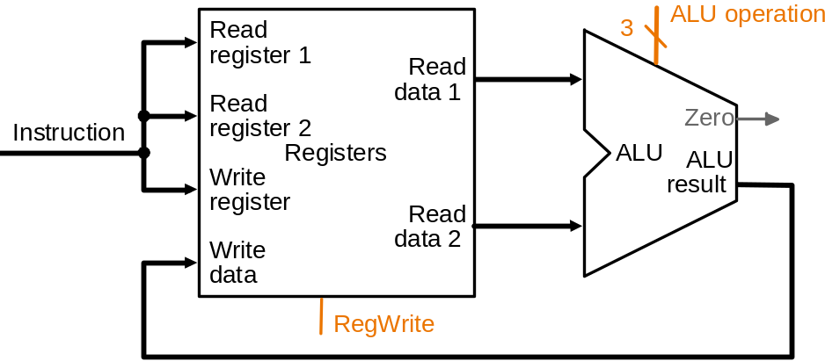
ADD Datapath
2
8:6
2:0
ADD?
imm5
11:9
SIGNX(4:0)
bit5
1
**Based on original figure from [P&H CO&D, COPYRIGHT 2004 Elsevier. ALL RIGHTS RESERVED.]

Slide 18
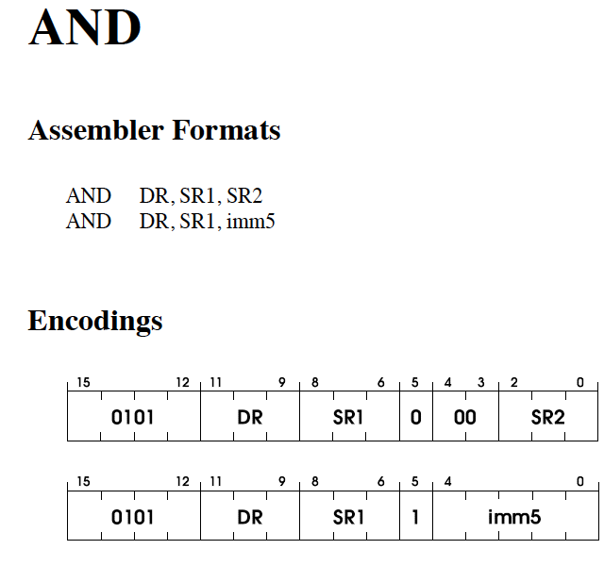
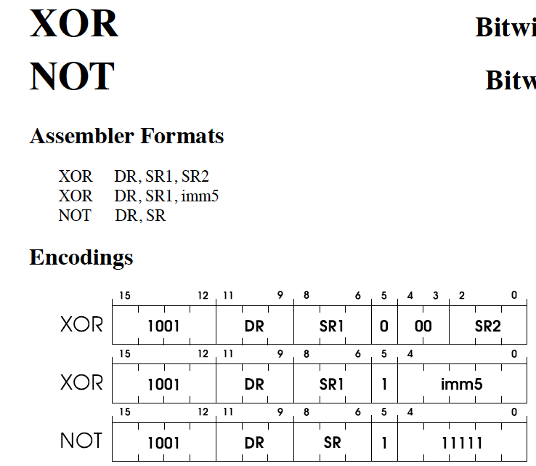
How about XOR and AND?

Slide 19
How about XOR and AND?
2
8:6
2:0
???
imm5
11:9
SIGNX(4:0)
bit5
1
**Based on original figure from [P&H CO&D, COPYRIGHT 2004 Elsevier. ALL RIGHTS RESERVED.]

Slide 20
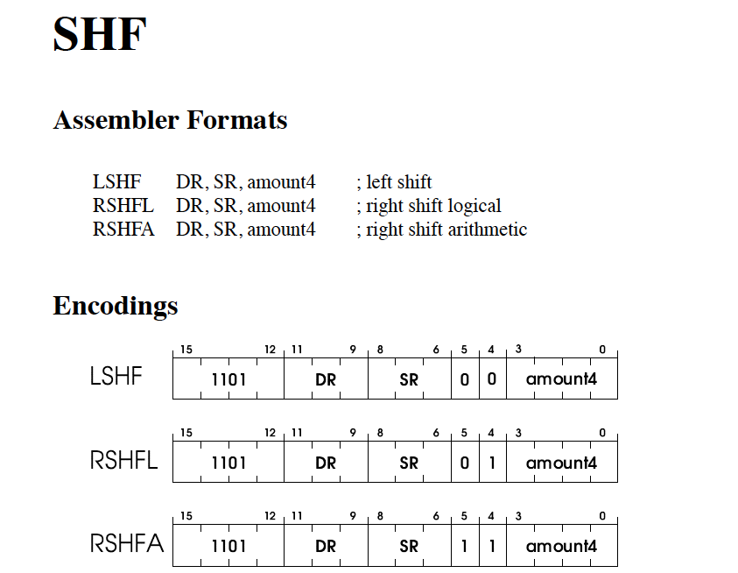
How about Shift ?
2
8:6
2:0
???
imm5
11:9
SIGNX(4:0)
bit5
1

Slide 21
SHIFT
amnt4
L/R
A/L
2
SHIFTER
8:6
2:0
SHF
11:9
1

Slide 22
How about LD/ST?
2
AGEN+
Memory
8:6
2:0
????
11:9
1 for ST (0 for LD)

Slide 23
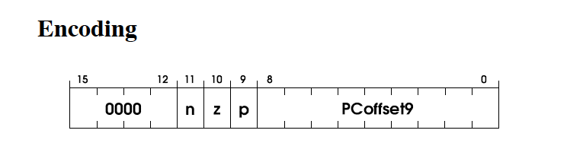
How about BR?
???
8:6
2:0
11:9
0

Slide 24
Evaluating the Single-Cycle Microarchitecture

Slide 25
A Single-Cycle Microarchitecture
Is this a good idea/design?
When is this a good design?
When is this a bad design?
How can we design a better microarchitecture?

Slide 26
A Single-Cycle Microarchitecture: Analysis
Every instruction takes 1 cycle to execute
  CPI (Cycles per instruction) is strictly 1
How long each instruction takes is determined by how long the slowest instruction takes to execute
  Even though many instructions do not need that long to execute
Clock cycle time of the microarchitecture is determined by how long it takes to complete the slowest instruction
  Critical path of the design is determined by the processing time of the slowest instruction

Slide 27
What is the Slowest Instruction to Process?
  Let’s go back to the basics
  All six phases of the instruction processing cycle take a single machine clock cycle to complete
  Fetch
  Decode
  Evaluate Address
  Fetch Operands
  Execute
  Store Result
Do each of the above phases take the same time (latency) for all instructions?
  1. Instruction fetch (IF)
  2. Instruction decode and
  register operand fetch (ID/RF)
  3. Execute/Evaluate memory address (EX/AG)
  4. Memory operand fetch (MEM)
  5. Store/writeback result (WB)

Slide 28
What is the Slowest Instruction to Process?
Memory is not magic
What if memory sometimes takes 40ns to access?
Does it make sense to have a simple register to register add or jump to take {40ns+all else to do a memory operation}?
And, what if you need to access memory more than once to process an instruction?
  Which instructions need this?
  VAX INDEX instruction
  Do you provide multiple ports to memory?

Slide 29
Single Cycle uArch: Complexity
Contrived
  All instructions run as slow as the slowest instruction
Inefficient
  All instructions run as slow as the slowest instruction
  Must provide worst-case combinational resources in parallel as required by any instruction
  Need to replicate a resource if it is needed more than once by an instruction during different parts of the instruction processing cycle
Not necessarily the simplest way to implement an ISA
  Single-cycle implementation of REP MOVS, INDEX, POLY?
Not easy to optimize/improve performance
  Optimizing the common case does not work (e.g. common instructions)
  Need to optimize the worst case all the time

Slide 30
Microarchitecture Design Principles
Critical path design
  Find the maximum combinational logic delay and decrease it
Bread and butter (common case) design
  Spend time and resources on where it matters
    i.e., improve what the machine is really designed to do
  Common case vs. uncommon case
Balanced design
  Balance instruction/data flow through hardware components
  Balance the hardware needed to accomplish the work
How does a single-cycle microarchitecture fare in light of these principles?

Slide 31
Announcements
Lab 2 posted
Read the Microarchitecture.pdf (T-square) for background
Final exam will be on Monday, Dec 8th (2:50pm-5:40pm)
Visitor talk for 15 minutes
  Brian Lasseter, Georgia Tech grad (2001)
  IBM Engineer, physical design and static timing analysis
  Talk about modern microprocessor design (Power N, mainframe)
  Hardware: Power 7+ chips, Wii chips, and 300mm wafers

Slide 32
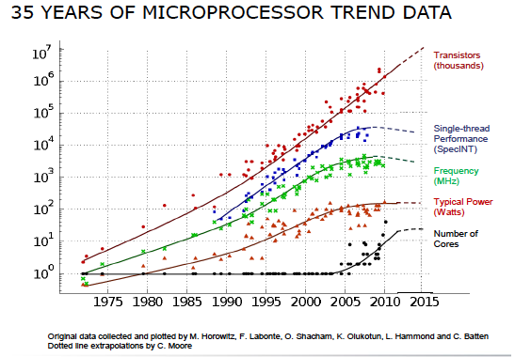
The Route to a Billion Transistor Chip
*Power 7+ has 2.1 billion transistors

Slide 33


Slide 34
Multi-Cycle Microarchitectures

Slide 35
Multi-Cycle Microarchitectures
Goal: Let each instruction take (close to) only as much time it really needs
Idea
  Determine clock cycle time independently of instruction processing time
  Each instruction takes as many clock cycles as it needs to take
    Multiple state transitions per instruction
    The states followed by each instruction is different

Slide 36
Remember: The “Process instruction” Step
ISA specifies abstractly what A’ should be, given an instruction and A
  It defines an abstract finite state machine where
    State = programmer-visible state
    Next-state logic = instruction execution specification
  From ISA point of view, there are no “intermediate states” between A and A’ during instruction execution
    One state transition per instruction
Microarchitecture implements how A is transformed to A’
  There are many choices in implementation
  We can have programmer-invisible state to optimize the speed of instruction execution: multiple state transitions per instruction
    Choice 1: AS → AS’ (transform A to A’ in a single clock cycle)
    Choice 2: AS → AS+MS1 → AS+MS2 → AS+MS3 → AS’ (take multiple clock cycles to transform AS to AS’)

Slide 37
Multi-Cycle Microarchitecture
AS = Architectural (programmer visible) state
at the beginning of an instruction
Step 1: Process part of instruction in one clock cycle
Step 2: Process part of instruction in the next clock cycle
…
AS’ = Architectural (programmer visible) state
at the end of a clock cycle

Slide 38
Benefits of Multi-Cycle Design
Critical path design
  Can keep reducing the critical path independently of worst-case processing time of any instruction
Bread and butter (common case) design
  Can optimize the number of states it takes to execute “important” instructions that make up much of the execution time
Balanced design
  No need to provide more capability or resources than really needed
    An instruction that needs resource X multiple times does not require multiple X’s to be implemented
    Leads to more efficient hardware: Can reuse hardware components needed multiple times for an instruction

Slide 39
The Instruction Processing Cycle
  Fetch
  Decode
  Evaluate Address
  Fetch Operands
  Execute
  Store Result

Slide 40
A Basic Multi-Cycle Microarchitecture
Instruction processing cycle divided into “states”
    A stage in the instruction processing cycle can take multiple states
  A multi-cycle microarchitecture sequences from state to state to process an instruction
    The behavior of the machine in a state is completely determined by control signals in that state
  The behavior of the entire processor is specified fully by a finite state machine
  In a state (clock cycle), control signals control
    How the datapath should process the data
    How to generate the control signals for the next clock cycle

Slide 41
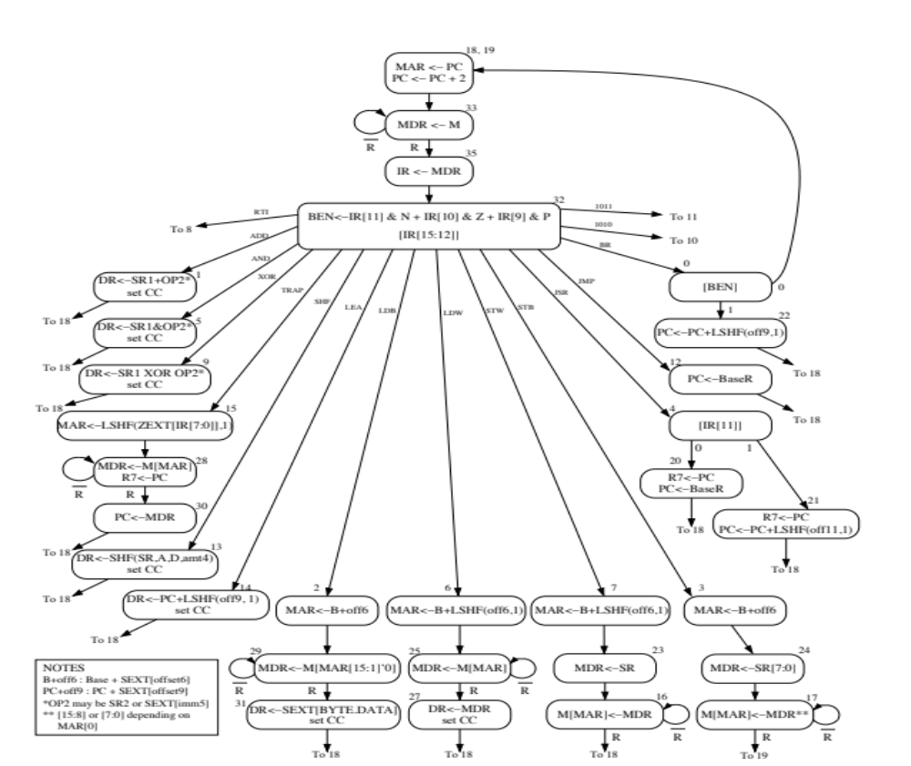

Slide 42
Microprogrammed Control Terminology
Control signals associated with the current state
  Microinstruction
Act of transitioning from one state to another
  Determining the next state and the microinstruction for the next state
  Microsequencing
Control store stores control signals for every possible state
  Store for microinstructions for the entire FSM
Microsequencer determines which set of control signals will be used in the next clock cycle (i.e. next state)

Slide 43
What Happens In A Clock Cycle?
The control signals (microinstruction) for the current state control
  Processing in the data path
  Generation of control signals (microinstruction) for the next cycle
Datapath and microsequencer operate concurrently

Slide 44
What Determines Next-State Control Signals?
What is happening in the current clock cycle
  See the 9 control signals coming from “Control” block
    What are these for?
The instruction that is being executed
  IR[15:11] coming from the Data Path
Whether the condition of a branch is met, if the instruction being processed is a branch
  BEN bit coming from the datapath
Whether the memory operation is completing in the current cycle, if one is in progress
  R bit coming from memory

Slide 45
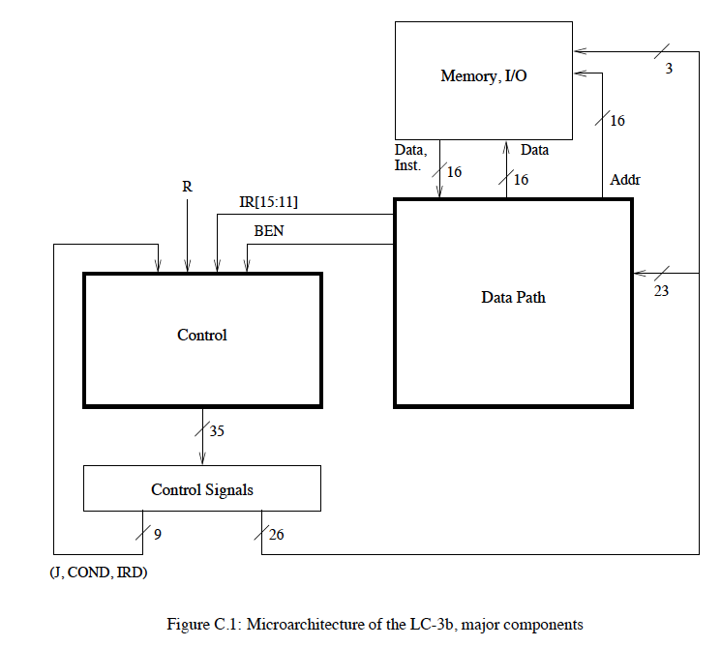
A Simple LC-3b Control and Datapath

Slide 46
The State Machine for Multi-Cycle Processing
The behavior of the LC-3b uarch is completely determined by
  the 35 control signals and
  additional 7 bits that go into the control logic from the datapath
35 control signals completely describe the state of the control structure
We can completely describe the behavior of the LC-3b as a state machine, i.e. a directed graph of
  Nodes (one corresponding to each state)
  Arcs (showing flow from each state to the next state(s))

Slide 47
An LC-3b State Machine
Check out the LC-3b Microarchitecture handout
Each state must be uniquely specified
  Done by means of state variables
31 distinct states in this LC-3b state machine
  Encoded with 6 state variables
Examples
  State 18,19 correspond to the beginning of the instruction processing cycle
  Fetch phase: state 18, 19 → state 33 → state 35
  Decode phase: state 32

Slide 49
LC-3b State Machine: Some Questions
How many cycles does the fastest instruction take?
How many cycles does the slowest instruction take?
Why does the BR take as long as it takes in the FSM?
What determines the clock cycle?

Slide 50
LC-3b Datapath
Single-bus datapath design
  At any point only one value can be “gated” on the bus (i.e., can be driving the bus)
  Advantage: Low hardware cost: one bus
  Disadvantage: Reduced concurrency – if instruction needs the bus twice for two different things, these need to happen in different states
Control signals (26 of them) determine what happens in the datapath in one clock cycle

Slide 51
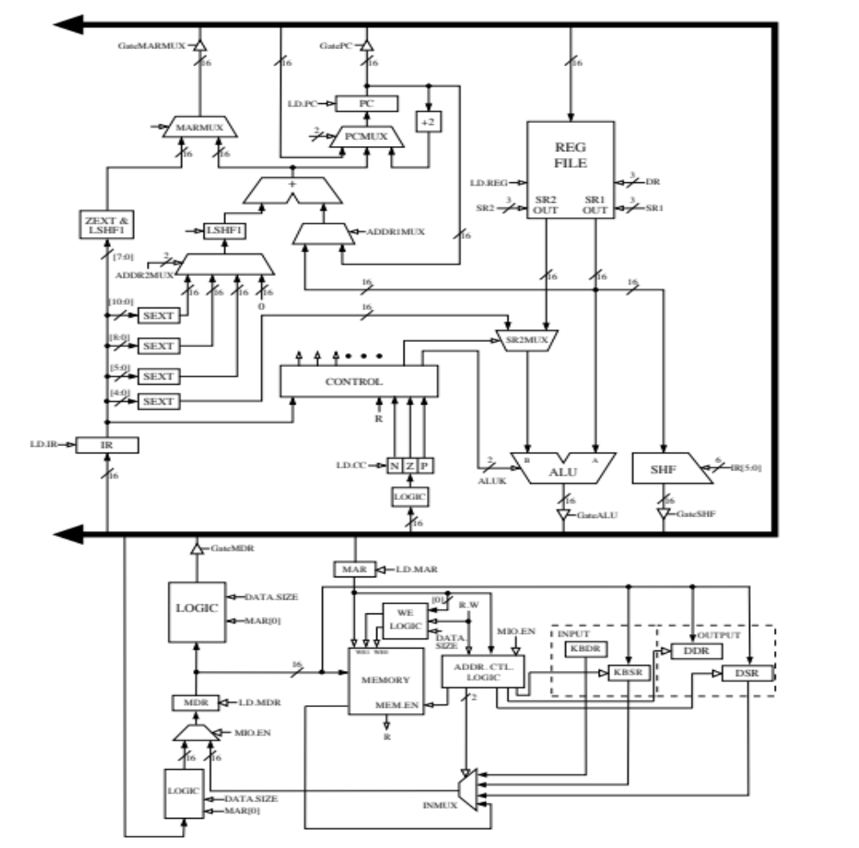

Slide 52
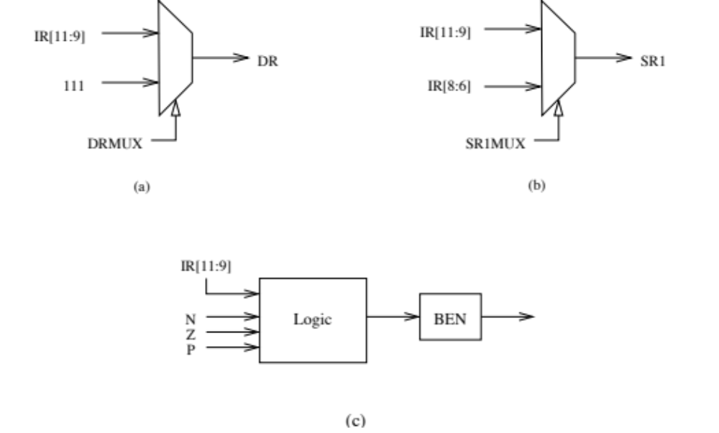

Slide 53
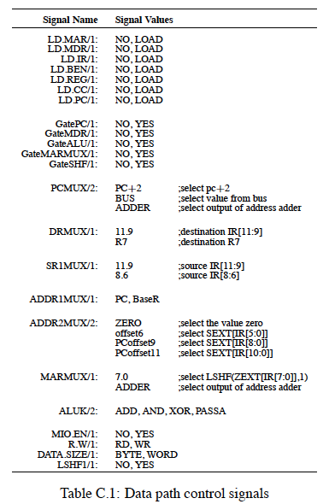

Slide 54
LC-3b Datapath: Some Questions
How does instruction fetch happen in this datapath according to the state machine?
What is the difference between gating and loading?

Slide 55
LC-3b Microprogrammed Control Structure
Three components:
  Microinstruction, control store, microsequencer
Microinstruction: control signals that control the datapath (26 of them) and determine the next state (9 of them)
Each microinstruction is stored in a unique location in the control store (a special memory structure)
Unique location: address of the state corresponding to the microinstruction
  Remember each state corresponds to one microinstruction
Microsequencer determines the address of the next microinstruction (i.e., next state)

Slide 56
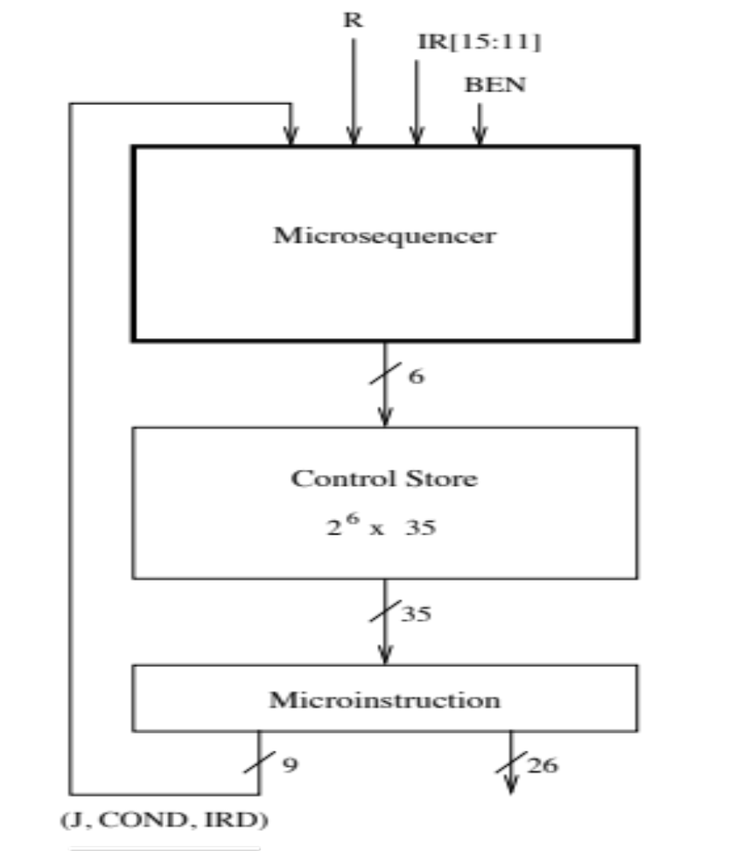

Slide 57
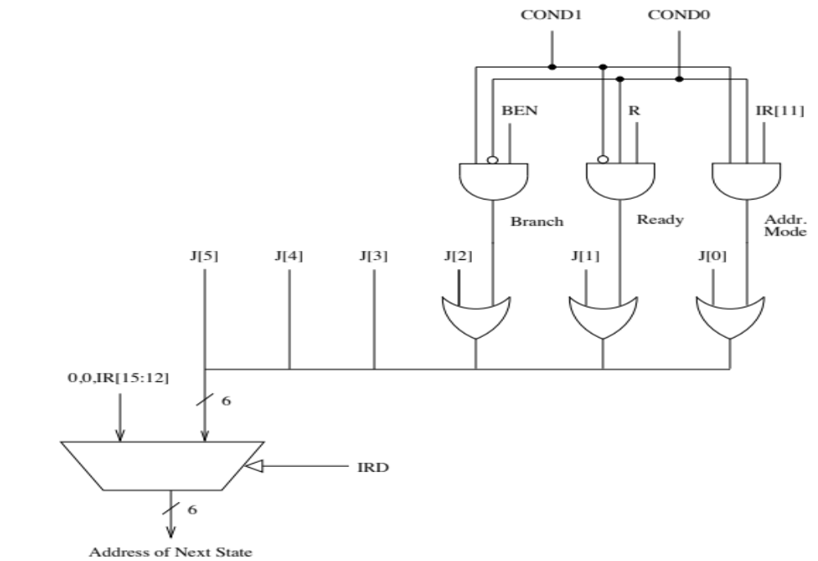

Slide 58
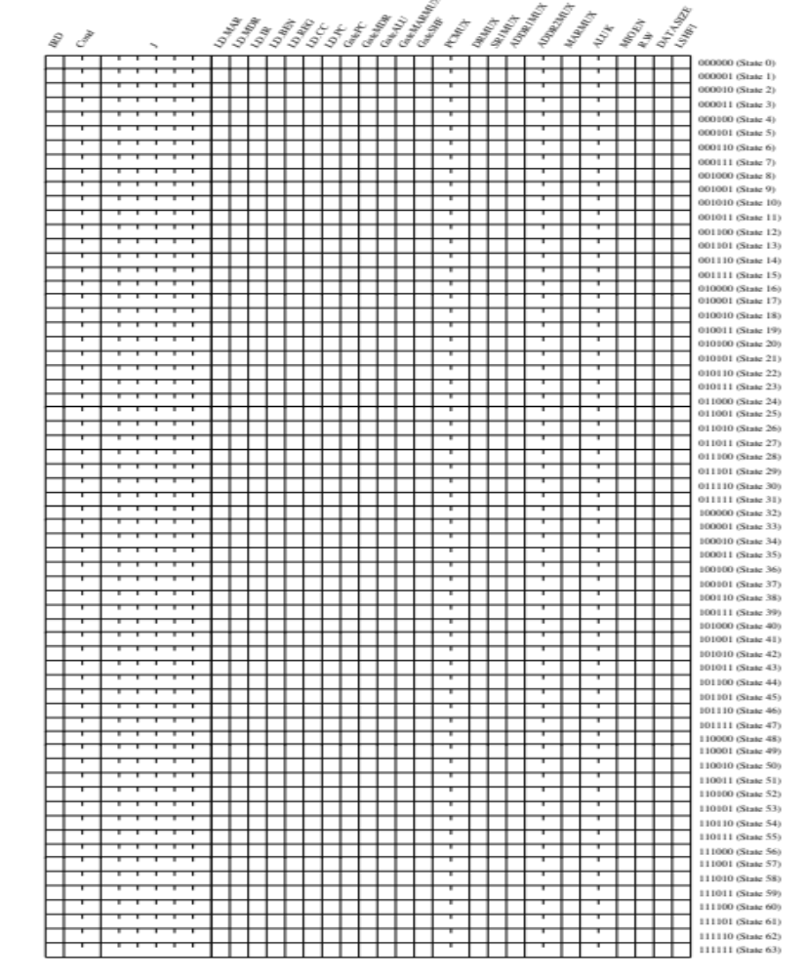

Slide 59
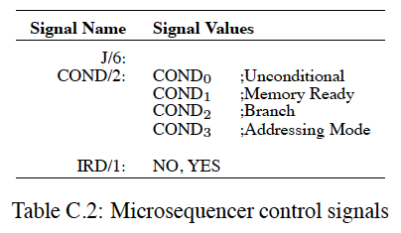
LC-3b Microsequencer
The purpose of the microsequencer is to determine the address of the next microinstruction (i.e., next state)
Next address depends on 9 control signals

Slide 61
The Microsequencer: Some Questions
When is the IRD signal asserted?
What happens if an illegal instruction is decoded?
What are condition (COND) bits for?
How is variable latency memory handled?
How do you do the state encoding?
  Minimize number of state variables
  Start with the 16-way branch
  Then determine constraint tables and states dependent on COND

Slide 62
Variable-Latency Memory
The ready signal (R) enables memory read/write to execute correctly
  Example: transition from state 18 to state 33 is controlled by the R bit asserted by memory when memory data is available
Could we have done this in a single-cycle microarchitecture?

Slide 63
The Microsequencer: Advanced Questions
What happens if the machine is interrupted?
What if an instruction generates an exception?
How can you implement a complex instruction using this control structure?
  Think REP MOVS

Slide 64
The Power of Abstraction
The concept of a control store of microinstructions enables the hardware designer with a new abstraction: microprogramming
The designer can translate any desired operation to a sequence microinstructions
All the designer needs to provide is
  The sequence of microinstructions needed to implement the desired operation
  The ability for the control logic to correctly sequence through the microinstructions
  Any additional datapath control signals needed (no need if the operation can be “translated” into existing control signals)

Slide 65
Let’s Do Some Microprogramming
Extra Credit (for Lab2):
Implement MUL instruction in the LC-3b microarchitecture
Use opcode “1010”. Format: MUL RD, RS1, RS2 (like ADD)
Regs RD specifies the address of destination register. Regs RS1 and RS2 provides the 8-bit operands.
MUL sets condition codes
What changes, if any, do you make to the
  state machine?
  datapath?
  control store?
  microsequencer?
Show all changes and microinstructions

Slide 66
Advantages of Microprogrammed Control
Allows a very simple datapath to do powerful computation by controlling the datapath (using a sequencer)
  High-level ISA translated into microcode (sequence of microinstructions)
  Microcode enables a minimal datapath to emulate an ISA
  Microinstructions can be thought of a user-invisible ISA
Enables easy extensibility of the ISA
  Can support a new instruction by changing the ucode
  Can support complex instructions as a sequence of simple microinstructions
If I can sequence an arbitrary instruction then I can sequence an arbitrary “program” as a microprogram sequence
  will need some new state (e.g. loop counters) in the microcode for sequencing more elaborate programs

Slide 67
Update of Machine Behavior
The ability to update/patch microcode in the field (after a processor is shipped) enables
  Ability to add new instructions without changing the processor!
  Ability to “fix” buggy hardware implementations
Examples
  IBM 370 Model 145: microcode stored in main memory, can be updated after a reboot
  B1700 microcode can be updated while the processor is running
    User-microprogrammable machine!

Slide 68
A Multi-Cycle Microarchitecture
A Closer Look

Slide 69
Performance Analysis
Execution time of an instruction
  {CPI} x {clock cycle time}
Execution time of a program
  Sum over all instructions [{CPI} x {clock cycle time}]
  {# of instructions} x {Average CPI} x {clock cycle time}
Single cycle microarchitecture performance
  CPI = 1
  Clock cycle time = long
Multi-cycle microarchitecture performance
  CPI = different for each instruction
    Average CPI → hopefully small
  Clock cycle time = short
Now, we have
two degrees of freedom
to optimize independently

Slide 70
CPI vs. Frequency
CPI vs. Clock cycle time
At odds with each other
  Reducing one increases the other for a single instruction
  Why?
Average CPI can be amortized/reduced via concurrent processing of multiple instructions (covered later)
  The same cycle is devoted to multiple instructions
  Example: Pipelining, superscalar execution

Slide 71
Computer Performance Equation
Figure of Merit: Execution Time
Execution Time determined by three figures:
  Number of Instruction in Program (I)
  Cycles per Instruction (CPI) [property of microarchitecture]
  Instructions Per Second (F) [Frequency]
Execution Time (T) = Seconds per Program
= (Inst/Program) * (Cycles/Instruction) * (Seconds/Cycle)
= I * CPI * (1/f)
[Which of the three depends on ISA, which on microarch?]

Slide 72
Aside: Alignment Correction in Memory
Remember unaligned accesses
LC-3b has byte load and byte store instructions that move data not aligned at the word-address boundary
  Convenience to the programmer/compiler
How does the hardware ensure this works correctly?
  Take a look at state 29 for LDB
  State 17 for STB
  Additional logic to handle unaligned accesses

