Slide 1
Working of DRAM system: A Logical Overview
Moinuddin K Qureshi

Slide 2
In the Beginning, there was an Array …
Row
RowID
Row decoder
One Line
Line In Row
Column mux
64-byte BUS
(1 cycle to
transfer a line)
Cache Line (64 bytes)

Slide 3
Now, Let’s Make the Bus Realistic
RowID
Row decoder
Rows
One Line
Line In Row
Column mux
8-byte BUS
(8 transfers of 8B for 64-byte line)
4-cycles with DDR
Cache Line (8Bx8=64 bytes)

Slide 4
Now, Let’s Bank our Memory
Row decoder
Bank0
Row decoder
Bank1
Row decoder
Bank7
Column mux
Column mux
Column mux
Cache Line (8Bx8=64 bytes)

Slide 5
What about the chips then?
Bank0
Bank1
Bank7
Bank0
Bank1
Bank7
Row decoder
Bank0
Row decoder
Bank1
Row decoder
Bank7
Row decoder
Bank7
Row decoder
Bank0
Row decoder
Bank1
Row decoder
If you have two chips, each chip provides half the data per transfer
If eight chips, each chip would provide 1/8th the data per transfer
This is physical implementation (logical operation is similar to one chip)
Column mux
Column mux
Column mux
Column mux
Column mux
Column mux
Column mux
Cache Line (8Bx8=64 bytes)

Slide 6
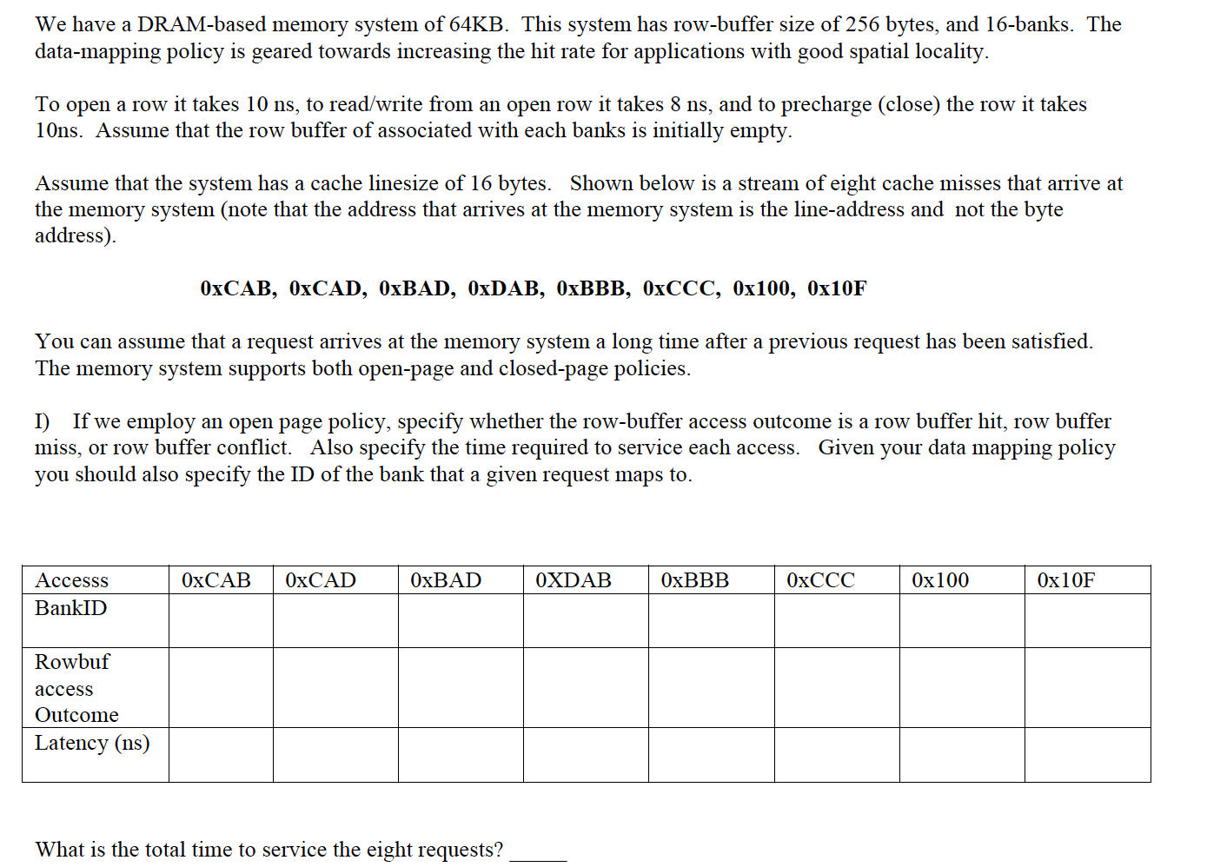
Question

Slide 7
Breaking Down the Address
Byte Addr (16 bits, why?)
Line Addr (12 bits, why?)
ByteInLine(4 bits)
RowBufID(8 bits, why?)
LineinRow(4 bits)
There are 256 Rowbufs
x00 to xFF
Row x00, x10, x20, … xF0 in Bank 0
Row x01, x11, x21, … xF1 in Bank 1
Row x0F, x1F, x2F, … xFF in Bank F
WhichBank(4 bits, why?)

Slide 8
Laying it out
BANK 0
BANK A
BANK B
BANK C
BANK F
x00
x0A
x0B
x0C
x0F
Row
x10
x1A
x1B
x1C
x1F
x20
x2A
x2B
x2C
x2F
x30
x3A
x3B
x3C
x3F
xF0
xFA
xFB
xFC
xFF
INV
INV
xCA
INV
INV
xBA
INV
What is the RowID for Lineaddr xCAB? What about the BankID?
What is the RowID for Lineaddr xCAD? What about the BankID?
What is the RowID for Lineaddr xBAD? What about the BankID?

