Slide 1
ECE3056A Architecture, Concurrency, Energy Lecture: GPU Architectures
Slides derived from Prof. Onur Mutlu (CMU)

Slide 2
Course Grade Thus Far (Out of 80pts)
Max: 93.1 Mean: 71.3 Median: 74.5
Range | Students | Grade
80+ | 25 | A+
72-80 | 11 | A
64-72 | 10 | B
56-64 | 7 | C
48-56 | 6 | ??
<48 | 4 | F

Slide 3
Slicing and Dicing the Scores

Slide 4
VECTOR Processors

Slide 5
Vector Processors
A vector is a one-dimensional array of numbers
Many scientific/commercial programs use vectors
for (i = 0; i<=49; i++)
C[i] = (A[i] + B[i]) / 2
A vector processor is one whose instructions operate on vectors rather than scalar (single data) values
Basic requirements
Need to load/store vectors → vector registers (contain vectors)
Need to operate on vectors of different lengths → vector length register (VLEN)
Elements of a vector might be stored apart from each other in memory → vector stride register (VSTR)
Stride: distance between two elements of a vector

Slide 6
Vector Processors (II)
A vector instruction performs an operation on each element in consecutive cycles
Vector functional units are pipelined
Each pipeline stage operates on a different data element
Vector instructions allow deeper pipelines
No intra-vector dependencies → no hardware interlocking within a vector
No control flow within a vector
Known stride allows prefetching of vectors into cache/memory

Slide 7
Vector Processor Advantages
+ No dependencies within a vector
Pipelining, parallelization work well
Can have very deep pipelines, no dependencies!
+ Each instruction generates a lot of work
Reduces instruction fetch bandwidth
+ Highly regular memory access pattern
Interleaving multiple banks for higher memory bandwidth
Prefetching
+ No need to explicitly code loops
Fewer branches in the instruction sequence

Slide 8
Vector Registers
Each vector data register holds N M-bit values
Vector control registers: VLEN, VSTR, VMASK
Vector Mask Register (VMASK)
Indicates which elements of vector to operate on
Set by vector test instructions
e.g., VMASK[i] = (V_{k}[i] == 0)
Maximum VLEN can be N
Maximum number of elements stored in a vector register
M-bit wide
M-bit wide
V0,0
V1,0
V0,1
V1,1
V0,N-1
V1,N-1

Slide 9
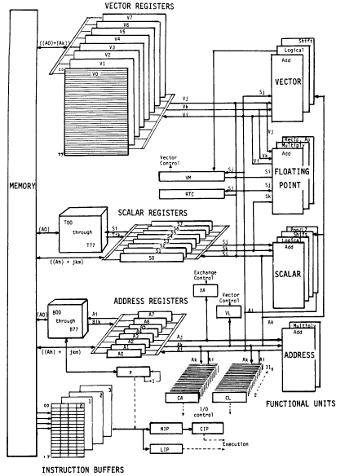
Vector Machine Organization (CRAY-1)
CRAY-1
Russell, “The CRAY-1 computer system,” CACM 1978.
Scalar and vector modes
8 64-element vector registers
64 bits per element
16 memory banks
8 64-bit scalar registers
8 24-bit address registers

Slide 10
Graphics Processing Units SIMD not Exposed to Programmer (SIMT)

Slide 11
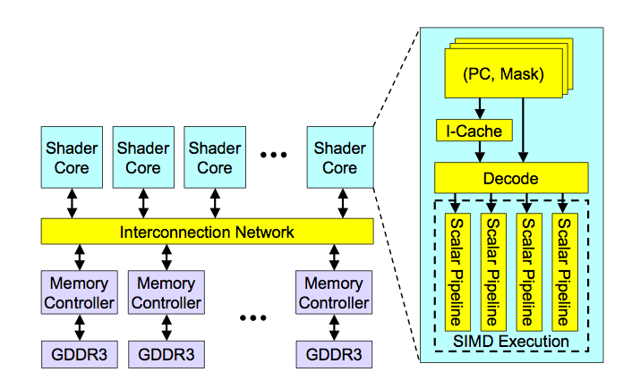
High-Level View of a GPU

Slide 12
Concept of “Thread Warps” and SIMT
Warp: A set of threads that execute the same instruction (on different data elements) → SIMT (Nvidia-speak)
All threads run the same kernel
Warp: The threads that run lengthwise in a woven fabric …
Thread Warp 3
Thread Warp 8
Thread Warp
Common PC
Scalar
Scalar
Scalar
Scalar
Thread Warp 7
Thread
Thread
Thread
Thread
W
X
Y
Z
SIMD Pipeline
In SIMD, you need to specify the data array + an instruction (on which to operate the data on) + THE INSTRUCTION WIDTH. Eg: You might want to add 2 integer arrays of length 16, then a SIMD instruction would look like (cooked up instruction) add.16 arr1 arr2 However, SIMT doesn't bother about the instruction width. So, essentially, you could write the above example as: arr1[i] + arr2[i] and then launch as many threads as the length of the array, as you want. Note that, if the array size was, let us say, 32, then SIMD EXPECTS you to explicitly call two such 'add.16' instructions! Whereas, this is not the case with SIMT.

Slide 13
Loop Iterations as Threads
for (i=0; i < N; i++)
C[i] = A[i] + B[i];
Scalar Sequential Code
Vectorized Code
load
load
load
Iter. 1
load
load
load
Time
add
add
add
store
store
store
load
Iter. 1
Iter. 2
Iter. 2
load
Vector Instruction
add
store
Slide credit: Krste Asanovic

Slide 14
SIMT Memory Access
Same instruction in different threads uses thread id to index and access different data elements
Let’s assume N=16, blockDim=4 → 4 blocks
0
1
2
3
4
5
6
7
8
9
10
11
12
13
14
15
+
0
1
2
3
4
5
6
7
8
9
10
11
12
13
14
15
+
+
+
+
Slide credit: Hyesoon Kim

Slide 15
Sample GPU SIMT Code (Simplified)
CPU code
for (ii = 0; ii < 100; ++ii) {
C[ii] = A[ii] + B[ii];
}
CUDA code
// there are 100 threads
__global__ void KernelFunction(…) {
int tid = blockDim.x * blockIdx.x + threadIdx.x;
int varA = aa[tid];
int varB = bb[tid];
C[tid] = varA + varB;
}
Slide credit: Hyesoon Kim

Slide 16
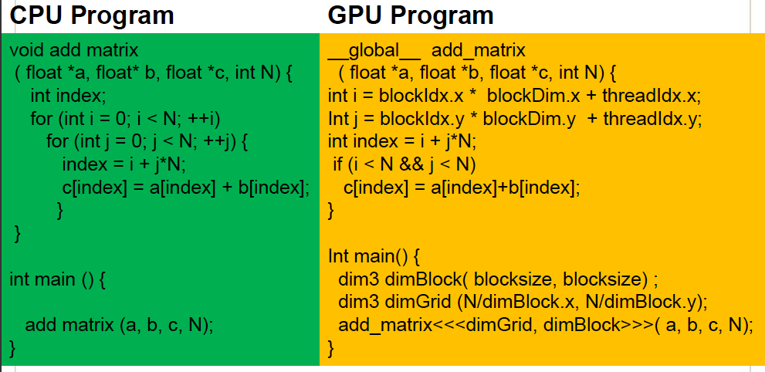
Sample GPU Program (Less Simplified)
Slide credit: Hyesoon Kim

Slide 17
Latency Hiding with “Thread Warps”
Warp: A set of threads that execute the same instruction (on different data elements)
Fine-grained multithreading
One instruction per thread in pipeline at a time (No branch prediction)
Interleave warp execution to hide latencies
Register values of all threads stay in register file
No OS context switching
Memory latency hiding
Graphics has millions of pixels
Thread Warp 3
Warps available
Thread Warp 8
for scheduling
Thread Warp 7
SIMD Pipeline
I-Fetch
Decode
R
R
R
F
F
F
Warps accessing
A
A
A
memory hierarchy
L
L
L
U
U
U
Miss?
D-Cache
Thread Warp 1
All Hit?
Data
Thread Warp 2
Writeback
Thread Warp 6
Slide credit: Tor Aamodt
Notes:
With a large number of shader threads multiplexed on the same execution re- sources, our architecture employs fine-grained multithreading where individual threads are interleaved by the fetch unit to proactively hide the potential latency of stalls before they occur. As illustrated by Figure, warps are issued fairly in a round-robin queue. When a thread is blocked by a memory request, shader core simply removes that thread’s warp from the pool of “ready” warps and thereby allows other threads to proceed while the memory system processes its request.
With a large number of threads (1024 per shader core) interleaved on the same pipeline, FGMT effectively hides the latency of most memory operations since the pipeline is occupied with instructions from other threads while memory operations complete. also hides the pipeline latency so that data bypassing logic can potentially be omitted to save area with minimal impact on performance. simplify the dependency check logic design by restricting each thread to have at most one instruction running in the pipeline at any time.

Slide 18
Warp-based SIMD vs. Traditional SIMD
Traditional SIMD contains a single thread
Lock step
Programming model is SIMD (no threads) → SW needs to know vector length
ISA contains vector/SIMD instructions
Warp-based SIMD consists of multiple scalar threads executing in a SIMD manner (i.e., same instruction executed by all threads)
Does not have to be lock step
Each thread can be treated individually (i.e., placed in a different warp) → programming model not SIMD
SW does not need to know vector length
Enables memory and branch latency tolerance
ISA is scalar → vector instructions formed dynamically
Essentially, it is SPMD programming model implemented on SIMD hardware

Slide 19
SPMD
Single procedure/program, multiple data
This is a programming model rather than computer organization
Each processing element executes the same procedure, except on different data elements
Procedures can synchronize at certain points in program, e.g. barriers
Essentially, multiple instruction streams execute the same program
Each program/procedure can 1) execute a different control-flow path, 2) work on different data, at run-time
Many scientific applications programmed this way and run on MIMD computers (multiprocessors)
Modern GPUs programmed in a similar way on a SIMD computer

Slide 20
Branch Divergence Problem in Warp-based SIMD
SPMD Execution on SIMD Hardware
NVIDIA calls this “Single Instruction, Multiple Thread” (“SIMT”) execution
A
Thread Warp
Common PC
B
Thread
1
Thread
2
Thread
3
Thread
4
C
D
F
E
G
Slide credit: Tor Aamodt

Slide 21
Control Flow Problem in GPUs/SIMD
GPU uses SIMD pipeline to save area on control logic.
Group scalar threads into warps
Branch divergence occurs when threads inside warps branch to different execution paths.
Branch
Branch
Path A
Path A
Path B
Path B
Slide credit: Tor Aamodt

Slide 22
Branch Divergence Handling (I)
Stack
A
A/1111
Reconv. PC
Next PC
Active Mask
TOS
TOS
TOS
TOS
-
-
-
-
-
-
-
G
A
E
E
B
E
E
1111
1111
1111
1111
1111
1111
1111
E
E
D
D
0110
TOS
E
D
0110
0110
B
B/1111
TOS
TOS
E
E
C
E
1001
1001
C/1001
D/0110
C
D
F
Thread Warp
Common PC
E
E/1111
Thread
1
Thread
2
Thread
3
Thread
4
G
G/1111
A
B
C
D
E
G
A
Time
Slide credit: Tor Aamodt

Slide 23
What About Memory Divergence?
Modern GPUs have caches
Ideally: Want all threads in the warp to hit (without conflicting with each other)
Problem: One thread in a warp can stall the entire warp if it misses in the cache.
Need techniques to
Tolerate memory divergence
Integrate solutions to branch and memory divergence

Slide 24
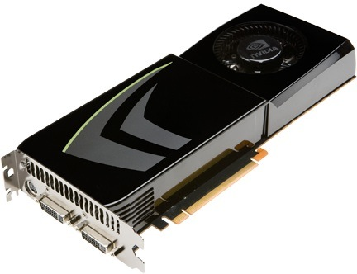
NVIDIA GeForce GTX 285
NVIDIA-speak:
240 stream processors
“SIMT execution”
Generic speak:
30 cores
8 SIMD functional units per core
Slide credit: Kayvon Fatahalian

Slide 25
NVIDIA GeForce GTX 285 “core”
64 KB of storage
for fragment contexts (registers)
…
= SIMD functional unit, control
shared across 8 units
= instruction stream decode
= multiply-add
= execution context storage
= multiply
Slide credit: Kayvon Fatahalian
Notes:
30 * 32 * 32 = 30 * 1024 = 30K fragments
64KB register file = 16 32-bit registers per thread = 64B (1/32 that of LRB)
16KB of shared scratch
80KB / core available to software

Slide 26
NVIDIA GeForce GTX 285 “core”
64 KB of storage
for thread contexts (registers)
…
Groups of 32 threads share instruction stream (each group is a Warp)
Up to 32 warps are simultaneously interleaved
Up to 1024 thread contexts can be stored
Slide credit: Kayvon Fatahalian
Notes:
To get maximal latency hiding:
Run 1/32 of the time
16 words per thread = 64B

Slide 27
NVIDIA GeForce GTX 285
Tex
Tex
…
…
…
…
…
…
Tex
Tex
…
…
…
…
…
…
Tex
Tex
…
…
…
…
…
…
Tex
Tex
…
…
…
…
…
…
Tex
Tex
…
…
…
…
…
…
There are 30 of these things on the GTX 285: 30,720 threads
Slide credit: Kayvon Fatahalian
Notes:
If you’re running a CUDA program, and your not launching 30K threads, you are certainly not getting full latency hiding, and you might not be using the GPU well

