Slide 1

ECE3056A Multithreading, SMT, and SIMD
Thanks to Prof. Kim, and Prof. Mutlu

Slide 2
Announcements
REGRADE for all lab assignments open (until Sunday night)
Half the points
Midterm 2 is graded, will be returned today
Final Exam, Two weeks from today
No class on Wednesday. Enjoy Thanksgiving!

Slide 3
Checkpoint Status
We have covered 79% of the course grade
(plus 10 points of extra credit, plus offset Midterm1/2)
5%: Lab1 10% each: Lab2, Lab3, Lab4 2% each: HW1,HW2
20% Midterm1 20%: Midterm2
If your score is 71+, you have A so far
If your score is between 63 and 71, you have B so far
If your score is between 55 and 63, you have C so far
We will post your score out of 79 by end of this week

Slide 4
CIOS
Important: Not just scores, but provide comments also
This is relatively a new course, only way it will improve is from feedback from you
Ideas from last offerings helped you: Test Harness, Submit-Only-Homework for midterm prep, Extra Credit
Ideas from the mid semester survey helped also:
Splitting the lab into parts and have incremental submissions
Otherwise Lab 4 would be 4A+4B+4C
Let us know what is working, and what needs improvement

Slide 5
Incentive for CIOS
By 3 pm next Wednesday (12/3), if we reach
75% participation: Donut party in last class
90% participation: “Do-No-Harm” Final Exam
DNH is like insurance policy ➔ guarantees that your grade won’t go down from current grade because of a low score Final Exam
So, you get BestGrade(Now, ConsideringFinalExam)
If you already have an A, then Final Exam becomes optional
If you have a B, then you will either get an A or B
Note: DNH activates only if we have 90% participation by the deadline
So, do the CIOS yourself, and encourage others to do it too

Slide 6
Multithreaded Processors
Single thread in superscalar execution: dependences cause most of stalls
Idea: when one thread stalled, other can go
Different granularities of multithreading
Coarse MT: can change thread every few cycles
Fine MT: can change thread every cycle
Simultaneous Multithreading (SMT)
Instrs from different threads even in the same cycle
AKA Hyperthreading

Slide 7
MT Architecture Performance
Why multi-threading can improve performance?
Processor is not utilized
Th 1
C
M
C
M
C
M
C
M
Th 2
C
M
C
M
C
M
C
M
Th 3
C
M
C
M
C
M
C
M
Th 4
C
M
C
M
C
M
C
M
Better utilization !
Th 5
C
M
C
M
C
M
C
M

Slide 8
Simple Performance Analysis
We will study more complex cases later
Q1) Average memory latency = 100 cycles. Average compute cycles per each memory instruction is 20 cycles. How many threads do we need to hide memory latency?
Q2) What if there is 5 cycles hardware context switch overhead, how many threads do we need?
100/20 = 5 more threads (6 total)
100/(20+5) = 4 more threads (5 total)

Slide 9
Simultaneous Multi-Threading
Uni-Processor: 4-6 wide, lucky if you get 1-2 IPC
poor utilization
SMP: 2-4 CPUs, but need independent tasks
else poor utilization as well
SMT: Idea is to use a single large uni-processor as a multi-processor

Slide 10
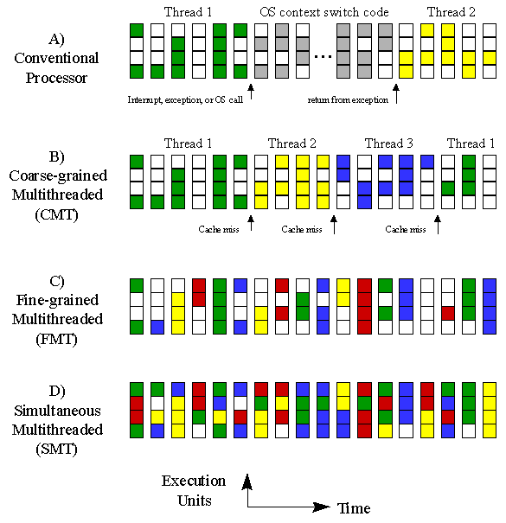
SMT (2)
Regular CPU
SMT (4 threads)
CMP
Approx 1x HW Cost
2x HW Cost

Slide 11
Overview of SMT Hardware Changes
For an N-way (N threads) SMT, we need:
Ability to fetch from N threads
N sets of architectural registers (including PCs)
N rename tables (RATs)
N virtual memory spaces
Front-end: branch predictor?: no, RAS? :yes
But we don’t need to replicate the entire OOO execution engine (schedulers, execution units, bypass networks, ROBs, etc.)

Slide 12
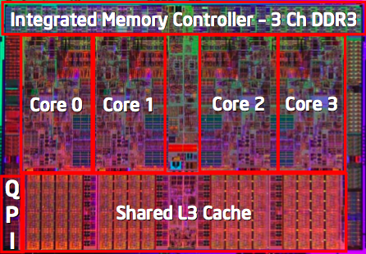
SMT+CMP
Intel’s Nehalemn
Each core is 2-way SMT
http://www.intel.com/technology/product/demos/turboboost/demo.htm?iid=tech_tb+demo

Slide 13
SIMD Operations in Modern ISAs

Slide 14
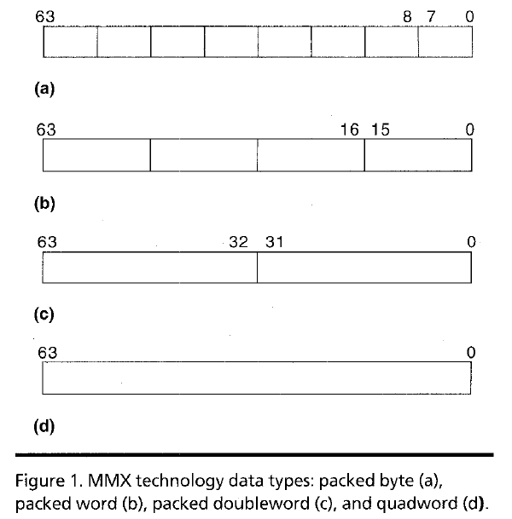
Intel Pentium MMX Operations
Idea: One instruction operates on multiple data elements simultaneously
Ala array processing (yet much more limited)
Designed with multimedia (graphics) operations in mind
No VLEN register
Opcode determines data type:
8 8-bit bytes
4 16-bit words
2 32-bit doublewords
1 64-bit quadword
Stride always equal to 1.
Peleg and Weiser, “MMX Technology
Extension to the Intel Architecture,”
IEEE Micro, 1996.

Slide 15
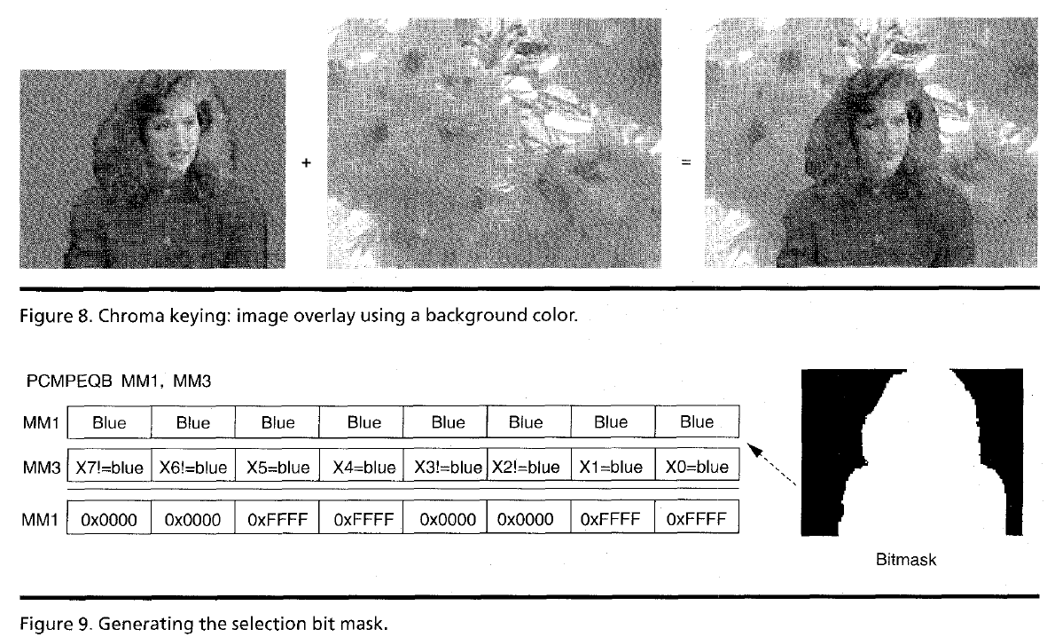
MMX Example: Image Overlaying (I)

Slide 16
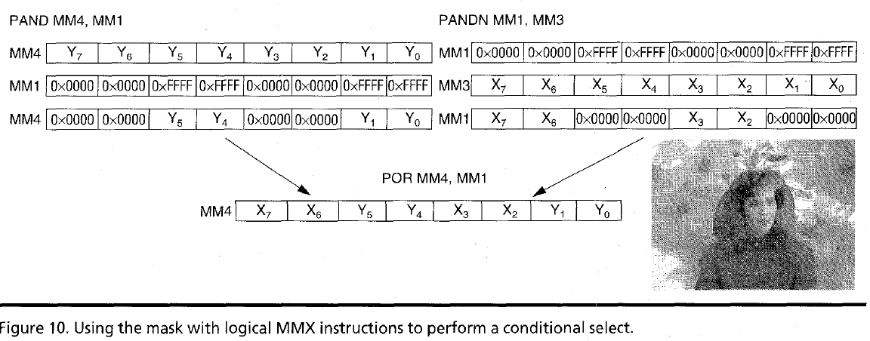
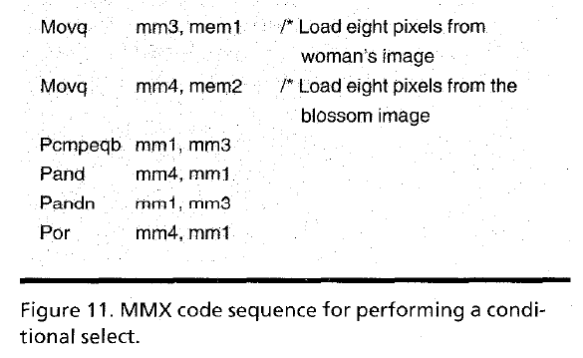
MMX Example: Image Overlaying (II)

