Slide 1

ECE3056A
Thanks to Prof. Kim for some of the content

Slide 2
Some Definitions
Work: Refers to movement (of objects/electrons)
In our case work refers to computation required to solve a given problem
Energy: Capacity to do work (unit: Joules)
Power: Work per unit time (unit: Joules per sec = Watts)
Power Density: power per unit area (Watts/cm^2)

Slide 3
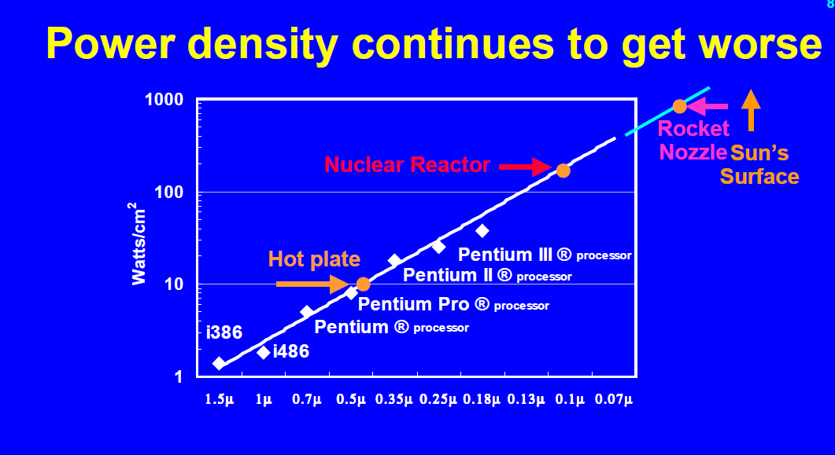
Why Power?
Fred Pollack, Intel, Micro-32 Keynote

Slide 4
Importance of Temperature Control
How to fry an egg on graphics processor (don’t try it):
http://www.youtube.com/watch?v=zrg8nJ0bsUk
No heat sink (for old processors, before kill switch was implemented):
http://www.youtube.com/watch?v=Xf0VuRG7MN4&feature=related

Slide 5
Power Dissipation in CMOS
V dd
V dd
V_{in}
V _{out}
0
Vcc
C_{L}
I _{leakage}
Static
Dynamic

Slide 6
Power Basics
Power vs. Energy
Dynamic power vs. Static power
Dynamic: “switching” power
Static: “leakage” power
Dynamic power dominates, but static power is increasingly important

Slide 7
Why do we care?
1) Increase the CPU cost
Thermal cost: keeping the devices below a given threshold
2) the cost of power delivery

Slide 8
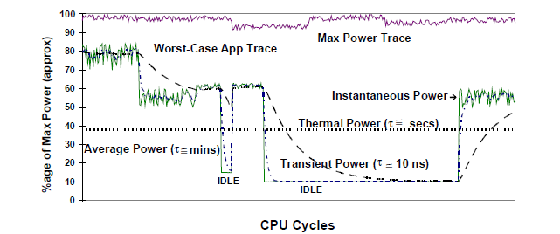
Power power power
Max Power
Worst-case application
Average power
Thermal power: running average of worst-case app for several seconds : used to decide cooling option
Transient power (power delivery) , standby power (battery life),
Reducing Power in High-performance Microprocessors, Tiwari et al. ‘98

Slide 9
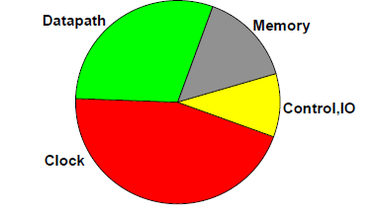
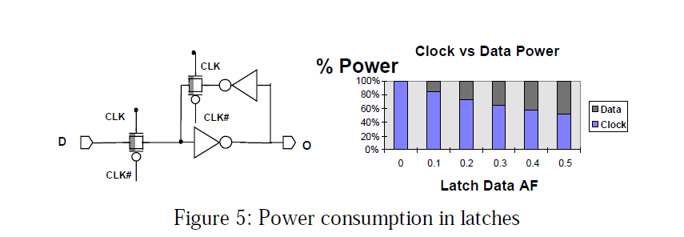
Where does Power Go?
Clock power consumption is high
Even when AF is 0.5
AF (activity factor)
Reducing Power in High-performance Microprocessors, Tiwari et al. ‘98

Slide 10
DVS (Dynamic Voltage Scaling)
O/S controls the processor speed: find the minimum voltage required for the desired speed.
DVFS (Dynamic Voltage Frequency Scaling): Intel's CPU throttling technology, SpeedStep ➔ Turbo Boost

Slide 11
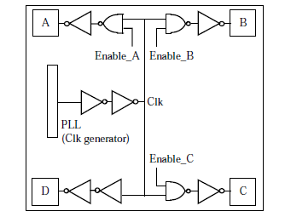
Clock Gating
Adds additional logic to a circuit to prune the clock tree
Reduce dynamic power consumption
Power up delay (timing problem)
Variations in current

Slide 12
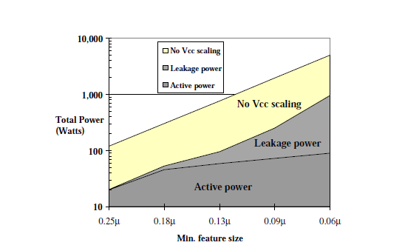
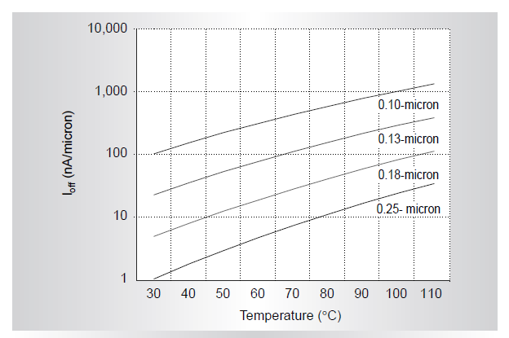
Leakage Power Trend
Technology scales, leakage power consumption is increased
Leakage power/current increases as temperature increases
DESIGN CHALLENGES OF TECHNOLOGY SCALING, Borkar’99

Slide 13
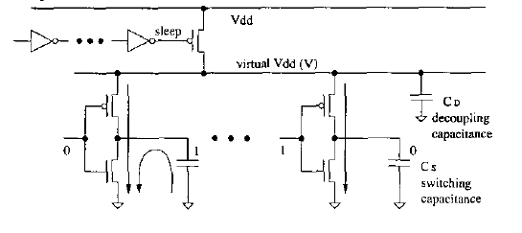
Power Gating
Power blocker
Virtual Vdd(V)
Sleep signal to turn off the supply voltage
Save both dynamic power and leakage power
Microarchitectural Techniques for Power Gating
of Execution Units, Hu et al.

Slide 14
Benefits of Power/Clock Gating
Clock Gating → reduce dynamic power consumption but not the static power consumption
Power gating → eliminate both dynamic and static power consumption

Slide 15
Metrics: What do they mean?
Power
Energy
EDP (Energy Delay Product)
EDDP (Energy Delay^2 Product) : more emphasis on performance
EPI (Energy per instructions)
Performance per Watt (Similar to EPI?)

Slide 16
Essence of Power Model
Lets say we have three components: A, B, C.
We denote power with idle and power with 100% activity as X➔ Y
B
10W➔30W
A
10W➔20W
C
2W➔10W
%A | %B | %C | SUM W
0 | 0 | 0 | 10+10+2=22W
100 | 100 | 100 | 20+30+10=60W
50 | 50 | 50 | 15+20+6=41W
60 | 20 | 50 | 16+14+6=36W
Notes:
The next term, MaxPower is the allowable maximum power consumption per architectural unit.
In order to obtain these series of maxpower terms, we devise (-) special microbenchmarks that will maximize the accesses to specific architectural units.
These microbenchmarks are executed on the real machine and the power measurements are recorded.
Then, this equation is set up to solve the series of maxpower terms.
The left side that shows the series of recorded power values.
The middle term specifies the accessrates of the microbenchmarks.
Since we devise the benchmarks, we know the exact accessrates.
Then the right side shows the series of maxpower terms.
Since we know these two terms, we solve for the set of maxpower values that will close solve the equation.
Please note that maxpower values depend on the measured microbenchmark power, and they do not necessarily represent the physically possible power consumption.

Slide 17
Power Virus
Maximum power consumption code
How?
Use data from L1 or L2
Pipelines and queues are maintained full
For longer period (meaningful program

Slide 18
Review Questions
A CMP : 8 cores in a chip. The total power budget for the chip is 140W. When all cores are active, the frequency of each core is 2GHz and Vdd=2.7V.
(1) Power gating: Maximum frequency of the rest of 6 cores?
(2) Clock gating: Maximum frequency of the rest of 6 cores?
(assume that static power was the 50% of total power in original configuration and static power is proportional to voltage)
(3) EDP for clock gating and power gating, if execution IPC = 1 and 1G instructions to execute?

Slide 19
Review Questions
A CMP : 8 cores in a chip. The total power budget for the chip is 140W. When all cores are active, the frequency of each core is 2GHz and Vdd=2.7V.
(1) Power gating: Maximum frequency of the rest of 6 cores?
P ∝ V³: V_{orig}³/V_{new}³ = (140W/8)/(140W/6)
(2) Clock gating: Maximum frequency of the rest of 6 cores?
assume that static power was the 50% of total power in original configuration and static power is proportional to voltage
P ∝ V³: V_{orig}³/V_{new}³ = (70W/8)/(70W/6)
(3) EDP for clock gating and power gating, if execution IPC = 1 and 1G instructions to execute?
# of cycles = # total_inst/IPC = 1G/1 = 1G
cycles time = # of cycles * frequency
f ∝ V f_pg/f_orig = Vpg/Vorig f_cg/f_orig = Vpg/Vorig
EDP = (P*time)*time

