Slide 1
ECE3056
Thanks to Prof. Kim, Prof. Loh, Prof. Pruvulovic for earlier versions of the lecture notes!

Slide 2
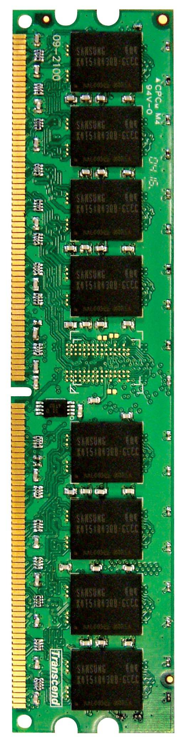
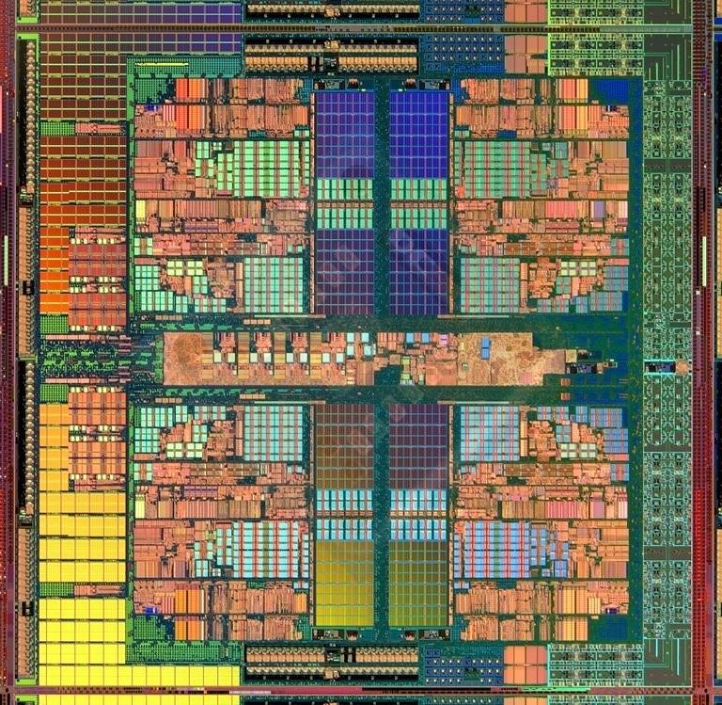
Main Memory in the System
CORE 0
L2 CACHE 1
CORE 1
L2 CACHE 0
SHARED L3 CACHE
DRAM INTERFACE
DRAM MEMORY CONTROLLER
DRAM BANKS
L2 CACHE 2
CORE 3
CORE 2
L2 CACHE 3

Slide 3
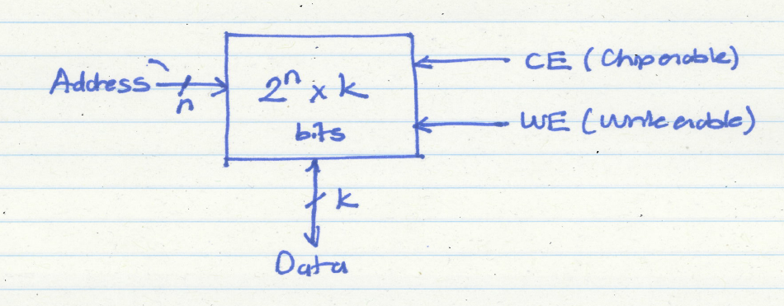
The Memory Chip/System Abstraction

Slide 4
SRAM vs. DRAM
DRAM = Dynamic RAM
SRAM: 6T per bit
built with normal high-speed CMOS technology
DRAM: 1T per bit
built with special DRAM process optimized for density

Slide 5
Hardware Structures
SRAM
DRAM
wordline
wordline
b
b
b
Bit lines

Slide 6
DRAM Chip Organization
Bit lines
Row Decoder
Row
Address
Memory
Cell Array
Word lines
Sense Amps
Row Buffer
Column
Address
Column Decoder
Data Bus

Slide 7
DRAM Chip Organization (2)
Differences with SRAM
reads are destructive: contents are erased after reading
Row buffer/DRAM Page
Read lots of bits all at once, and then parcel them out based on different column addresses
Read from the same row buffer from different locations order

Slide 8
DRAM Read Operation
Row Decoder
0x1FE
Memory
Cell Array
Sense Amps
Row Buffer
0x001
0x000
0x002
Column Decoder
Data Bus
Accesses need not be sequential

Slide 9
Need for Writeback of DRAM Page
So after a read, the contents of the DRAM cell are gone
The values are stored in the row buffer
Write them back into the cells for the next read in the future
DRAM cells
Sense Amps
Row Buffer

Slide 10
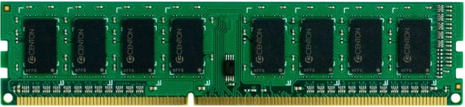
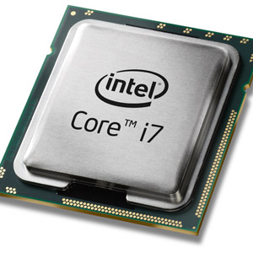
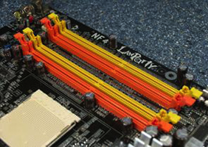
Memory subsystem
“Channel”
DIMM (Dual in-line memory module)
Processor
Memory channel
Memory channel

Slide 11
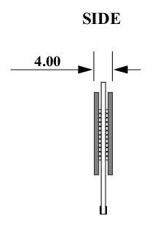
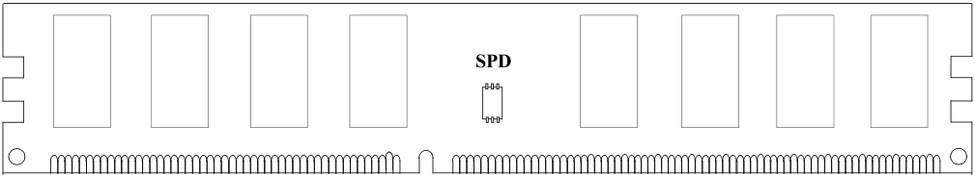
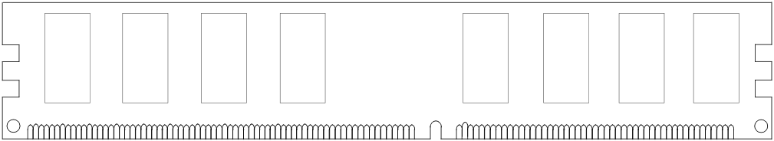
Breaking down a DIMM
DIMM (Dual in-line memory module)
Side view
Front of DIMM
Back of DIMM

Slide 12
Breaking down a DIMM
DIMM (Dual in-line memory module)
Side view
Front of DIMM
Back of DIMM
Rank 0: collection of 8 chips
Rank 1

Slide 13
Rank
Rank 0 (Front)
Rank 1 (Back)
<0:63>
<0:63>
Addr/Cmd
CS <0:1>
Data <0:63>
Memory channel

Slide 14
Breaking down a Rank
. . .
Chip 0
Chip 1
Chip 7
Rank 0
<0:63>
<0:7>
<8:15>
<56:63>
Data <0:63>

Slide 15
Breaking down a Chip
8 banks
Chip 0
Bank 0
<0:7>
<0:7>
<0:7>
...
<0:7>
<0:7>

Slide 16
Breaking down a Bank
2kB
1B (column)
row 16k-1
Bank 0
...
row 0
<0:7>
Row-buffer
1B
1B
1B
...
<0:7>

Slide 17
Memory subsystem organization
Memory subsystem organization
Channel
DIMM
Rank
Chip
Bank
Row/Column

Slide 18
Announcements
Lab4A due this weekend
Dynamic allocation, and how to get started
How to access the data structures
What is the line address?
Functions: access and install
Expecting perfect match for results on slide 4.1 for bzip2
Writing your own traces (check out ../traces/genmtr.c)
Lab 4B will be posed shortly,
you will need to get 4A working to do 4B

Slide 19
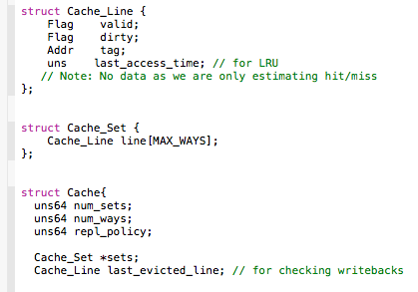
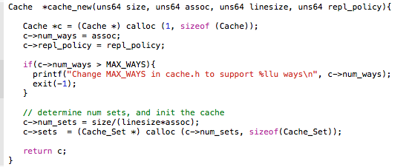
Cache.h and cache.c

Slide 20
4B: Memsys Model
DRAM (100 cycles)
RD
WR
L2.MISS
L2.WRITEBACK
L2CACHE
DCACHE.WRITEBACK
WR
RD
RD
ICACHE
ICACHE
MISS
LD/ST
MISS
DCACHE
IFETCH
LOAD STORE

Slide 21
Page Mode DRAM
A DRAM bank is a 2D array of cells: rows x columns
A “DRAM row” is also called a “DRAM page”
“Sense amplifiers” also called “row buffer”
Each address is a <row,column> pair
Access to a “closed row”
Activate command opens row (placed into row buffer)
Read/write command reads/writes column in the row buffer
Precharge command closes the row and prepares the bank for next access
Access to an “open row”
No need for activate command

Slide 22
DRAM Bank Operation
Access Address:
(Row 0, Column 0)
Columns
(Row 0, Column 8)
(Row 0, Column 80)
(Row 1, Column 0)
Row address 0
Row address 1
Row decoder
Rows
Row Buffer
CONFLICT !
HIT
Row 1
HIT
Row 0
Empty
Column address 0
Column mux
Column address 0
Column address 8
Column address 80
Data

Slide 23
Latency Components:
CPU → controller transfer time
Controller latency
Queuing & scheduling delay at the controller
Access converted to basic commands
Controller → DRAM transfer time
DRAM bank latency
Simple tCAS is row is “open” OR
tACT + tCAS if array precharged OR
tACT + tCAS + tPRE (worst case)
DRAM → CPU transfer time (through controller) tBUS

Slide 24
Open Page vs. Close Page Policies
Open Page: Keep the row opened until a conflict
A row buffer hit will take only CAS delay: say 10 ns +tBUS
A row buffer conflict will take PRE+ACT+CAS: say 30 ns+tBUS
Close Page: Close the row buffer after access
A row buffer miss take ACT+ CAS: say 10+10 = 20ns +tBUS
Right policy depends on row buffer hit rate
Server processors typically use close page policy

Slide 25
Address Mapping (Single Channel)
Single-channel system with 8-byte memory bus
2GB memory, 8 banks, 4KB Row buffer, 64K rows per bank
64 byte cache blocks (so 6 bits for line in Row Buffer)
Row interleaving
Consecutive rows of memory in consecutive banks
Cache block interleaving
Consecutive cache block addresses in consecutive banks
Accesses to consecutive cache blocks serviced in parallel
How about random accesses? Strided accesses?
Which Row in Bank (16 bits)
BankID (3 bits)
Which Line in Row (6 bits)
Which Row in Bank (16 bits)
Which Line in Row (6 bits)
BankID (3 bits)

Slide 26
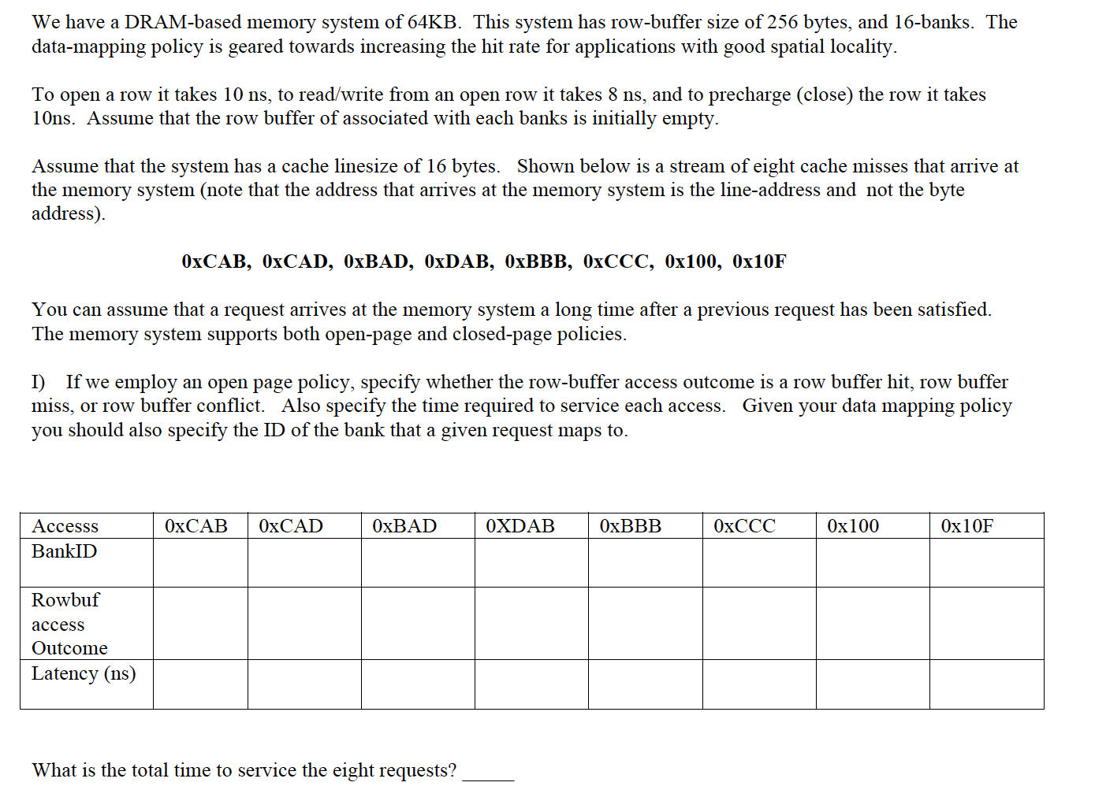
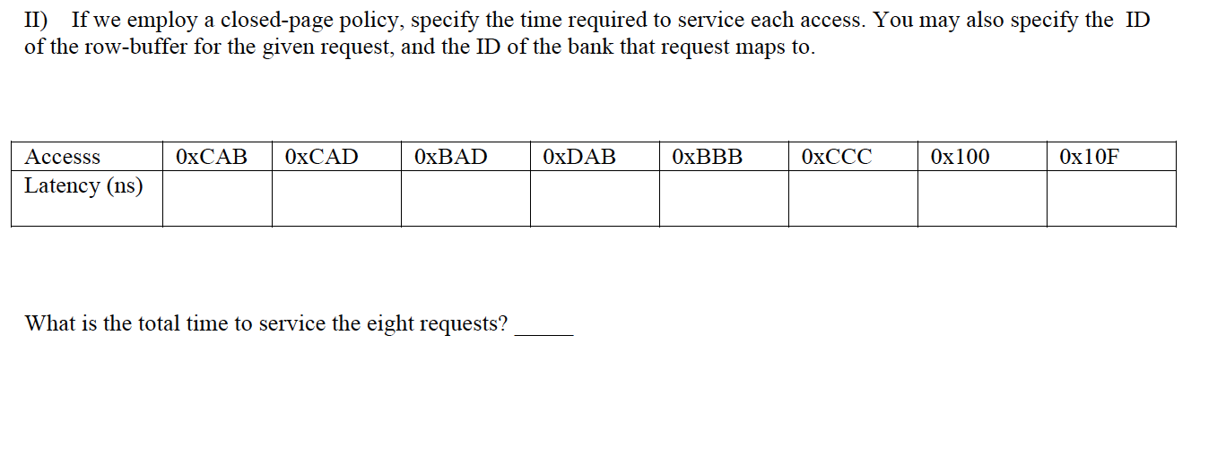
Question

