Slide 1
Study information and consent
Purpose
We study how people perceive similarities between apartment floor plans. Responses will be used to evaluate and calibrate a computational similarity measure.
Your Task
For each question, compare a reference (A) with two alternatives (B and C). Indicate which looks more similar to A, or select a tie / unable-to-judge response. This is not a housing-preference survey.
Data and rights
We will record your responses, Prolific participant ID and background answers. Data will be stored securely and analyzed for research.
I do not agree
I agree and continue

Slide 2
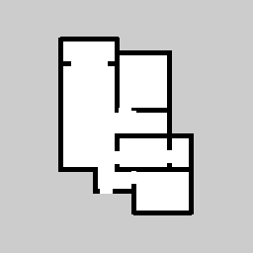
How to read the floor plans
The diagram below is the example of floor plan.
All diagrams use the same spatial canvas: 18 m × 18 m.
The colors represent as follows:
- Black | walls
- White | interior
- Gray | exterior
The orientation of the entrances is consistently downward.
Room labels and furniture are not shown.
Compare the visible outline and room arrangement. Do not choose based on which home you would prefer.
Submit answer

Slide 3
Comprehension check
What is your task when comparing floor plans B and C?
Reminder: choose the plan that looks more similar to reference A, based on the visible layout.
⚪️ Which apartment I would prefer to live in.
⚪️ Which floor plan is more similar to A.
⚪️ Which apartment would be more in fashion than A.
⚪️ Which apartment would be more expensive than A.
Submit answer
Notes:
正答（Which floor plan is more similar to A.）できたら次のセクションに進む

Slide 4
Comprehension check — second attempt
What is your task when comparing floor plans B and C?
Reminder: choose the plan that looks more similar to reference A, based on the visible layout.
Your first answer was incorrect. Please review the reminder and try once more.
⚪️ Which apartment I would prefer to live in.
⚪️ Which floor plan is more similar to A.
⚪️ Which apartment would be more in fashion than A.
⚪️ Which apartment would be more expensive than A.
Submit answer
Notes:
正答（Which floor plan is more similar to A.）できたら次のセクションに進む

Slide 5
End of study — comprehension check
Thank you for your time.
You did not pass the comprehension check after two attempts, so you cannot continue with this study.
Please follow these steps:
1. Close this survey tab.
2. Return to the Prolific website.
3. Click "Stop Without Completing" (or "Cancel participation") to return your submission.
Notes:
終了

Slide 6
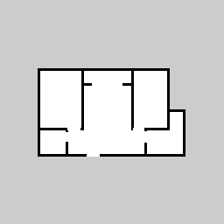
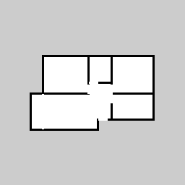
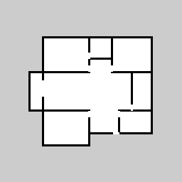
Practice
The floor plan at the top is the reference A.
Please choose which of the two floor plans below (B or C) is more similar to A.
Some comparisons may be difficult. Please make your best judgment.
A — Reference
B
C
⚪️ Floor plan B.
⚪️ Floor plan C.
⚪️ Both are equally similar.
⚪️ I cannot judge from these images.
Continue
Notes:
練習問題は別途用意
回答は記録するが、解析からは除外

Slide 7
Question 1 /42
Which floor plan is more similar to A?
A — Reference
B
C
⚪️ Floor plan B.
⚪️ Floor plan C.
⚪️ Both are equally similar.
⚪️ I cannot judge from these images.
Continue

Slide 8
Questions 2–14

Slide 9
Question 15 /42
Which floor plan is more similar to A?
A — Reference
B
C
⚪️ Floor plan B.
⚪️ Floor plan C.
⚪️ Both are equally similar.
⚪️ I cannot judge from these images.
Continue

Slide 10
Question 16 /42
For this question only, select “Floor plan B” regardless of similarity.
A — Reference
B
C
⚪️ Floor plan B.
⚪️ Floor plan C.
⚪️ Both are equally similar.
⚪️ I cannot judge from these images.
Continue
Notes:
注意力確認
問題は別途用意

Slide 11
Question 17 /42
Which floor plan is more similar to A?
A — Reference
B
C
⚪️ Floor plan B.
⚪️ Floor plan C.
⚪️ Both are equally similar.
⚪️ I cannot judge from these images.
Continue

Slide 12
Questions 18–29

Slide 13
Question 30 /42
Which floor plan is more similar to A?
A — Reference
B
C
⚪️ Floor plan B.
⚪️ Floor plan C.
⚪️ Both are equally similar.
⚪️ I cannot judge from these images.
Continue

Slide 14
Question 31 /42
For this question only, select “Floor plan C” regardless of similarity.
A — Reference
B
C
⚪️ Floor plan B.
⚪️ Floor plan C.
⚪️ Both are equally similar.
⚪️ I cannot judge from these images.
Continue
Notes:
注意力確認
問題は別途用意

Slide 15
Question 32 /42
Which floor plan is more similar to A?
A — Reference
B
C
⚪️ Floor plan B.
⚪️ Floor plan C.
⚪️ Both are equally similar.
⚪️ I cannot judge from these images.
Continue

Slide 16
Questions 33–41

Slide 17
Question 42 /42
Which floor plan is more similar to A?
A — Reference
B
C
⚪️ Floor plan B.
⚪️ Floor plan C.
⚪️ Both are equally similar.
⚪️ I cannot judge from these images.
Continue

Slide 18
About your judgement
Which aspects did you consider when judging similarity? Select all that apply.
⚪️ Overall floor plan shape
⚪️ Number of rooms
⚪️ Room sizes
⚪️ Arrangement of rooms
⚪️ Connections between rooms
⚪️ Position of entrance and corridors
⚪️ Position of entrance and corridors
⚪️ Speculation of the room's intended use
⚪️ Other [ ]
Continue
Notes:
最低1つ選択
Other には記述欄を設ける

Slide 19
Most important aspect
Which aspects did you consider most when judging similarity? Select one that apply.
⚪️ Overall floor plan shape
⚪️ Number of rooms
⚪️ Room sizes
⚪️ Arrangement of rooms
⚪️ Connections between rooms
⚪️ Position of entrance and corridors
⚪️ Position of entrance and corridors
⚪️ Speculation of the room's intended use
⚪️ Other [ ]
Continue
Notes:
1つだけ選択
前の設問で選ばれたものだけを表示
Other には前の問題の記述を記入しておく

Slide 20
Overall difficulty
How difficult was it to compare the floor plans?
⚪️ 1 — Very easy
⚪️ 2 — Somewhat easy
⚪️ 3 — Neither easy nor difficult
⚪️ 4 — Somewhat difficult
⚪️ 5 — Very difficult
Continue
Notes:
1つだけ選択

Slide 21
Additional comments
Was there anything that made the floor plans difficult to compare? Please share any comments about how you made your judgments.
Optional.
Continue
Notes:
自由記述

Slide 22
About you
Finally, we'd like to ask about your background and experience.
Questions marked * are required. You may select "Prefer not to say" where available.
1. What is your age group? *
⚪️ 18 – 24
⚪️ 25 – 34
⚪️ 35 – 44
⚪️ 45 – 54
⚪️ 55 – 64
⚪️ 65 or older
⚪️ Prefer not to say
2. What is your gender? *
⚪️ Woman
⚪️ Man
⚪️ Non-binary / Another gender
⚪️ Prefer not to say
3. What is the highest level of education you have completed? *
⚪️ Secondary school or below
⚪️ Vocational / Technical qualification
⚪️ Some college / University (no degree)
⚪️ Bachelor's degree
⚪️ Master's degree
⚪️ Doctoral degree
⚪️ Other / Prefer not to say
4. Have you received education or worked in architecture, interior design, or building design? *
⚪️ No, neither
⚪️ Yes, education only
⚪️ Yes, professional experience only
⚪️ Yes, both education and professional experience
⚪️ Prefer not to say
5. How many times have you moved to a different home in your lifetime? *
⚪️ 0
⚪️ 1
⚪️ 2–3
⚪️ 4–5
⚪️ 6–9
⚪️ 10 or more
⚪️ Not sure / Prefer not to say
6. How familiar are you with reading residential floor plans? *
⚪️ 1 — Not at all familiar
⚪️ 2 — Slightly familiar
⚪️ 3 — Moderately familiar
⚪️ 4 — Very familiar
⚪️ 5 — Extremely familiar
Submit survey
Notes:
各問最低1つ選択

Slide 23
End of Study
Thank you for your time.
Your survey responses have been saved.
Please click the button below and register your completion.
Return to Prolific
Notes:
Completion のリダイレクト

