Slide 1

Student Name: Igiraneza Honette
ID: 27707
Course: INSY 8413 – Introduction to Big Data Analytics
Instructor: Eric Maniraguha
Date: August 2025

Slide 2
1.Project Introduction
Context & Objective
The Online Retail Dataset is a transactional dataset from a UK-based online retailer.
The company sells unique gifts and household items, mainly to wholesalers.
However, they lack insightful data analysis to understand:
Who their most valuable customers are
What products perform best
When peak sales occur
Objective of this project:
Clean and analyze the dataset using Python
Segment customers using clustering (unsupervised ML)
Build an interactive Power BI dashboard
Provide actionable business recommendations

Slide 3
2. Methodology
Step-by-step Approach
Data Preparation (Python):
Loaded dataset into Pandas
Dropped nulls in CustomerID, Description
Removed duplicates
Converted InvoiceDate to datetime
Removed transactions with negative quantity or price
2. Exploratory Data Analysis (EDA):
Used visualizations to explore sales trends
Identified top-selling products and customer countries
Created RFM metrics:
Recency: Days since last purchase
Frequency: Number of transactions
Monetary: Total amount spent

Slide 4
CONT…….
3. Clustering Model (K-Means):
Applied K-Means on RFM data
Used Elbow Method to find optimal clusters (k=4)
Grouped customers into segments based on value
4. Dashboard Creation (Power BI):
Connected cleaned dataset
Added visuals: bar charts, pie charts, trend lines
Used slicers for interactivity

Slide 5
3.Data Cleaning & Transformation
Techniques Used
Missing Values: Removed rows where CustomerID or InvoiceNo was missing
Outliers: Removed rows with Quantity <= 0 or UnitPrice <= 0
Inconsistent Formats:
Converted InvoiceDate to datetime format
Encoded Country as categorical
New Columns Created:
TotalPrice = Quantity * UnitPrice
RFM features for clustering

Slide 6
4.Key Findings & EDA Insights
Exploratory Insights
Sales Over Time:
Monthly sales peaked in November (pre-Christmas spike)
Top 5 Countries by Revenue:
UK dominates (>85% of transactions), followed by Netherlands, Germany, France
Top Products:
White Hanging Heart T-Light Holder and Regency Teacup sold most
Customer Behavior:
A small segment of customers generated the highest revenue
Frequent purchases were made by business clients in bulk

Slide 7
5.Machine Learning – Clustering
Customer Segmentation with K-Means
Used RFM Analysis for features:
Recency: How recently a customer purchased
Frequency: How often they purchase
Monetary: How much they spend
K-Means Clustering (k=4):
Segment 0: High-frequency, high-value customers
Segment 1: Low recency, moderate spenders
Segment 2: Infrequent customers with low spend
Segment 3: Dormant or lost customers
Silhouette Score: Used to validate cluster performance

Slide 8
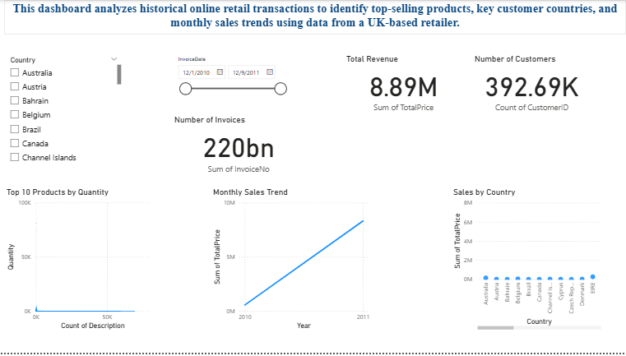
6.Power BI Dashboard
Interactive Visual Summary
Visuals Included:
Monthly Sales Trend (X: Month, Y: Total Sales)
Country-wise Sales Distribution (Map visual or pie chart)
Top 10 Products (X: Product, Y: Total Quantity Sold)
Customer Segments from Clustering (X: Segment, Y:
Avg Revenue)
Interactive Features:
Slicers for Year, Country, Product Category
Drill-down into specific countries or products
Tooltips to show RFM values on hover

Slide 9
7.Business Recommendations
Data-Driven Actions
Focus on Segment 0 (Top Buyers): Use loyalty programs and special offers
Stock Planning: Ensure availability of top 10 products
Email Campaigns: Target customers before November peak season
Explore Markets Outside UK: Netherlands and Germany show potential
8.Future Work
How This Can Be Extended
Predict customer churn using classification models (e.g., Logistic Regression)
Forecast sales with Time Series models (e.g., ARIMA, Prophet)
Build a recommender system for product suggestions
Combine this dataset with website activity for richer behavioral analysis

