Slide 1

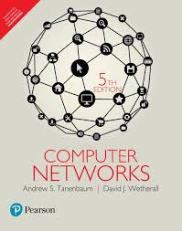
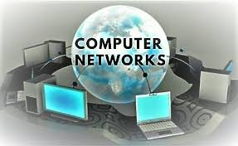
COMPUTER NETWORKS
Dr. U. SRILAKSHMI
Asst. Professor
Dept. of CSE
VFSTR

Slide 2
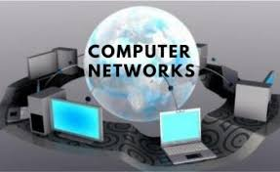
Syllabus
UNIT - 2 DATA LINK LAYER
Design issues, Error detection and correction, Elementary data link protocols, Sliding window protocols. MEDIUM ACCESS CONTROL SUB LAYER: The channel allocation problem, Multiple access protocol, Wireless LANs.
UNIT - 1 INTRODUCTION
Use of computer networks, Network hardware, Network software, Reference models, Example networks.
UNIT - 3 NETWORK LAYER
Design issues, Routing algorithms, Congestion control algorithms, Quality of service, Internet working, The network layer in the internet-IPv4, IP addresses, IPv6, ICMP, Mobile IP
UNIT - 4 TRANSPORT LAYER
The transport service, Elements of transport protocols, The internet transport protocols-UDP and TCP.
UNIT - 5 APPLICATION LAYER
DNS-Domain name system, E-mail, The World Wide Web, Streaming audio and video, Content delivery networks.
Dr. UPPALAPATI SRILAKSHMI, Asst. Professor, Dept. of CSE, VFSTR Deemed to be University, E-mail: usl_cse@vignan.ac.in

Slide 3
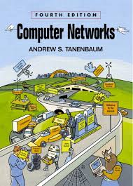
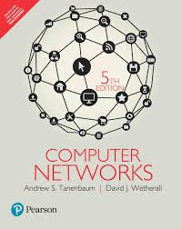
Dr. UPPALAPATI SRILAKSHMI, Asst. Professor, Dept. of CSE, VFSTR Deemed to be University, E-mail: usl_cse@vignan.ac.in

Slide 4
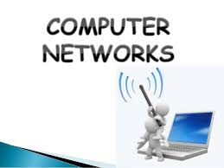
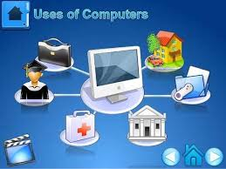
UNIT - I
INTRODUCTION
Dr. UPPALAPATI SRILAKSHMI, Asst. Professor, Dept. of CSE, VFSTR Deemed to be University, E-mail: usl_cse@vignan.ac.in

Slide 5
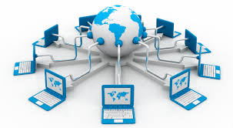
Computer Network: It is a system in which multiple computers are connected to each other to share information and resources
Dr. UPPALAPATI SRILAKSHMI, Asst. Professor, Dept. of CSE, VFSTR Deemed to be University, E-mail: usl_cse@vignan.ac.in

Slide 6
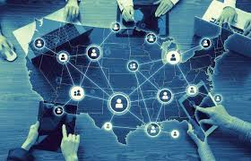
A network is a set of devices (often referred to as nodes) connected by communication links.
A node can be a computer, printer, or any other device capable of sending and/or receiving data generated by other nodes on the network.
A popular example of a computer network is the Internet, which allows millions of users to share information stored on various devices in the network.
Dr. UPPALAPATI SRILAKSHMI, Asst. Professor, Dept. of CSE, VFSTR Deemed to be University, E-mail: usl_cse@vignan.ac.in

Slide 7
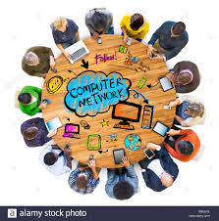
Every Network Includes:
At least two computers that have something to share.
A cable or wireless pathway, called Transmission Media, for computers to signal each other.
Rules, called Protocols, so that computers can use the unified principle of data communication.
Networking Interface Cards (NIC).
Dr. UPPALAPATI SRILAKSHMI, Asst. Professor, Dept. of CSE, VFSTR Deemed to be University, E-mail: usl_cse@vignan.ac.in

Slide 8
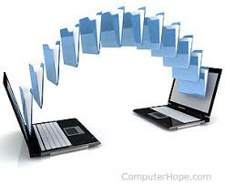

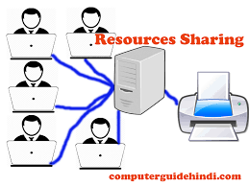
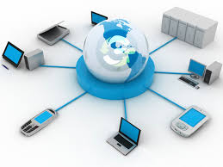
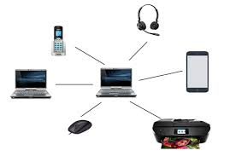
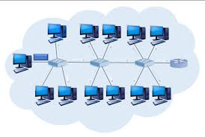
Advantages of computer networks
File Sharing
Sharing or accessing a file stored on a computer across the computers on the network.
Resource Sharing
All computers in the network can share resources such as printers, fax machines, modems and scanners.
Communication
Devices on the network can communicate with each other via e-mail, instant messages etc.
Flexible Access
Users can access the information or resources on the network from anywhere in the network
Dr. UPPALAPATI SRILAKSHMI, Asst. Professor, Dept. of CSE, VFSTR Deemed to be University, E-mail: usl_cse@vignan.ac.in

Slide 9
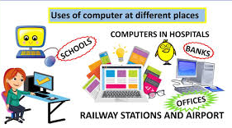
Uses of Computer Network
Business Applications
Home Applications
Mobile Users
Social Issues
Dr. UPPALAPATI SRILAKSHMI, Asst. Professor, Dept. of CSE, VFSTR Deemed to be University, E-mail: usl_cse@vignan.ac.in

Slide 10
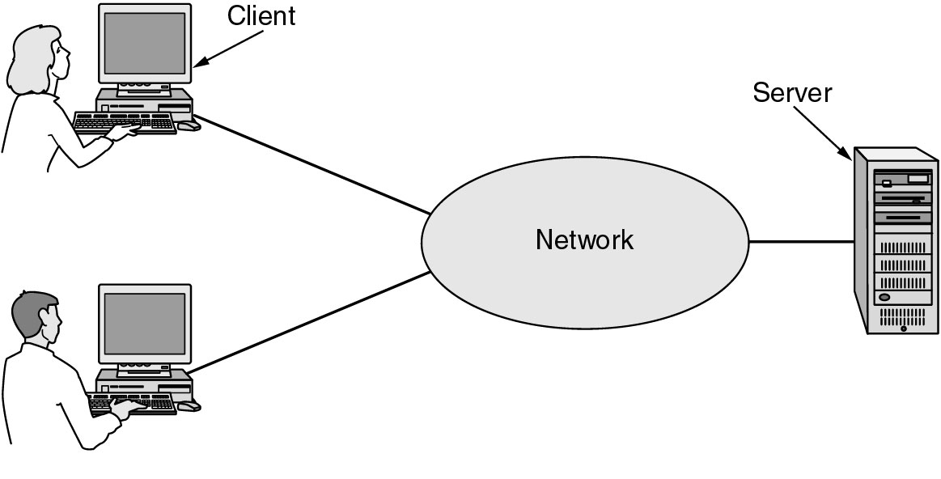
Business Applications
Resource Sharing
High reliability
Saving money
Scalability
A network with two clients and one server.
Dr. UPPALAPATI SRILAKSHMI, Asst. Professor, Dept. of CSE, VFSTR Deemed to be University, E-mail: usl_cse@vignan.ac.in

Slide 11
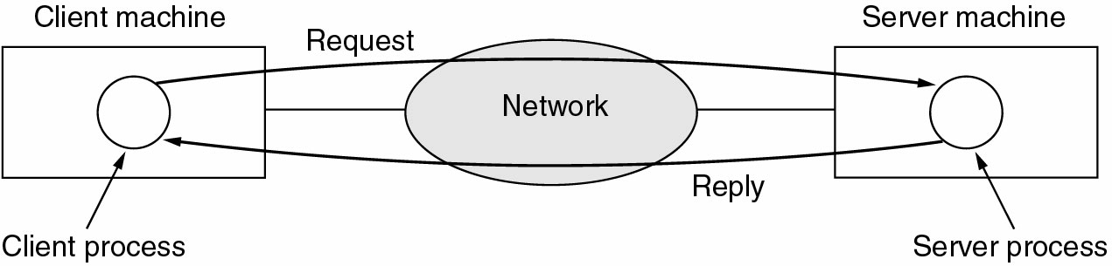
Business Applications
The client-server model involves requests and replies.
Dr. UPPALAPATI SRILAKSHMI, Asst. Professor, Dept. of CSE, VFSTR Deemed to be University, E-mail: usl_cse@vignan.ac.in

Slide 12
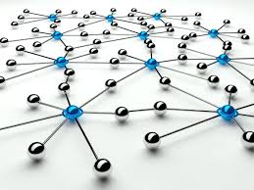
Home Applications
Access to remote information
Peer - to - peer communication
Interactive entertainment
Electronic commerce
Dr. UPPALAPATI SRILAKSHMI, Asst. Professor, Dept. of CSE, VFSTR Deemed to be University, E-mail: usl_cse@vignan.ac.in

Slide 13
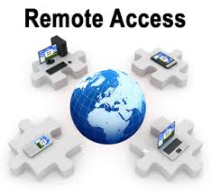
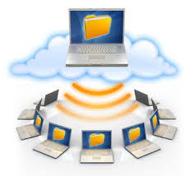
Access to Remote Information
Online bill payment, Bank accounts.
Home shopping.
On-line newspaper.
Access to information system like world wide web, which contains information about arts, business, cooking, government, health, history, science, sports, travel,……..
All the above applications involve in interactions between a person and remote database.
Dr. UPPALAPATI SRILAKSHMI, Asst. Professor, Dept. of CSE, VFSTR Deemed to be University, E-mail: usl_cse@vignan.ac.in

Slide 14

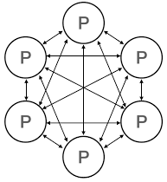
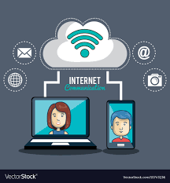
Peer - to - Peer Communication
Electronic mail or email which allow users to communicate with no delay
Videoconference - which makes possible
Dr. UPPALAPATI SRILAKSHMI, Asst. Professor, Dept. of CSE, VFSTR Deemed to be University, E-mail: usl_cse@vignan.ac.in

Slide 15
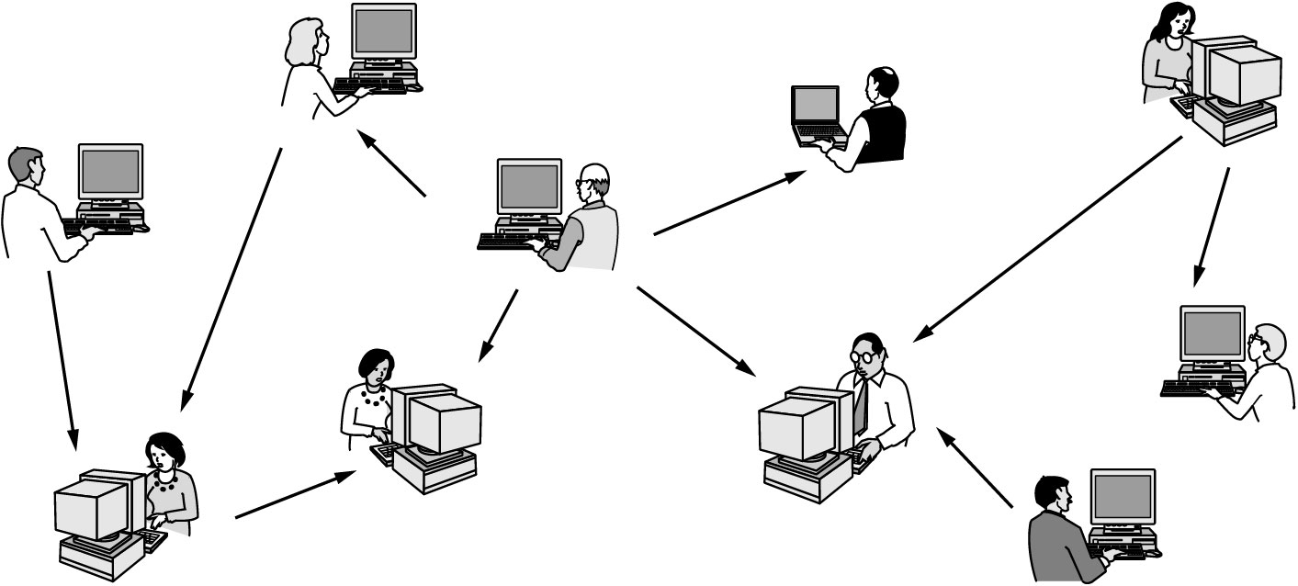
Interactive Entertainment
In peer-to-peer system there are no fixed clients and servers.
Huge and growing industry.
Video
Game playing
Dr. UPPALAPATI SRILAKSHMI, Asst. Professor, Dept. of CSE, VFSTR Deemed to be University, E-mail: usl_cse@vignan.ac.in

Slide 16
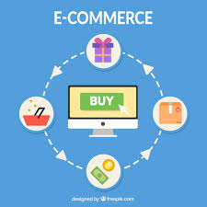
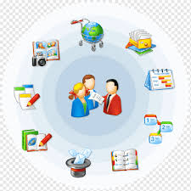
Electronic Commerce
Electronic Commerce, commonly known as E- commerce or eCommerce, is trading in products or services using computer networks, such as the Internet E-commerce facilitates home shopping, catalogue of company products.
It is also popularly employed for bill payments , banking, investments, etc...
Dr. UPPALAPATI SRILAKSHMI, Asst. Professor, Dept. of CSE, VFSTR Deemed to be University, E-mail: usl_cse@vignan.ac.in

Slide 17
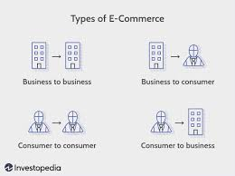
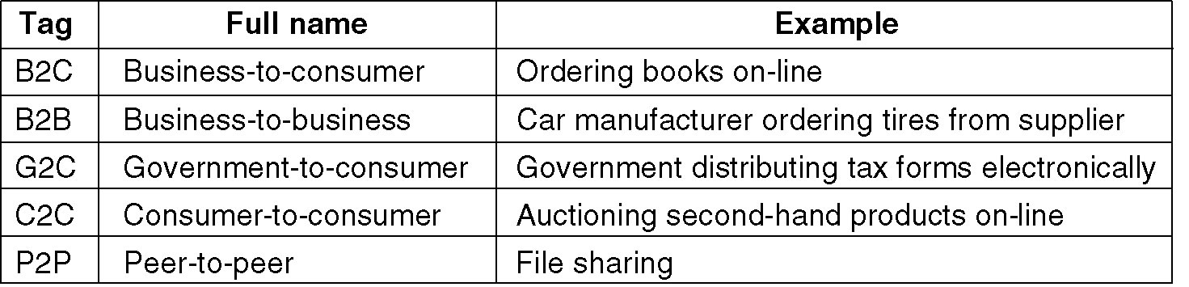
Electronic Commerce
Some forms of e-commerce
Dr. UPPALAPATI SRILAKSHMI, Asst. Professor, Dept. of CSE, VFSTR Deemed to be University, E-mail: usl_cse@vignan.ac.in

Slide 18
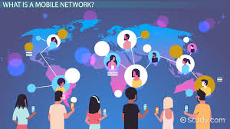
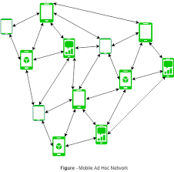
Mobile Users
Many professionals uses desktop computers at office and want to be connected to the office network while travelling and at home also.
This is possible by wireless networks, hence use of laptop, notebook computers and personal digital assistants(PDAs) is increased.
Wireless networks are used in taxis, military applications, airports, banking, weather reporting
Dr. UPPALAPATI SRILAKSHMI, Asst. Professor, Dept. of CSE, VFSTR Deemed to be University, E-mail: usl_cse@vignan.ac.in

Slide 19
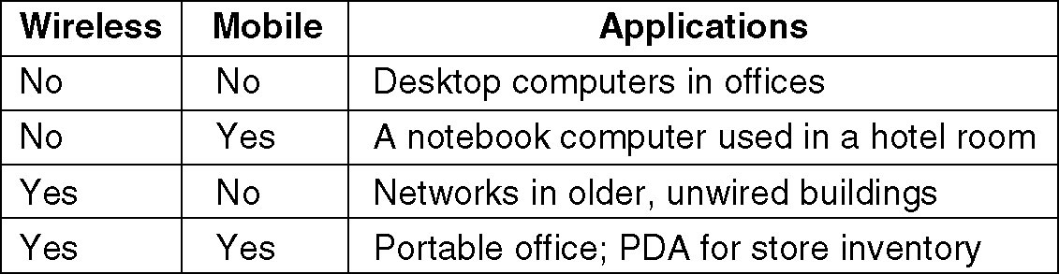
Mobile Users
Combinations of wireless networks and mobile computing.
Dr. UPPALAPATI SRILAKSHMI, Asst. Professor, Dept. of CSE, VFSTR Deemed to be University, E-mail: usl_cse@vignan.ac.in

Slide 20
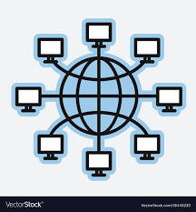
Summary
A computer network is a group of two or more computers that are linked together.
Networks are usually used to share resources, exchange files or communicate with other users.
Advantages of Computer Networks are:
File Sharing, Resource Sharing, Communication, Flexible Access and Sharing of Information.
Uses of Computer Networks are:
Business Applications, Home Applications, Mobile Users and Social Issues.
Dr. UPPALAPATI SRILAKSHMI, Asst. Professor, Dept. of CSE, VFSTR Deemed to be University, E-mail: usl_cse@vignan.ac.in

Slide 21
THANKS!
Any questions?

