Slide 1

Project on
Students Grievance System
Presented by- Mr. Ritesh Agarwal, Mr. Viraj Bhutada,
Mr. Prathamesh Deshmukh, Mr. Prathmesh Upadhyay,
Mr. Shreyas Amale
Guided by- Dr. Pritish Tijare Sir
Department of Computer Science & Engineering
Sipna College of Engineering and Technology, Amravati
Sant Gadge Baba Amravati University, Amravati
2022 – 2023

Slide 2
Table of content
Introduction
Literature Review
Current System versus New Web/Application-Based SystemCurrent System versus New Web/Application-Based System
System Framework
Methodology
Conclusion

Slide 3
Introduction
Student grievance systems are a essential reporting mechanisms of any educational educational institution.
For students to voice their concerns properly and in timely and safe manner. Student grievance system play a important role.
Traditionally, these systems were pen-and-paper-based, which are very inefficient and hard to maintain and manage.
In our project, we have created a much more efficient and simplistic web-based system.

Slide 4
Literature Review
1. Importance of Student Grievance System:
- Ensures students' voices are heard and concerns addressed promptly and fairly.
- Helps detect and solve systemic problems that affect multiple students.
- Improves educational quality.
2. Challenges:
- Fear of repercussions and discrimination discourages reporting.
- Timely and fair complaint management crucial for student confidence.

Slide 5
3. Strategies to overcome challenges:
- Create safe, comfortable environment for students to speak up.
- Introduce complaint portal or application for easy sharing.
- Train staff, develop guidelines for resolving different complaints.
- Seek student feedback for continuous improvement.
4. Ensuring student awareness and support:
- Provide clear information on grievance procedure and rights.
- Train staff in professional, impartial dispute resolution.
- Foster culture of trust and support.
- Implement measures like anonymous reporting, protection against retaliation, and trauma support.

Slide 6
5. Regular evaluation and monitoring:
- Collect feedback, data, and benchmark best practices.
- Design adaptable system and allocate resources.
6. Benefits of effective grievance system:
- Promotes safe, supportive learning environment.
- Ensures transparency, accessibility, and responsiveness to student needs.

Slide 7
Current System versus New Web/Application-Based System
1. Current System:
- Pen and paper-based approach for filing complaints.
- Students visit specific departments to address their concerns.
- Application submitted to departmental clerk.
- Delay period for investigation and response.
- Inconvenient and potential loss of documents.
- Longer wait times and lack of timely responses.

Slide 8
Web/Application-Based System:
- Web-based technology enables efficient grievance system.
- Students register online to create an account.
- Login to account to lodge complaints.
- Select department and specific problem category.
- Write complaint and attach supporting documents.
- Option to remain anonymous.
- Complaint visible to respective department/admin.
- Admin formulates appropriate response.
- Remarks for required changes if needed.

Slide 9
Benefits of New System:
1. Immediate complaint submission from anywhere.
2. Secure storage and easy retrieval of complaints.
3. Efficient complaint management for administrators.
4. Email alerts and website updates for students.
5. Ability to update and correct applications.

Slide 10
System Framework
1. Students Section:
- Attractive site with user-friendly features.
- Dashboard, Account Settings, Lodge Complaints, Complaint History.
- Dashboard: Announcements and complaint overview.
- Lodge Complaints: File complaints with supporting documents.
- Complaint History: Track complaint status.

Slide 11
2. Administrator Section:
- Main Admin, Department Admin, College Admin, University Admin.
- Main Admin manages system functionality and database.
- Admins respond to and resolve students' complaints.
- Complaint escalation if unresolved within seven days.
- Admins trained and experienced in handling student issues.
- Group management for admin accounts improves efficiency.

Slide 12
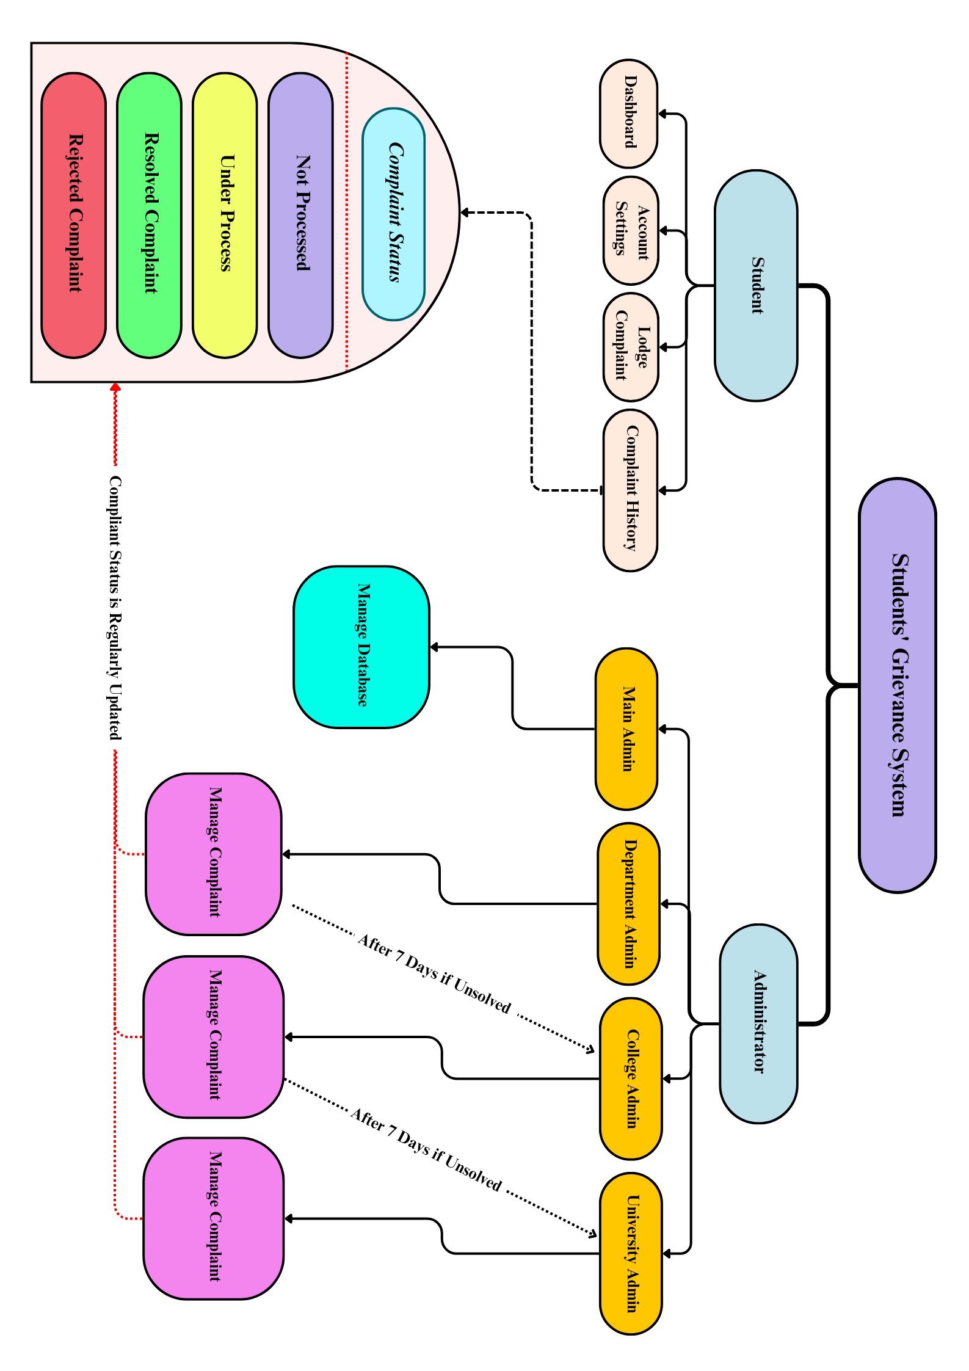
Students Grievance System Framework

Slide 13
Methodology
1. Frontend Development:
- Use of HTML, CSS, and JavaScript for interactive and user-friendly interface.
- Enables effective communication of student complaints.
- Facilitates responsive design for enhanced user experience.
- Applies to both student and administrator portals.

Slide 14
2. Backend Programming:
- PHP, JavaScript, and MySQL used for data processing.
- Efficient handling of high volumes of data.
- Provides prompt feedback to students.
- Enables seamless integration of database with frontend.

Slide 15
Conclusion
It is evident that a student grievance system is a vital aspect of any educational institution. The provision of channels for students to express their views and complaints, as well as the quick resolution of these issues, is crucial. It is noted that implementation of such systems can further create a positive learning environment for the students. So not only do the teachers know about various concerns of the students. The student can also freely express their concerns. Thus investing in the development of students' grievance systems can be a viable investment choice for all types of educational institutions.

Slide 16
Thank You.

