Slide 1
DBaaS
(Database as a Service)

Slide 2
DBaaS refers to cloud-based database services where cloud providers manage the database infrastructure, scalability, backup, and maintenance. Users can access, manage, and use the database without worrying about hardware or underlying software.

Slide 3


Relational DBaaS (SQL databases)
+

Slide 4
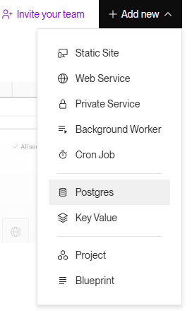

Slide 5
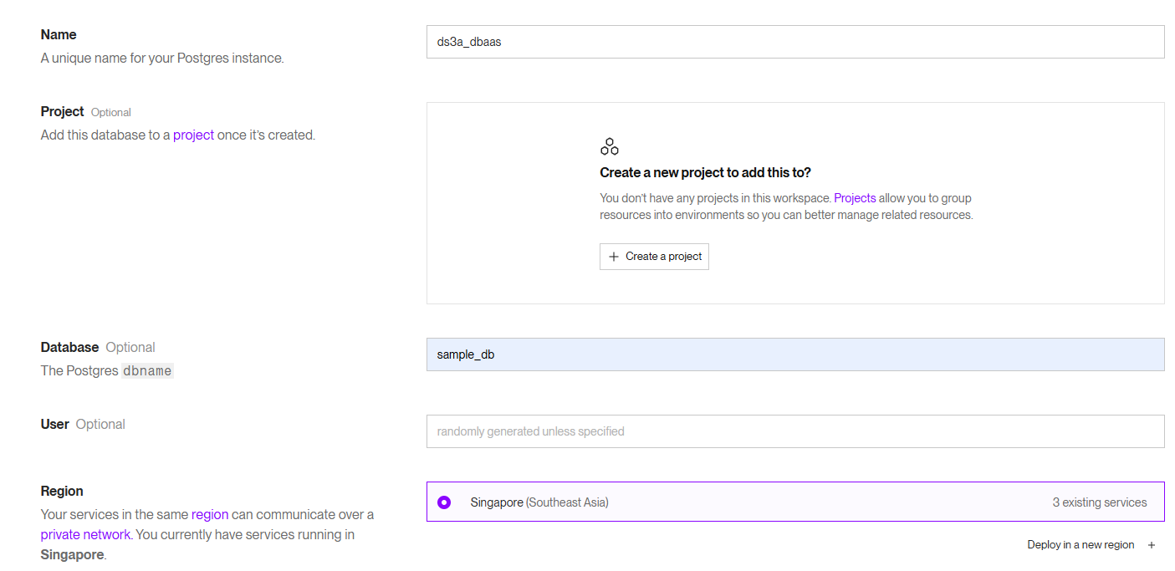

Slide 6
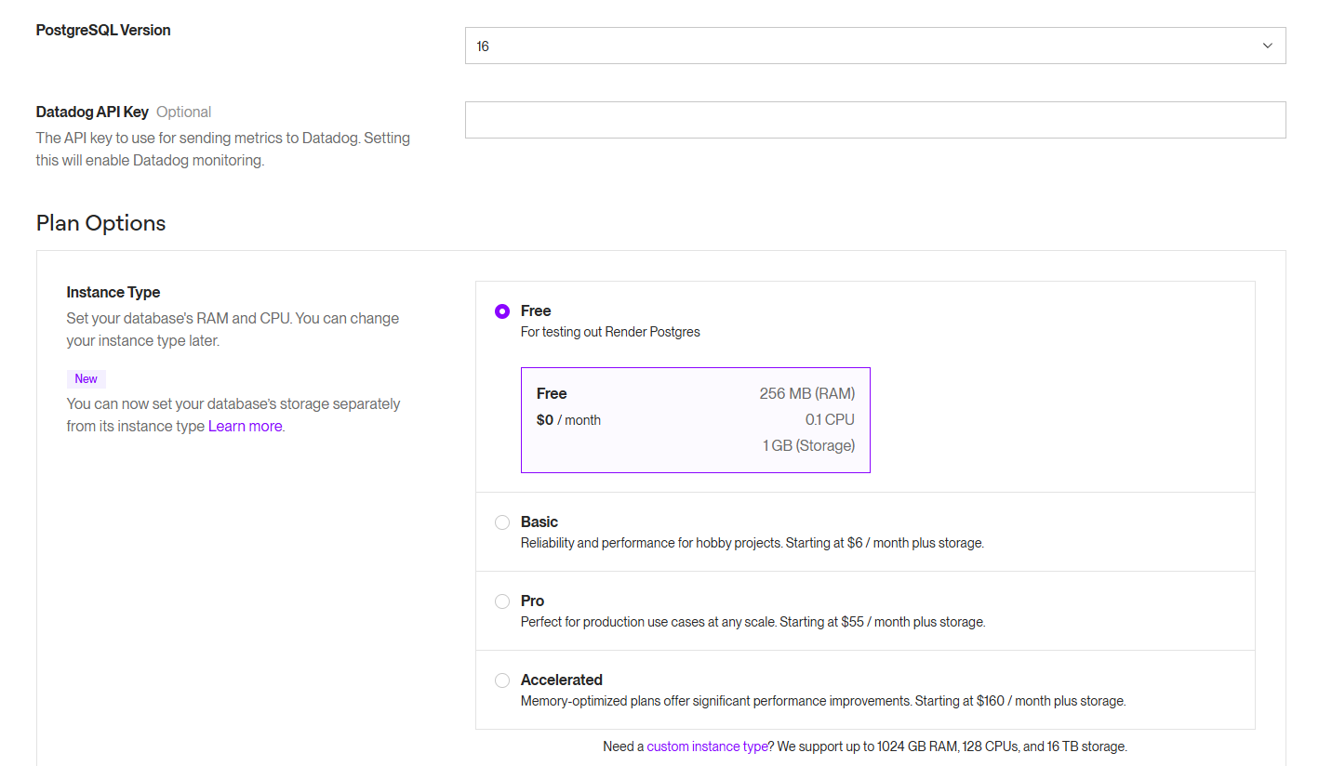

Slide 7
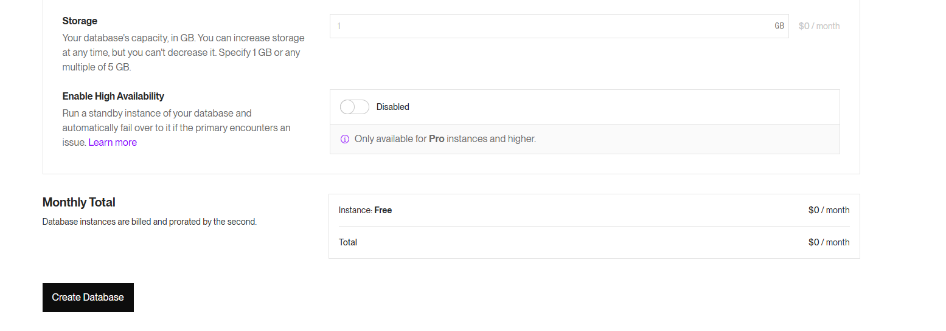

Slide 8
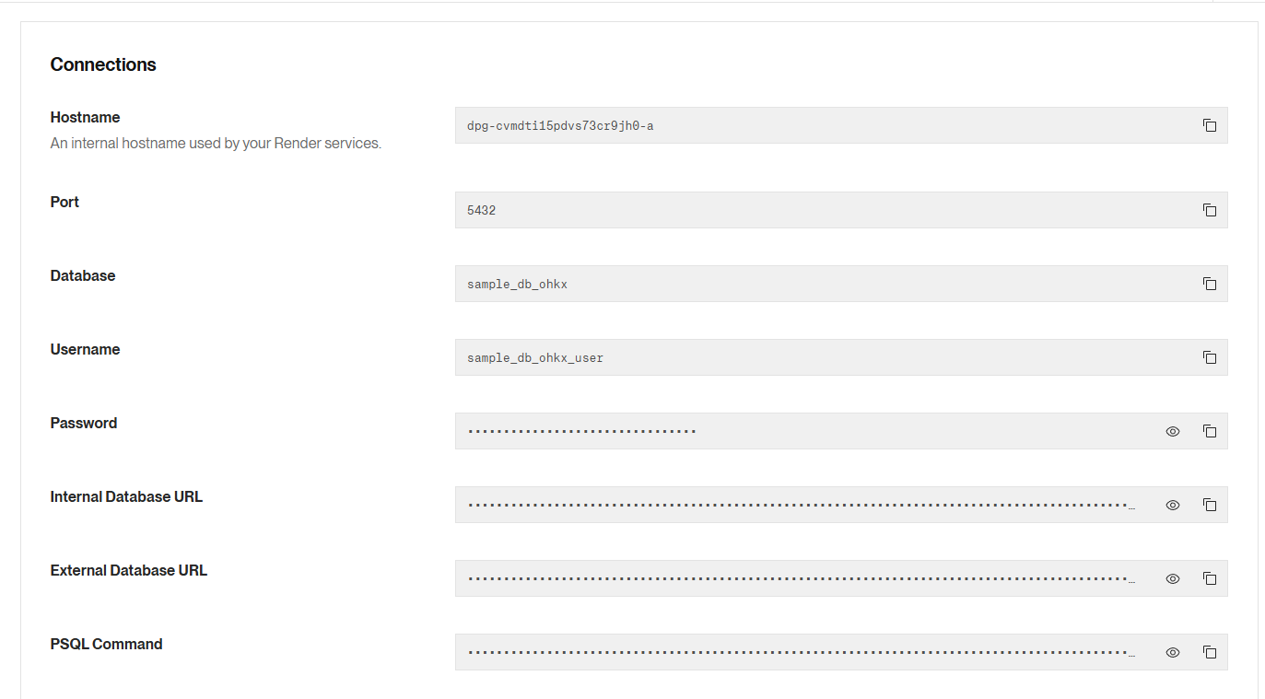

Slide 10
“
“Don't worry about failures, worry about the chances you miss when you don’t even try.”

