Slide 1
一、课题进展
1.无法使用 非时变数据集（王昕妍师姐的数据集）
饮茶与CVD
队列分层，年龄、性别、 7大区、area、教育程度、体力活动、是否饮酒、是否吸烟、cvd家族史、膳食（fish、meat、fresh、soya）、sbp、血糖、总胆固醇、高密度脂蛋白
饮茶对CVD的保护效应全部消失
PM2.5与CVD
队列分层，年龄、性别、南北方、area、教育程度、体力活动、是否饮酒、是否吸烟、cvd家族史、膳食（fish、meat、fresh、soya）、sbp、血糖、总胆固醇、高密度脂蛋白
PM2.5对CVD的危害效应全部消失
因此选用时变数据集

Slide 2
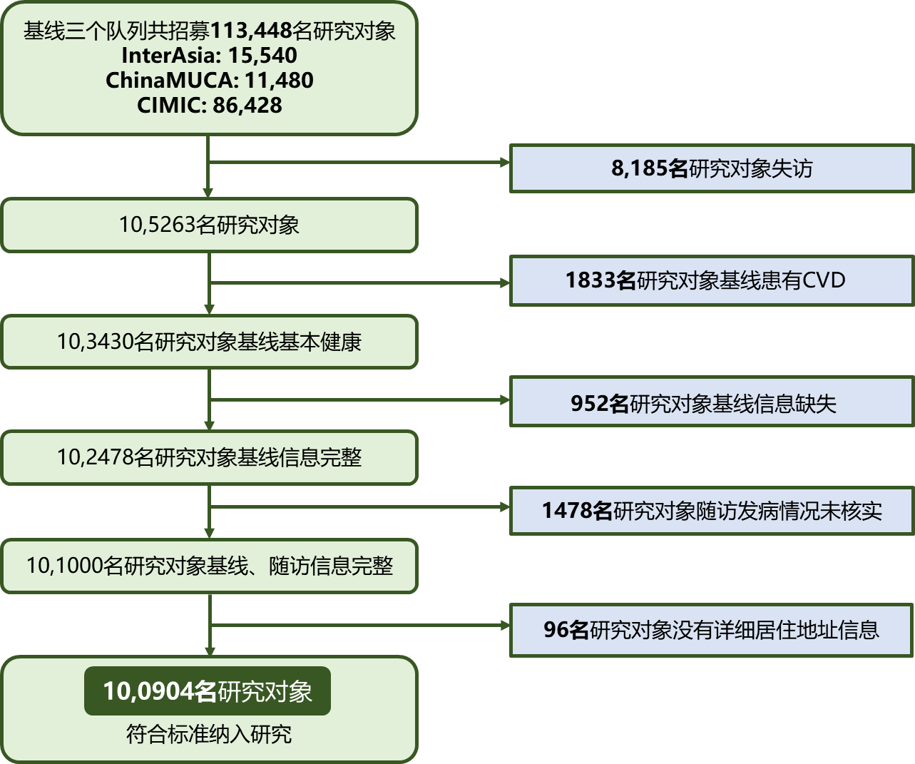
1.研究对象的纳入排除

Slide 3
2. 基线特征
Table 1 Characteristics of 100904 participants at baseline according to tea drinking habits.
 |  | Total | Never or <3 times/week | ≥3 times/week | P-value
No. of participants |  | 100904 | 69041 | 31863
Age, yrs |  | 51.5 ±12.2 | 52.0±12.4 | 50.5±11.7 | <0.001
Male, n(%) |  | 40654(40.3) | 21084(30.5) | 19570(61.4) | <0.001
Geographic area, n(%) |  |  |  |  | <0.001
 | North | 4177(4.1) | 1775(2.6) | 2402(7.5)
 | East | 68851(68.2) | 46413(67.2) | 22438(70.4)
 | Northwest | 2862(2.8) | 1491(2.2) | 1371(4.3)
 | Northeast | 2126(2.1) | 1791(2.6) | 335(1.1)
 | Central | 16530(16.4) | 13488(19.5) | 3042(9.5)
 | Southwest | 2013(2.0) | 989(1.4) | 1024(3.2)
 | South | 4345(4.3) | 3094(4.5) | 1251(3.9)
Urban, n(%) |  | 9245(9.2) | 4664(6.8) | 4581(14.4) | <0.001
Education≥12 years, N (%) |  | 13726(13.6) | 7947(11.5) | 5779(18.2) | <0.001
BMI |  | 23.7 ± 3.6 | 23.6±3.6 | 24.0±3.6 | <0.001
SBP, mmHg |  | 128.3 ± 21.4 | 127.5±21.4 | 130.2±21.3 | <0.001
Smoker, n(%) |  | 26023(25.8) | 12199(17.7) | 13824(43.5) | <0.001
Habitual alcohol drinkers, n(%) |  | 18762(18.6) | 9026(13.1) | 9736(30.6) | <0.001
Family history of CVD, N (%) |  | 10218(10.1) | 6812(9.9) | 3406(10.7) | <0.001
Fasting blood glucose, mg/dl |  | 91.9 ±26.4 | 91.7±26.0 | 92.2±27.3 | 0.232
Total serum cholesterol, mg/dl |  | 175.15 ±35.2 | 174.6±35.1 | 176.4±35.5 | <0.001
HDL-C, mg/dl |  | 51.4 ± 12.9 | 51.5±12.9 | 51.0±12.9 | <0.001
Physical activity standard, n(%) |  |  | 21383(31.0) | 12120(38.1) | <0.001
Ideal diet standard, n(%) | Fish | 34501(34.3) | 23456(34.1) | 11045(34.8) | <0.001
 | Fresh vegetables and fruits | 45875(45.5) | 29962(43.5) | 15913(50.0) | <0.001
 | Soy | 5151(5.1) | 3765(5.5) | 1386(4.4) | 0.036
 | Red meat | 84195(83.6) | 59465(86.3) | 24730(77.7) | <0.001
PM_{2.5} exposure(μg/m³) |  | 65.8 ± 15.3 | 64.7±15.0 | 67.9±15.8 | <0.001
PM_{2.5} exposure groups |  |  |  |  | <0.001
 | Low (<57.43μg/m³) | 49.5 ± 6.5 | 49.6±6.4 | 49.1±6.9
 | Intermediate(57.43-74.00μg/m³) | 63.7 ± 4.8 | 63.6±4.8 | 63.7±4.6
 | High(>74.00μg/m³) | 83.5 ± 6.7 | 83.0±6.6 | 84.6±6.9
平均随访7.28年，随访期间新发
脑卒中2887人，发病密度为3.96/1000人年
缺血性脑卒中1821人，发病密度为2.50/1000人年
出血性脑卒中847人，发病密度为1.16/1000人年
研究对象总体平均年龄为51.5±12.2岁，其中31863人有饮茶习惯，占31.6％；无饮茶习惯者69041(68.4%)。
相比于无饮茶习惯者，有饮茶习惯者中男性占比较高，且饮酒者和吸烟者占比远超无习惯饮茶者。有饮茶习惯者的BMI、收缩压、总胆固醇水平都略高于无饮茶习惯者。
有饮茶习惯者的体力活动达标比例比无饮茶习惯者较多。

Slide 4
3. 大气PM2.5暴露与脑卒中发病风险的关系
表2 大气PM2.5长期暴露与脑卒中发病风险的关系
PM2.5 exposure (ug/m3) | Case(N) | Model 1 |  | Model 2
 |  | HR 95%CI | P-value | HR 95%CI | P-value
Stroke
Low | 38585(1052) | 1 |  | 1
Intermediate | 21477(413) | 1.182(1.154-1.211) | <0.001 | 1.023(0.993-1.054) | 0.129
High | 40842(1422) | 1.984(1.939-2.030) | <0.001 | 1.131(1.092-1.170) | <0.001
per 10 μg/m³ increment | —— | 1.199(1.192-1.207) | <0.001 | 1.044(1.035-1.053) | <0.001
Ischemic stroke
Low | 38585(652) | 1 |  | 1
Intermediate | 21477(219) | 1.245(1.207-1.284) | <0.001 | 1.088(1.047-1.129) | <0.001
High | 40842(950) | 2.297(2.232-2.365) | <0.001 | 1.336(1.280-1.395) | <0.001
per 10 μg/m³ increment | —— | 1.255(1.245-1.265) | <0.001 | 1.098(1.087-1.110) | <0.001
Hemorrhagic stroke
Low | 38585(307) | 1 |  | 1
Intermediate | 21477(143) | 1.117(1.069-1.167) | <0.001 | 1.052(0.995-1.113) | 0.077
High | 40842(397) | 1.728(1.657-1.803) | <0.001 | 1.087(1.018-1.161) | 0.012
per 10 μg/m³ increment | —— | 1.147(1.134-1.160) | <0.001 | 1.032(1.016-1.048) | <0.001
分类变量，暴露于中、高水平PM2.5的研究对象与脑卒中风险增加显著相关，其中将脑卒中分为缺血性、出血性脑卒中，中、高暴露水平与这两种脑卒中亚型发病风险也显著相关；
连续型变量，PM2.5每升高10μg/m3，总脑卒中、缺血性、出血性脑卒中发病风险分别增加4%、10%，3%。
Stratified Cox proportional hazard model
Model 1: adjusted for age, gender(male/female).
Model 2: Model 1 + geographic region (north/northeast/east/southwest/south/central/northwest), area (rural/urban), education level ( ≥12 years or not), family history of CVD (yes or no), smoking (yes or no), drinking (yes or no), physical activity level (ideal or not), dietary factors (ideal or not for consumption of fresh vegetables and fruits, red meat, soy products, fish), body mass index, systolic blood pressure, fasting blood glucose, total cholesterol, high-density lipoproteincholesterol.

Slide 5
4. 基线有无饮茶习惯与脑卒中发病风险的关系
表3 基线有无饮茶习惯与脑卒中发病风险的关系
Habitual tea drinking | Case(N) | Model 1 |  | Model 2
 |  | HR 95%CI | P-value | HR 95%CI | P-value
Stroke
Never or <3 times/week | 69041(2040) | 1 |  | 1
≥3 times/week | 31863(847) | 0.921(0.902-0.941) | <0.001 | 0.959(0.934-0.985) | 0.002
Ischemic stroke
Never or <3 times/week | 69041(1285) | 1 |  | 1
≥3 times/week | 31863(536) | 0.916(0.896-0.937) | <0.001 | 0.919(0.893-0.945) | <0.001
Hemorrhagic stroke
Never or <3 times/week | 69041(583) | 1 |  | 1
≥3 times/week | 31863(264) | 0.940(0.904-0.977) | 0.002 | 0.977(0.937-1.019) | 0.281
有饮茶习惯（每周饮茶≥3次/周）发生总脑卒中、缺血性脑卒中的风险约分别减少4%、8%。
然而有无饮茶习惯与出血性脑卒中发生风险无统计学意义。
Stratified Cox proportional hazard model
Model 1: adjusted for age, gender(male/female).
Model 2: Model 1 + geographic region (north/northeast/east/southwest/south/central/northwest), area (rural/urban), education level ( ≥12 years or not), family history of CVD (yes or no), smoking (yes or no), drinking (yes or no), physical activity level (ideal or not), dietary factors (ideal or not for consumption of fresh vegetables and fruits, red meat, soy products, fish), body mass index, systolic blood pressure, fasting blood glucose, total cholesterol, high-density lipoproteincholesterol.

Slide 6
5.大气PM2.5暴露与有无饮茶习惯相加、相乘交互作用
表4 大气PM_{2.5}暴露与有无饮茶习惯相加、相乘交互作用
PM_{2.5} exposure | Tea drinking frequency（<3 times/week） |  | P for interaction*
 | RERI† | AP‡
Stroke |  |  | 0.26
Intermediate | 0.07(0.02 to 0.13) | 0.06(0.01 to 0.12)
High | 0.10(0.04 to 0.16) | 0.08(0.03 to 0.12)
Ischemic Stroke |  |  | 0.46
Intermediate | 0.05(-0.03 to 0.12) | 0.04(-0.02 to 0.11)
High | 0.19(0.12 to 0.27) | 0.12(0.07 to 0.17)
Hemorrhagic Stroke |  |  | 0.82
Intermediate | 0.16(0.06 to 0.26) | 0.14(0.05 to 0.23)
High | 0.04(-0.06 to 0.14) | 0.04(-0.05 to 0.13)
PM_{2.5}暴露与有无饮茶习惯不存在相乘交互作用，但是二者对于总脑卒中、缺血性、出血性脑卒中存在相加交互作用。
总脑卒中发病约6%-8%可归因于二者的相加交互作用；其中脑卒中的亚型缺血性、出血性脑卒中发病分别约12%、14%可归因于二者的相加交互作用。
Stratified Cox proportional hazard model
Adjusted for age, gender, geographic region (north/northeast/east/southwest/south/central/northwest), area (rural/urban), cohort, education level ( ≥12 years or not), family history of CVD (yes or no), smoking (yes or no), drinking (yes or no), physical activity level (ideal or not), dietary factors (ideal or not for consumption of fresh vegetables and fruits, red meat, soy products, fish), body mass index, systolic blood pressure, fasting blood glucose, total cholesterol, high-density lipoproteincholesterol.
*Likelihood test was used to test the significance of interaction term by comparing the model with and without the interaction term.
†RERI=the relative excess risk due to interaction.To estimate the RERI and AP, the low-PM2.5 category and the ≥3 times/week groups were the reference categories
‡AP=attributable proportion due to the interaction

Slide 7
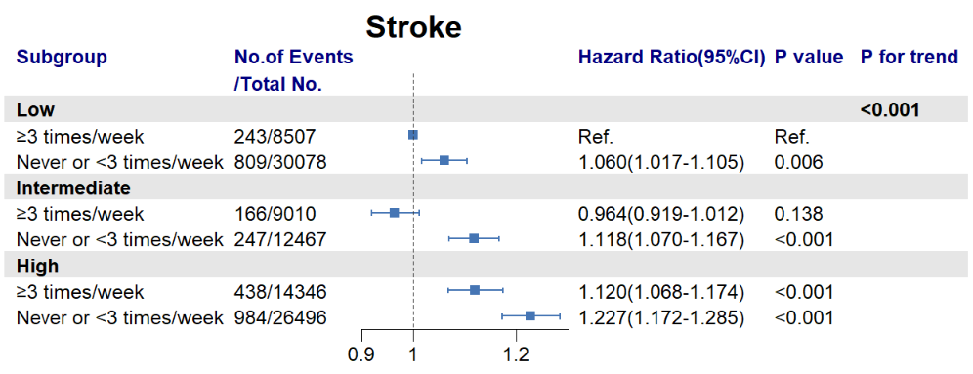
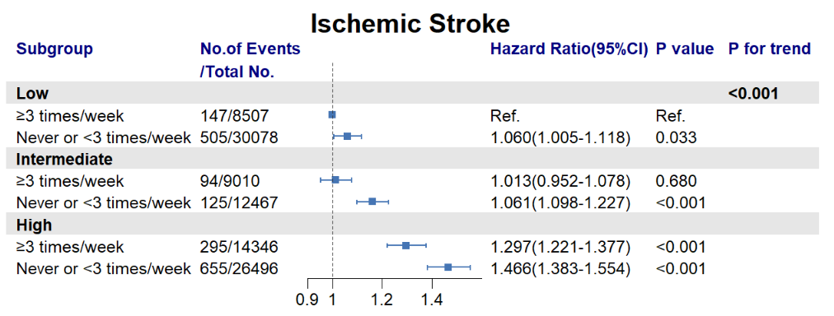
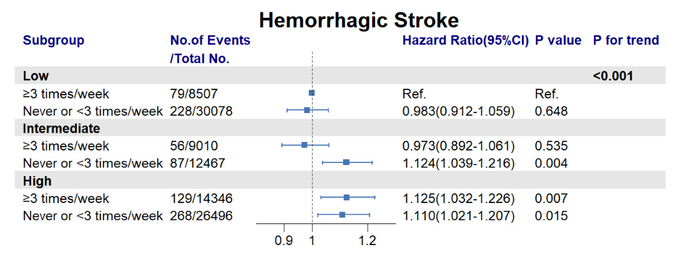
6.大气PM2.5暴露与有无饮茶习惯对脑卒中发病风险的联合暴露
Stratified Cox proportional hazard model
Adjusted for age, gender, geographic region (north/northeast/east/southwest/south/central/northwest), area (rural/urban), cohort, education level ( ≥12 years or not), family history of CVD (yes or no), smoking (yes or no), drinking (yes or no), physical activity level (ideal or not), dietary factors (ideal or not for consumption of fresh vegetables and fruits, red meat, soy products, fish), body mass index, systolic blood pressure, fasting blood glucose, total cholesterol, high-density lipoproteincholesterol.
相较于低水平的PM2.5暴露和经常饮茶的人群，随着PM2.5暴露的增加以及不经常饮茶，脑卒中及其亚型缺血性脑卒中的风险逐渐增加，呈现梯度上升的趋势。
暴露于高水平的PM2.5和不经常饮茶的人群脑卒中及缺血性脑卒中发病风险最大，分别增加22.7%、46.6%的发病风险。
结论：
经常饮茶（>3次/周）可能会改变大气PM_{2.5}长期暴露与脑卒中发病风险的关系，尤其是缺血性脑卒中亚型。
图2 大气PM2.5暴露与有无饮茶习惯的联合暴露对脑卒中发病风险的影响

Slide 8
6种结局
2. 大气PM2.5暴露与CVD发病风险的关系
Table 2 HR and 95%CI for CVD incidence associated with the long-term exposure to PM2.5.
 | CVD |  | Stroke |  | Ischemic stroke |  | Hemorrhagic stroke |  | CHD |  | ASCVD
PM2.5 level (ug/m³) | Adjusted HR (95% CI) | P value | Adjusted HR (95% CI) | P value | Adjusted HR (95% CI) | P value | Adjusted HR (95% CI) | P value | Adjusted HR (95% CI) | P_value | Adjusted HR (95% CI) | P value
Low(<54.79) | 1 |  | 1 |  | 1 |  | 1 |  | 1 |  | 1
Medium(54.79-79.72) | 1.158(1.131-1.185) | <0.001 | 1.023(0.993-1.054) | 0.129 | 1.088(1.047-1.129) | <0.001 | 1.052(0.995-1.113) | 0.077 | 1.629(1.549-1.714) | <0.001 | 1.097(1.068-1.127) | <0.001
High(>79.72) | 1.541(1.500-1.583) | <0.001 | 1.131(1.092-1.170) | <0.001 | 1.336(1.280-1.395) | <0.001 | 1.087(1.018-1.161) | 0.012 | 2.693(2.543-2.852) | <0.001 | 1.279(1.240-1.319) | <0.001
per 10 μg/m³ increment | 1.143(1.136-1.150) | <0.001 | 1.044(1.035-1.053) | <0.001 | 1.098(1.087-1.110) | <0.001 | 1.032(1.016-1.048) | <0.001 | 1.324(1.307-1.340) | <0.001 | 1.086(1.078-1.094) | <0.001
Stratified Cox proportional hazard model
Adjusted for age, gender, geographic region (north/northeast/east/southwest/south/central/northwest), area (rural/urban), cohort, education level ( ≥12 years or not), family history of CVD (yes or no), smoking (yes or no), drinking (yes or no), physical activity level (ideal or not), dietary factors (ideal or not for consumption of fresh vegetables and fruits, red meat, soy products, fish), body mass index, systolic blood pressure, fasting blood glucose, total cholesterol, high-density lipoproteincholesterol.
3. 基线有无饮茶习惯与CVD发病风险的关系
Table 3 HR and 95%CI for CVD incidence associated with the habitual tea drinking.
 | CVD |  | Stroke |  | Ischemic stroke |  | Hemorrhagic stroke |  | CHD |  | ASCVD
 | Adjusted HR (95% CI) | P value | Adjusted HR (95% CI) | P value | Adjusted HR (95% CI) | P value | Adjusted HR (95% CI) | P value | Adjusted HR (95% CI) | P_value | Adjusted HR (95% CI) | P value
Never or <3 times/week | 1 |  | 1 |  | 1 |  | 1 |  | 1 |  | 1
>=3 times/week | 0.986(0.969-1.003) | 0.108 | 0.916(0.896-0.937) | <0.001 | 0.919(0.893-0.945) | <0.001 | 0.977(0.937-1.019) | 0.28 | 1.067(1.033-1.102) | <0.001 | 0.925(0.907-0.944) | <0.001
Stratified Cox proportional hazard model
Adjusted for age, gender, geographic region (north/northeast/east/southwest/south/central/northwest), area (rural/urban), cohort, education level ( ≥12 years or not), family history of CVD (yes or no), smoking (yes or no), drinking (yes or no), physical activity level (ideal or not), dietary factors (ideal or not for consumption of fresh vegetables and fruits, red meat, soy products, fish), body mass index, systolic blood pressure, fasting blood glucose, total cholesterol, high-density lipoproteincholesterol.

Slide 9
4.是否习惯性饮茶分层下 大气PM2.5暴露与CVD发病的关系
5.大气PM2.5暴露与有无饮茶习惯相加、相乘交互作用
表4 是否有饮茶习惯分层下大气PM2.5暴露与CVD 的发病关系
表5 相加、相乘交互作用
PM2.5 exposure | Never or <3 times/week |  |  | ≥3 times/week
 | Adjusted HR(95% CI) | P-value |  | Adjusted HR(95% CI) | P-value
CVD
Quartile 1 | Reference |  |  | Reference
Quartile 2 | 1.161(1.130-1.193) | <0.001 |  | 1.173(1.128-1.221) | <0.001
Quartile 3 | 1.537(1.491-1.584) | <0.001 |  | 1.707(1.634-1.784) | <0.001
per 10 μg/m³ increment | 1.139(1.130-1.148) | <0.001 |  | 1.153(1.141-1.166) | <0.001
Stroke
Quartile 1 | Reference |  |  | Reference
Quartile 2 | 1.016(0.982-1.051) | 0.362 |  | 1.063(1.009-1.120) | 0.022
Quartile 3 | 1.083(1.042-1.126) | <0.001 |  | 1.288(1.215-1.364) | <0.001
per 10 μg/m³ increment | 1.033(1.022-1.044) | <0.001 |  | 1.072(1.057-1.088) | <0.001
Ischemic Stroke
Quartile 1 | Reference |  |  | Reference
Quartile 2 | 1.050(1.006-1.096) | 0.025 |  | 1.104(1.033-1.178) | <0.001
Quartile 3 | 1.243(1.184-1.305) | <0.001 |  | 1.557(1.448-1.673) | <0.001
per 10 μg/m³ increment | 1.082(1.068-1.097) | <0.001 |  | 1.127(1.107-1.148) | <0.001
Hemorrhagic Stroke
Quartile 1 | Reference |  |  | Reference
Quartile 2 | 1.095(1.027-1.168) | 0.006 |  | 1.110(1.007-1.224) | 0.036
Quartile 3 | 1.116(1.036-1.201) | <0.001 |  | 1.204(1.080-1.342) | <0.001
per 10 μg/m³ increment | 1.034(1.013-1.055) | <0.001 |  | 1.040(1.012-1.068) | <0.001
CHD
Quartile 1 | Reference |  |  | Reference
Quartile 2 | 1.541(1.451-1.636) | <0.001 |  | 1.472(1.365-1.587) | <0.001
Quartile 3 | 2.821(2.643-3.011) | <0.001 |  | 2.802(2.575-3.050) | <0.001
per 10 μg/m³ increment | 1.331(1.310-1.352) | <0.001 |  | 1.322(1.296-1.348) | <0.001
ASCVD
Quartile 1 | Reference |  |  | Reference
Quartile 2 | 1.082(1.049-1.116) | <0.001 |  | 1.178(1.125-1.233) | <0.001
Quartile 3 | 1.246(1.204-1.291) | <0.001 |  | 1.536(1.459-1.617) | <0.001
per 10 μg/m³ increment | 1.076(1.065-1.086) | <0.001 |  | 1.123(1.109-1.138) | <0.001
PM_{2.5} exposure | Tea drinking frequency（≥3 times/week） |  | P for interaction*
 | RERI | AP
CVD |  |  | 0.238
 | 0.03(-0.01 to 0.08) | 0.03(-0.01 to 0.07)
 | 0.21(0.16 to 0.26) | 0.11(0.08 to 0.14)
Stroke |  |  | 0.264
 | 0.07(0.02 to 0.13) | 0.06(0.01 to 0.12)
 | 0.10(0.04 to 0.16) | 0.08(0.03 to 0.12)
Ischemic Stroke |  |  | 0.464
 | 0.05(-0.03 to 0.12) | 0.04(-0.02 to 0.11)
 | 0.19(0.12 to 0.27) | 0.12(0.07 to 0.17)
Hemorrhagic Stroke |  |  | 0.817
 | 0.16(0.06 to 0.26) | 0.14(0.05 to 0.23)
 | 0.04(-0.06 to 0.14) | 0.04(-0.05 to 0.13)
CHD |  |  | 0.008
 | -0.02(-0.11 to 0.08) | -0.01(-0.09 to 0.07)
 | 0.67(0.51 to 0.82) | 0.19(0.15 to 0.23)
ASCVD |  |  | 0.325
 | 0.01(-0.04 to 0.06) | 0.01(-0.04 to 0.05)
 | 0.18(0.13 to 0.23) | 0.12(0.08 to 0.15)
Stratified Cox proportional hazard model
Adjusted for age, gender, geographic region (north/northeast/east/southwest/south/central/northwest), area (rural/urban), cohort, education level ( ≥12 years or not), family history of CVD (yes or no), smoking (yes or no), drinking (yes or no), physical activity level (ideal or not), dietary factors (ideal or not for consumption of fresh vegetables and fruits, red meat, soy products, fish), body mass index, systolic blood pressure, fasting blood glucose, total cholesterol, high-density lipoproteincholesterol.

Slide 10
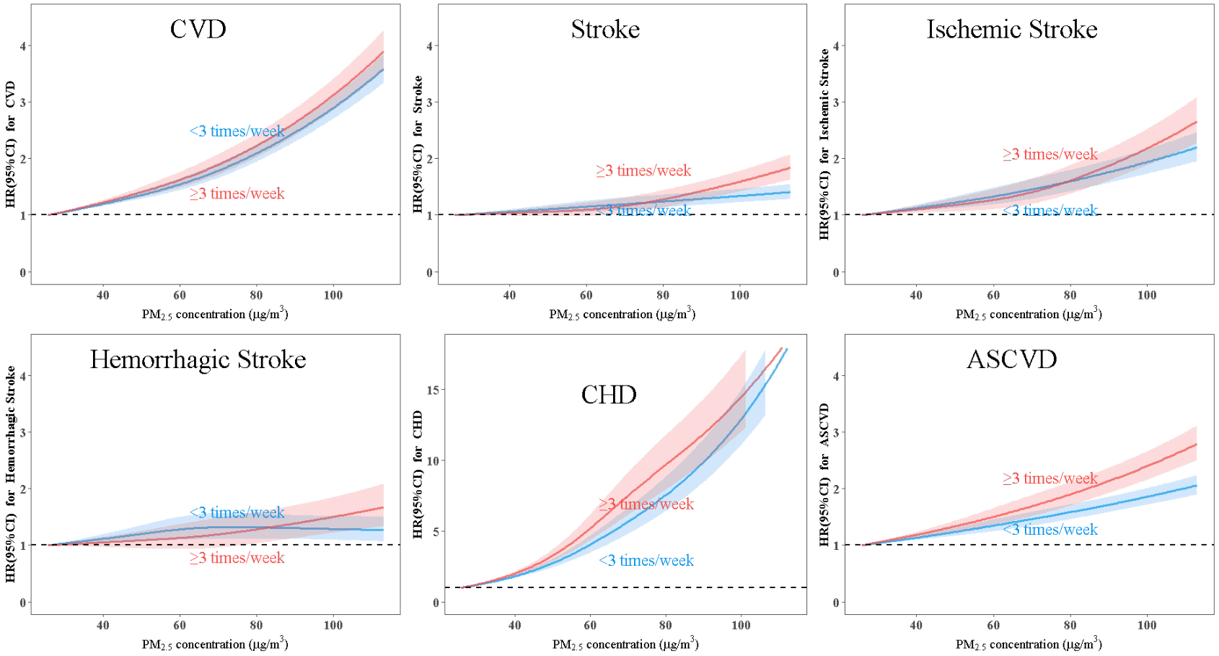
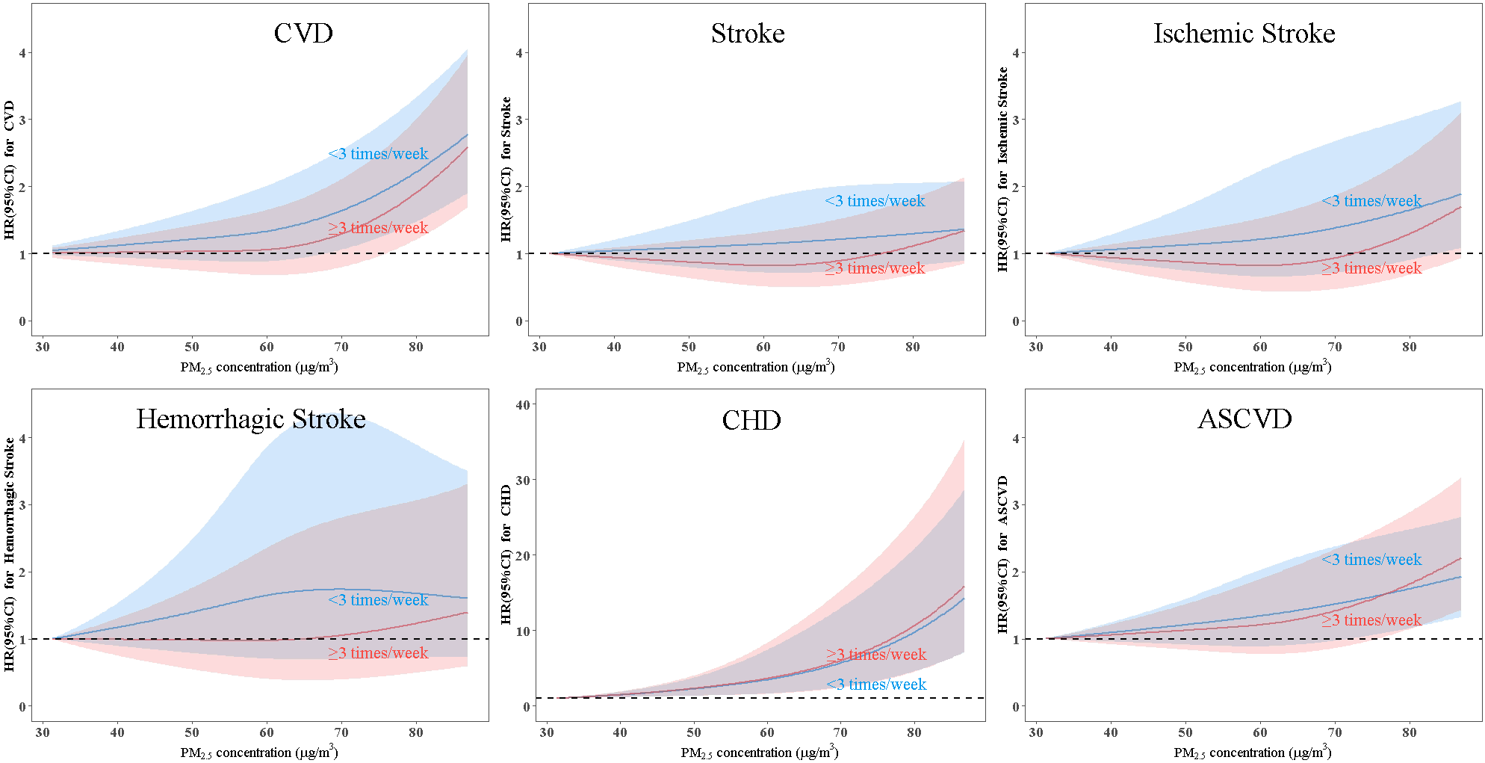
非时变数据集
6.是否习惯性饮茶分层下 大气PM2.5暴露与CVD发病RCS曲线
时变数据集
Stratified Cox proportional hazard model
Adjusted for age, gender, geographic region (north/northeast/east/southwest/south/central/northwest), area (rural/urban), cohort, education level ( ≥12 years or not), family history of CVD (yes or no), smoking (yes or no), drinking (yes or no), physical activity level (ideal or not), dietary factors (ideal or not for consumption of fresh vegetables and fruits, red meat, soy products, fish), body mass index, systolic blood pressure, fasting blood glucose, total cholesterol, high-density lipoproteincholesterol.

Slide 11
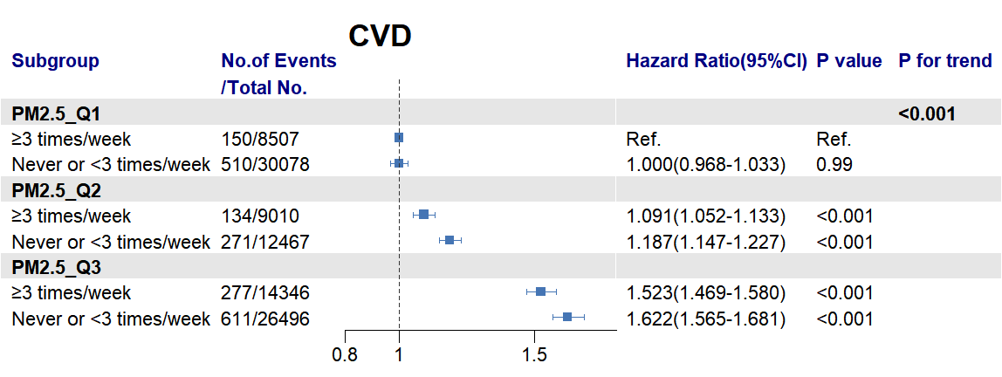
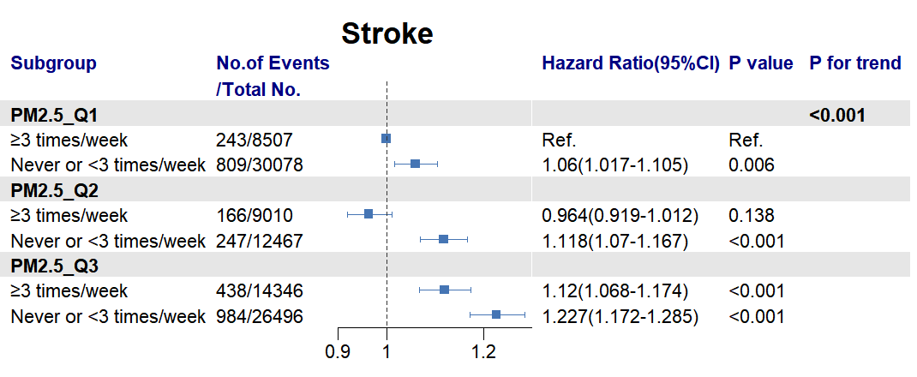
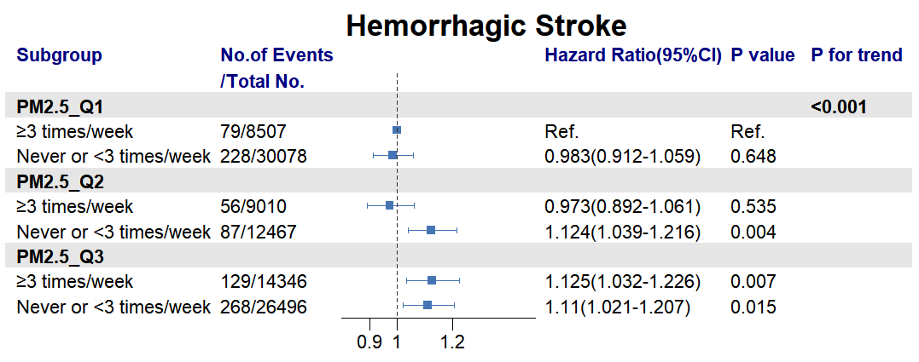
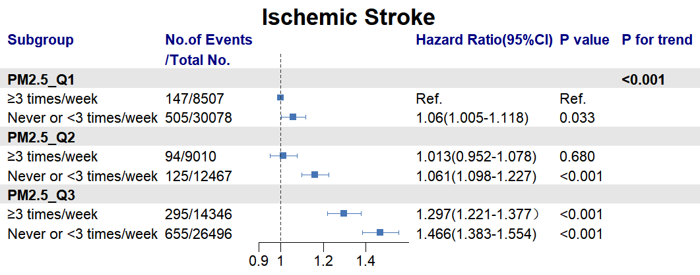
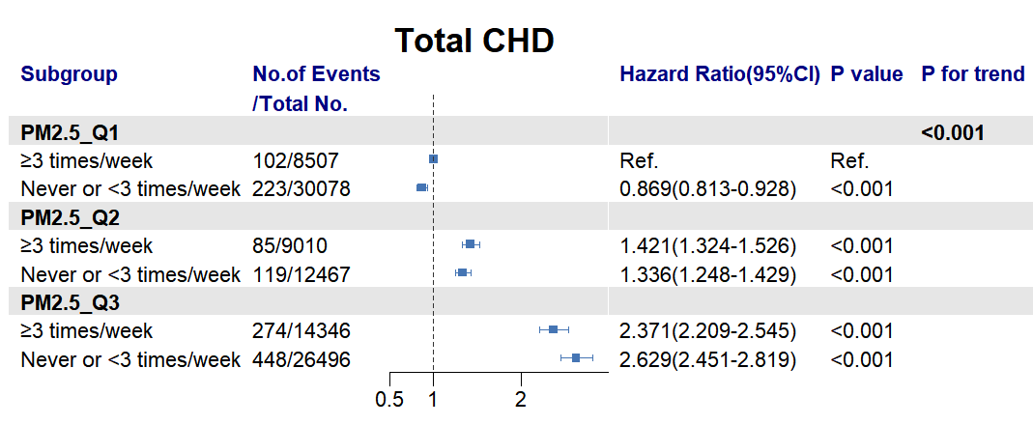
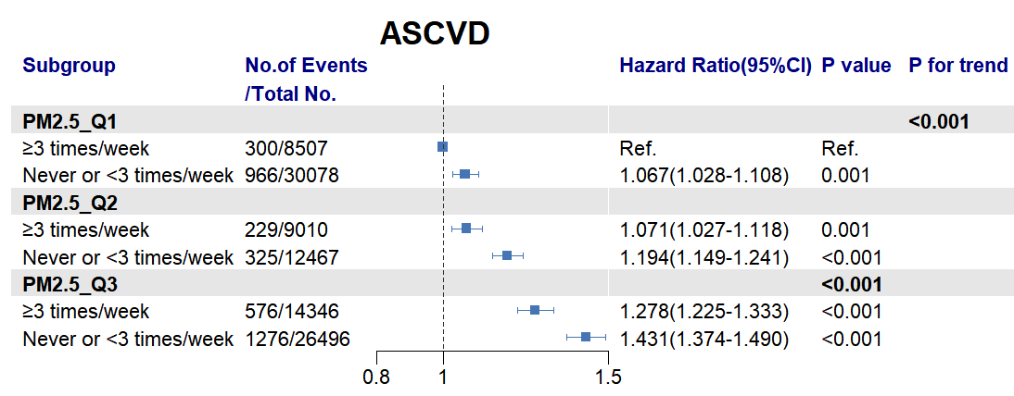
7.大气PM2.5暴露与有无饮茶习惯对CVD发病风险的联合暴露

