Slide 1
HoneyComb
Everyone can be a Data Scientist

Slide 2









HoneyComb
Background
Data Scientist
Data
Valuable Result
Iterative
Time Consuming
Human Drive

Slide 3




HoneyComb
Name: Adam
Title: CEO of E-commerce Start Up
Aim: Make next year’s marketing plan based on current data
Plight: Low budget
Limited data scientists
Manual Computation?
Auto Calculation
Face-to-face Operation?
Remote Conduct

Slide 4
HoneyComb
HoneyComb
Machine Learning as a Service
A platform that provides general machine learning/big data analysis services.

Slide 5



HoneyComb
Customer Segments
Value Propositions
Business Model
Channels
Customer Relationships
——The Nine Building Blocks
Key Resources
Key Activities
Key Partnerships
Revenue Stream
Cost Structure

Slide 6




HoneyComb
Customer Segments
Value Propositions
Mass Market
Channels
Customer Relationships
Anyone who needs the data analysis:
Such as data scientists and analysis
in research, company or start up
Key Resources
Key Activities
Key Partnerships
Revenue Stream
Cost Structure

Slide 7





HoneyComb
Customer Segments
Value Propositions
Lack of Qualified Data Scientists & Money cost for employment?
Channels
Customer Relationships
Difficult for Spark?
Difficult for Cassandra?
Key Resources
Key Activities
Difficult for Algorithm implementation?
Time Consuming for Data Visualisation?
Key Partnerships
Revenue Stream
Cost Structure

Slide 8
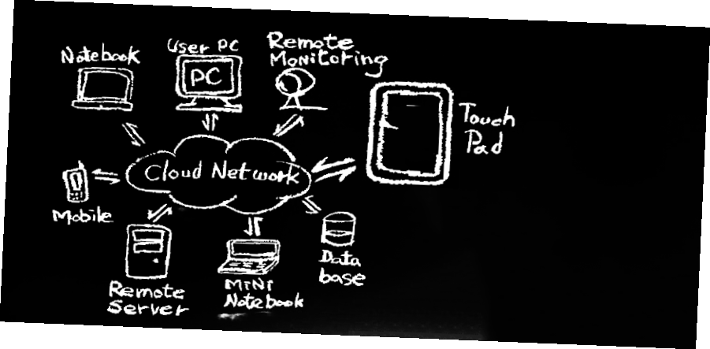
HoneyComb
Customer Segments
Value Propositions
Cloud Platform & Remote cluster
Channels
Customer Relationships
Key Resources
Key Activities
Key Partnerships
Revenue Stream
Cost Structure

Slide 9
HoneyComb
Customer Segments
Get—> Keep—> Grow
Value Propositions
Channels
Company mainly need it for cutting off cost
Customer Relationships
Key Resources
Individual mainly need it for better data analysis
Key Activities
Key Partnerships
Revenue Stream
Cost Structure

Slide 10
HoneyComb
Key Resources
Customer Segments
Developer well in technology
such as Spark & Cassandra
Value Propositions
Business plan for venture capital
Channels
Customer Relationships
Key Activities
Key Resources
Market Searching
HoneyComb Development and Updating
Key Activities
Key Partnerships
Key Partnerships
Revenue Stream
Venture Capitalist
Stakeholder
Cost Structure

Slide 11
HoneyComb
Customer Segments
Transaction Revenue
Value Propositions
Free trial for specific days or specific scales
Channels
Large scale support for paid customers
with data confidentiality agreement
Customer Relationships
Key Resources
Recurring Revenue
Key Activities
Website open for all the sign-up users
Key Partnerships
Long-term data analysis service for company
or individuals in need
Revenue Stream
Cost Structure

Slide 12
HoneyComb
Customer Segments
Value Propositions
Channels
Developer resource
• Cost of clusters
• Customer maintenance
• Marketing exploration
Customer Relationships
Key Resources
Key Activities
Key Partnerships
Revenue Stream
Cost Structure

Slide 13












HoneyComb
Rivalry
H2O
Spark
Machine Learning
Deeplearning4j
Hadoop
Caffe
Deep Learning

Slide 14
HoneyComb
Why us?
Business
People without programming skills can do data analysis
Save money on recruiting more data scientists
Fast Data Computing to save time

Slide 15






HoneyComb
Procedure
HoneyComb
Backend Calculation
HoneyCell
Frontend
Data Input
Analysis Result Output
Visualisation

Slide 16


HoneyComb
Architecture
Dispatcher
Machine Learning Library
Map Reduce Distributed Storage
Microservice
…
SVM
Logistic Regression
Octave Tutorial
KNN
Spark/Scala
Cassandra

Slide 17
HoneyComb
Why us?
Technology
Each module language independent.
Updating machine learning algorithms for all kinds of data necessary
Remote Procedure Call Protocol by distributed system

Slide 18







HoneyComb
Procedure
HoneyCell
Website
Cassandra
Database
6. Check
HTTP Request
2. Save
4. Fetch
5. Result
Server
Spark Backend
3. Call

Slide 19


HoneyComb
Team Work
HoneyCell
HoneyComb
Manager
Ruijian Wang
Log in register & deployment
Xiaoming Sun
Weixiang Ding
Spark
Bin Zhu
Wenyan Hu
Bowei Zhang
Bangjie Liu
Qing Li
Server
Ningna Wang
Zhoucheng Li
Handi Xu
Long He
Visualisation
SooHyun Jeon
Shengbiao Li
Authentication &
Integration
Yangqiu Peng
Cassandra
Jianhe Luo
Qing Li
Bowei Zhang
Presentation
Wenyan Hu

Slide 20
HoneyComb
Thank you !
Any Questions?

