Slide 1

NEXT HIKES IT SOLUSTION
Bike Sharing Demand Analysis Project Using EXCEL
Presented by : Honey Patel
Date : October 2025

Slide 2

Problem statement
Contant : understanding bike rental demands helps optimize fleet size and service availability.
This project explores how time, weather, and holiday affect user behavior - using excel analytics and automation.

Slide 3
Data sources
Contant:
Dataset_1: Time and weather data (hourly)
Dataset_2: Rental counts and user types
Dataset_3: Full hourly records
Merged dataset 1 and 2: Humidity and rental gap
Merged dataset and dataset 3: Temperature category and humidity
All datasets were cleaned, merged and analyzed in excel .

Slide 4
Methodology
Contant:
Imported and cleaned all datasets
Merged using power query as key
Created derived columns (e.g., Rentalgap, Week)
Built pivot tables and dashboards

Slide 5
Key metrics
Weather label: Convert weather codes to readable labels
Rental Gap: Difference between registered and casual users
Rental Efficiency: Total rentals per hour
Weekend Flag: Weekday vs weekend classification
Humidity: Comfortable labels to understand humidity code

Slide 6
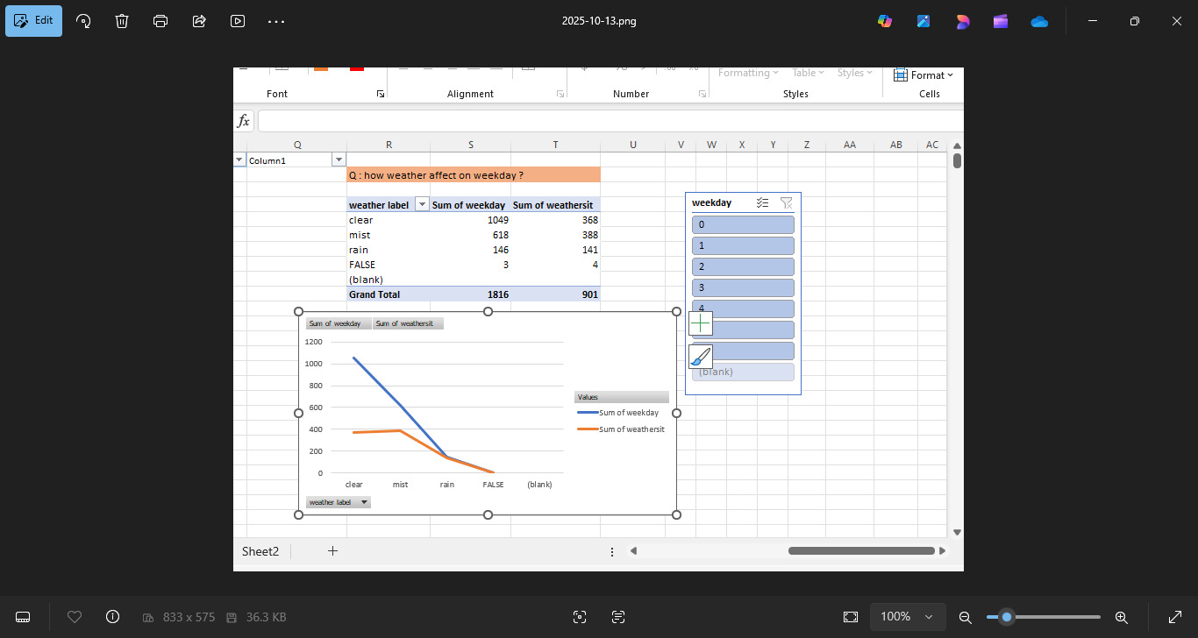
Weather impact
Charts: Line chart showing rentals by weather condition
Insights : Clear weather drives highest demand.
Rain and mist significantly reduce casual user activity.

Slide 7
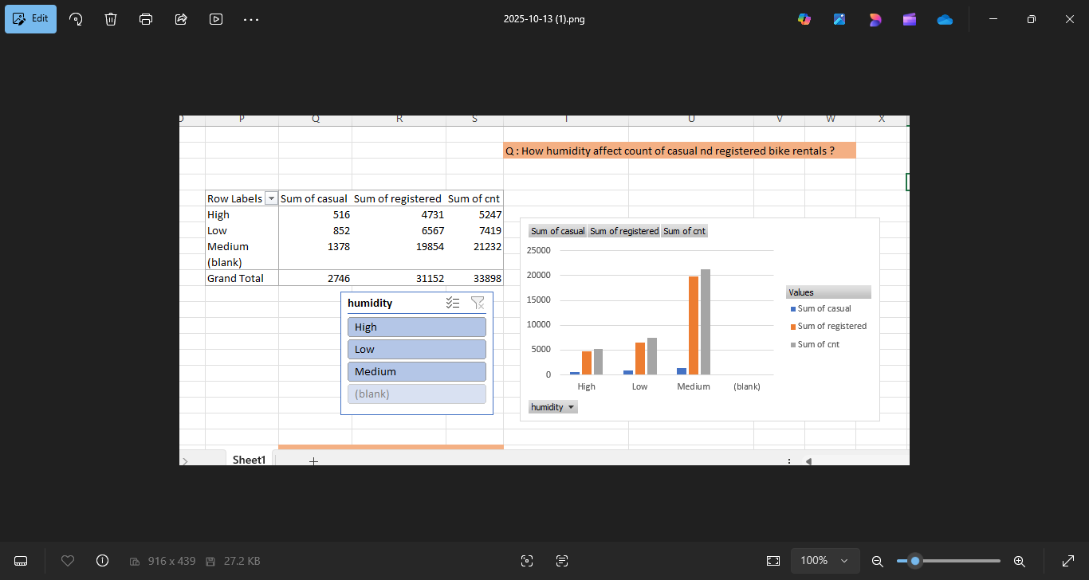
Humidity affect :
Chart: Column chart shows how humidity affect on registered and casual bike rentals.
Insights: High and low humidity affect on bike rentals. In medium humidity sales are higher than low and high humidity.

Slide 8
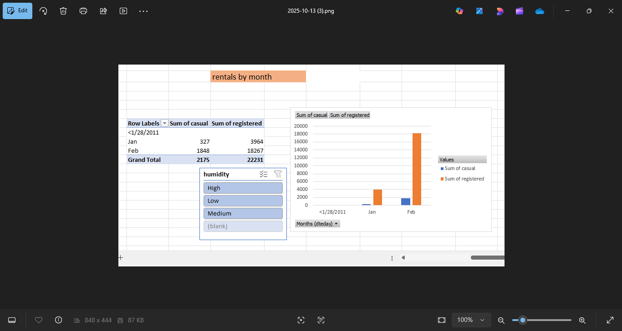
Monthly demand by trends
Chart: Column chart showing rental by months
Insights: Peak demand occurs in February month more than January month.

Slide 9
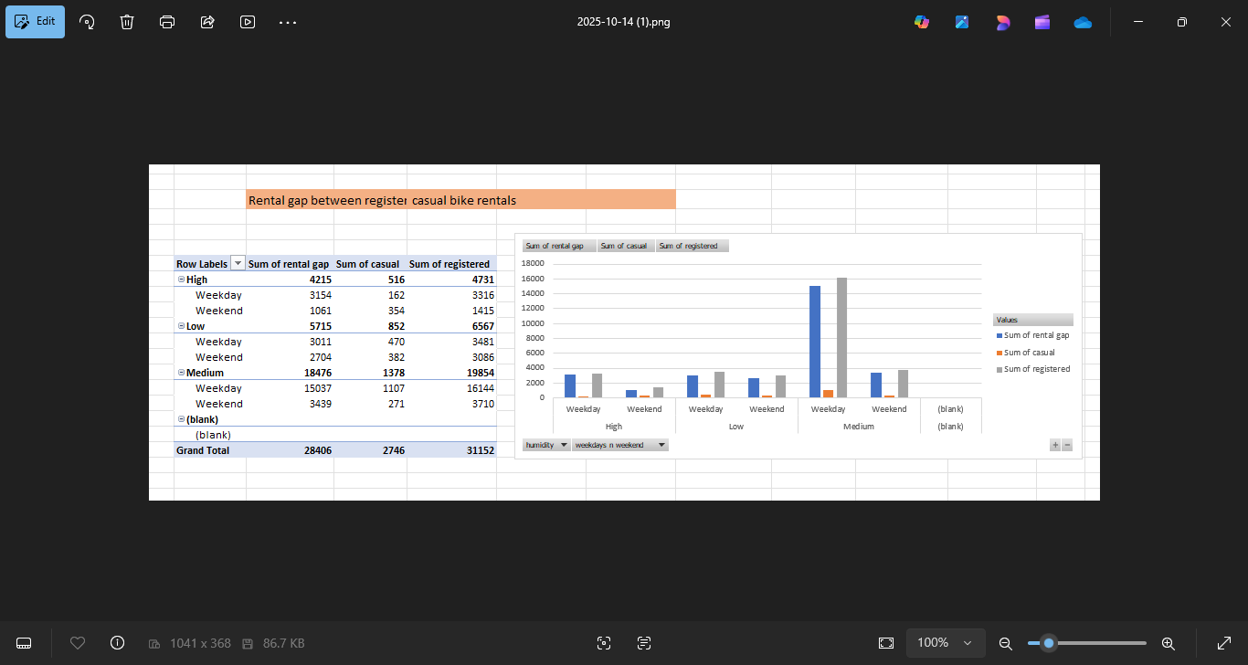
Rental gap
Chart: Column chart showing rental gap between registered and casual bike rentals.
Insights: Registered rentals are higher than casual. Highest rentals are in meadium humidity on weekdays.

Slide 10
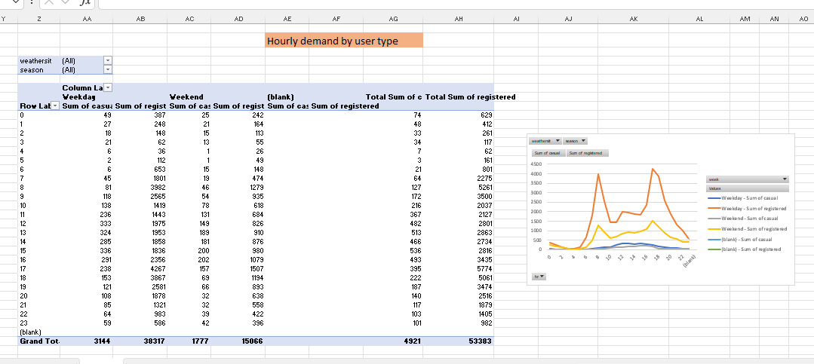
Hourly demand by user type
Chart: Line chart showing rentals by hour.
Insights: Peak demand occurs between 8-9 AM and 5-7 PM. Weekend shows flatter curves.

Slide 11
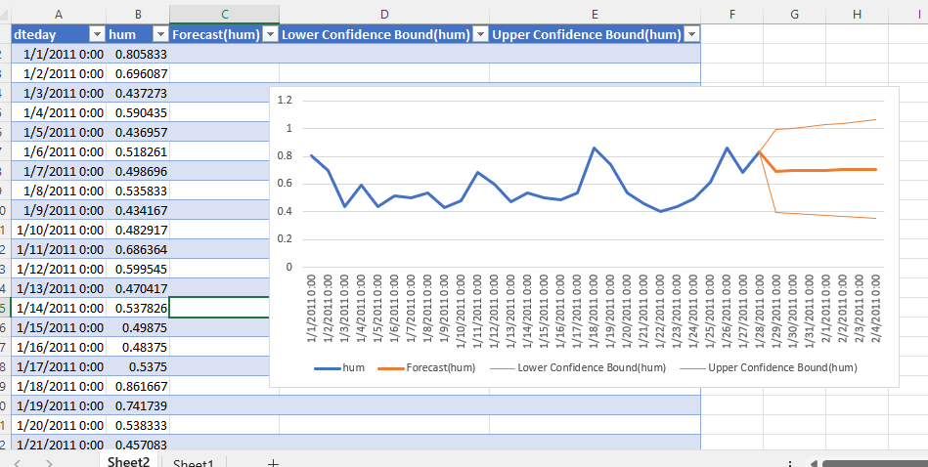
Forecast
Chart: Excel forecast sheet chart
Insights: AI tool predict future demand based on historical patterns.

Slide 12
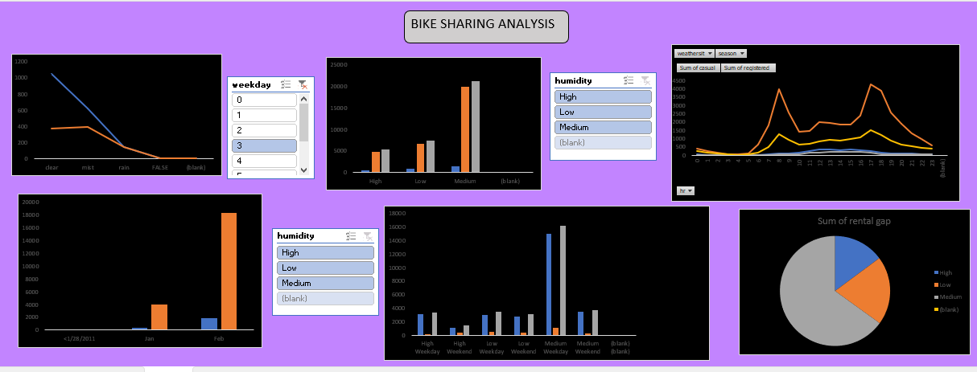
Dashboard

Slide 13
THANK YOU

