Slide 1
Digital Portfolio
STUDENT NAME: E . Honey Rebecca
REGISTER NO AND NMID: A4E04E29CF1D20AAD114C2228A610DB4
DEPARTMENT: BCA ( Bachelor of Computer Application)
COLLEGE: Valliammai women's college of arts and science / Annamalai University

Slide 2
PROJECT TITLE
Bbgfnmmahbaahbsns
Creative student portfolio using FWD

Slide 3


AGENDA
Problem Statement
Project Overview
End Users
Tools and Technologies
Portfolio design and Layout
Features and Functionality
Results and Screenshots
Conclusion
Github Link
3/21/2024 Annual Review

Slide 4

PROBLEM STATEMENT
- Title: "Creating a Creative Student Portfolio" - Problem Statement: "As a student, I want to showcase my projects and skills in a visually appealing and easy-to-navigate portfolio, so that I can demonstrate my capabilities to potential employers and peers."

Slide 5

PROJECT OVERVIEW
- Title: "FWD Creative Student Portfolio" - Project Description: "A web-based portfolio showcasing my projects, skills, and experience in front-end development, web design, and other creative pursuits." Goals: - Showcase projects and skills - Demonstrate creativity and technical abilities - Easy to navigate and visually appealing

Slide 6

WHO ARE THE END USERS?
- Title: "Target Audience" - Description: "Potential employers, peers, and mentors who want to view my projects and skills." - User Personas: - Employers looking for skilled developers/designers - Peers seeking inspiration or collaboration opportunities - Mentors providing guidance and feedback

Slide 7

TOOLS AND TECHNIQUES
- Title: "Technologies Used" - List: - HTML/CSS/JavaScript - Front-end framework (e.g., React) - Design tools (e.g., Figma, Adobe XD) - Version control (e.g., GitHub)

Slide 8
PORTFOLIO DESIGN AND LAYOUT
- Title: "Design Concept" - Description: "A clean, modern design with a focus on showcasing projects and skills." - Layout: - Hero section with introduction and call-to-action - Project showcase with images, descriptions, and links - Skills and experience section
8

Slide 9
FEATURES AND FUNCTIONALITY
- Title: "Key Features" - List: - Responsive design for mobile and desktop - Project filtering and sorting - Interactive elements (e.g., animations, hover effects) - Contact form or email link

Slide 10
RESULTS AND SCREENSHOTS
- Title: "Portfolio Showcase" - Screenshots: - Description: "A visually appealing and functional portfolio that showcases my skills and experience."
3/21/2024 Annual Review
10

Slide 11
CONCLUSION
- Title: "Conclusion" - Summary: "My FWD creative student portfolio showcases my skills and experience in front-end development, web design, and other creative pursuits." - Call-to-Action: "View my portfolio and let's connect!"
11

Slide 12
GitHub link
- Title: "GitHub Repository" - Link: https://github.com/honeyrebecca07 - Description: "View the code for my portfolio on GitHub."

Slide 13
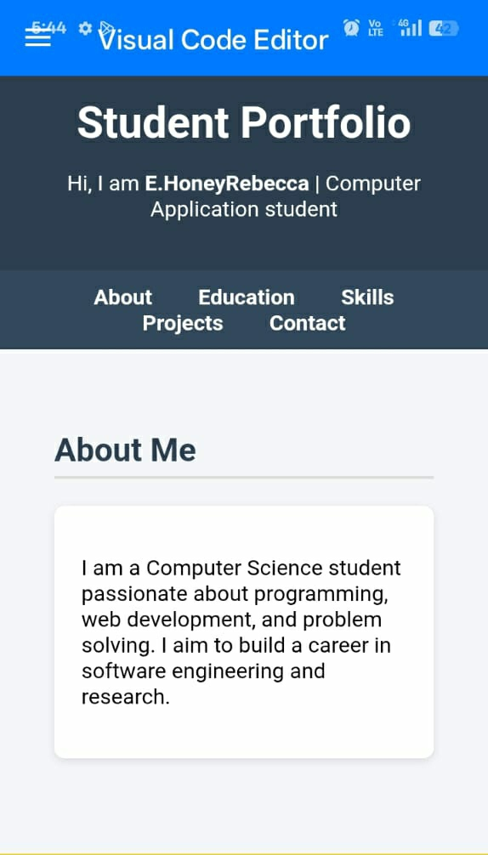
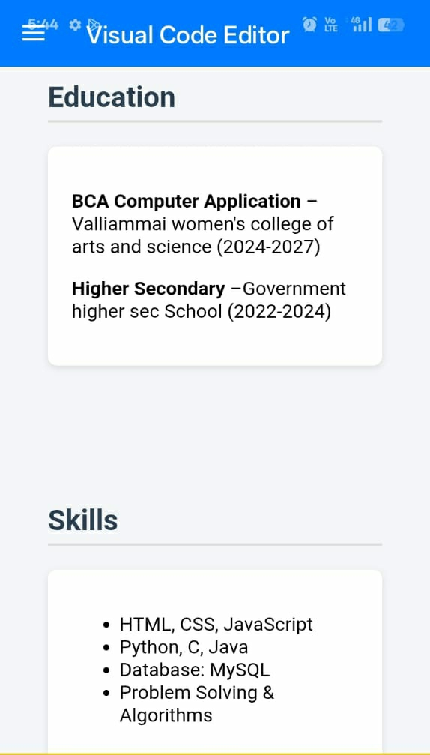
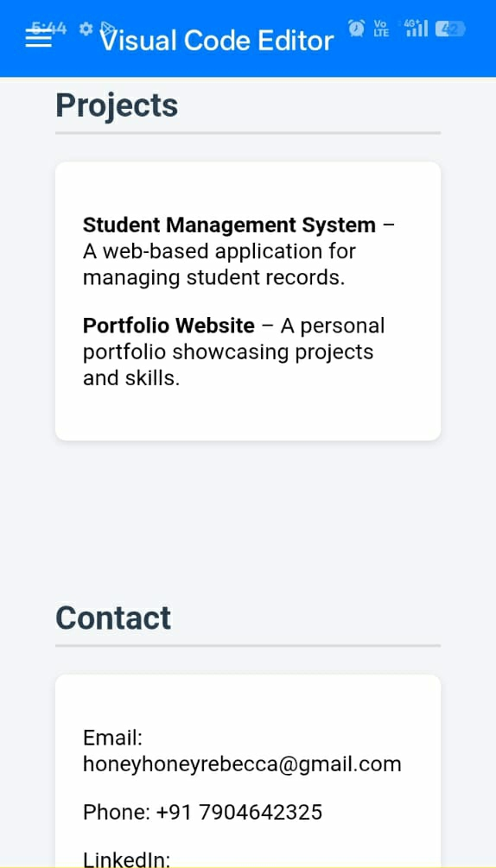

Slide 14
