Slide 1







ONLINE SUBMISSION
TEAM NAME: TYPE HERE
COLLEGE NAME: TYPE HERE
PROBLEM TRACK: TYPE HERE

Slide 2
PROBLEM STATEMENT
TYPE HERE

Slide 3
SOLUTION ABSTRACT
TYPE HERE

Slide 4


ARCHITECTURE AND SYSTEM DESIGN

Slide 5
ARCHITECTURE AND SYSTEM DESIGN
TYPE HERE

Slide 6

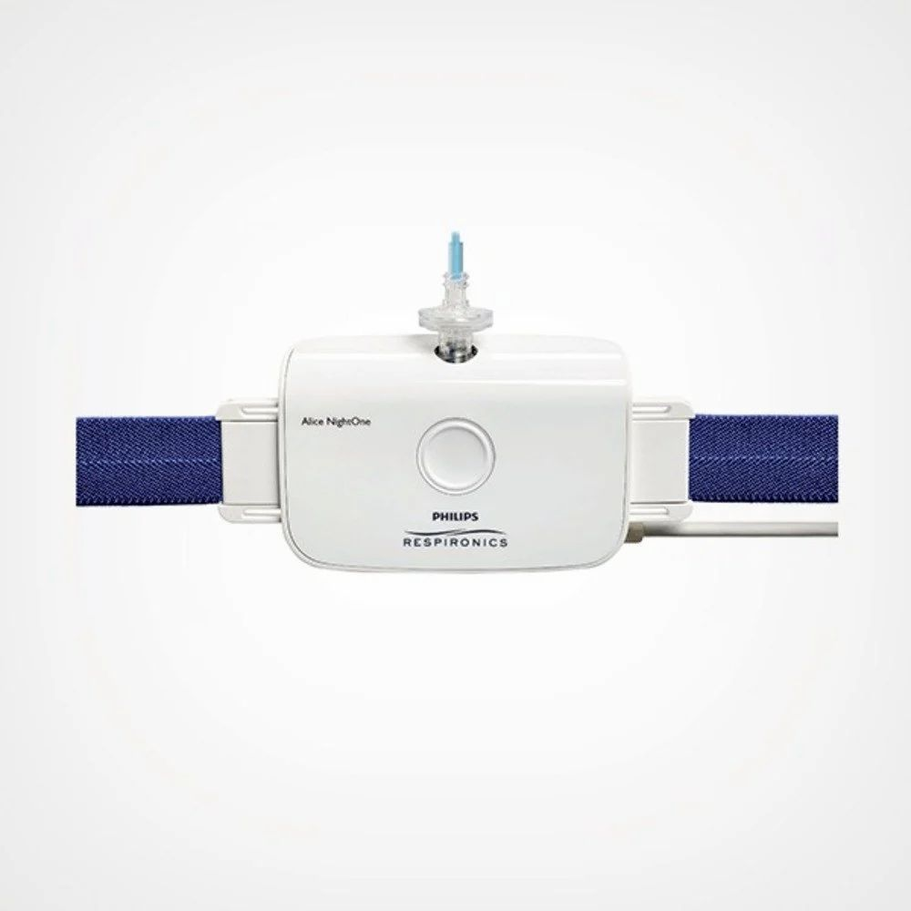
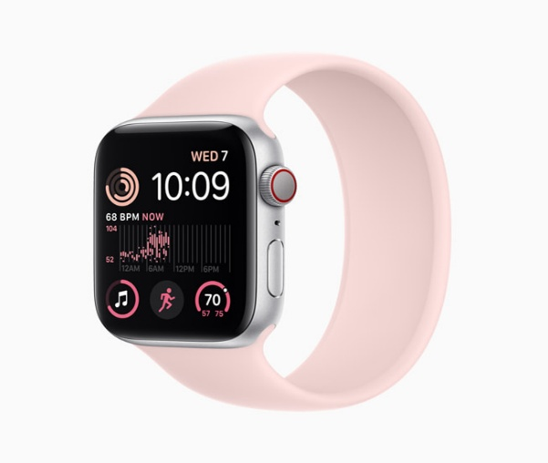
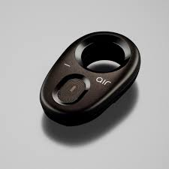
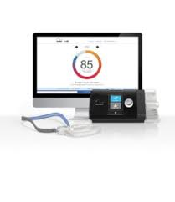
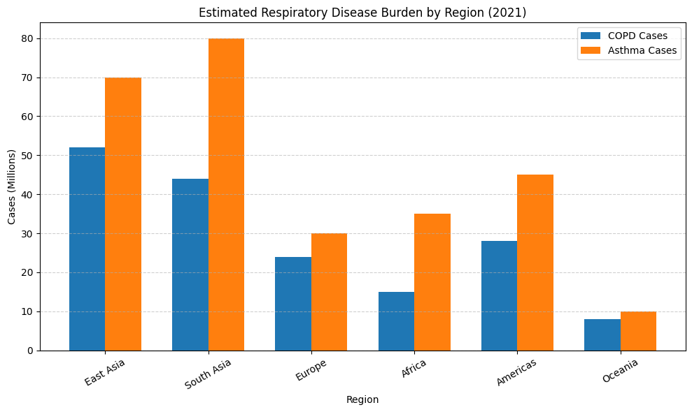
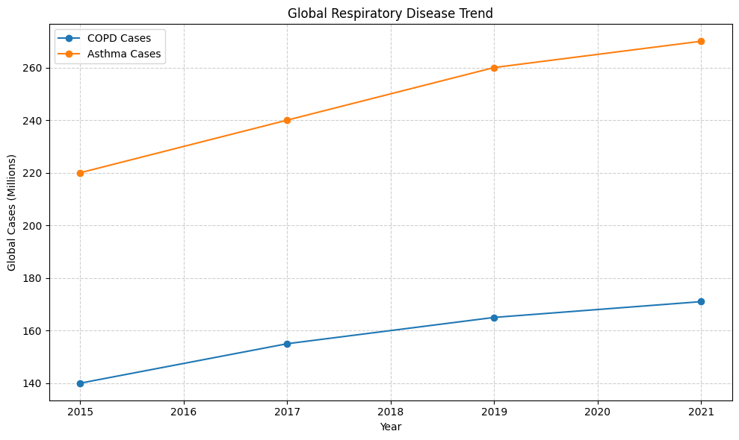
MARKET STUDY AND BUSINESS MODEL
Philips Respironics Alice Night One Home Sleep Testing Device
Google fit
APPLE WATCH
Nuvo air
ResMed air med
The consistently high and rising burden of COPD and asthma—especially in South and East Asia—indicates a large, underserved market for scalable respiratory monitoring and early-detection solutions.
The upward global trend confirms a recurring, long-term demand, supporting a subscription-based or device-plus-analytics business model rather than one-time sales.
Regional variability enables a tiered pricing and B2B2C strategy hospitals, insurers, home care), aligning affordability with high-burden markets while sustaining margins

Slide 7
RESEARCH AND REFERENCES
TYPE HERE

Slide 8
TEAM DETAILS
ROLE
NAME
STREAM/
DEPT
YEAR
COLLEGE

