Slide 1
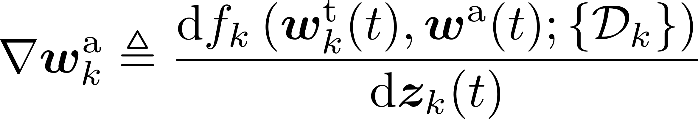
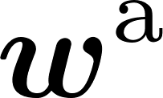
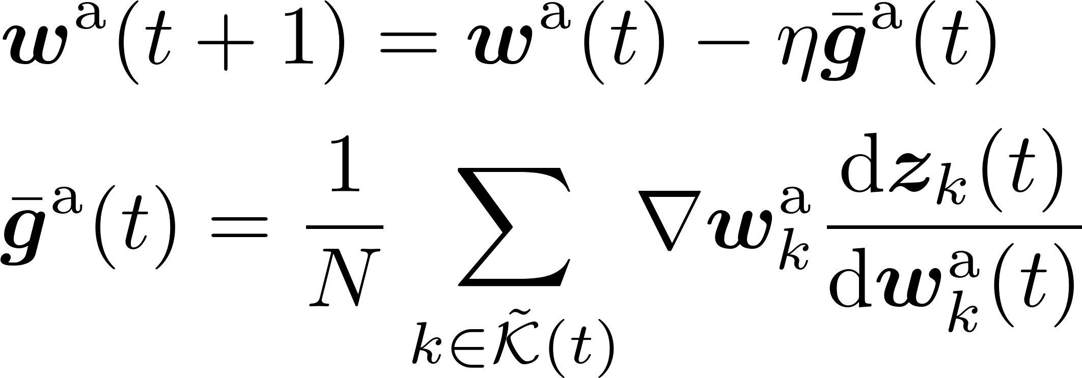
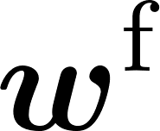


Gradient
Edge server
Low-rank matrices
Encoder (frozen)
Inner device communication
Wireless
communication
Task module

Slide 2
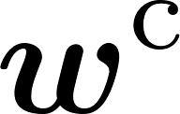

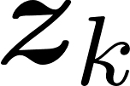



Edge server
Low-rank matrices
Encoder (frozen)
Encoded message
Representation vector
Embedding module (frozen)
Task module
Inner device communication
Wireless
communication
Local raw data

Slide 3
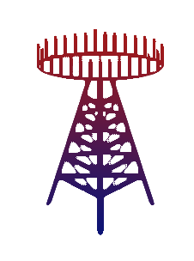

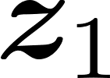
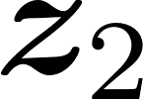

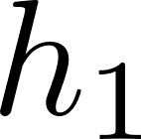
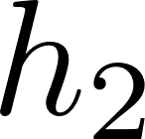
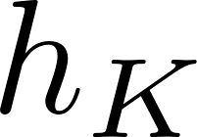
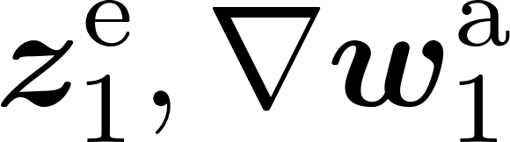
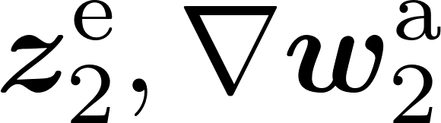

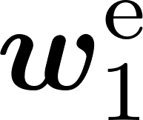

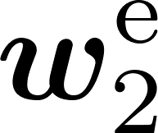





Edge server
Downlink:
Downlink:
Downlink:
Uplink:
Uplink:
Uplink:
I’m ok
I’m Good
Go away!
$$⋯$$
Edge device 1
Edge device 2
Edge device $K$

Slide 4



Embedding module
$$Q$$
$$K$$
$$V$$
Layer norm
Transformer block
MatMul
Masked MSA/MHA
Scale
Transformer block
Mask
…
Layer norm
Transformer block
SoftMax
FFN
MatMul
Output module
Decoder-only transformer model
Transformer block
Attention Calculation

Slide 5
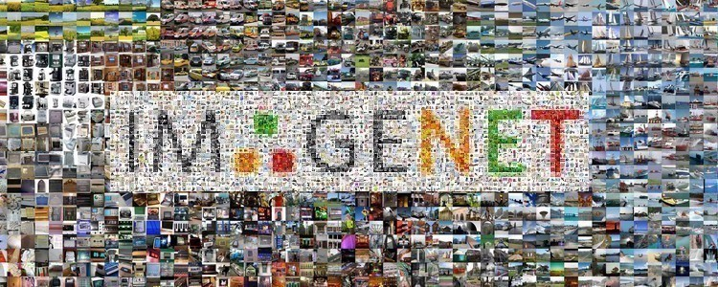




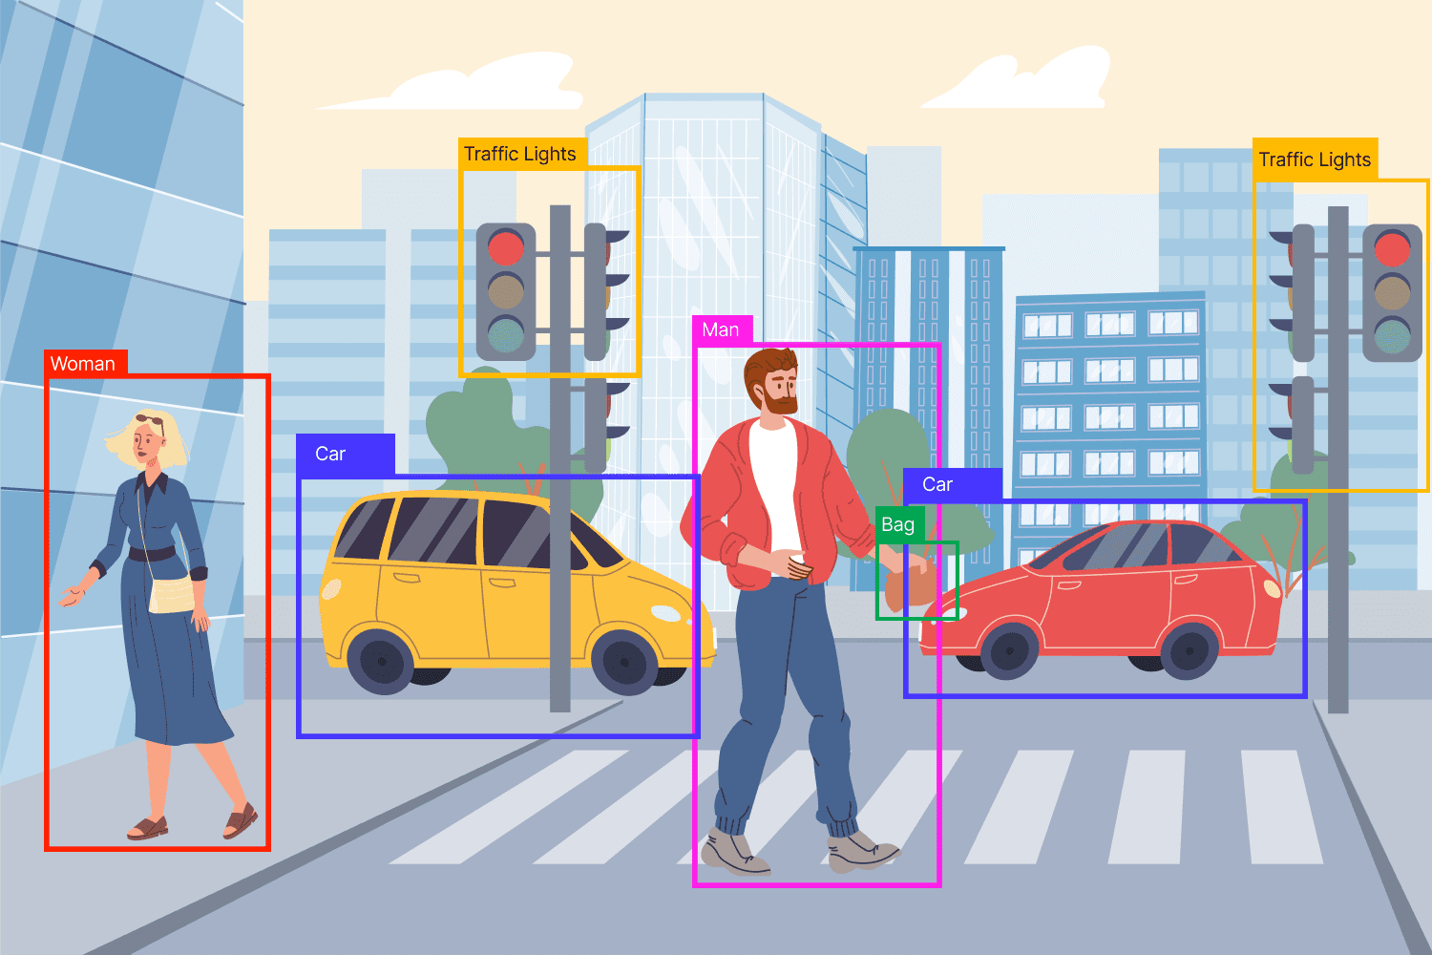
Massive number of data samples from real-world
Task specific dataset
Task-specific data for adaptation of pre-trained foundation models
Public dataset
Foundation Models
Fine-tuned Modes
Pre-training
Fine-tuning
General use
Personalized use
Foundation model shows its potential in general representation.
Foundation model with numerous neurons are trained with general public datasets.
Fine-tune the pre-trained model for better adaptation over local datasets.
Slight modifications results in significant calculation and storage consumption

Slide 6






























Embedding layer
Device $1$
Dataset
Parameter server
Model
Transformer block
Device $2$
Transformer block
Device $3$
Subset $1$
Subset $2$
Subset $3$
…
Model
Model
Model
Transformer block
Device $n$
Device $1$
Device $2$
Device $3$
(a) Model parallel
(b) Data parallel
$W_{1}$
$${ X}_{1}$$
$${ X}_{2}$$
$$⋅$$
$$F_{12}$$
$$F_{11}$$
Bubble
$$B_{11}$$
$$B_{12}$$
update
$$W_{2}$$
$$F_{22}$$
$${ F}_{21}$$
$$B_{21}$$
$$B_{22}$$
update
$$W⋅X$$
$${ F}_{32}$$
$$F_{31}$$
$$B_{31}$$
$$B_{32}$$
Device $1$
update
Device $2$
(c) Tensor parallel
(d) Pipeline parallel

Slide 7
Wireless Channel
Communication
inference
Caching
Computation

Slide 8
Edge server
Downlink:
Downlink:
Downlink:
Uplink:
Uplink:
Uplink:
I’m ok
I’m Good
Go away!
$$⋯$$
Edge device 1
Edge device 2
Edge device $K$

Slide 9



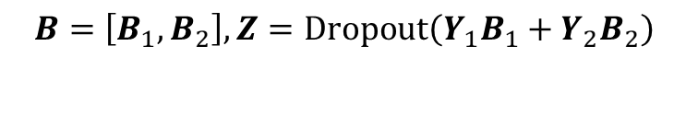






$$W=\left[W_{1}, W_{2}\right],Y=GLUE\left(X_{1}W_{1}+{X_{2}W}_{2}\right)$$
$$B=\left[B_{1}, B_{2}\right],Z=Dropout\left(Y_{1}B_{1}+{Y_{2}B}_{2}\right)$$
$${ X}_{1}$$
All-Reduce +GLUE
All Scatter
$${ Y}_{1}$$
All-Reduce
Dropout
$X_{1}W_{1}$
$Y_{1}B_{1}$
$$Z$$
$${ X}_{2}$$
$${ Y}_{2}$$
$${X_{2}W}_{2}$$
$${Y_{2}B}_{2}$$
Local data
Weight
Weight
Predictions
Achieved with edge server
MLP blocks

Slide 10
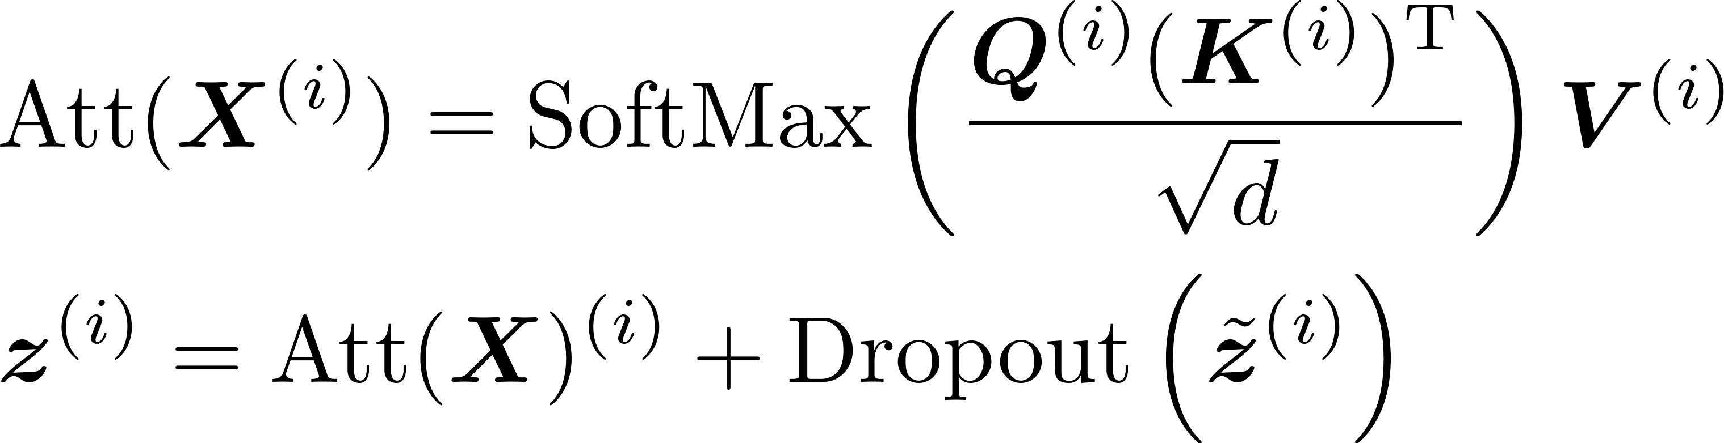
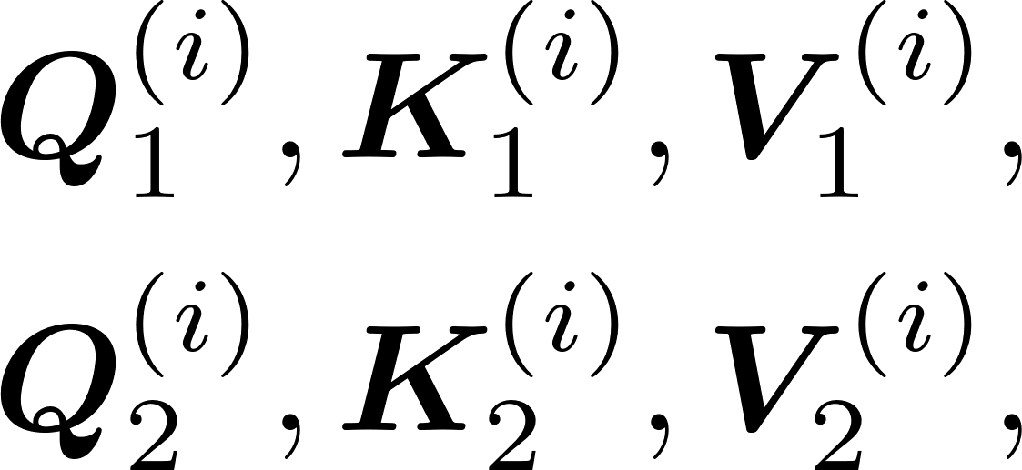
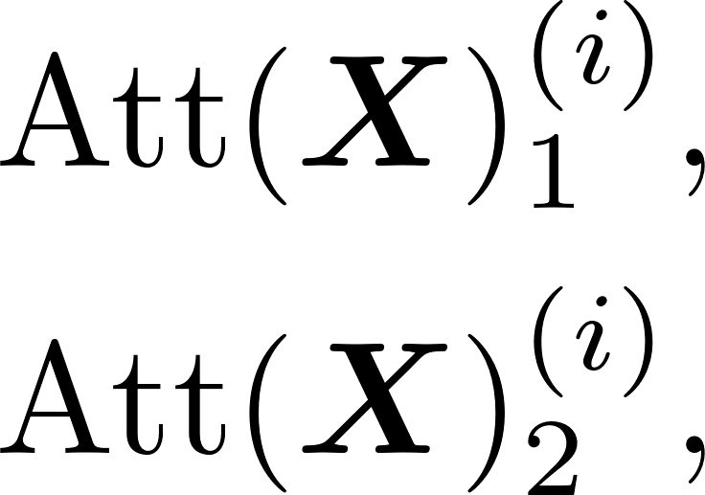
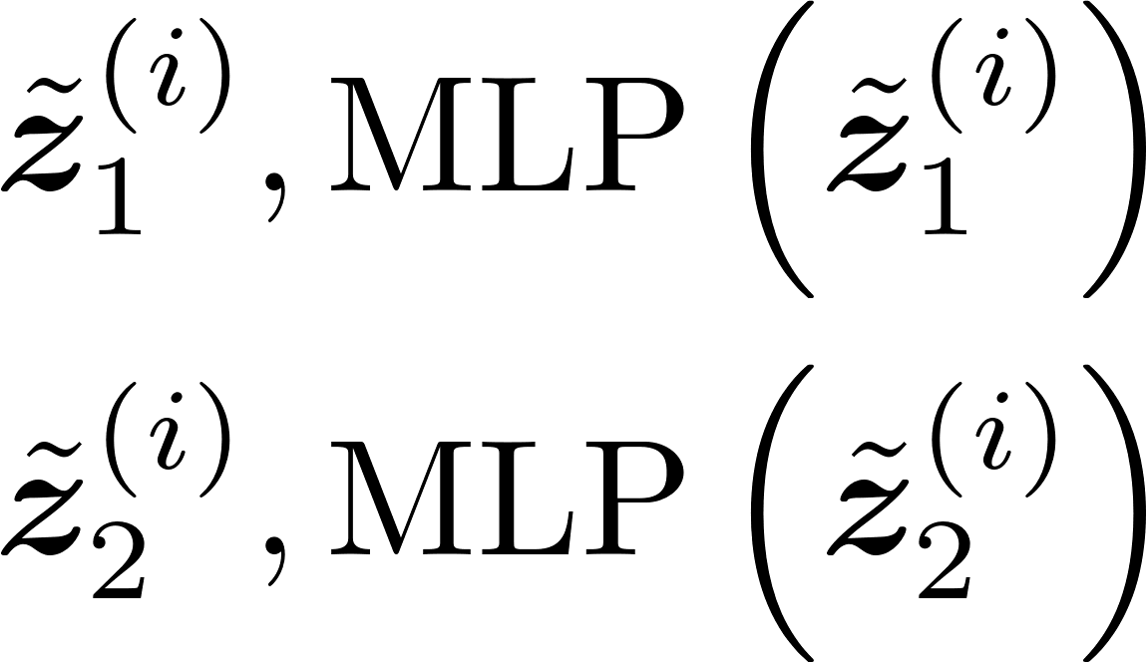
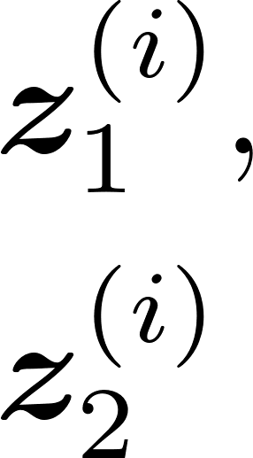














Self attention transformer blocks
Edge Server
Device 1
$$×L$$
$$V_{1}^{(i)}=X_{1}^{(i)}{W_{v}}_{1}$$
All-Reduce
All Scatter
$${\tilde{z}}_{1}^{\left(i\right)}$$
All-Reduce
$${ X}_{1}$$
$$B=\left[B_{1}, B_{2}\right],$$
$$MLP\left({\tilde{z}}_{1}^{\left(i\right)}\right)$$
$$Q_{1}^{(i)}=X_{1}^{(i)}{W_{q}}_{1}$$
$$Z$$
$$K_{1}^{(i)}=X_{1}^{(i)}{W_{k}}_{1}$$
Device 2
$${\tilde{z}}_{2}^{\left(i\right)}$$
$$V_{2}^{(i)}=X_{1}^{(i)}{W_{v}}_{2}$$
$$MLP\left({\tilde{z}}_{2}^{\left(i\right)}\right)$$
$${ X}_{2}$$
$$Q_{2}^{(i)}=X_{1}^{(i)}{W_{q}}_{2}$$
Weight
Predictions
$$K_{2}^{(i)}=X_{2}^{(i)}{W_{k}}_{2}$$
Attention
MLP
Notes:
Attention

Slide 11
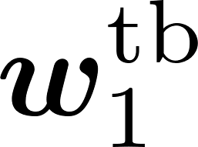

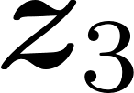
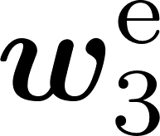
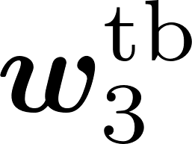
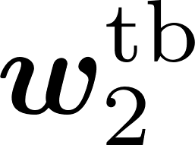
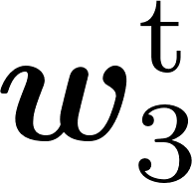


Loss
Embedding module
Transformer block
Local dataset
Forward:
Forward:
Transformer block
Transformer block
Backward
Local dataset
Local dataset
Output module
Forward:

Slide 12
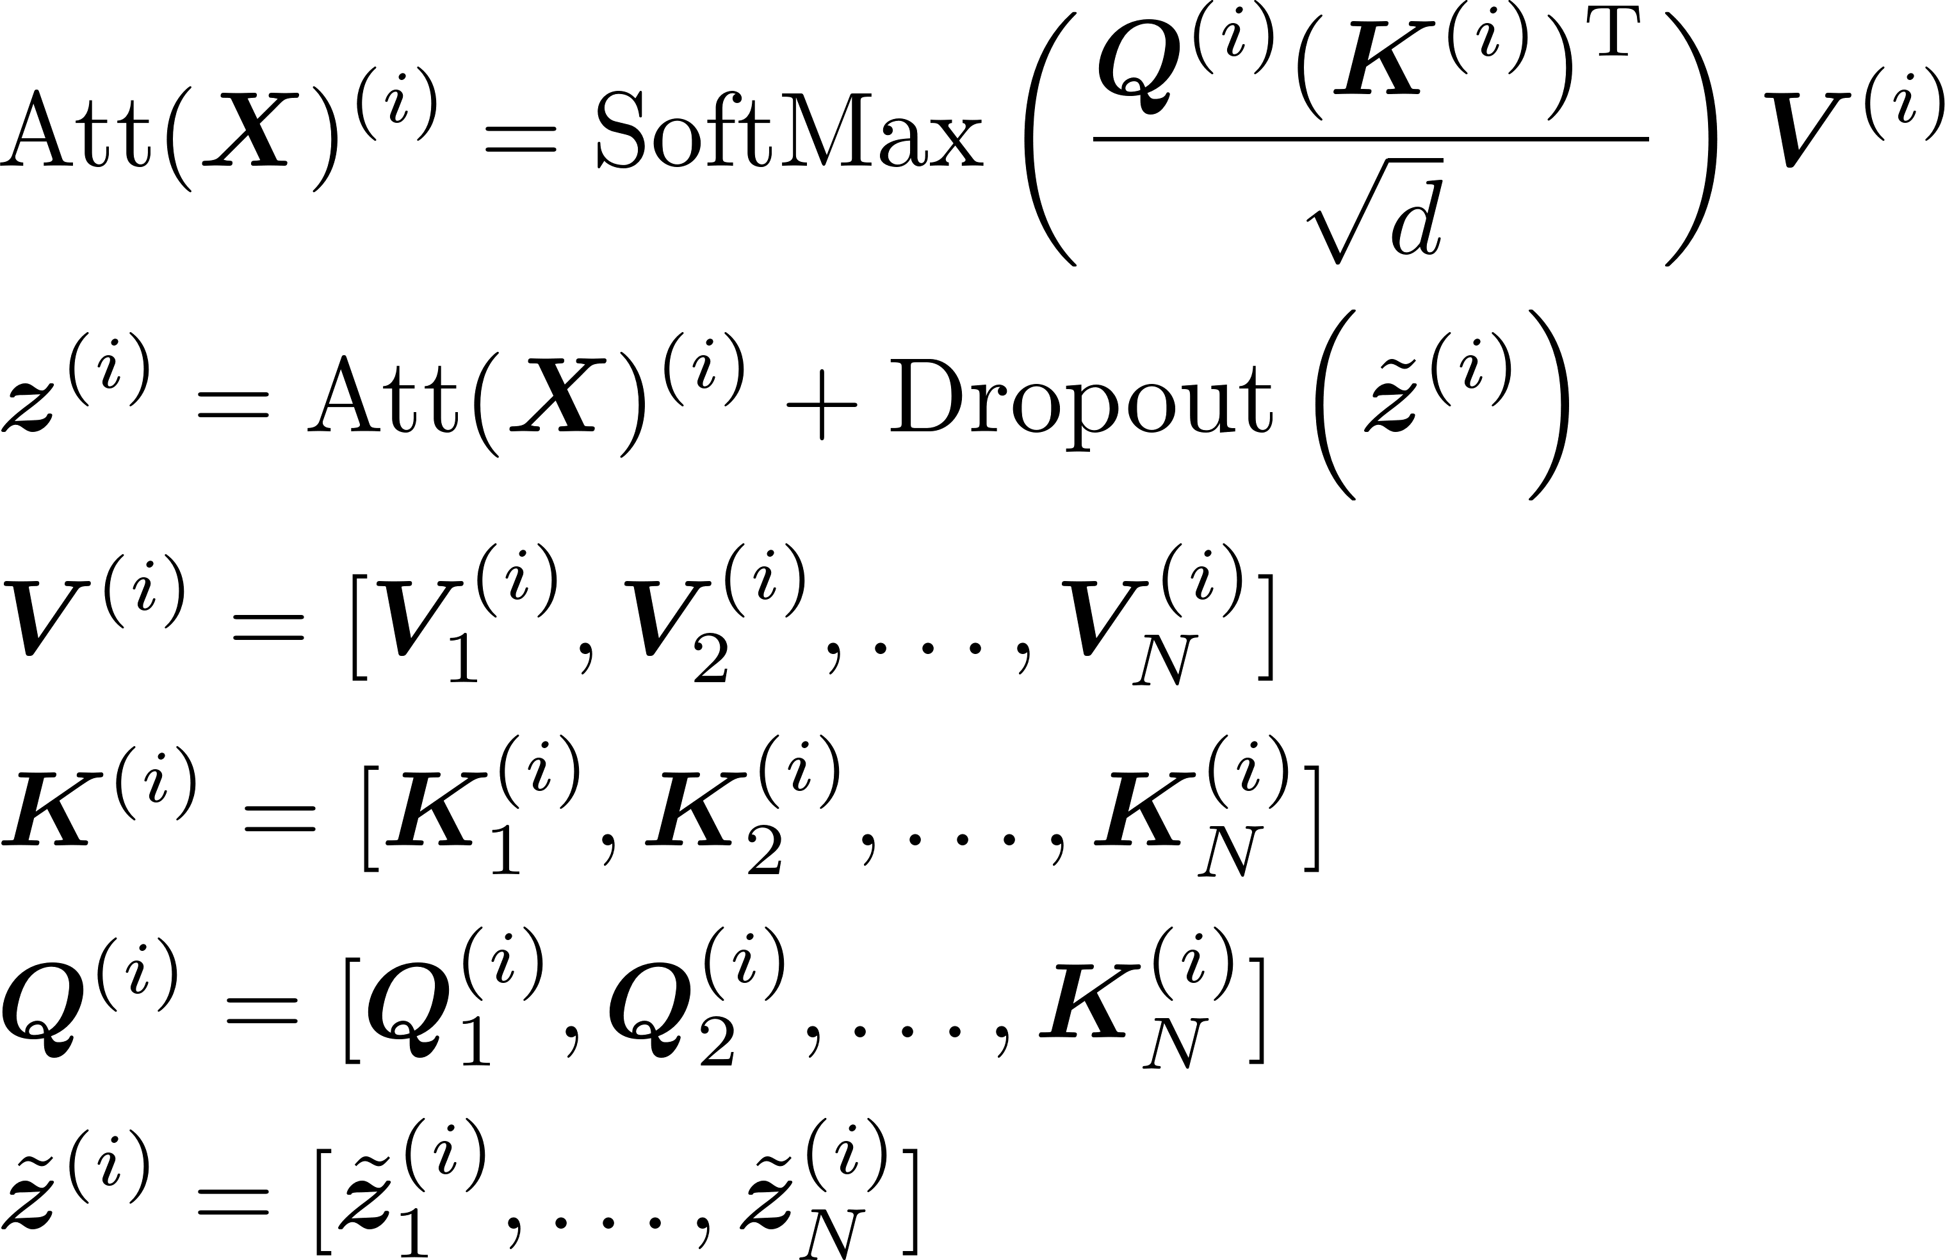
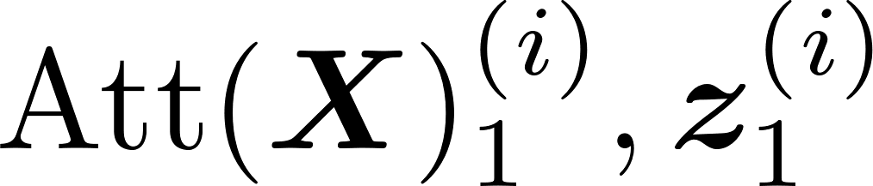
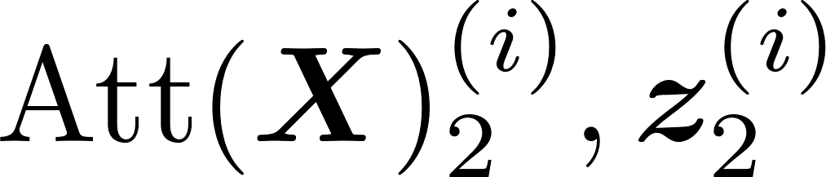
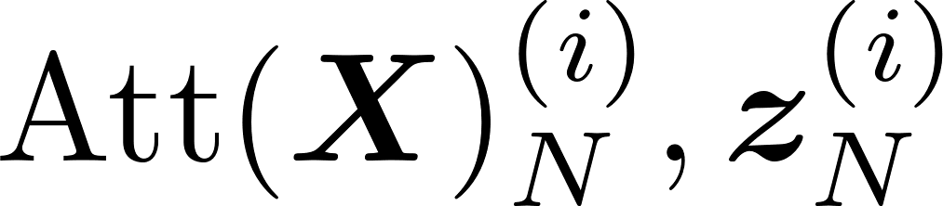
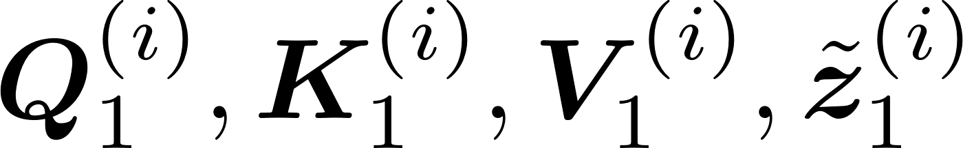

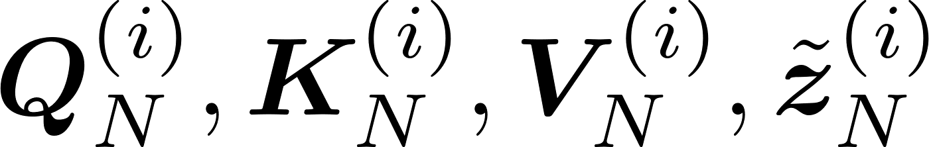


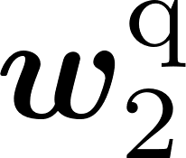
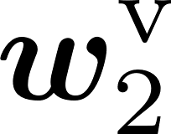




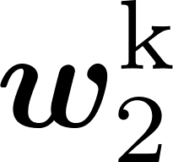
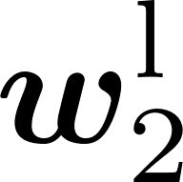


Downlink:
Downlink:
Downlink:
Uplink:
Uplink:
Uplink:
Local dataset
Local dataset
Local dataset
Edge device 1
Edge device 2
Edge device N

