Slide 1
O-1
O-2
O-3
O-4

Slide 2
Satellite Constellation & Microservice Deployment Topology
0
0
2
9
1
4
6
2
1
4
3
5
9
4
O-1
1
7
2
8
7
10
3
11
6
7
10
12
O-2
5
6
7
8
3
9
4
10
5
11
12
6
8
12
5
8
9
12
O-3
6
9
10
11
12
Orbit
Satellite
3
4
1
10
4
7
2
11
O-4
13
14
15
16
Microservice

Slide 3
确定微服务链
识别用户请求
构造增广图
求斯坦纳树解
确定微服务树
2
9
1
4
6
2
1
4
3
5
9
4
O-1
CoS
Satellites
2
1, 16
7
10
3
11
6
7
10
12
O-2
5
6
7
8
3
6, 13
6
2, 7, 9
6
8
12
5
8
9
12
O-3
9
10
11
12
7
7, 15
11
6, 16
3
4
13
1
10
14
4
7
15
2
11
16
O-4

Slide 4
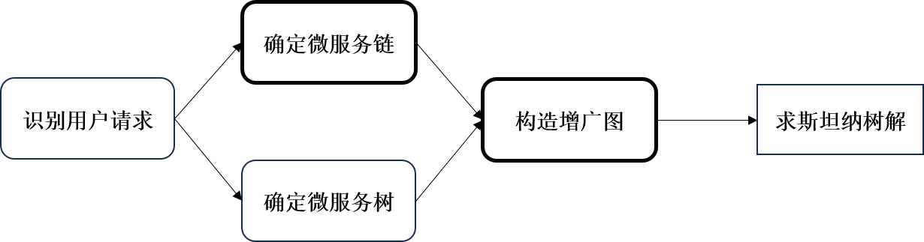
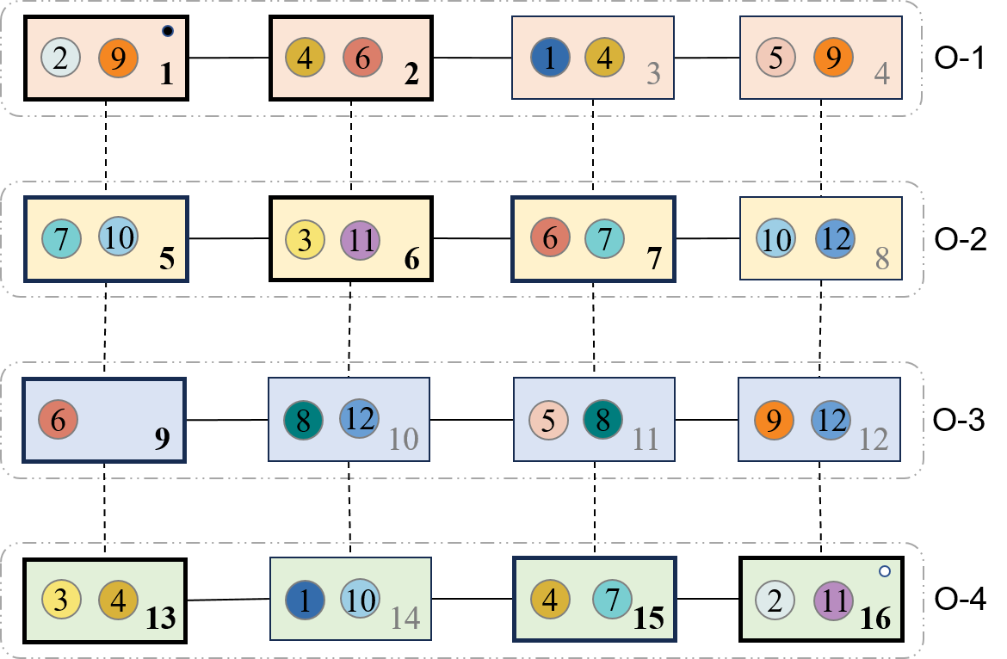
















构造卫星-微服务联合部署子图
CoS
Satellites
$$3^{1}$$
6
$$3^{2}$$
2
1, 16
$$3^{1}$$
13
$$3^{2}$$
3
6, 13
$$6^{1}$$
2
$$6^{2}$$
6
2, 7, 9
$$6^{1}$$
7
$$6^{2}$$
7
7, 15
$$7^{1}$$
7
$$7^{2}$$
11
6, 16
$$7^{1}$$
15
$$7^{2}$$
$$2^{1}$$
1
$$2^{2}$$
$${11}^{1}$$
6
$${11}^{2}$$
$$2^{1}$$
16
$$2^{2}$$
$${11}^{1}$$
16
$${11}^{2}$$

Slide 5
Orbit
Satellite
Microservice
2
9
1
4
6
2
1
4
3
5
9
4
O-1
7
10
3
11
6
7
10
12
O-2
5
6
7
8
6
8
12
5
8
9
12
O-3
9
10
11
12
3
4
13
1
10
14
4
7
15
2
11
16
O-4
Microservice and Satellite Joint Deployment Graph

Slide 6
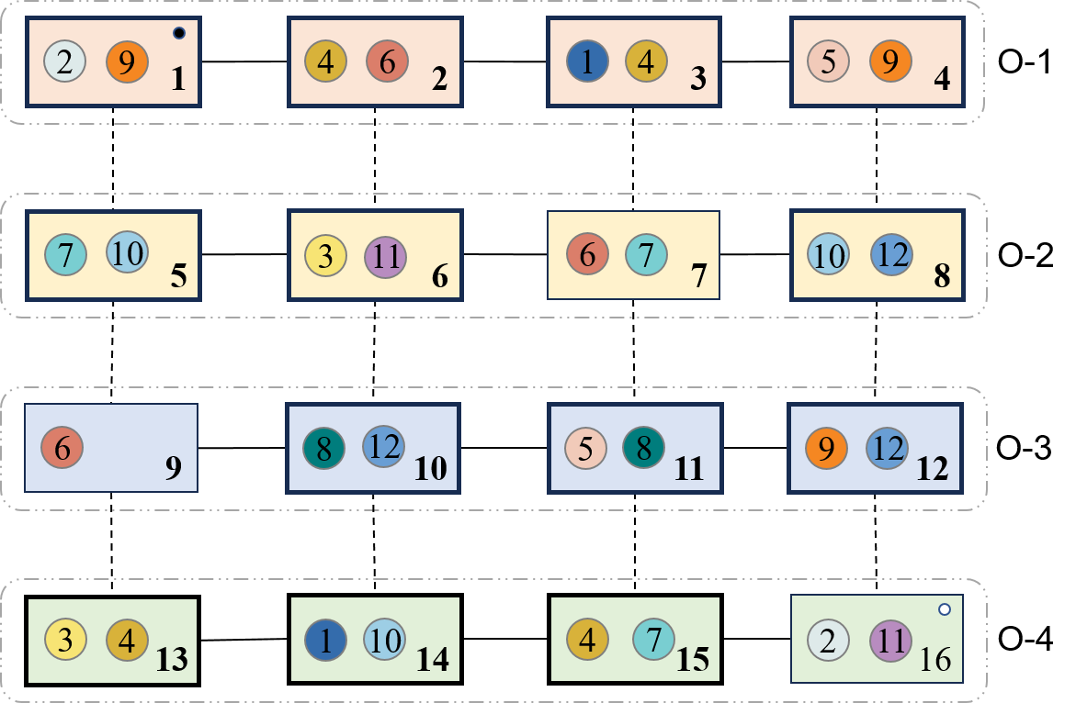

























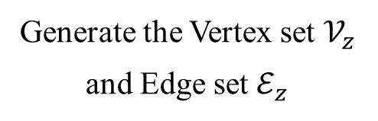

















$$1^{1}$$
3
$$1^{2}$$
$$1^{3}$$
14
$$1^{4}$$
1
$$3^{1}$$
6
$$3^{2}$$
$$3^{3}$$
13
$$3^{4}$$
3
$$4^{1}$$
2
$$4^{2}$$
$$4^{3}$$
3
$$4^{4}$$
$$4^{5}$$
13
$$4^{6}$$
$$4^{7}$$
15
$$4^{8}$$
4
$${10}^{1}$$
5
$${10}^{2}$$
$${10}^{3}$$
8
$${10}^{4}$$
10
5
$${10}^{5}$$
14
$${10}^{6}$$
$${12}^{1}$$
8
$${12}^{2}$$
$${12}^{3}$$
10
$${12}^{4}$$
$${12}^{5}$$
12
$${12}^{6}$$
12
8
$$5^{1}$$
4
$$5^{2}$$
$$5^{3}$$
11
$$5^{4}$$
9
$$8^{1}$$
10
$$8^{2}$$
$$8^{3}$$
11
$$8^{4}$$
$$9^{1}$$
1
$$9^{2}$$
$$9^{3}$$
4
$$9^{4}$$
Microservice and Satellite Joint Deployment Graph
$$9^{5}$$
12
$$9^{6}$$
Treed Service
Topology
Generate the Vertex set $𝒱_{z}$
and Edge set $ℰ_{z}$
1
2
Get the Corresponding
Service Deployment Scheme
3

Slide 7




















































4
Construct the augmented satellite-microservice graph $𝒢_{z}$
$${10}^{1}$$
5
$${10}^{2}$$
$${12}^{1}$$
8
$${12}^{2}$$
$$4^{1}$$
2
$$4^{2}$$
$${10}^{3}$$
8
$${10}^{4}$$
$${12}^{3}$$
10
$${12}^{4}$$
14
$$1^{1}$$
3
$$1^{2}$$
$$3^{1}$$
6
$$3^{2}$$
$$4^{3}$$
3
$$4^{4}$$
$${12}^{5}$$
12
$${12}^{6}$$
2
$${10}^{5}$$
14
$${10}^{6}$$
$${12}^{1}$$
$$1^{3}$$
14
$$1^{4}$$
$$3^{3}$$
13
$$3^{4}$$
$$4^{5}$$
13
$$4^{6}$$
1
$$9^{1}$$
$$9^{2}$$
$$5^{1}$$
4
$$5^{2}$$
$$8^{1}$$
10
$$8^{2}$$
$$4^{7}$$
15
$$4^{8}$$
$$9^{3}$$
4
$$9^{4}$$
16
$$5^{3}$$
11
$$5^{4}$$
$$8^{3}$$
11
$$8^{4}$$
5
Get the Directed Steiner Tree Solution $𝒜_{a}$
$$9^{5}$$
12
$$9^{6}$$
$${10}^{1}$$
5
$${10}^{2}$$
$${12}^{3}$$
10
$${12}^{4}$$
14
2
$$1^{1}$$
3
$$1^{2}$$
$$3^{1}$$
6
$$3^{2}$$
$$4^{1}$$
2
$$4^{2}$$
$$5^{1}$$
4
$$5^{2}$$
$$8^{3}$$
11
$$8^{4}$$
$$9^{5}$$
12
$$9^{6}$$
16
Computing cost
Communication cost
2
Source satellite node
Communication cost with relay
14
Destination satellite node
Orbit
Satellite
Microservice

Slide 8
















$${10}^{1}$$
5
$${10}^{2}$$
$${12}^{3}$$
10
$${12}^{4}$$
14
2
$$1^{1}$$
3
$$1^{2}$$
$$3^{1}$$
6
$$3^{2}$$
$$4^{1}$$
2
$$4^{2}$$
$$5^{1}$$
4
$$5^{2}$$
$$8^{3}$$
11
$$8^{4}$$
$$9^{5}$$
12
$$9^{6}$$
16
Computing cost
Communication cost

Slide 9

































$${10}^{1}$$
5
$${10}^{2}$$
$${12}^{1}$$
8
$${12}^{2}$$
$${10}^{3}$$
8
$${10}^{4}$$
$${12}^{3}$$
10
$${12}^{4}$$
14
$$4^{1}$$
2
$$4^{2}$$
$${12}^{5}$$
12
$${12}^{6}$$
$$1^{1}$$
3
$$1^{2}$$
$$3^{1}$$
6
$$3^{2}$$
$${10}^{5}$$
14
$${12}^{1}$$
$$4^{3}$$
3
$$4^{4}$$
$${10}^{6}$$
2
$$4^{5}$$
13
$$4^{6}$$
$$1^{3}$$
14
$$1^{4}$$
$$3^{3}$$
13
$$3^{4}$$
$$9^{1}$$
1
$$9^{2}$$
$$5^{1}$$
4
$$5^{2}$$
$$8^{1}$$
10
$$8^{2}$$
$$4^{7}$$
15
$$4^{8}$$
$$9^{3}$$
4
$$9^{4}$$
16
$$5^{3}$$
11
$$5^{4}$$
$$8^{3}$$
11
$$8^{4}$$
$$9^{5}$$
12
$$9^{6}$$
$${10}^{1}$$
5
$${10}^{2}$$
$${12}^{3}$$
10
$${12}^{4}$$
14
2
$$1^{1}$$
3
$$1^{2}$$
$$3^{1}$$
6
$$3^{2}$$
$$4^{1}$$
2
$$4^{2}$$
$$5^{1}$$
4
$$5^{2}$$
$$8^{3}$$
11
$$8^{4}$$
$$9^{5}$$
12
$$9^{6}$$
16
Computing cost
Communication cost

Slide 10
<=loss
>loss

Slide 11
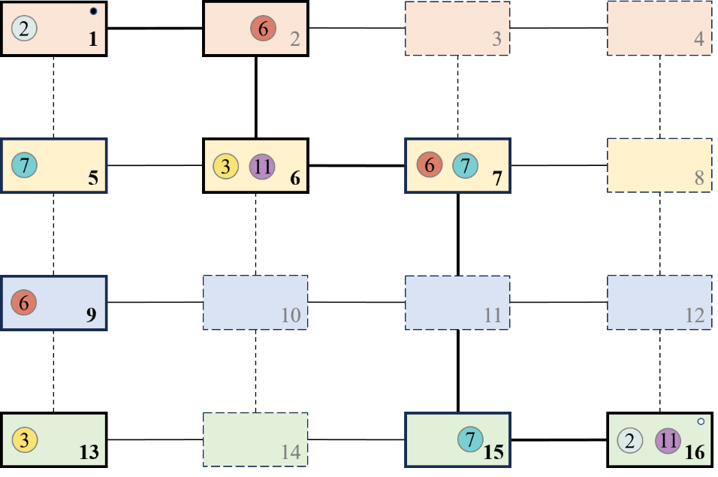

识别用户请求
确定服务链
找出卫星子集
构造（多副本）微服务子图
求解最短路径（链型）
2
3
$$→$$
6
7
①②③④⑤⑥⑦⑧⑨⑩⑪⑫⑬⑬⑭⑮⑯
11
Potential Steiner point

Slide 12
算力路由 (Computing First Network Routing)
算力路由在单一网络寻址的基础上，融合叠加算力信息进行联合路由。
突破了传统意义上的互联网（IP）路由方式。
通过服务实例的算力节点，进行算力信息通告，经由算力路由入口节点，收集来自客户端和算网的信息，选择最佳的算力节点和路径，再执行业务流量调度，经算力路由出口节点反馈给服务实例。
Liu, B., Mao, J., Xu, L., Hu, R., & Chen, X. (2021, March). CFN-dyncast: Load Balancing the Edges via the Network. In 2021 IEEE Wireless Communications and Networking Conference Workshops (WCNCW) (pp. 1-6). IEEE.

Slide 13

















构造卫星-微服务联合部署子图
求解斯坦纳树问题
4
$${10}^{1}$$
5
$${10}^{2}$$
$${12}^{1}$$
8
$${12}^{2}$$
3
$${12}^{3}$$
10
$${12}^{4}$$
T1
$${10}^{3}$$
8
$${10}^{4}$$
$$4^{1}$$
2
$$4^{2}$$
$${12}^{5}$$
12
$${12}^{6}$$
$$1^{1}$$
3
$$1^{2}$$
$$3^{1}$$
6
$$3^{2}$$
$${10}^{5}$$
14
$${12}^{1}$$
$$4^{3}$$
3
$$4^{4}$$
$${10}^{6}$$
S
$$4^{5}$$
13
$$4^{6}$$
$$1^{3}$$
14
$$1^{4}$$
$$3^{3}$$
13
$$3^{4}$$
$$9^{1}$$
1
$$9^{2}$$
$$5^{1}$$
4
$$5^{2}$$
$$8^{1}$$
10
$$8^{2}$$
$$4^{7}$$
15
$$4^{8}$$
14
4
T2
5
$$9^{3}$$
$$9^{4}$$
$$5^{3}$$
11
$$5^{4}$$
$$8^{3}$$
11
$$8^{4}$$
Steiner solution
$$9^{5}$$
12
$$9^{6}$$
Computing cost
Communication cost

Slide 14
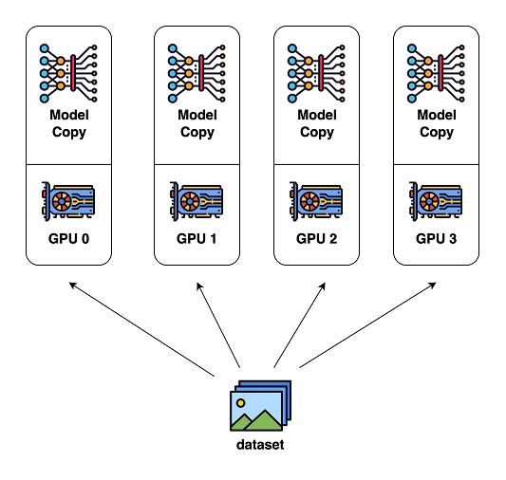
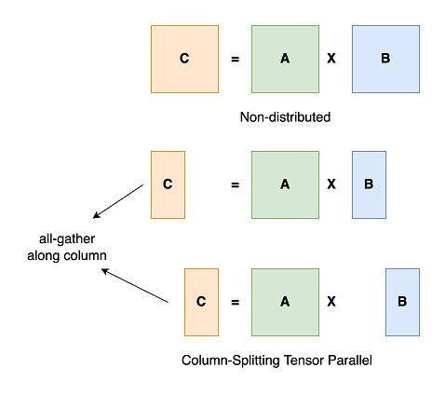
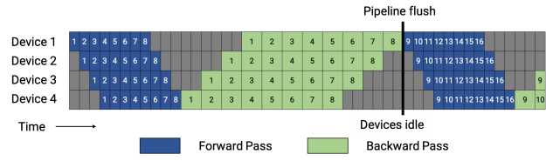
AI流量路由
大模型推理/训练加速
数据并行（all-reduce）
模型并行
张量并行（inner-layer, matrix splitment）
流水线并行（inter-layer）
混合并行

Slide 15

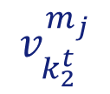




$$v_{ξ}$$
$$m_{j}$$
$$v^{m_{i}}$$
$$m_{i}$$
$$v_{k_{1}^{r}}^{m_{i}}$$
$$v_{k_{2}^{t}}^{m_{j}}$$

