Slide 1
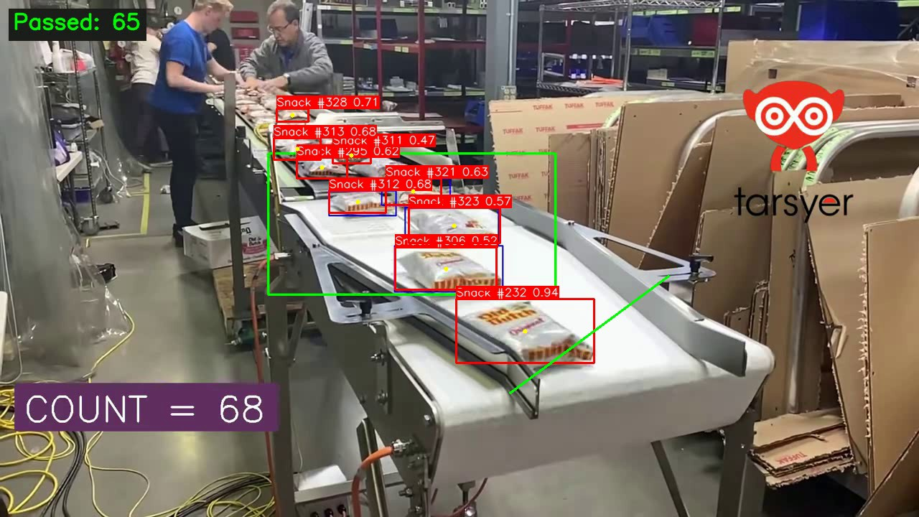
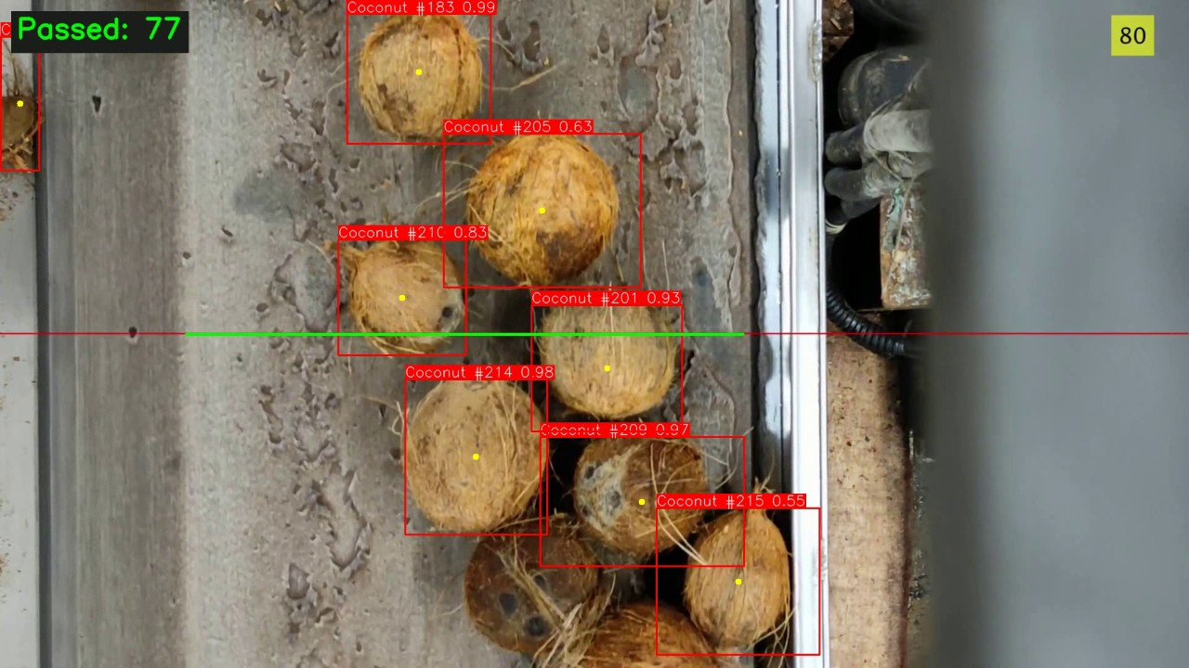
COMPUTER VISION PROJECT
Counting
on the Belt
Real-time object counting with YOLO26 and ByteTrack
github.com/hongan151206-ai/cpv_project
Notes:
Good morning, everyone. Our project counts objects on a conveyor belt, automatically, from a video. We use YOLO26 for detection and ByteTrack for tracking, and we built the counting logic ourselves. We have two demos: packs of snacks and coconuts. Over the next twenty-five minutes we will show how the system works, how we measured it against a careful human count, what went wrong along the way, and what we would do next.

Slide 2



The problem: count every item once
Counting by eye is slow, and the count drifts.
Detect
Find every object in every frame.
Our own hand count of a 17-second coconut video took several passes: the items move fast and it is easy to lose track.
Track
Keep the same ID for the same object across frames.
Goal
A system whose count matches a careful human count.
Count
Count each object exactly once, when it crosses a line.
Notes:
Why this problem? Counting by eye is tiring. When we hand-counted our own test video we needed several passes, because the coconuts come fast and it is very easy to lose track. So the goal is a system whose count matches a careful human count. That breaks into three jobs. First, detect every object in every frame. Second, track it, so the same object keeps the same ID from frame to frame. Third, count it exactly once, at the moment it crosses a line. Each job has its own way of failing, and most of our work was about those failures.

Slide 3




The pipeline
Video
Detect
Track
Count
Output
OpenCV reads frames one by one
YOLO26, keeps low-score boxes (conf 0.1)
ByteTrack gives each object a persistent ID
Line crossing, once per object
Overlay, result.mp4 and events.csv
Layered configuration
settings.yaml > preset > .env > command line
41 automated tests
Counters, config and full pipeline. No GPU or model needed.
Notes:
Here is the whole pipeline. OpenCV reads the video frame by frame. YOLO26 detects objects; we deliberately keep low-confidence boxes, with a threshold of 0.1, because the tracker can use them. ByteTrack gives each object an ID that persists across frames. The line counter watches the centre of each tracked object and counts it when it crosses the line. Finally we draw the overlay and save the results: an annotated video, and a CSV file with one row per counted object. Around the pipeline there is a configuration layer, with one YAML preset per demo that can be overridden from the environment or the command line, and 41 automated tests that run without a GPU or a model.

Slide 4
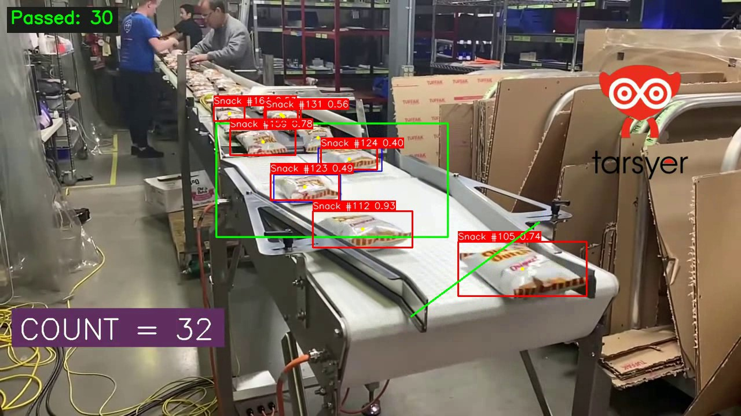
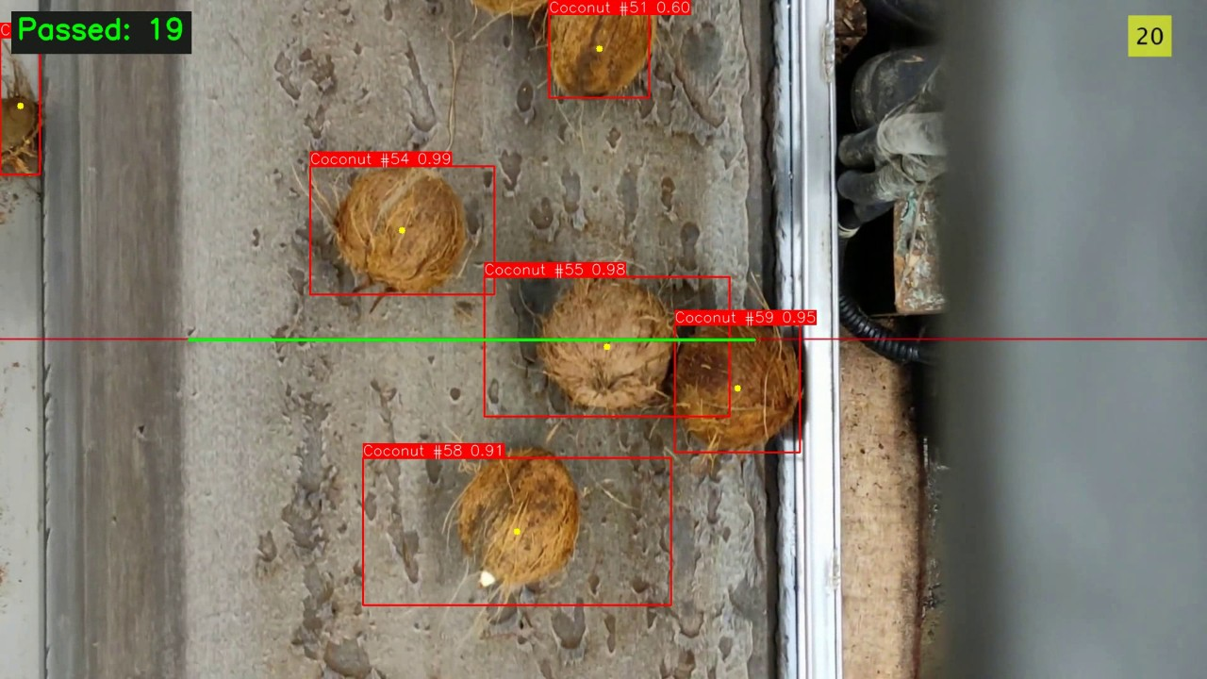
Two demos, one codebase
Snack packs
snack.pt | diagonal line | counts packs moving down-right
Coconuts
coconut.pt | horizontal line | counts coconuts moving up
Same code for both: only the YAML preset changes. Green line = counting line, yellow dot = tracked centre.
Notes:
Both demos run on exactly the same code; only the YAML preset changes. On the left, packs of snacks travel down and to the right, and the green diagonal is the counting line. On the right is a top-down view of coconuts moving up the belt, with a horizontal line. Each model was trained for its own object. The yellow dots are the centres we track. Notice that the videos also carry an overlay from whoever made them, such as the blue boxes and the number in the corner. That is not ours, and we will come back to why it matters.

Slide 5



Detection with YOLO26
End-to-end, NMS-free
YOLO26 does not remove duplicate boxes itself. This matters later.
0.978
0.854
Precision
Recall
Two custom models
snack.pt and coconut.pt, each trained for one object.
0.948
0.738
mAP50
mAP50-95
Low threshold on purpose
conf = 0.1 keeps the weak boxes ByteTrack uses to hold tracks.
coconut.pt on an 8-image test split. Very small, and it may overlap the training data. snack.pt has no dataset in the repo, so no metrics.
Notes:
YOLO26 is the detector. It is end-to-end and NMS-free, which means it does not remove duplicate boxes by itself. Please remember that, because it matters later. We use two custom-trained models. For coconuts we measured the model on a held-out split: precision 0.98, recall 0.85, mAP50 0.95. Be careful with these numbers. The test split is only eight images, and the model's metadata points to a different dataset from the folder in our repository, so we cannot rule out overlap with the training data. For the snack model there is no dataset in the repository, so we have no such metrics. That is why we judge the models mainly by the final result, the count.

Slide 6
Tracking with ByteTrack
Confident boxes (score 0.25 or more)
Matched to existing tracks first.
Parameter | Value | Role
track_high_thresh | 0.25 | First-pass matching
track_low_thresh | 0.1 | Second-pass rescue
new_track_thresh | 0.5 | Default 0.25; fewer junk IDs
track_buffer | 30 | Frames a lost track survives
match_thresh | 0.8 | Matching strictness
1
2
Weak boxes (score 0.1 to 0.25)
Rescue tracks that are partly hidden.
3
New track only if score 0.5 or more
Stops one-frame junk from becoming an ID.
225 to 141
115 to 105
tracks entering the zone
line count (hand count 105)
Notes:
ByteTrack links detections across frames in two passes. First, confident detections, with a score of at least 0.25, are matched to existing tracks. Second, low-score boxes between 0.1 and 0.25 are used to rescue tracks that are partly hidden, which is why we keep the detector threshold at 0.1. A new track is started only if the score is at least 0.5. The Ultralytics default is 0.25, and raising it removed a lot of junk IDs. On the snack video, tracks entering the zone fell from 225 to 141, and the line count dropped from 115 to 105. Every other tracker parameter is left at its default.

Slide 7






Counting: line, not zone
Zone counting (first attempt)
Line counting (final)
Counts every ID that ever enters a region. Each ID switch is a second count.
Counts a track once, when its centre passes from one side of the line to the other.
131 vs 105
105 vs 105
snack video, hand count = 105
Signed cross product: any line angle
Segment check: crossing is inside the line
Direction filter: both, positive or negative
Once per track ID; state kept 30 frames
Notes:
Our first version counted zones: every ID that ever appeared inside a region. The flaw is obvious in hindsight. Whenever the tracker changes an object's ID, that object is counted again. On the snack video this gave 131 against a true 105. The final version counts line crossings. A track is counted once, when its centre actually passes from one side of the line to the other. We use a signed cross product, so the line can have any angle. We check that the crossing happens inside the segment. We filter by direction. Each track ID is counted only once. And we remember a track for 30 frames, so a brief detection dropout at the line does not lose the object.

Slide 8




How we measured it
1. Hide the system
2. Count by hand
3. Compare
4. Inspect mismatches
A copy of each video with our boxes, IDs and count removed. Only the green line stays.
Twice, in slow motion, by one person. Every object crossing the line counts once.
Against our system and against the number burned into the video.
Every counted event is logged to events.csv with its frame and position.
Honest caveat
Parameters were tuned on these same videos, so the numbers are optimistic for new footage.
Notes:
How do we know it works? We did a blind hand count. We produced a version of each video where our boxes, IDs and count are hidden and only the green line remains. One of us counted the objects crossing the line, in slow motion, twice. Then we compared that with our system and with the number burned into the video. Where they disagreed, we went and looked at every counted event. One honest caveat: we tuned the parameters on these same videos, so the results are optimistic for new footage.

Slide 9
Results
Snack
105 = 105
hand count = system. Exact match.
Coconut, 4x speed
128 vs 128-129
system vs two hand counts. Within one.
Real-speed coconut video (no hand count): system 131, on-screen reference 129. Chart uses the higher hand count (129).
Notes:
The results. On the snack video: hand count 105, on-screen reference 105, our system 105. An exact match. On the coconut video: hand counts of 128 and 129, reference 129, our system 128, which is within one object. For comparison, the old zone counter gave 131 on snacks and 174 on coconuts, a quarter to a third too many. On the longer, real-speed coconut video we have no hand count, but the system says 131 against the on-screen 129. Matching totals do not prove that every single count is right, because over-counts and under-counts can cancel out, so we also examined individual events.

Slide 10
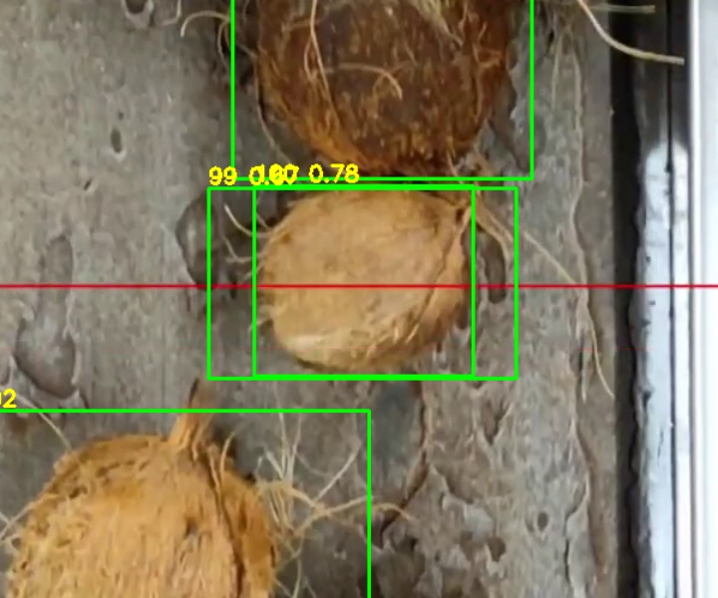


Finding the last errors
Found by logging every count
Coconut gave 136, about 6% too many. 8 to 9 extras shared one pattern: two boxes, two IDs, one coconut.
Cause
YOLO26 has no NMS and conf is 0.1, so both overlapping boxes survive and both cross the line.
Fix: duplicate_iou = 0.6
Ignore a second crossing in the same frame if its box overlaps a counted one.
Frame 297: IDs 99 and 100 on one coconut, overlap 0.70
Coconut 136 to 128
Snack 105 to 102: off
Notes:
This is how we found the last errors. At first the coconut video gave 136, about six percent too many. We logged every counted event with a crop, and found a pattern. Eight or nine of the extra counts were two boxes on the same coconut, overlapping by 0.7 to 0.9, each with its own track ID, both crossing the line in the same frame. Because YOLO26 has no NMS and our confidence threshold is low, both boxes survive. The fix: if a second crossing in the same frame has a box that overlaps an already counted one by at least 0.6, ignore it. The coconut count goes from 136 to 128. But on snacks the same rule drops 105 to 102, because there the packs really do overlap. So it is an option, switched on for coconuts and off by default. And since we picked 0.6 on this video, please treat it as tuned.

Slide 11


What mattered
Keep every frame
Skipping frames makes the tracker lose objects.
Keep low-score boxes
Conf 0.5 throws away what ByteTrack needs.
Place the line well
Where detection is reliable, not where packs fall.
Fewer junk IDs
A higher new-track threshold removes false tracks.
Notes:
Here is what mattered, on the snack video, where the right answer is 105. Our final setup gives 105. With the default new-track threshold it gives 115. Raising the detector confidence to 0.5, which sounds sensible, gives 89, because we throw away the boxes the tracker needs. Putting the line where packs fall off the belt and change shape gives 56. And skipping frames is fatal: processing every second frame gives 58, and every third gives 29, because the tracker loses objects between frames. The lessons: keep every frame, keep low-score boxes, and put the line where detection is reliable.

Slide 12


Built to be trusted
Layered configuration
41 unit tests
Base settings, then a preset per demo, then environment, then command line. Validated with clear errors.
Counters, configuration and the full pipeline on a fake video. Runs in seconds, no GPU.
Auditable runs
One command
Each run writes its own folder: annotated video and events.csv, one row per counted object.
Add --save-video to export results.
py run.py --config config/coconut.yaml
Notes:
Some engineering choices that made this reliable. Configuration is layered: base settings, then a preset per demo, then environment variables, then command-line flags, and it is validated with clear error messages. We have 41 unit tests covering the counters, the configuration and the whole pipeline on a fake video, so they run in a few seconds without a GPU. Each run writes its own folder with the annotated video and the events CSV, so any result can be audited afterwards. And running a demo is one command. We also added regression tests for real bugs we hit, such as a logging setup that silently switched off all log output.

Slide 13


Performance
25-38 ms
~1 ms
30-50 FPS
~20 FPS
YOLO per frame
counting and drawing
without a window
with a 1080p preview
The detector is the bottleneck
Our counting and drawing code costs about 1 ms. Half precision (FP16) gave no gain.
Faster than the source
Headless runs beat both videos (15 and 30 FPS). The 4x coconut preview plays slower, but counts the same.
Laptop with RTX 3050 6 GB. Numbers vary with the machine.
Notes:
Performance. On a laptop with an RTX 3050, YOLO takes 25 to 38 milliseconds per frame. Counting and drawing together take about one millisecond, so the detector is the bottleneck, not our code. Running without a window we get 30 to 50 frames per second, faster than both source videos. With a preview window on 1080p video it is about 20 FPS, so the four-times-speed coconut demo plays slower than the source, but the count is identical. Half precision gave no gain. Numbers will differ on other machines.

Slide 14

Limitations
No held-out video
Parameters were tuned on the demo videos, so results are optimistic.
One person, two passes
The hand count is a single person counting twice (128 and 129 on coconuts).
Gaps in the model data
coconut.pt test split may overlap its training data. snack.pt has no dataset in the repo.
Line fixed in pixels
A new camera angle needs new coordinates. Skipping frames breaks tracking.
Overlays in the samples
The videos carry boxes and counters from another system the model may have learned.
Touching objects
Tightly packed items can still give duplicate or merged boxes.
Notes:
Limitations, stated plainly. We tuned on the demo videos and have no held-out video yet. The hand count is one person and two passes. The coconut test split may overlap its training data, and the snack model has no dataset in the repository. The line is fixed in pixels, so a new camera needs new coordinates. And the sample videos contain overlays from another system, so the model may have partly learned those. We also could not find more conveyor footage of these two objects to test on.

Slide 15




What comes next
1
2
3
4
Held-out test
Throughput and alerts
More object types
Dashboard
New footage and a fresh hand count. The most important missing piece.
Items per minute and an empty-belt alarm turn a count into a tool.
More varied labelled data and retraining, for example nuts on a roller sorter.
Read events.csv to show live counts and history.
Notes:
Next steps. First, a held-out test on new footage, with a fresh hand count. That is the most important missing piece. Second, throughput per minute and an empty-belt alert, which turn a count into something an operator can use. Third, more varied training data, so the models work on other objects such as nuts on a roller sorter; that needs new labelled images and training. Fourth, a dashboard that reads the events CSV.

Slide 16
Thank you
105 = 105
snack: hand count = system
128 vs 128-129
coconut: system vs hand counts
41 tests
one-command demos, all on GitHub
Questions?
github.com/hongan151206-ai/cpv_project
Notes:
To summarise. We built a complete pipeline, detect, track and count, that matches human counts on two demos: 105 against 105, and 128 against 128 to 129. The biggest wins came from understanding failures, such as ID switches, duplicate boxes and line placement, not from a bigger model. We are also upfront about the limits. Everything is on GitHub, with tests and one-command demos. Thank you, and we are happy to take questions.

