Slide 1
Fundamentals of Deep Learning
Part 6: Advanced Architectures

Slide 2
Agenda
• | Part 1: An Introduction to Deep Learning
• | Part 2: How a Neural Network Trains
• | Part 3: Convolutional Neural Networks
• | Part 4: Data Augmentation and Deployment
• | Part 5: Pre-Trained Models
• | Part 6: Advanced Architectures

Slide 3
Moving Forward
Notes:
Now that we’ve mastered the basics of neural networks, we’re going to do a brief survey of some more advanced neural network architectures.

Slide 4
Fields of AI
Natural Language Processing
Linguistics
Reinforcement Learning
Game Theory
Psychology
Anomaly Detection
Security
Medicine
Computer Vision
Optometry
Notes:
Ultimately, the goal of artificial intelligence is to solve problems, as well as or better than humans. The more we try to find practical uses of artificial intelligence, the better we should understand how humans think and operate.

Slide 5
Fields of AI
Natural Language Processing
Linguistics
Reinforcement Learning
Game Theory
Psychology
Anomaly Detection
Security
Medicine
Computer Vision
Optometry
Notes:
For example, for most of today, we talked about how AI is used in the field of Computer Vision. But we’ve only scratched the surface of the research in that field. Many of the breakthroughs in computer vision have to do with a better understanding of our own human hardware.
Ever wonder why computers have three color channels for red, green and blue? It’s not a coincidence that those colors are chosen. In human eyes, we have specialized cells called photoreceptors, and there are photoreceptors with the function of picking up red, green, and blue light. So when the RGB data structure for computers was proposed, it was very much done with humans in mind.

Slide 6
Fields of AI
Natural Language Processing
Linguistics
Reinforcement Learning
Game Theory
Psychology
Anomaly Detection
Security
Medicine
Computer Vision
Optometry
Notes:
Let’s switch gears a little bit and try our hand at Natural Language Processing, where the goal is to make an intelligence that can perceive and generate language in the way that humans do. There are a lot of interesting mechanisms in place here. To start, for a computer to perceive anything at all, it must be represented as a number. How are we going to do that? And the order in which we choose our words is also important. How are we going to capture sentence structure?
With that in mind, it’s incredible to think that humans have the ability to communicate with each other through language. Turing test time! Are these instructor notes written by a human or by a machine? We look forward to seeing your response in the course feedback : )

Slide 7
Natural Language Processing
Notes:
Just like with Computer Vision, we’re only going to be able to scratch the surface of Natural Language Processing. Even so, we’re going to learn a few interesting tricks to help us get started.

Slide 8
From Words to Numbers
Dictionary
“A dog barked at a cat.”
A
An
And
At
Ate
Bark
Barked
Cat
Cats
Dog
Dogs
Eat
[1, 10, 7, 4, 1, 8]
Notes:
Let’s say we’re going to make a tool to help with writer’s block. Given the first few words of a sentence, we want our model to fill in the rest of the sentence.
The first thing we need to figure out is how are we going to represent our words as numbers? When people were first approaching this problem, one solution they came up with was to make their own dictionary. We’ll take every unique word and assign it a number, and we’ll call this list of words our dictionary. We can then run our sentence through our dictionary to get the number assigned to each word. A function that does this is called a tokenizer.

Slide 9
From Words to Numbers
Inputs
Outputs
Dictionary
A
A
An
An
And
And
At
At
A
An
And
At
Ate
Bark
Barked
Cat
Cats
Dog
Dogs
Eat
Ate
Ate
Bark
Bark
Barked
Barked
Cat
Cat
Cats
Cats
Dog
Dog
Dogs
Dogs
Eat
Eat
Notes:
We’ll start simple and create a model that takes one word as an input and tries to predict the next word as an output. Given our dictionary, we might predict the word to come after “dog” would be “ate” or “barked”. How would we set up our model to do this?
Even though we’ve assigned each word a number, it’s still a categorical variable. To treat it as such, we’ll assign each word to an input neuron.

Slide 10
From Words to Numbers
Inputs
Outputs
Dictionary
0
0%
0
0%
0
10%
0
5%
A
An
And
At
Ate
Bark
Barked
Cat
Cats
Dog
Dogs
Eat
0
35%
0
0%
0
50%
0
0%
0
0%
1
0%
0
0%
0
0%
Notes:
From the computer’s perspective, it will assign the input word a 1 and all other inputs a 0. This is called one-hot encoding because we’re giving one value a one (the hot) and everything else is cold (the zeros). For the outputs, it will assign a percentage chance that the output word will follow the input word.

Slide 11
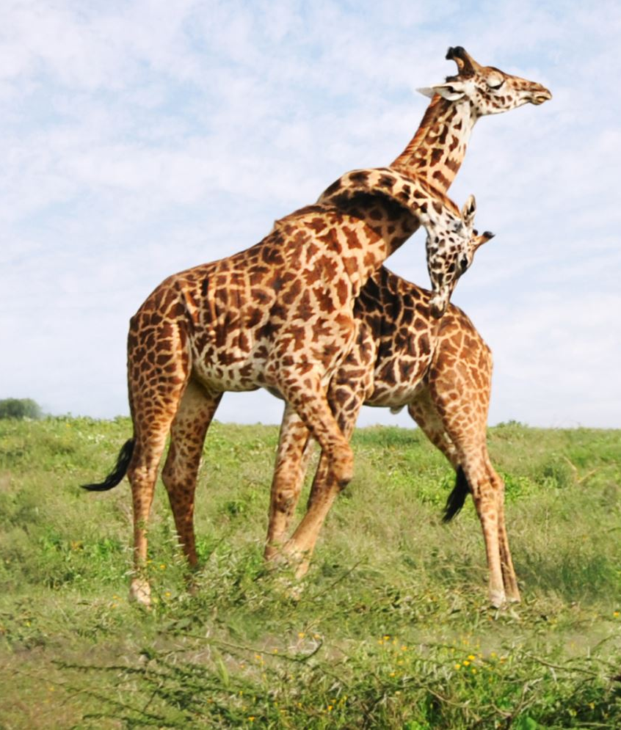
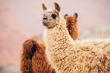
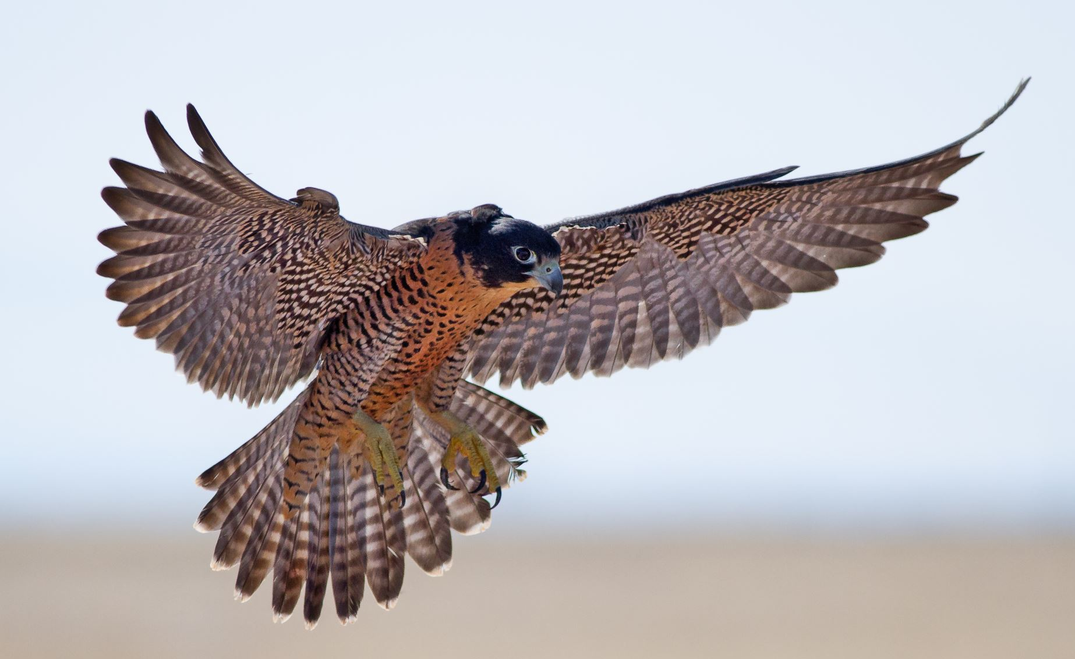
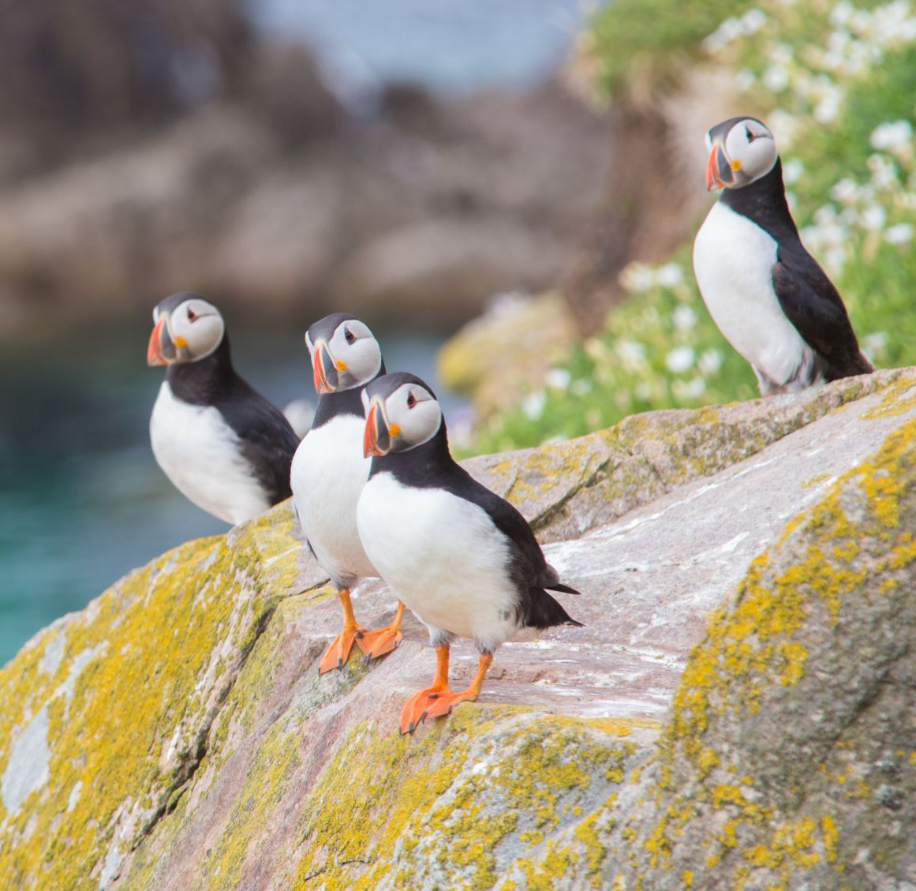

From Words to Numbers
Big
Bigger Dictionary
Giraffe
(.9, .9)
Llama
(-.9, .1)
A
An
And
At
Ate
Bark
Barked
Cat
Cats
Dog
Dogs
Eat
Eaten
A
An
And
At
Ate
Bark
Barked
Cat
Cats
Dog
Dogs
Eat
Eaten
A
An
And
At
Ate
Bark
Barked
Cat
Cats
Dog
Dogs
Eat
Eaten
A
An
And
At
Ate
Bark
Barked
Cat
Cats
Dog
Dogs
Eat
Eaten
A
An
And
At
Ate
Bark
Barked
Cat
Cats
Dog
Dogs
Eat
Eaten
A
An
And
At
Ate
Bark
Barked
Cat
Cats
Dog
Dogs
Eat
Eaten
…
…
…
…
Domestic
Wild
Falcon
(.15, -.4)
Kitty
(-.75, -.8)
Puffin
(.85, -.65)
Small
Notes:
That works well if we have a small dictionary size, but what if we have millions of words? That would result in us having millions of weights! One trick to handle this situation is to make something called an embedding. Let’s say we have a dictionary of animals, and we want to represent them with two numbers. We might take two ways we can describe these animals like how domestic/wild they are and how big/small they are. We’ll assign an animal that’s totally domestic a -1 on the domestic/wild scale and assign an animal that’s totally wild a +1 on the domestic/wild scale.
This is called an embedding because we’re taking something that’s higher dimensional (all of our animals as categories) and mapping them in a smaller dimensional space. We’re using two descriptors here, so it’s a 2-dimensional embedding. If we used three descriptors like domestic/wild, big/small, and prey/predator, that would be a 3-dimensional embedding.
A long time ago, a group of linguists tried to do this exercise where they assigned values to word descriptors. Today, we can use neural networks.

Slide 12
From Words to Numbers
Inputs
Technically an Embedding
Outputs
Bigger Dictionary
A
A
An
An
And
And
A
An
And
At
Ate
Bark
Barked
Cat
Cats
Dog
Dogs
Eat
Eaten
A
An
And
At
Ate
Bark
Barked
Cat
Cats
Dog
Dogs
Eat
Eaten
A
An
And
At
Ate
Bark
Barked
Cat
Cats
Dog
Dogs
Eat
Eaten
A
An
And
At
Ate
Bark
Barked
Cat
Cats
Dog
Dogs
Eat
Eaten
A
An
And
At
Ate
Bark
Barked
Cat
Cats
Dog
Dogs
Eat
Eaten
A
An
And
At
Ate
Bark
Barked
Cat
Cats
Dog
Dogs
Eat
Eaten
…
…
…
…
At
At
Ate
Ate
Bark
Bark
Barked
Barked
Cat
Cat
Cats
Cats
Dog
Dog
Dogs
Dogs
Eat
Eat
Notes:
Whenever we go from higher dimensional space down to lower dimensional space in our neural network, that’s technically an embedding. In other words, whenever we go from more neurons to less neurons, we’re creating an embedding. The number of neurons in the lower dimension is the embedding size.
These days, people often use transfer learning for word embeddings. This follows the results of recent research. In the lab today, we’ll be creating our own to see how it’s done.

Slide 13
Attention
Notes:
Cool, so we now know how to map our words to numbers. Let’s look at how Large Language Models, or LLMs, use these embeddings to generate text.

Slide 14

Sentence Prediction
I am the very model of a modern Major-Gineral,
I've information vegetable, animal, and mineral,
...
I'm very good at integral and differential calculus;
I know the scientific names of beings animalculous:
In short, in matters vegetable, animal, and mineral,
I am the very model of a modern Major-Gineral.
~ Major-General Stanley
Notes:
It used to be that neural networks could only predict one word at a time, but they since become more sophisticated. For example, let’s look at these lyrics sung by Major-General Stanley in Pirates of Penzance. Based on the text, can you guess what’s missing from the green box?

Slide 15
Sentence Prediction
I am the very model of a modern Major-Gineral,
I've information vegetable, animal, and mineral,
...
I'm very good at integral and differential calculus;
I know the scientific names of beings animalculous:
In short, in matters vegetable, animal, and mineral,
I am the very model of a modern Major-Gineral.
~ Major-General Stanley
Notes:
The information is right in the first sentence. This is a long and rambling song. How would a neural network remember this information?

Slide 16
Attention
I
am
the
very
model
5 x 3
5 x 3
Q
K
Query
Key
Notes:
Let’s say we have two neural networks designed to give us an embedding for a tokenized word. The key here is the output embeddings should be the same size. In this case, let’s say each embedding model outputs three numbers for a given input. To keep our ducks in a row, let’s call one embedding the Query and the other the Key.

Slide 17
Attention
I
am
the
very
model
5 x 3
5 x 3
Q
K
Query
Key
Notes:
Then for each word, we would get 2 3 number embeddings. In this case, we have 5 words, so we would have 2 5 by 3 matrices.

Slide 18
Attention
5 x 3
3 x 5
Notes:
If we take the transpose of one of the matrices…

Slide 19
Attention
Attention
5 x 3
3 x 5
5 x 5
Notes:
We can multiply them together. This is called the attention matrix, because it represents how each word in our sequence is related to each other.

Slide 20
Attention
 | I | Understand | Equations | Both | Simple | and | Quadraical
I
Understand
Equations
Both
Simple
And
Quadratical
Notes:
An attention matrix might look something like this. The more a word influences another word, the higher their intersection value would be.

Slide 21
Attention
I
am
the
very
model
5 x 3
5 x 3
5 x 3
Q
K
V
Query
Key
Value
Notes:
5 by 5 is an awkward shape to work with if we want to create another encoding based on this attention relationship, so let’s make another 5 by 3 matrix called the Value matrix

Slide 22
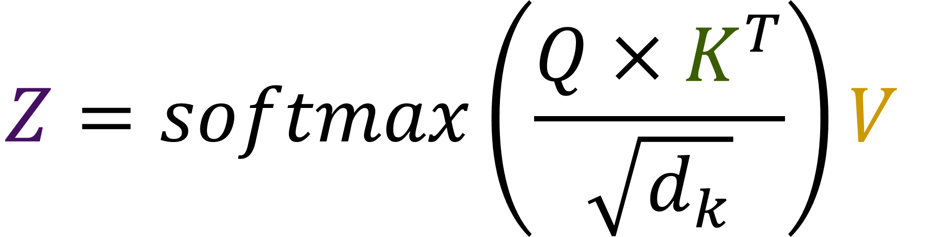
Attention
$$Z=softmax\left(\frac{Q×K^{T}}{\sqrt{d_{k}}}\right)V$$
I
am
the
very
model
5 x 3
5 x 3
5 x 3
5 x 3
Q
K
V
Z
Query
Key
Value
Attention Score
Notes:
By multiplying everything together, we get what’s called the attentions score. We can use this attention score in a variety of natural language processing challenges.

Slide 23
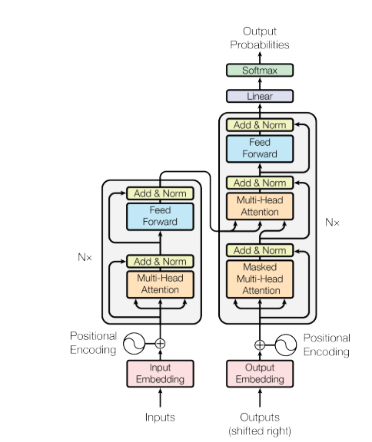
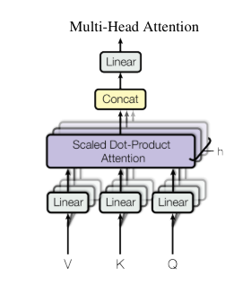
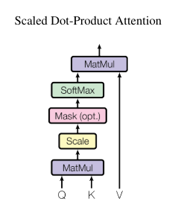
Transformers
Notes:
Large language models use the attention mechanism in a neural network architecture called a Transformer. One of the first famous models to use this architecture is BERT, which stands for Bidirectional Encoder Representations from Transformers.
https://arxiv.org/pdf/1706.03762

Slide 24
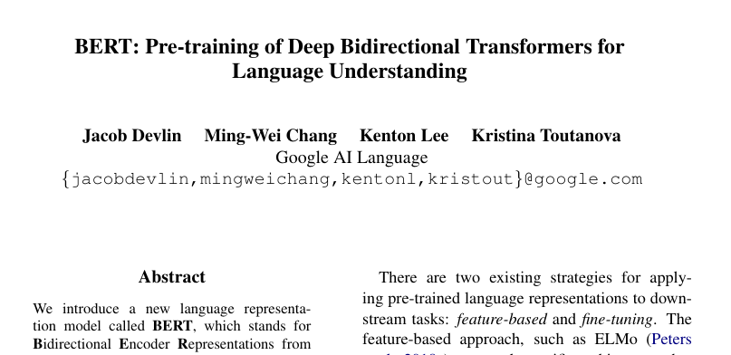
BERT
Notes:
We will use BERT in the lab to see how it uses embeddings and attention to predict sentences.
BERT is not the only famous model to use attention. Llama 2 and GPT also use attention transformers. I’ve included links in the notes if you’d like to dive deeper into how it works.
https://deepgram.com/learn/visualizing-and-explaining-transformer-models-from-the-ground-up
https://medium.com/analytics-vidhya/understanding-attention-in-transformers-models-57bada0cce3e
https://arxiv.org/pdf/1706.03762
https://arxiv.org/pdf/1810.04805

Slide 25
Other Architectures
Notes:
We’re getting close to the end of the class, so before we go, let’s go over how we can take our new skills further.

Slide 26
Autoencoders
Inputs
Outputs
Notes:
Autoencoders are a great next step after mastering embeddings as they’re closely related. Like embeddings, one of the goals is to take higher dimensional data and be able to represent it in a lower dimensional space. Here’s our strategy: we’re going to make a model that’s a mirror image of itself with a low number of neurons in the center. Then, we’re going to take our input and also use it as our output when training.
As an example, in the above, we’ve taken a flattened image, and we’ll train this model to output the same flattened image as what was inputted.

Slide 27

Autoencoders
Inputs
Outputs
Notes:
Why would we go through this complicated process if we’re just going to get the same thing as what we entered? Check out this magic. After we train the model, we’re going to cut it right after the middle…

Slide 28
Autoencoders
-.3
-.3
.6
.6
Encoder
Decoder
Notes:
And we’ll get an encoder and decoder. There are a couple of great uses for this. If our model is accurate, we can store large amounts of data with only a few numbers, and we can restore the original data if and when we ever need the raw data format.
The other use for this is for something called anomaly detection, which is useful in security, fault detection, and medicine. If we train an accurate autoencoder on lots of data, but there are some datapoints for which the output is significantly different than the input, then we might consider that an anomaly that we need to pay more attention to.

Slide 29
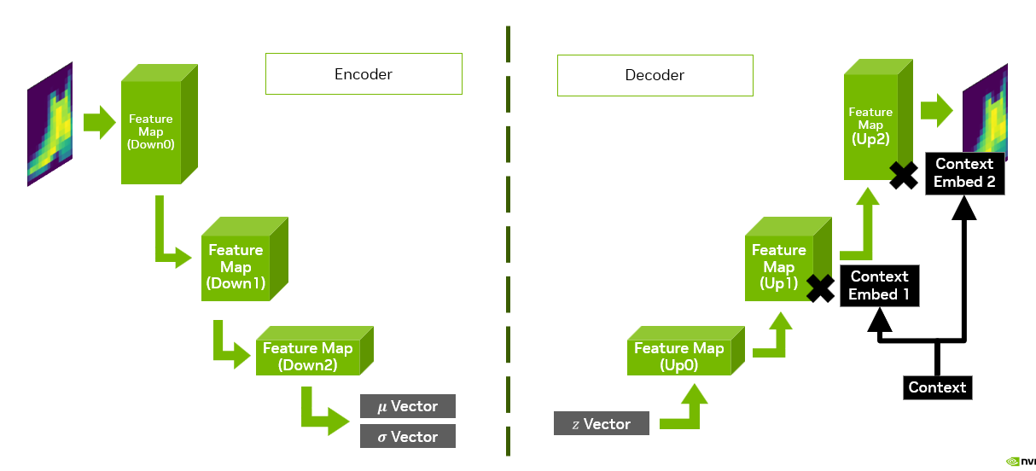
Variational Autoencoder
Notes:
Not long after the invention of the autoencoder came Variational Autoencoders, which we can use as Generative AI for images. We could train an autoencoder on images so that we can use the decoder to generate images.

Slide 30
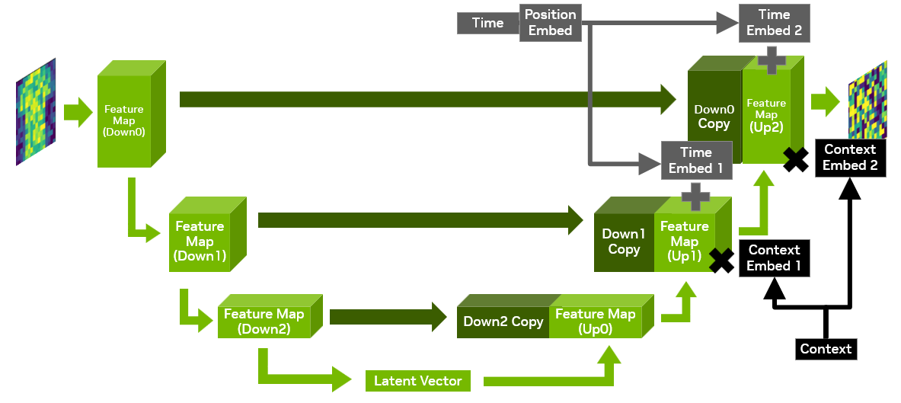
Diffusion Models
Notes:
Similar to variational autoencoders, but much more complicated, are diffusion models. Diffusion Models work by taking a noisy image and slowly subtracting small amounts of noise at a time until an image is formed. It’s the neural network equivalent of an inkblot test.
Diffusion Models are the bases for many famous image generation tools like Adobe Firefly, Stable Diffusion, and DALL E.

Slide 31
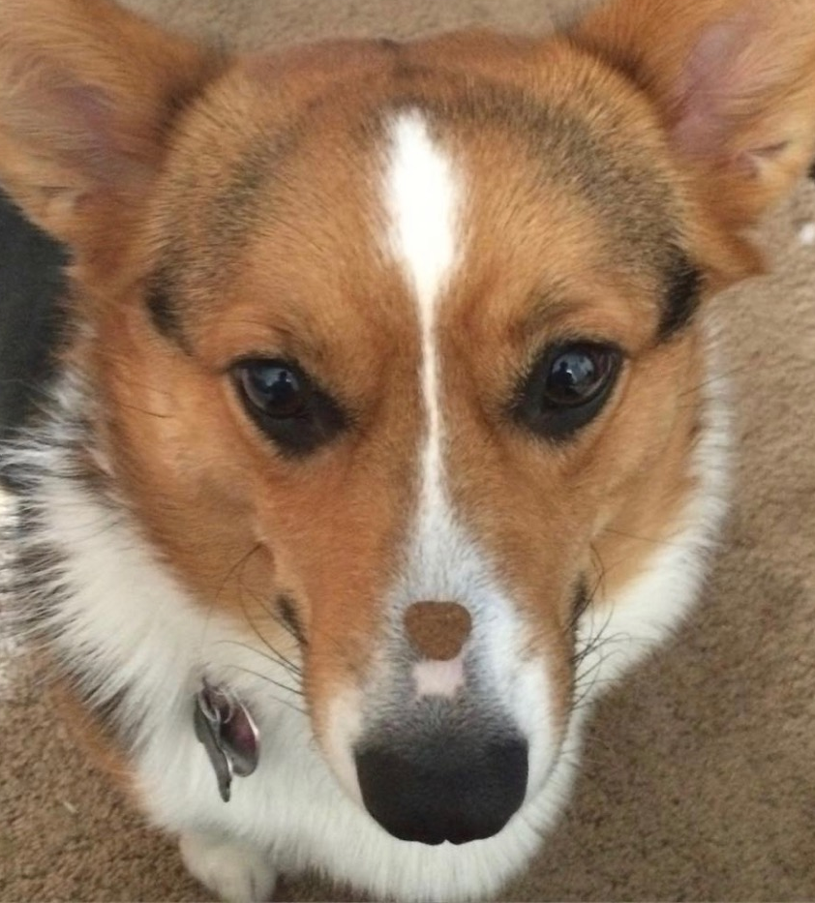


Reinforcement Learning
Agent
Environment
Notes:
The last architecture we’re going to talk about is Reinforcement Learning. Well, it’s less of an architecture and more of a clever way to use the machine learning models we learned how to make today. Reinforcement Learning comes from an idea from Psychology called delayed rewards: the idea that we can put off a reward now for a better reward later.
On the left here, I have a picture of my sister’s corgi trying very hard not to eat the treat on her nose. If you have a pet at home, you might recognize that it’s especially hard to teach them concepts that require a bit of time delay. This is something that humans are surprisingly good at.
In Reinforcement Learning, there are two systems at play: there’s the agent, or the intelligence that is trying to learn a skill, and there’s the environment that the agent needs to react to. People who work with Reinforcement Learning are both Data Scientists and Game Designers. Our neural network lives in the agent, where it will predict the best action to take given information about the environment. The environment can change given what the agent does, and that’s where being a Game Designer comes in. It’s quite tricky designing an environment that’s reflective of real-world conditions.
The neural networks in the agent are only a part of what we need to build the agent. We also need to give it memory so it can learn from past actions and a sense of curiosity so that it’s willing to try new things for the sake of learning.
Remember way way back to the beginning of this course when we talked about how humans learn versus how artificial intelligence learns? Much of that insight comes from Reinforcement Learning. The field is known for having applications in robotics and finance, but it’s also a great topic just to have a better appreciation for how humans learn. It takes time and patience to be able to learn a new skill, and those who are a little fearless and are willing to make mistakes in order to learn will have an easier time mastering a subject. Reinforcement Learning shows that our failures are as much a powerful teaching tool as our successes. So genuinely, congrats on making it through the class today. If it was easy for you, that’s great! But if it was hard, that’s fine too. By taking on the challenge, there is a bigger opportunity to learn.

Slide 32
Next Steps
Notes:
The next lab is the last one, so if you’re interested, we’d like to share how to set up the same coding environment we used in class so you can use it for your own projects.

Slide 33
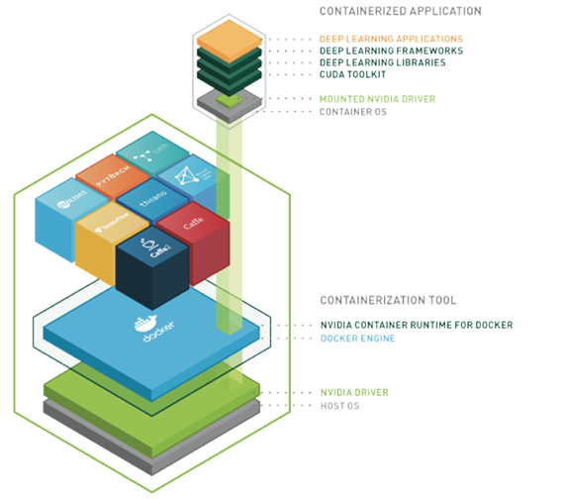
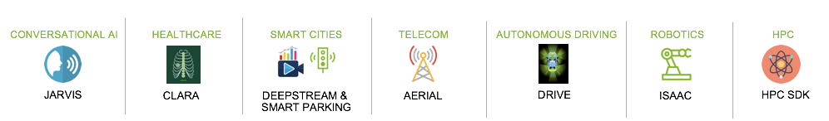
ENABLING PORTABILITY WITH NGC CONTAINERS
NGC Deep Learning Containers
Extensive
Diverse range of workloads and industry specific use cases
Optimized
DL containers updated monthly
Packed with latest features and superior performance
Secure & Reliable
Scanned for vulnerabilities and crypto
Tested on workstations, servers, & cloud instances
Scalable
Supports multi-GPU & multi-node systems
Designed for Enterprise & HPC
Supports Docker, Singularity & other runtimes
Run Anywhere
Bare metal, VMs, Kubernetes
x86, ARM, POWER
Multi-cloud, on-prem, hybrid, edge
Riva
Learn more about NGC Containers
Notes:
Docker is a useful tool for packaging software stacks for use on other machines. These packages are called containers. They’re very similar to virtual machines, but the difference is that they use the host machine’s operating system and hardware instead of using simulated hardware.
NGC is an online platform that hosts Containers and other AI resources that are free to download.

Slide 34
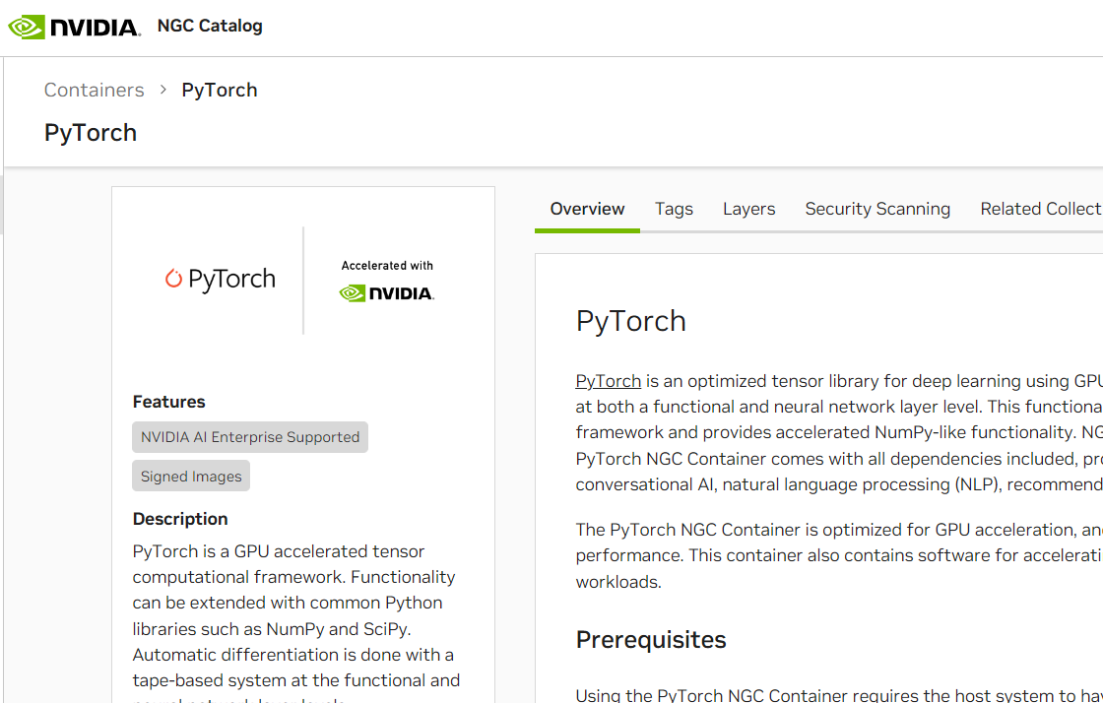
Next Steps for This Class
Step 1
Sign up for NGC
https://docs.nvidia.com/dgx/ngc-registry-for-dgx-user-guide/index.html
Step 2
Visit NGC Catalog
https://catalog.ngc.nvidia.com/orgs/nvidia/containers/pytorch
Step 3
Pull and Run Container
Visit localhost:8888 to check out a JupyterLab environment
Notes:
If you know how to use Docker and have a machine that supports CUDA 10.0, 10.1, or 10.2, you can easily recreate the environment for this class. We’re not going to go over Docker Setup as that is going to be unique to each person’s machine. Once docker is set up, it’s easy to use. “docker run” will run the container, the contents of which can be accessed both through the command line and through the browser if it has ports exposed.
For DLI, we’ve prepared follow up material for the class in a Docker Container. It creates a JupyterLab environment just like the one we’ve used in the class so you can get it set up locally on your own machine. More detailed instructions on how to get this container up and running are provided in the links above, so please check it out.

Slide 35
Closing Thoughts
Notes:
Before we end lecture, let’s do a quick thought experiment in order to appreciate computer intelligence a little more.

Slide 36
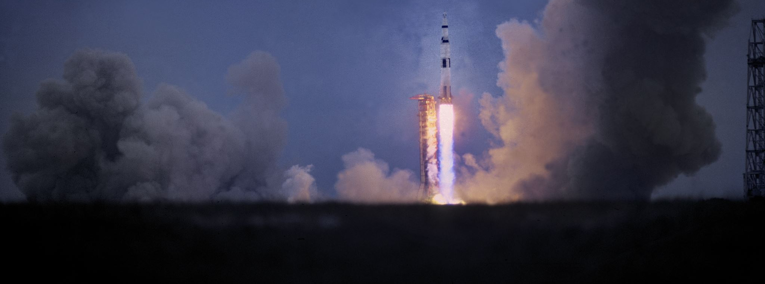
Copying Rocket Science
Notes:
Let’s say there’s a person locked away in a room where people slip equations related to Rocket Science under the door. The person in the room doesn’t know anything about Rocket Science, but they have a list of instructions to follow depending on the symbols on the paper slipped to them. The locked person follows the instructions and returns the solutions on a piece of paper back under the door. The locked person acts like a computer, following a list of instructions with an output, and the people outside the room, none the wiser, believe that the locked person is a Rocket Scientist.
My question to you is, where does mimicry end and understanding begin? When humans first learn how to do math, it’s done by copying, such as memorizing our times tables. We can debate all day on where that line is drawn but the point is this:
The greatest breakthroughs in AI are from people who not only understand computers, but can mathematically express how humans think. See if you can define “understanding” in a way that a computer can interpret, and you will help it grow from mimicry to understanding.
https://plato.stanford.edu/entries/chinese-room/

Slide 37
Let’s get Started!
Notes:
That’s all for now. Thank you for joining us.
Alright, last lab! Best of luck!

