Slide 1
On Scheduling of Fuzzing Test
Hongbo Zhang ANU
Superadvisors: Steve Blackburn, Tony Hosking, Shane Magrath
Feb 13 2017
Sydney

Slide 2
Overview
Problem
Model
Result
Discussion
2

Slide 3
Fuzzing Test

Slide 4
Fuzzing Test
Scheduler

Slide 5

Fuzzing Test
Scheduler
Experi-ment
Theory
Simulation

Slide 6
Fuzzing Test
Scheduler
Experi-ment
Crash
Model
Bug
Model
Theory
Simulation

Slide 7
Fuzzing Test
Scheduler
Experi-ment
Crash
Model
Bug
Model
Theory
Simulation

Slide 8
Model
Bernoulli Model

Slide 9
Crash Model
Bernoulli Model
Infinite is impossible
Probability to find a new unique crash should be decrease.

Slide 10
Crash Model
Limited Crashes Model
λ is decay parameter
n is unique crashes triggered by a seed potentially
p is much smaller than 1.
All of them are unknown as a priori.

Slide 11
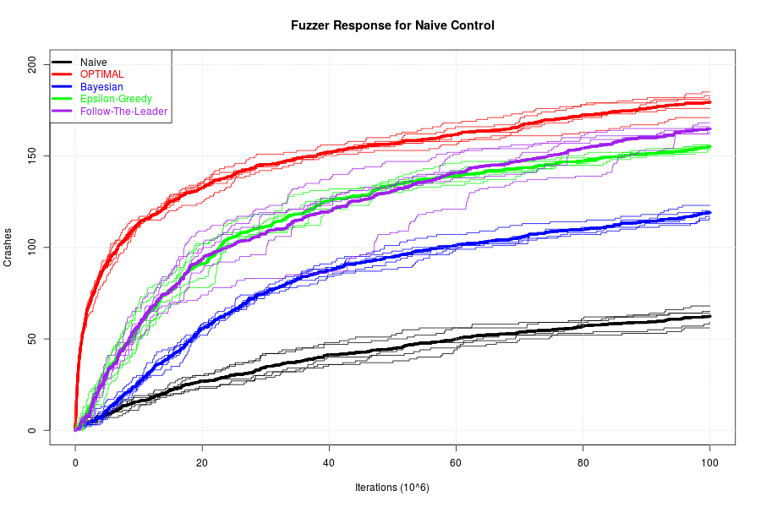
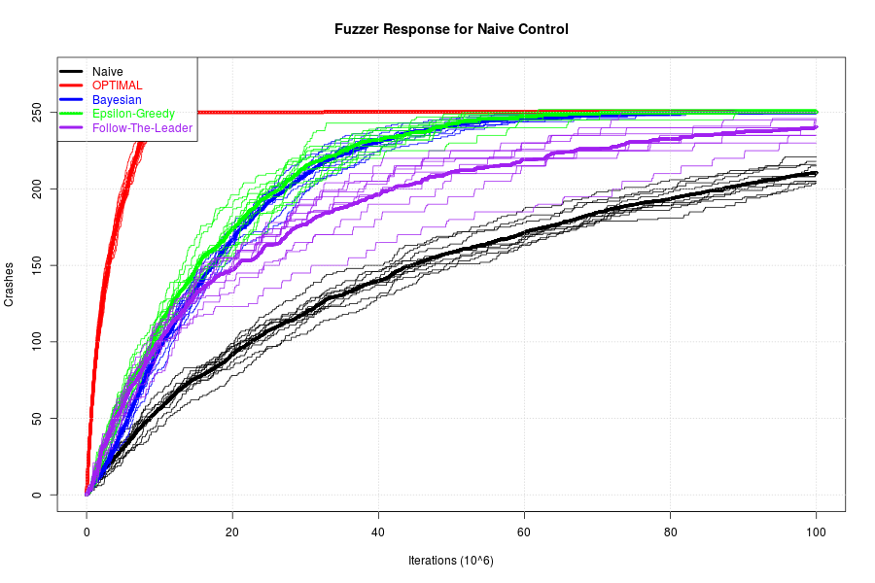
Result: Limited Crashes Model
n -> ∞ n = 5

Slide 12
Result: Limited Crashes Model
n -> ∞ n = 5
Exploration vs. Exploitation
A critical number n*

Slide 13
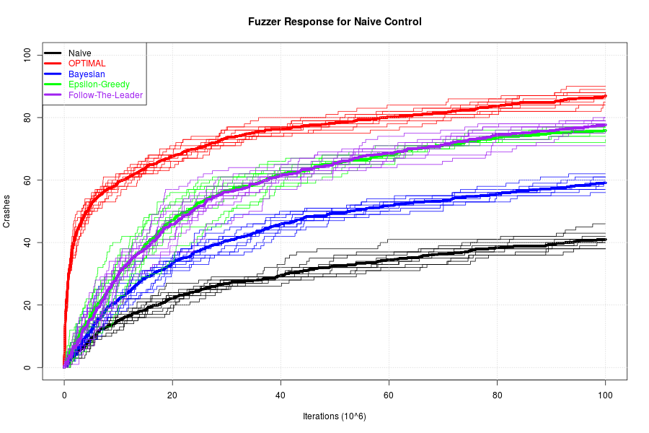
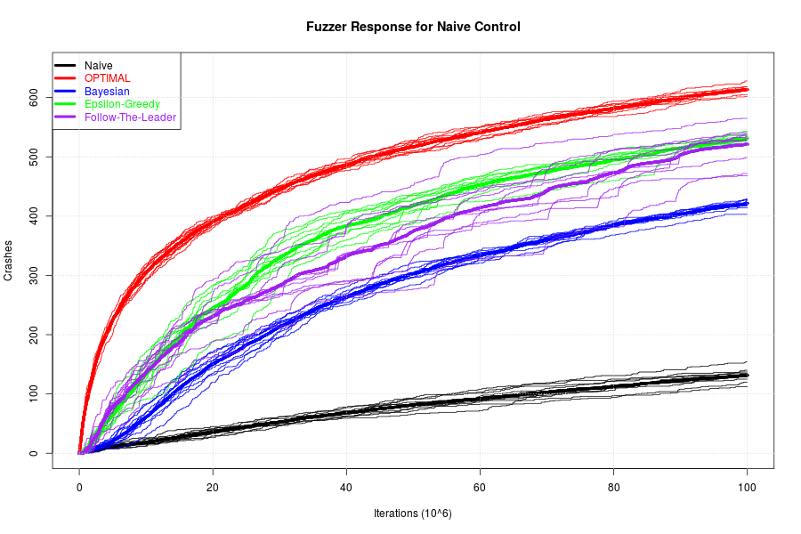
Result: Decay factor
λ = 0.3 λ = 0.9
n >> n*
Crashes are expected to be found earlier for smaller λ, hence favor more exploration

Slide 14
Result: α-UCB1
To see “explore vs. exploit” more clearly
UCB1 : Mean + Variance
Exploit Explore
α -UCB1 : α×Mean + Variance
Retrieve from https://au.pinterest.com/pin/150729918751441146/

Slide 15
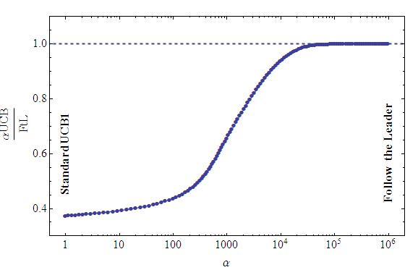
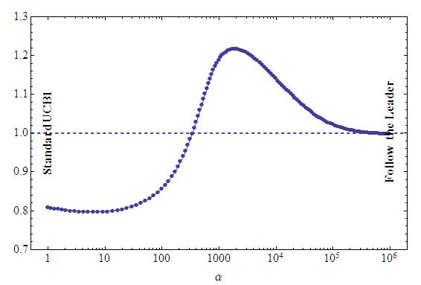
Result: α-UCB1
n -> ∞ n = 5
/

Slide 16
Discussion
Exploration vs. Exploitation
Accurate crash modeling is essential in designing a scheduling policy.
Mortal multi-arm bandits
Bug model

Slide 17
THANKS

Slide 18
Appendix
n*

