Slide 1
On Scheduling of Fuzzing Tests
Hongbo Zhang ANU
Supervisors: Steve Blackburn, Tony Hosking, Shane Magrath
Feb 13 2017
Sydney

Slide 2
Overview
Problem
Models
Results
Conclusion

Slide 3
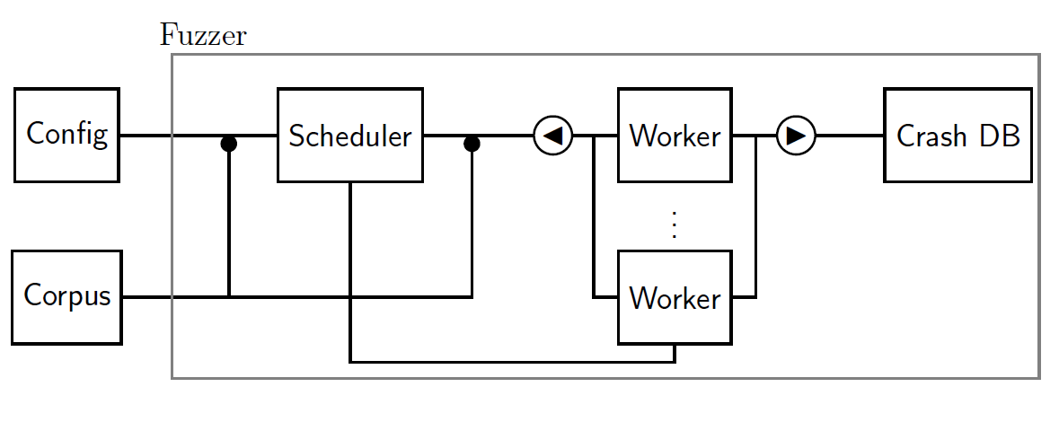
Fuzzing Tests

Slide 4
Fuzzing Tests
Scheduler

Slide 5
Fuzzing Tests
Scheduler
Experi-ment
Simula-tion
Theory

Slide 6
Fuzzing Tests
Scheduler
Experi-ment
Simula-tion
Crash
Model
Bug
Model
Theory

Slide 7
Fuzzing Tests
Scheduler
Experi-ment
Simula-tion
Crash
Model
Bug
Model
Theory

Slide 8
Fuzzing Tests
Scheduler
Experi-ment
Simula-tion
Crash
Model
Bug
Model
One Target
Theory

Slide 9
Fuzzing Tests
Follow the Leader
Scheduler
Experi-ment
Simula-tion
Crash
Model
Bug
Model
One Target
Theory

Slide 10
Fuzzing Tests
Follow the Leader
Scheduler
Is it true
In which cases
Why
Experi-ment
Simula-tion
Crash
Model
Bug
Model
One Target
Theory

Slide 11

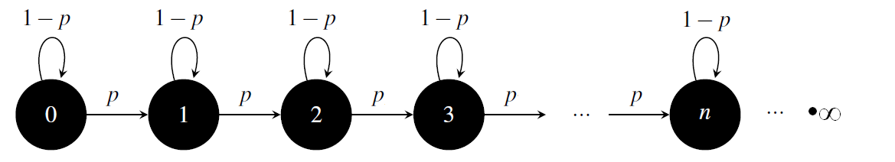
Crash Models
Bernoulli Model

Slide 12
Crash Models
Bernoulli Model
Infinite is impossible
Probability to find a new unique crash should decrease.
Follow the leader is optimal

Slide 13
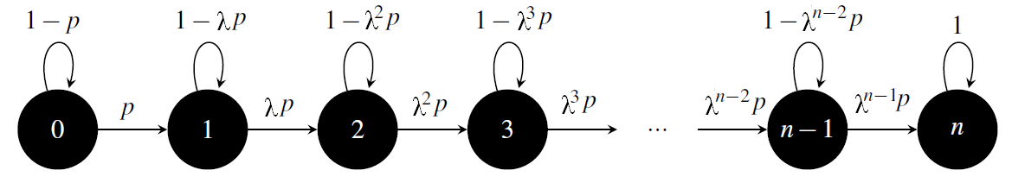
Crash Models
Limited Crashes Model
λ is decay parameter
n is unique crashes triggered by a seed potentially
p is much smaller than 1.
All of them are unknown as a priori.

Slide 14
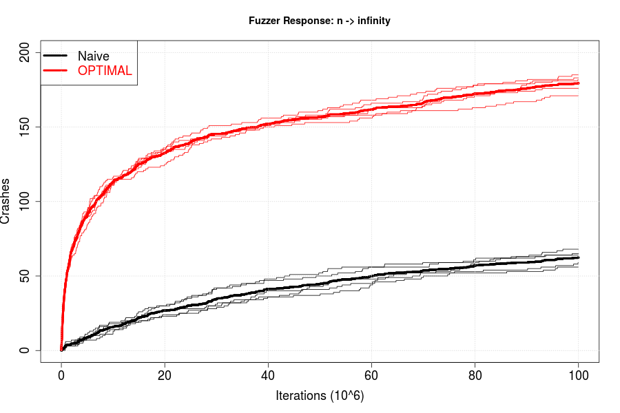

Result: Limited Crashes Model
n = ∞

Slide 15
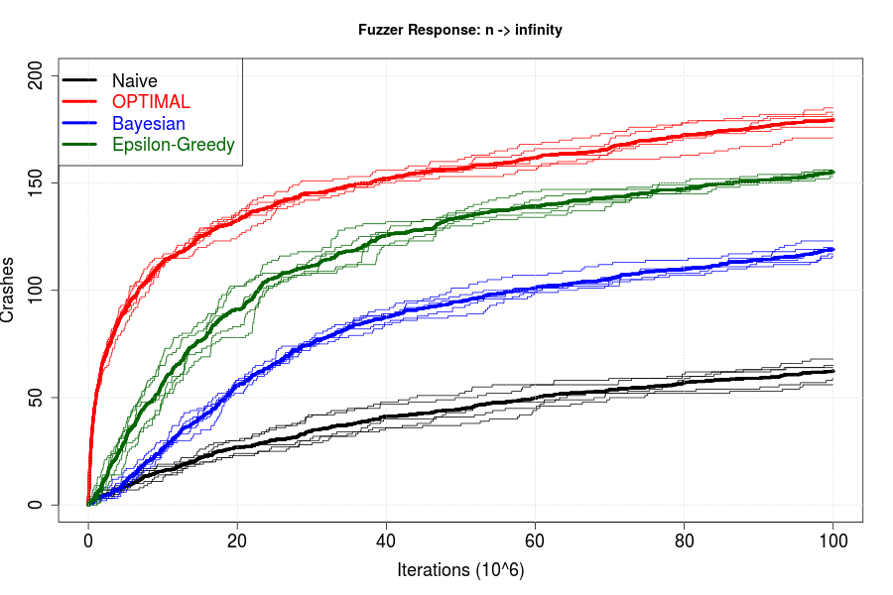
Result: Limited Crashes Model
n = ∞

Slide 16
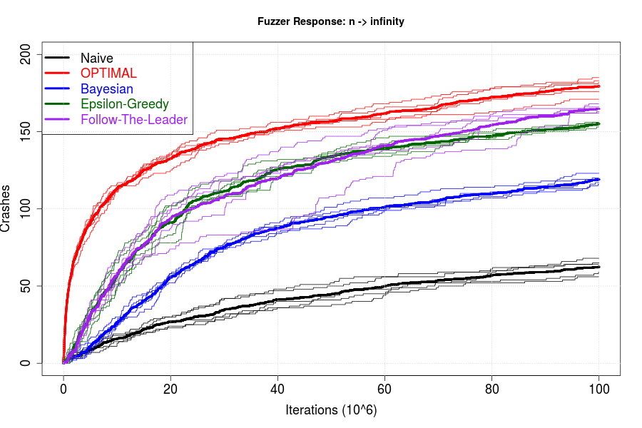
Result: Limited Crashes Model
n = ∞

Slide 17
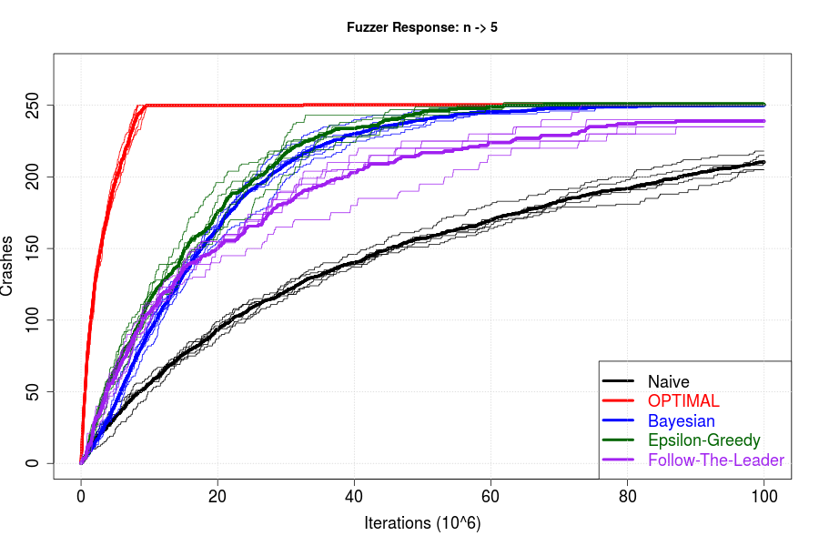
Result: Limited Crashes Model
n = ∞
n = 5

Slide 18
Result: Limited Crashes Model
n = ∞
n = 5
Exploration vs. Exploitation
A critical number n*

Slide 19
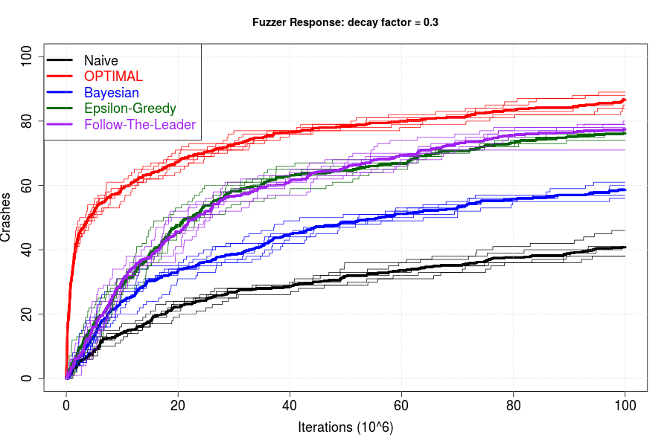
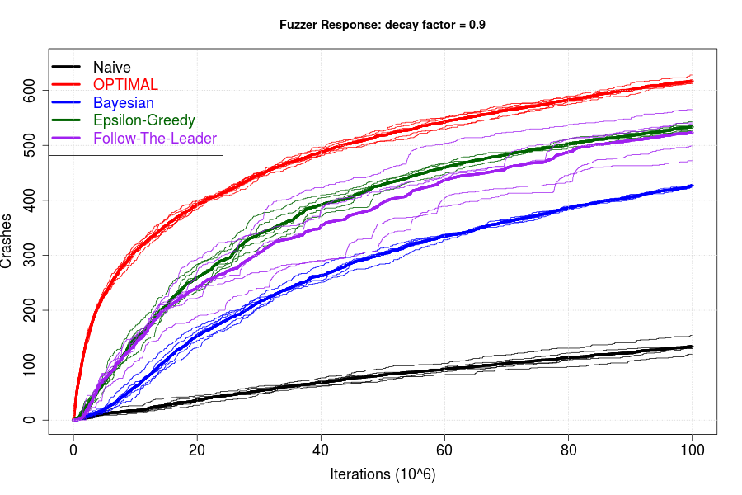
Result: Decay factor
λ = 0.3
λ = 0.9
Smaller λ, early crash, more exploration
n >> n*

Slide 20
Result: α-UCB1
To see “explore vs. exploit” more clearly
UCB1 : Mean + Variance
Exploit Explore
α -UCB1 : α×Mean + Variance
Retrieve from https://au.pinterest.com/pin/150729918751441146/

Slide 21
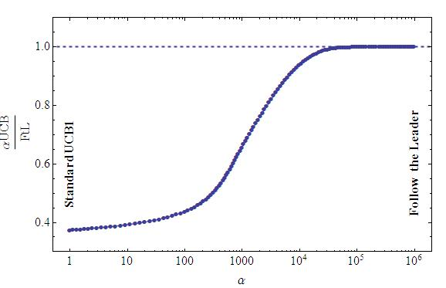
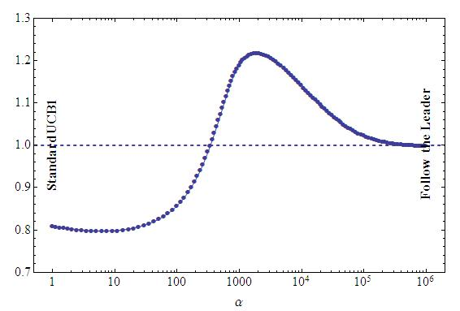
Result: α-UCB1
n -> ∞ n = 5
/

Slide 22
Conclusion
Exploration vs. Exploitation
Accurate crash modeling is essential in designing a scheduling policy.
Questions
  Theory: multi-arm bandits with finite lift-time*
  Bug model
* Chakrabarti D, Kumar R, Filip R, Eli U, Mortal Multi-Armed Bandits, in Advances in Neural Information Processing Systems 21, Curran Associates, Inc., pp. 2730280, 2009

Slide 23
THANKS
Hongbo Zhang
u6170245@anu.edu.au

Slide 24
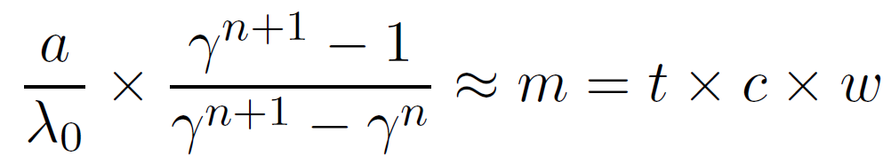
Appendix
n*

