Slide 1
COMP1110 Assignment 2
- thu11l
Hongbo Zhang u6170245
Yifan Huang u5898869
Shijie Qin u5553084
20/10/2016

Slide 2
Feature

Slide 3






Flip – Right click
Rotate – Scroll up/down

Slide 4
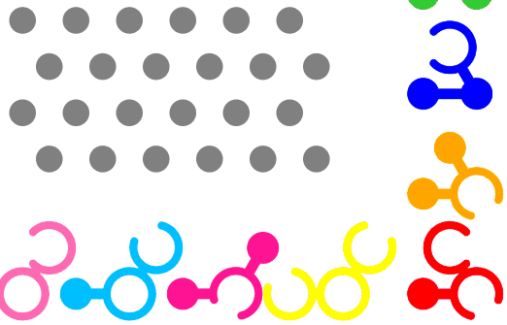
Drag & Snap – Drag the mouse(left mouse button)

Slide 5
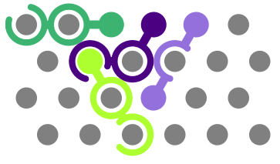

Hint – Press “/” Key

Slide 6



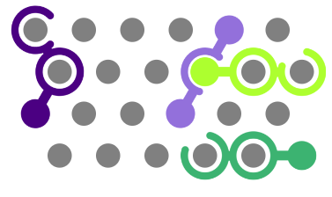
Difficulty

Slide 7
New Extension

Slide 8
Score System

Slide 9
Stage Mode

Slide 10
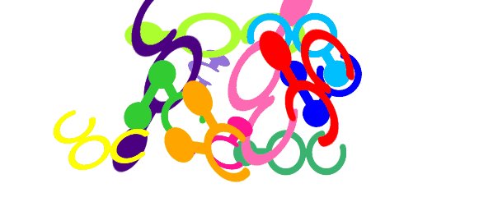
Animation

Slide 11
Play the Demo

Slide 12
Design

Slide 13
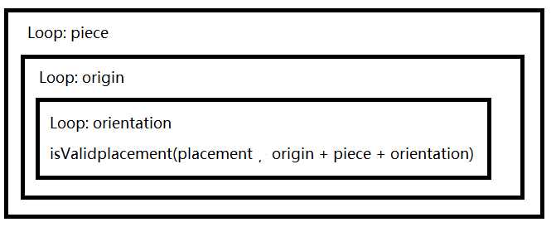
Main Problem
The method “getSolution(placement)” spend a long time

Slide 14
Optimize:
Record the data from last call of the function.
Such as placement, peg, occupation, peg index.

Slide 15








2. Pruning
Available peg:
Unavailable peg:

Slide 16


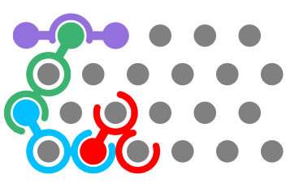
a. Only check the pegs occupied by the last piece

Slide 17


b. DeadPoint:
Check the peg around the origin (Delete invalid peg)
If(Number of the valid peg > 2)
Then, this peg is valid
Else(this peg is invalid(DeadPoint))

Slide 18


c. Neighbor DeadPoint. (Delete invalid peg)
DeadPoint:
Neighbor DeadPoint:

Slide 19


d.PegfaceRing1 (Delete invalid peg)
Available peg:
Unavailable peg:

Slide 20




e. Peg Neighbor & Shape
Straight angle:
Valid: Invalid:

Slide 21

Acute angle:
Valid: Invalid:

Slide 22

Obtuse angle:
Valid: Invalid:

Slide 23


f. Valid orientation:
For example: Piece C
Piece C only has two
orientation can fit this
placement. Which are
C and K.

Slide 24









g. Valid origin
centre of the piece: Valid origin:

