Slide 1
Implementing IQ Link
COMP1110 Assignment 2
thu11l
Hongbo Zhang u6170245
Yifan Huang u5898869
Shijie Qin u5553084
20/10/2016

Slide 2
Outline
Feature
Play the Demo
Design
Problem and Solution

Slide 3
Feature

Slide 4






Flip – Right click
Rotate – Scroll up/down

Slide 5
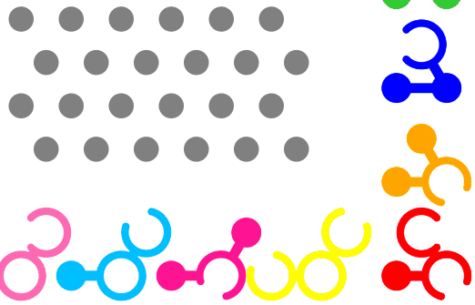
Drag, Snap & Check – Drag by left mouse button

Slide 6
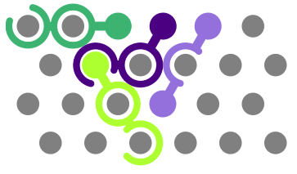
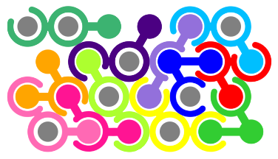
Hint – Press “/” Key

Slide 7


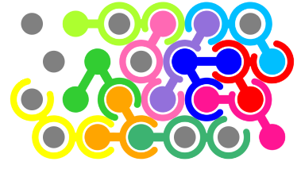
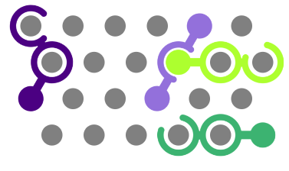
Difficulty

Slide 8
New Extension

Slide 9
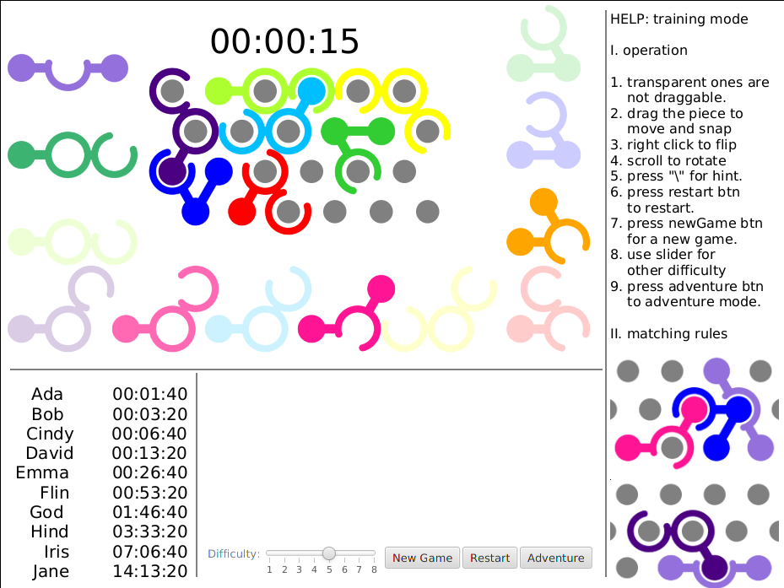
Timer & Help for New Users

Slide 10
Training Mode & Adventure Mode

Slide 11
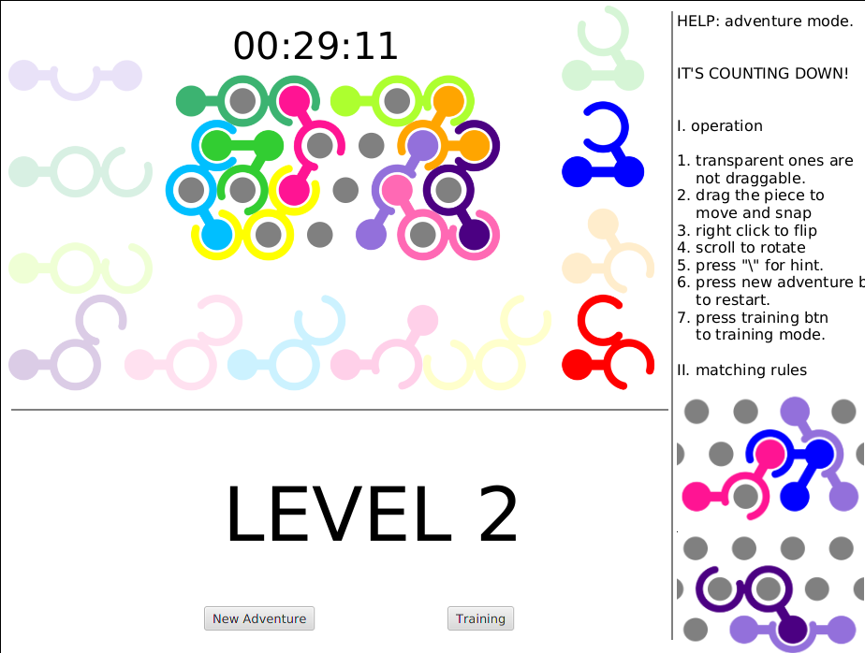
Training Mode & Adventure Mode

Slide 12
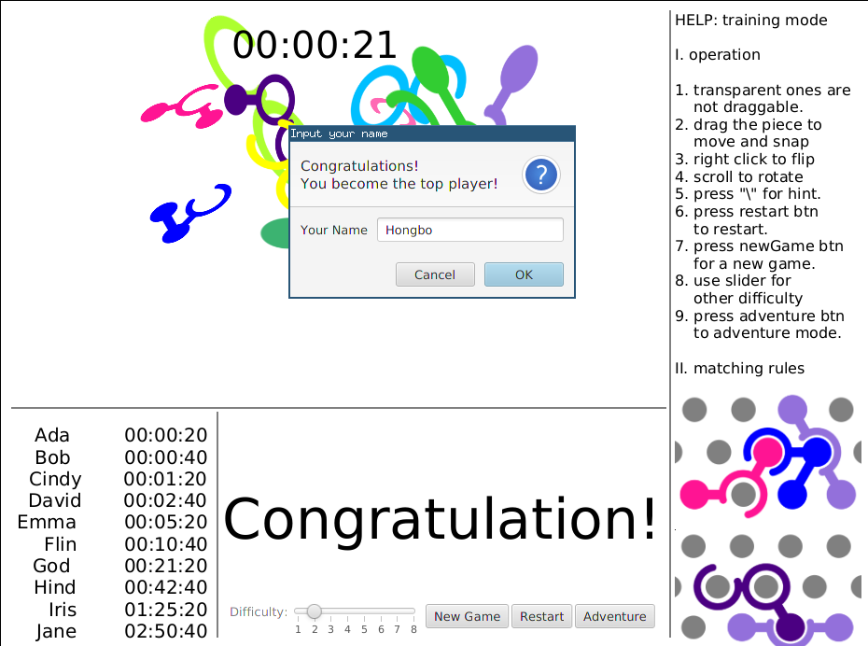
Score System

Slide 13
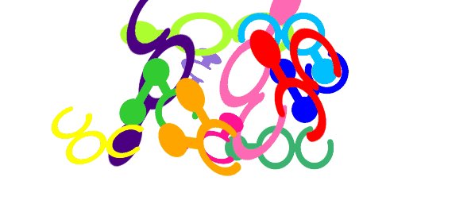
Clearance Animation

Slide 14
Play the Demo

Slide 15
Design

Slide 16
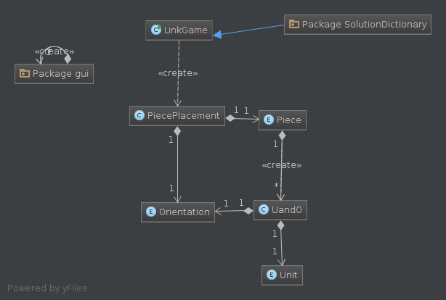
UML: logical part

Slide 17
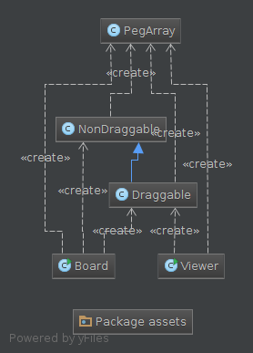
UML: GUI part

Slide 18
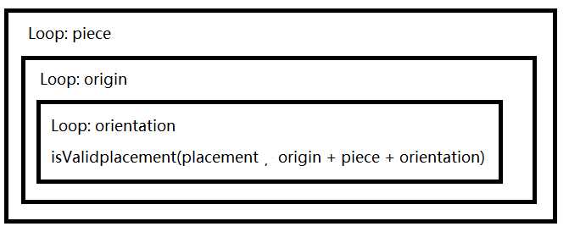
Main Problem
The method “getSolution(placement)” spend a long time

Slide 19
Optimize:
Record the data from last call of the function.
Such as placement, occupation, peg index.

Slide 20
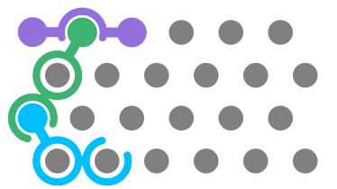

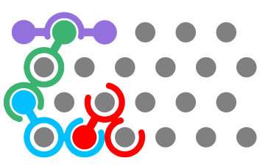
a. Only check the pegs occupied by the last piece

Slide 21
2. Pruning
  Neighbours of a piece
  Shape of a piece
  Unit in a piece

Slide 22
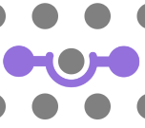

b. <Neighbor> Dead Point:
Check the neighbors
Number of the available peg < 2,
this peg is invalid (Dead Point)

Slide 23
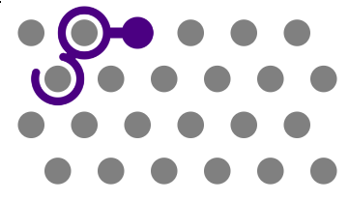
c. <Neighbor> Neighbor Dead Point.
Placing a piece on a peg will also affect the validity of its neighbors.

Slide 24

d. <Neighbor> Ring with one opening
Available but invalid peg:

Slide 25

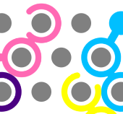
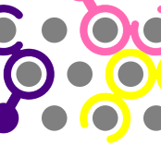

e. <Shape> Peg Neighbor & Shape
Straight angle:
Valid: Invalid:

Slide 26

e. <Shape> Peg Neighbor & Shape
Acute angle:
Valid: Invalid:

Slide 27

e. <Shape> Peg Neighbor & Shape
Obtuse angle:
Valid: Invalid:

Slide 28


f. <Shape> Valid orientation:
For example: Piece C
Piece C only has two
orientation can fit this
placement. Which are
C and K.

Slide 29









g. <Unit> Valid origin
centre of the piece: Valid origin:

Slide 30
Summary
Required features
Extensions
Object Oriented
Partially optimized, still have space to improve

Slide 31

Thanks

