Slide 1
Regulatory Drivers for Operational Risk

Slide 2
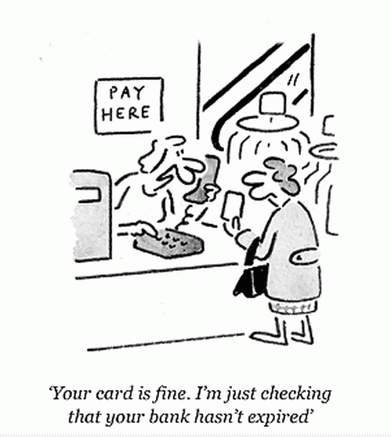
Was there a need for changes in financial regulation?

Slide 3
The Bank for International Settlements
Bank for International Settlements, 1930
Basel Committee on Banking Supervision, 1974
Basel I, 1988
Basel II, 2004
Basel III, 2011
BIS Functions:
Providing banking services for central banks
Working to foster international monetary and financial cooperation

Slide 4

History of the Bank for International Settlements
Established May, 1930 in Basel, Switzerland
Coordinate World War I reparation payments
Facilitate cooperation among central banks
Owned and operated by central banks
Not responsible to national governments
First meeting of the Board May 12, 1930
Informal forum for bank cooperation
Financial reconstruction of Europe after World War II
Bretton Woods Framework 1944 - 1971
European Monetary Union 1999 - present

Slide 5











The BIS Mission and the Basel Committee on Banking Supervision
Pursuit of global monetary and financial stability:
By providing emergency financial assistance to central banks in case of need; and
By supporting experts from national central banks and supervisory agencies in proposing measures and developing standards aimed at strengthening the international financial architecture, and in particular international banking supervision.
Collapse of Bankhaus Herstatt, 1974
Unregulated international transactions
Group of 10 countries

Slide 6
Basel I: International Convergence of Capital Measurement & Capital Standards
Basel I
Advise national financial regulators on how to improve banking supervision and cooperation
Credit risk—borrower defaults on payments
Purpose and Intent
Sound and stable international banking system
Consistent regulation around the world
Regulators implement details at their discretion
Specifics
Regulatory capital—reserve liquidity for sustaining expected and unexpected losses
8% Capital Adequacy Ratio
Basel I Today
Enforced by law in the “Group of 10,” 1992
Outdated assessment of a bank’s risk
Does not consider operational and market risk
No framework for government regulators

Slide 7
Main Objectives of Basel II
Capital Allocation
Ensure that capital allocation is more risk sensitive
Capture capital requirements for operational risk
Quantify Risk
Ensure that credit risk, operational risk and market risk are quantified based on statistical data and formal techniques
Disclosure Requirements
Enhance disclosure requirements allowing market participants to assess the capital adequacy of an institution
Regulatory & Economic Capital
Attempt to align economic and regulatory capital more closely to reduce the scope for regulatory arbitrage

Slide 8
Three Pillars of Basel II
Determines minimum capital requirements
Calculates credit, market and operational risk capital
Uses internal bank data
Pillar 1
Risk Weighting
Identifies other risks requiring capital
Considers top risks and expects stress testing to influence capital targets
Pillar 2
Capital Adequacy
Provides investors more insight on risk
Requires significantly higher disclosure requirements
Pillar 3
Disclosures
Increased data and model governance requirements
New statistical models for Commercial and Retail
Enhanced operational risk and data modeling
Enhanced governance and processes for determining capital adequacy
New detailed risk and capital reporting
Source: John Catron, Basel II PMO

Slide 9
Basel II Operational Risk
Pillar 1 offers three possible methods to calculate capital for operational risk:
the Basic Indicator Approach (BIA
the Standardized Approach (TSA) or
the Advanced Measurement Approach (AMA)
Notes:
Under BIA, capital is simply calculated from a percentage (currently set at 15%) of the average of the last three years revenue. TSA offers different percentage weightings depending upon the business line – ranging from 12% for retail banking to 18% for sales and trading. AMA offers banks the opportunity to develop their own risk based model for calculating operational risk capital. AMA requires that the model include four elements: internal loss data, external loss data, scenario analysis and business environment and internal control factors.
While Pillar 1 offers three possible methods to calculate operational risk capital, most large banks have found that their local regulator requires them to pursue an AMA approach. In addition, even where a bank is not required to take an AMA approach to calculating capital, their regulator often advises them that they should adopt best practices, and that best practices require them to ensure they have fully developed all four elements of AMA.
Therefore, the standard for a strong operational risk framework is based on the effective development of internal and external loss data systems, appropriate use of scenario analysis and effective development of business environment and internal control factors. Whether or not these are used as direct inputs into a capital model, they are considered vital elements of a sound operational risk management framework.

Slide 10
U.S. Final Rule on Basel II
U.S. Final Rule, December 2007
Large banks in the US follow the advanced approaches—the A-IRB approach for credit risk and the AMA approach for operational risk.
Published by regulators
Office of the Comptroller of the Currency (OCC)
Board of Governors of the Federal Reserve System (the Fed)
Federal Deposit Insurance Corporation (FDIC)
Office of Thrift Supervision (OTS)
Core banks must follow the rule; smaller banks can opt-in
$250 billion or more consolidated assets
$10 billion or more on-balance-sheet foreign exposure
U.S. Basel II Core Banks:
JPMorgan Chase
Bank of America
Citigroup
Wells Fargo
Goldman Sachs
Morgan Stanley
Bank of New York Mellon
US Bancorp
Northern Trust
PNC Financial Services
State Street Corporation
American Express

Slide 11
Preparation for Basel II and Parallel Run
Basel II PMO team ensures a smooth enterprise-wide implementation of the Basel II framework
Basel II Implementation Plan adopted June 2013
Parallel run—four consecutive quarters of reporting to regulators under Basel I and Basel II, fulfilling the requirements of both
Regulatory capital, government reporting, public disclosure
No bank has been allowed to exit parallel run
OCC, Fed, and FDIC are difficult to please

Slide 12
Importance of Implementing Basel II
Basel II improves risk management at banks and generates value
COFC Basel II Implementation Plan proves that we:
Understand the final rule
Have a plan to address gaps
Committed sufficient resources to meet the requirements
We determine our own regulatory capital needs
High level on scrutiny on A-IRB and AMA approaches that we develop
High governance expectations from executive management and the Board
Bottom line: Basel II is important because we are required to follow the government’s rules, and because it will improve the way we manage risk and the way we respond to unexpected losses.

Slide 13
Basel III
The Group of Twenty (G20)
A Financial Stability Board (FSB) formed
To make recommendations for change.
Strengthening the Resilience of the Banking Sector and International Framework for Liquidity Risk Measurement, Standards and Monitoring.
An increase in Tier One capital
Additional capital for derivatives, securities financing and repo markets
Tighter leverage ratios
Setting aside revenue during upturns to protect against cyclicality of markets
Minimum 30 day liquidity standards
Enhanced corporate governance, risk management, compensation practices, disclosure and board supervision practice

Slide 14
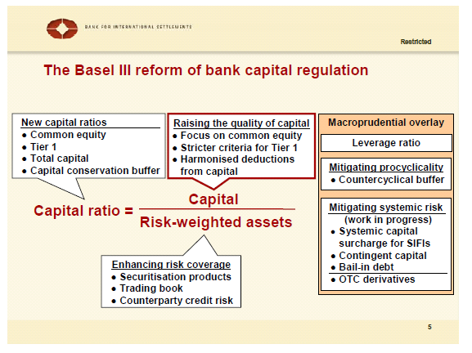
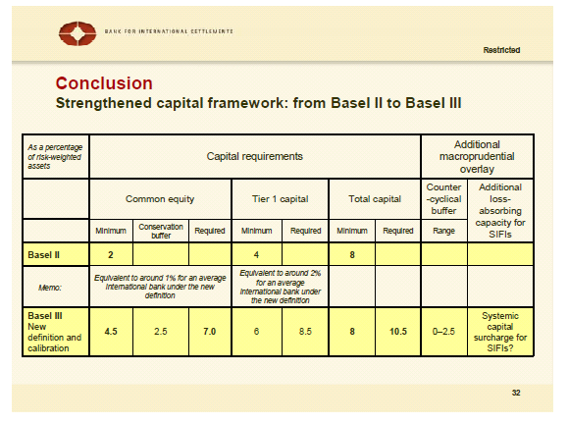
Basel III
Implications for governance
Increased focus on capital may distract from governance
How can governance contribute to robust framework for monitoring other risk and capital requirements?

Slide 15
Deconstructing the Definition of Operational Risk

Slide 16
The Definition of Operational Risk
What do we mean by operational risk?
Operational risk management had been defined in the past as
all risk that is not captured in market and credit risk management programs.
The Basel II definition of operational risk is:
Operational risk is defined as the risk of loss resulting from inadequate or failed processes, people and systems or from external events. This definition includes legal risk, but excludes strategic and reputational risk
S644, International Convergence of Capital Measurement and Capital Standards: A Revised Framework, Bank for International Settlements (2004)

Slide 17
Deconstructing the Definition
There must be a risk of loss.
Caused by:
(1) inadequate or failed processes
(2) inadequate or failed people
(3) inadequate or failed systems or
(4) external events.

Slide 18
Recent examples of operational risk in the Headlines
Fraud (Madoff, Stanford)
Unauthorized trading (Société General and UBS)
Insider trading (Raj Rajaratnam, Nomura, SAC Capital)
Technological failings (Knight Capital, NASDAQ Facebook IPO, anonymous cyber-attacks)
Weather catastrophes (hurricanes, tsunamis, earthquakes, terrorist attacks).

Slide 19
Exercise 1
Look at today’s newspaper and identify 5 different events that meet the definition of operational risk.
Operational risk is defined as the risk of loss resulting from inadequate or failed processes, people and systems or from external events.

Slide 20
Legal Risk
Specifically included
“Legal risk includes, but is not limited to, exposure to fines, penalties, or punitive damages resulting from supervisory actions, as well as private settlements”.
Footnote 90, Basel II

Slide 21
Exclusions
“This definition includes legal risk, but excludes strategic and reputational risk.”
S644

Slide 22
Banks Adopt the Definition
Operational risk is the risk of loss resulting from inadequate or failed processes or systems, human factors or external events.
JP Morgan Chase & Co., Annual Report, (2008) p117
Operational risk is the potential for failure (incl, the legal component) in relation to employees, contractual specifications and documentation, technology, infrastructure and disasters, external influences and customer relationships. Operational risk excludes business and reputational risk.
Deutsche Bank Financial Report, 2011 p110
Operational risk is the risk of loss resulting from inadequate or failed internal processes, systems or human factors, or from external events. It includes the reputation and franchise risk associated with business practices or market conduct in which Citi is involved.
Citi Annual Report 2011, p106

Slide 23
Societe Generale Event
Major ‘Fraud’
Jerome Kerviel
Low level trader from Delta One, vanilla trading desk
Hid positions totaled over $73bn (SG market cap is $50bn)
$7.2bn Losses incurred unwinding positions over 3 days
Red flags raised by
EUREX position enquiry in Nov 07
Middle and back office
Risk management
Accounting
Consequences
Supervisors fired
Head of IT security fired
Mr Kerviel arrested
Internal investigation
Regulatory investigation

Slide 24
Societe Generale (cont)
Causes
‘virtual’ OTC trades placed to offset real exchange trades
Personal ambition
Started small, and successfully
Attempts to hide gains ($1bn) resulted in losses
Passwords compromised
Knowledge of risk control environment : transferred from risk control department to trading desk
No vacation
Worked long hours
Advanced hacking skills
Supervisory lapses/indifference
Excuses accepted (fake emails)
Large bonus ignored

Slide 25
Societe Generale (cont)
Industry response
Regional and global discussions regarding:
Password integrity
Non-SOX systems
Front office non-LDAP systems
Use of cost center move reporting to shut off access
Increased awareness of password sharing policy
IT forensics
Tools to detect hacking
Development and production segregation of duties
HR
Back to front personnel moves
Mandatory vacation rules

Slide 26
Societe Generale Event (cont)
Kerviel quotes:
“I cannot believe that my superiors did not realize the amount I was risking. It is impossible to generate such profit with small positions. That’s what leads me to say that while I was positive [in the black], my supervisors closed their eyes on the methods I was using and the volumes I was trading. A trader can’t generate so much cash on a daily basis with standard activities”
“As long as we were winning, and this wasn’t too visible and suited everybody, nobody said anything”.

Slide 27
Five Key Regulatory Requirements for Operational Risk
If it meets the definition
Operational risk is defined as the risk of loss resulting from inadequate or failed processes, people and systems or from external events. This definition includes legal risk, but excludes strategic and reputational risk
Identify operational risks
Assess the size of operational risks
Monitor and control operational risks
Mitigate operational risks
Calculate capital to protect from operational risk losses

Slide 28
Seven Categories of Operational Risk
Internal Fraud
Losses due to acts of a type intended to defraud, misappropriate property or circumvent regulations, the law or company policy, excluding diversity/discrimination events, which involves at least one internal party.
External Fraud
Losses due to acts of a type intended to defraud, misappropriate property or circumvent the law, by a third party.
Employment Practices and Workplace Safety
Losses arising from acts inconsistent with employment, health or safety laws or agreements, from payment of personal injury claims, or from diversity/discrimination events.
Clients, Products & Business Practices
Losses arising from an unintentional or negligent failure to meet a professional obligation to specific clients (including fiduciary and suitability requirements), or from the nature or design of a product.
Damage to Physical Assets
Losses arising from loss or damage to physical assets from natural disaster or other events.
Business Disruption and System Failures
Losses arising from disruption of business or system failures
Execution, Delivery & Process Management
Losses from failed transaction processing or process management, from relations with trade counterparties and vendors.
Annex 9, International Convergence of Capital Measurement and Capital Standards: A Revised Framework, Bank for International Settlements (2004)

Slide 29
Exercise 2
Look at the 5 different events that you identified in Exercise 1 and place them in the correct Basel II Risk Category
Internal Fraud
External Fraud
Employment Practices and Workplace Safety
Clients, Products & Business Practices
Damage to Physical Assets
Business Disruption and System Failures
Execution, Delivery & Process Management

Slide 30
Operational Risk Management

Slide 31
Overview of the Operational Risk Framework
An operational risk program should ensure that operational risk is:
Identified
Assessed
Monitored & Controlled
Mitigated

Slide 32
“Sound Practices for the Management and Supervision of Operational Risk”
Guidelines for best practices for operational risk departments
Framework should
fit with the culture of the bank and
reflect best practice in the industry.
Sound Practices for the Management and Supervision of Operational Risk, Risk Management Group of the Basel Committee on Banking Supervision (2011), http://www.bis.org/publ/bcbs195.pdf

Slide 33
An Operational Risk Framework
Reporting
Measurement and Modeling
Governance and Organization
Risk Appetite
Internal
Loss Data
External Loss Data
RCSA
Scenario Analysis
Key Risk Indicators
Policies and Procedures
Culture and Awareness
* Risk and Control Self Assessment

Slide 34
The Foundations of the Framework
Governance
Escalation of risk
Who owns the Operational Risk functions?
What do the Operational Risk functions own?
Culture and Awareness.
training, marketing and building a brand for the operational risk function.
Policies and Procedures
Risk Appetite
Reporting
Measurement and Modeling
Governance and Organization
Risk Appetite
Internal
Loss Data
External Loss Data
RCSA
Scenario Analysis
Key Risk Indicators
Policies and Procedures
Culture and Awareness

Slide 35
The Four Data Building Blocks
Loss Data Collection
Internal Loss Data
External Loss Data
Risk and Control Self-Assessment
Scenario Analysis
Key Risk Indicators
Reporting
Measurement and Modeling
Governance and Organization
Risk Appetite
Internal
Loss Data
External Loss Data
RCSA
Scenario Analysis
Key Risk Indicators
Policies and Procedures
Culture and Awareness

Slide 36
The Outputs of the Framework
Measurement and Modeling
Reporting
Reporting
Measurement and Modeling
Governance and Organization
Risk Appetite
Internal
Loss Data
External Loss Data
RCSA
Scenario Analysis
Key Risk Indicators
Policies and Procedures
Culture and Awareness

Slide 37
The Use Test

Slide 38
Basel II Operational Risk requirements
Risk Management requirements
Identify, assess, monitor and mitigate operational risk
In all 7 risk categories
Internal Fraud
External Fraud
Clients, Products and Business Practices
Execution, Delivery and Process Management
Business Disruption and System Failures
Damage to Physical Assets
Employment Practice and Workplace Safety
Risk Measurement requirements
Gather all four elements for AMA
Internal Loss Data
External Loss Data
Business Environment Internal Control Factors
Scenario Analysis
For all 7 categories
Calculate AMA capital

Slide 39
Use Test
The “use test” is a regulatory standard that requires a bank to show that risk management standards are being used across the firm to support management decision
The Basel Committee on Banking Supervision has established how an AMA bank can demonstrate that the operational risk framework is embedded and effective and so meets the use test.
A bank may use various approaches to articulate and demonstrate the integrated use of its ORMF [Operational Risk Management Framework]. … The level to which the broader ORMF processes and practices have been embedded at all organizational levels across a bank is referred to as “embeddedness.”…
A bank should have sustainable and embedded ORMFs and policies that are used in its risk management decision‐making practices, with clear evidence of the integration and linkage between the measurement and management processes of the ORMF through the entire institution.
June 2011, the Committee published “Operational Risk—Supervisory Guidelines for the Advanced Measurement Approaches.”

Slide 40
Internal Loss Data

Slide 41
Operational risk event data
Not just losses, but a broader category of operational risk events.
Internal
External
Reporting
Measurement and Modeling
Governance and Organization
Risk Appetite
Internal
Loss Data
External Loss Data
RCSA
Scenario Analysis
Key Risk Indicators
Policies and Procedures
Culture and Awareness

Slide 42
Why collect operational risk event data?
capital modeling purposes
identify control weaknesses
risk mitigation activities
understand their current operational risk exposure and any areas of excessive risk
embed the operational risk discipline

Slide 43
Who should collect the loss data?
Departmental designee
Every employee
Finance, operations can capture events missed by front office
“if you see it, you must report it”
not associated with fault

Slide 44
What should be collected?
Any event that meets a firm’s definition of operational risk
Required data usually includes:
Risk event categories
Event-Type Category (Level 1) | Definition
Internal fraud | Losses due to acts of a type intended to defraud, misappropriate property or circumvent regulations, the law or company policy, excluding diversity/discrimination events, which involves at least one internal party.
External fraud | Losses due to acts of a type intended to defraud, misappropriate property or circumvent the law, by a third party.
Employment Practices and Workplace Safety | Losses arising from acts inconsistent with employment, health or safety laws or agreements, from payment of personal injury claims, or from diversity / discrimination events.
Clients, Products & Business Practices | Losses arising from an unintentional or negligent failure to meet a professional obligation to specific clients (including fiduciary and suitability requirements), or from the nature or design of a product.
Damage to Physical Assets | Losses arising from loss or damage to physical assets from natural disaster or other events.
Business Disruption and System Failures | Losses arising from disruption of business or system failures
Execution, Delivery & Process Management | Losses from failed transaction processing or process management, from relations with trade counterparties and vendors

Slide 45
Risk and Control Self Assessment

Slide 46
Risk and Control Self Assessment
Reporting
Measurement and Modeling
Governance and Organization
Risk Appetite
Internal
Loss Data
External Loss Data
RCSA
Scenario Analysis
Key Risk Indicators
Policies and Procedures
Culture and Awareness
46
Subjective and qualitative
An OR activity that ensures that you can identify, assess, control and mitigate operational risk
A method for the collection of business environment and internal control factors for Basel II AMA
An annual check up vs. a finger on the pulse of your OR exposure

Slide 47
What do RCSAs look like?
47
Questionnaire based
Usually annual
Standard questions
Distributed to representative in each area
Risks have standard expected controls to be scored
May have action tracking component
Output often captured in RCSA application/database

Slide 48
What do RCSAs look like?
48
Workshop/meetings based
Half day sessions with management teams
Brainstorming potential risks
Score mitigating controls and residual risk
Controls may vary
Some standard risks and controls
May have action tracking component
Output often captured on spreadsheets

Slide 49
Comparison of RCSA approaches
Questionnaire RCSA
Advantages | Disadvantages
Standard risks and controls ensures consistency Consolidated reporting is simple Use of standard expected controls helps ensure thoroughness Good with standard processes e.g. retail branches Can utilize technology for decentralized data entry | Possible to miss risks or controls that are not already listed Possible "check all" approach Irrelevant questions can cause frustration Can focus too heavily on control assessment Might have limited participation
Workshop RCSA
Advantages | Disadvantages
Taps management expertise and engages management team in OR awareness and mitigating action decision making Allows for raising of all risks and related controls Avoids irrelevant sections Allows for uniqueness of each area, good with differing processes e.g. wholesale securities business lines | Time consuming Might miss a standard risk and control Requires more complex data gathering Can focus too heavily on risk assessment Harder to consolidate or compare output
49

Slide 50
Impacts of Operational Risk

Slide 51
Impacts of Operational Risk
Impacts of operational risk events include:
Financial
Economic losses
Reputational
Adverse publicity
Legal and regulatory
Fines and settlements
Client and customer
Client dissatisfaction
Life safety
Employee safety compromised

