Slide 1
Donna Marie Howe CEO & Founder Windbeam Risk Analytics, LLC APR 19, 2017
Buy-Side
Risk Management

Slide 2
Table of Contents
Introduction
Structures of Buy-side Firms
Buy-Side Risk Strategies
Performance Analytics & Fee Structures
Risk Concerns & Solutions
Holding Capacity & Concentration
Key-man risk
Conduct risk
Due diligence issues
Liability risks
Fraud, AML & Data Privacy
3rd party vendor risks
Liability management
Leverage
Regulatory environment

Slide 3
TABLE OF CONTENTS
Other Issues
Modeling
Valuation
Leverage
Liquidity
Financing Methods
Types of Capital
Repo
Prime Brokerage

Slide 4
introduction
Similar goals

Slide 5
Risk-managing the Buy Side
How do funds (and dealers) lose money?
Over-leverage (e.g. LTCM)
Concentration
Illiquid Positions (e.g. Amaranth)
Fraud (e.g. Bayou, Wood River)
Protecting your firm requires a mix of quantitative and qualitative methods
NO SURPRISES!

Slide 6
Types of buy-side firms
Asset Managers (Black Rock)
Hedge Funds & Private Equity (HFOFs too)
Broker-Dealers
Insurance Companies
Commercial Banks
Retail Banks
Consumer Finance Companies
Corporates (utility company)
NGOs & Sovereign Funds
NGO: Non-government organization

Slide 7
What to do?
Utilize a range of analytic methods to measure the risks in client portfolios:
Evaluating “portfolio stress loss” based on a conservative product-customized stress-shock model
Assessing significant concentrations within client portfolios
Approval process for large and complex trades
Know the major client and their risks within the Business.
Have a process to validate accurate pricing
And not forgetting, a healthy dose of human judgment:
Risk team oversees risk and margin decisions in the business.
Risk Committee with senior business & support area persons: approves all major risk decisions;
Continual dialogue with clients and Credits to evaluate clients’ creditworthiness.

Slide 8
The Risk Management Process
What risks are you taking? Are there any hidden ?
Measure
You cannot manage what you do not measure.
Monitor
Are you being compensated for taking risk?
Evaluate
Are the risks you take the ones you want to take?
Discover
Are you within limits?
Are they sized the way you thought?
Risk
Methodology Choices

Slide 9
The simplest way to get a VAR?
Get the current positions
Get the values of the current positions
Get volatility assumptions for the positions
Position Value | Asset | Volatility over 10 day time horizon | If price declines 1 standard deviation, then new asset values is… | 68% chance over 10 days that the asset will lose no more than… | VaR (95%) is approximately 2.33 standard deviations so VaR =
10,000 | ABC | 10% | (1-10%)* 10,000 = 9,000 | 10,000- 9,000 = 1,000 | 2,330
50,000 | DEF | 6% | (1-6%)* 50,000 = 47,000 | 50,000 – 47,000 = 3,000 | 7,000
25,000 | XYZ | 25% | (1-25%)* 25,000 = 18,750 | 25,000 – 18,750 = 6,250 | 14,580

Slide 10
Then what? Correlation kicks in
Correlation/covariance matrix creation
If all the price changes are driven by the same event (positive correlation), then the portfolio could lose $23,910
If the price changes are all driven by different, independent events; then the portfolio could lose perhaps $7,970
If the event for one asset causes gains for the other two (negative correlation), the loss could be $5,250

Slide 11
Flaws in the assumptions
Definition is non-constructive
This means that the definition of the term specifies the attributes of the measure, but not precisely how to calculate it. This leads to the large range of “common” implementations.

Slide 12
Structures

Slide 13
Not all Structures See Risk the Same
Investment Banks are primarily total return
Many pension funds are Net Interest Income based
Some hedge funds manage to Maximum Probable Drawdown
Others focus on correlation and skew; outperform in down markets

Slide 14
Stand-alone Funds
Separate legal entity
Articles of Incorporation
Investment Advisor appointment
Investment Management Agreement
Services
Sub-adviser relationships
Custody
Transactions
Reporting
Fees
Acknowledgement of Risks
Regulatory & Legal issues; Disclosures
Termination of agreement
Key Man, etc.
Investment Strategy Statements
Fund
Investment
Advisor
Investor
Custodial Bank

Slide 15
Master-Feeder Structures
Multiple legal entities
Master fund is counterpart
Feeder funds own the assets
Investment Advisor
Master Fund
Feeder Fund A
(domestic)
Investor
Feeder Fund B
(offshore)
Investor
Bank

Slide 16
Fund of Funds
Investor
Fund of Funds
Cash
PM #1
Bank
PM #2
Bank
PM #3
Bank
2 layers of fees – FoF manager and PMs
Selection bias for FoF manager

Slide 17
Indexed Funds
Fund
Asset 3
Asset 1
Index
Asset 3
Asset 2
Asset 1
Index funds might be full replication (passive) or partial replication of an index (active management), The risk tolerance is generally defined as the level of tracking error you want to take.

Slide 18
Mutual Funds (Active Management)
Short Duration
Balanced Fund
Long Duration
Active funds are like buying a little piece of a trading desk. They have targets and goals, but are not as tightly constrained as an index fund

Slide 19
Insurance Risk
Investment Fund
Claims
Policy Premiums

Slide 20
Insurance Risk Process
Liability Cash Flows
Risk Neutral Cash Flows
Risk Adjusted Spread
Benchmark Portfolio
Assets

Slide 21
Broker-Dealers
Regulation
Principal vs Agent
Tri-party agreements
Conduits
Role in Funding
Client
Order
Broker
Routing System
Exchange
Fill
Client 2

Slide 22
STRATEGIES
Issues in Principal/agent

Slide 23
Principal/agent
Customer
Long or Short DURATION
Opportunity or Fixed
Portfolio Manager
Concentration
Risk Factor
Fund
Discretionary (Alpha)
Systemic (Beta)

Slide 24
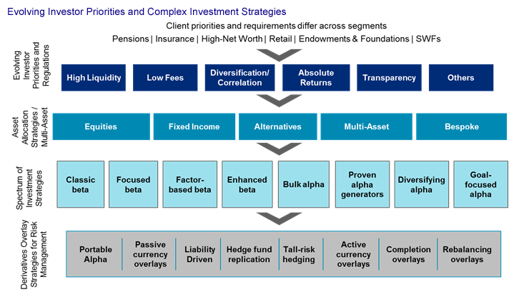
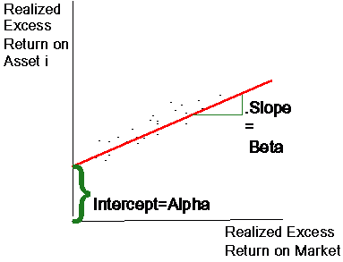
Alpha vs. beta

Slide 25
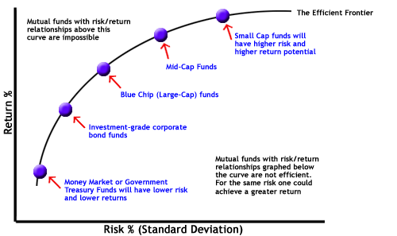
Beta
Lower cost
Market factor replication
Correlation checks

Slide 26
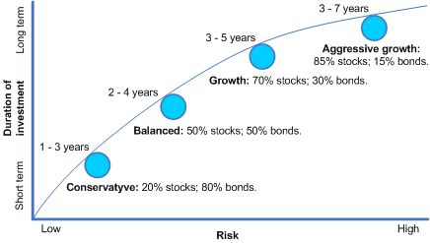
beta

Slide 27
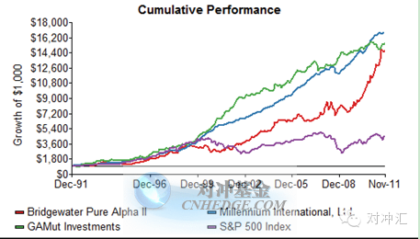
Alpha
Higher fees
Idiosyncratic returns
Correlation checks

Slide 28

Non-market Risks
Weather; Terrorism; Pandemic
Calculating Aggregate Exposures
Systems
Reinsurance
Catastrophe Bonds

Slide 29
More non-financial
Incentives
Whistleblowing
Fraud
Client –focus
Data Privacy
Segments& Product mix
Sales practice
Fiduciary Rules

Slide 30

Due diligence
Fraud, AML & Data Privacy

Slide 31
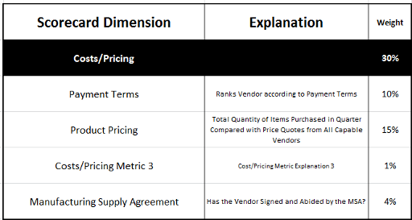
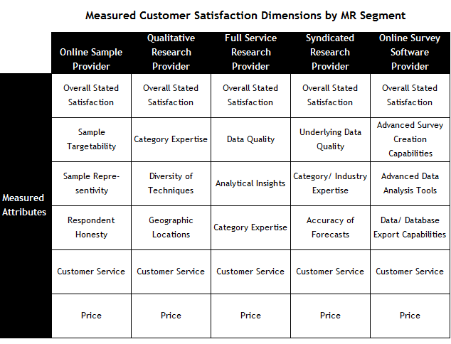
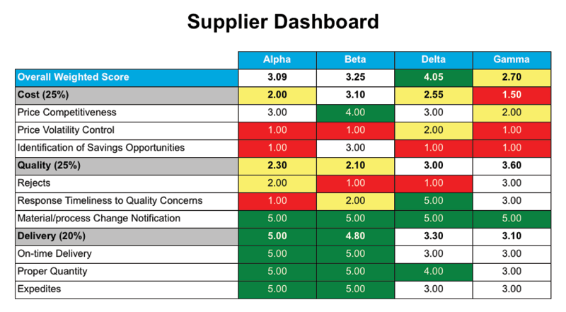
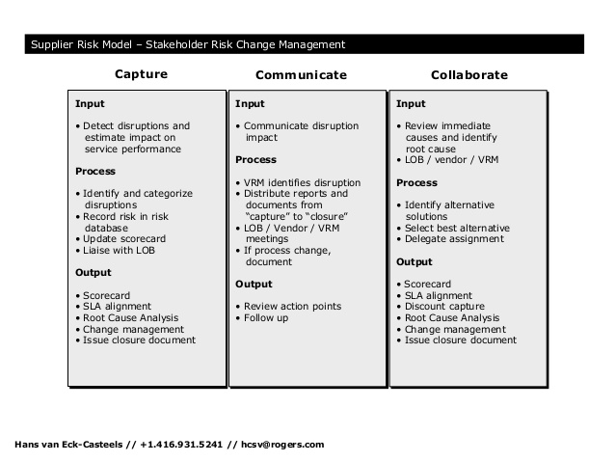
Score Cards
Away of making qualitative decisions more consistent and comparable
Subjective but reasonable inputs
Early behavioral modeling

Slide 32


LEVERAGE

Slide 33
Leverage & NAV
Leverage is the amount of securities controlled relative to the amount of capital in the account
The traditional calculation is:
L = (LMV+ Cash)/Capital
More conservative, L_{MOD}=(ABS(LMV)+ABS(SMV)+ CASH)/CAPITAL
Begs the treatment of zero cost derivatives like IRS, CDS
What about the cash coming in from shorts?
Inflates cash number in traditional formula!

Slide 34
How do you get leverage?
Borrow money
Unsecured
Secured
Brokerage & Reg T
Banks & Collateral

Slide 35
Definitions
MARGIN refers to both 1) the amount of upfront cash needed to complete a trade and 2) the cost of the borrowed monies
Initial Margin (IM) is the amount of upfront monies the fund will post to do a trade.
Variation Margin is the daily exchange of P&L on the trade
Total margin = IM+VM
This does not reduce credit exposure, but increases recovery rate
Purchasing securities on margin = borrowing money and posting securities as collateral
Debit balance is the amount owed the broker, minus profits on short sales
Credit balance is the amount of excess collateral lent to the broker

Slide 36
Margin Games
Initial Margin can be a static or a dynamic figure. The amount is dependent on the volatility of the traded product and the time frame to settlement.
Direct trading desks will try to negotiate the IM between their credit officer and the client
COs and PBs will set the IM at a level to cover all or part of the product volatility, dependent on
Their view of the risk of the fund defaulting (Probability of default)
The amount of residual equity in the legal entity after investors are redeemed (recovery rate)
Estimated client position unwind period
The regulatory capital methodology employed by the Bank

Slide 37
Why Prime Brokerage?
Acting as the Banker for traders and fund managers
Getting leverage by margining trades
Posting margin to exchanges on your behalf
Acting with Correspondent Banks to settle non-domestic currencies
Give-up and Intermediation products
Capital Introduction
Ultimate profit is from client balances: rates charged on debits vs. rates paid on credit
Access to markets
ACCESS TO CREDIT

Slide 38
How else to get Leverage?
Repos/Reverses
Securities Lending
Lend out the securities you own to brokers who lend them onwards
Operationally intensive
Historic challenges of rehypothecation

Slide 39
Collateral and Credit Risk
Collateral does not impact Counterparty Current Exposure (CE)
-CE is the (-)mark-to-market of all positions with the counterparty, also known as the Replacement Cost. This is how the fund is evaluated by their counterparty bank
It increases the Recovery Rate for defaulting counterparties
Reduces theoretical Loss Given Default (LGD)
= Expected Exposure * (1-RR)

Slide 40
Leverage & Liquidity
You can use leverage, and you can deal in illiquids. Doing both simultaneously is dangerous! See the SIVs…

Slide 41
Liquidity

Slide 42
Liquidity
Periodicity of when you can unwind a legal investment agreement
Ability to place a trade in a given size (Sell-side)
The ability to fund liabilities as they come due

Slide 43
Liquidity – a buy-side definition
In this context Liquidity refers to when you can liquidate the investment
Mutual funds
Liquid assets
100% of capital required on Day1
100% invested Day 2
Daily redemption capability
Hedge Funds
100% of capital required Day1 for existing fund; new funds may ramp up
Fully invested Day 2
Possibility of side-pockets; liquidating trusts
Quarterly or annual redemption with 30-90 day advance notice
Private Equity structure
May include a ramp-up period; could last 3 year or more
Tail period of unwind could be much longer than original projections
Quarterly or annual redemption with 30-90 day advance notice
Often significant portion of assets are illiquid

Slide 44
New Rules
Retail – stable NAV (Net asset value in Money market fund)
Institutional - floating NAV

Slide 45
Liquidity Measures
In the markets, a lack of liquidity is the inability to execute a trade
Most illiquidity claims are a reluctance to move price – check VWAP against Hi/lo
Look for breadth of market – defined as number of two-way participants
Breadth sharply declined in 2008 with failure of Bear, Lehman, and closing of 30-odd large funds
Depth of market defined as size of trade possible without moving price significantly
US Treasuries typically the poster child for liquidity
Market becomes one-sided as firm de-leverage
Depth significantly reduced

Slide 46
Close-out risk
Defined as the additional costs involved in unwinding portfolios of defaulted counterparties
Most firms mark-to-market at mid ; unwind will at very least be done at bid or offer
Question of unwind trades or execute offsetting hedge and let bad trades roll off
Increases operational risks due to re-booking trades; monitoring hedge execution and effectiveness; restructuring parts of portfolio to reduce model risk or move into more liquid sectors of the market

Slide 47

Common risk tools

Slide 48
Introduction to New Metric: Tracking Error
It is a measure of potential expected difference in return between an actual portfolio and its benchmark portfolio
It incorporates differences in Expected Mean Return E(r) and differences in Volatility
TE = STANDARD DEVIATION[(Return(Portfolio) – Return(Benchmark)]

Slide 49
Here’s an example…
Expected Return = 5.25%, Standard Deviation = 14.28%
Expected Return = 2.15%, Standard deviation = 4.65%

Slide 50
Arrives at the Distribution of Excess Returns
The TE is the standard deviation of the resulting distribution. It is also called the “Active Risk”. There is a corresponding increase in expected return when running active risk in a portfolio.
Average = +63 bps
TE = 192 bps
Scale now in BPS rather than %

Slide 51
Caveats
The TE is used both ex-ante and ex-post. Ex-ante is predictive and can be used to asses whether the size of an increase in expected return is sufficient for the increase in Active Risk taken on.
TE is more predictive the longer the time period it has been measured
AND the more stable the mandate of the portfolio
TE is used ex-post to examine the contributions to performance and whether the expected returns have been accurately assessed.
It is vulnerable to changes in volatility
It can be misleading (quite large) when the actual portfolio is not normally distributed

Slide 52
Systemic Risk
Systemic Risk in CAPM is also known as Beta Risk; viewed more as idiosyncratic in some arenas
(Excess Expected Return of the Asset)/(Excess Expected Return of the Market) is Beta in CAPM
Residuals from Hedge Effectiveness are viewed more as idiosyncratic risk
Regress risk position against portfolio of hedge instruments – residual is idiosyncratic

Slide 53
So if systemic risk is market risk…
Idiosyncratic risk is the residual
In theory, the residuals are uncorrelated
In practice, we see Beta risk as the risk that can be hedged by an index
Some residual risks can then be offset by single instrument CDS or futures
Some alpha is due to no hedge instrument
If you can’t hedge it – it should get a higher expected return

Slide 54
Tracking Error as an Attribution Tool
Tracking Error
Systematic -Market
Duration
Correlation
Systematic – Credit
Idiosyncratic – Credit
Duration
Other Idiosyncratic Risk

Slide 55
Credit Risk for the Buy-Side
Individual name exposure
Portfolio level exposure
Concentration risk
Default
Migration/Transition
Credit Spread Volatility
Liquidity
Portfolio Exposure
Single Issuer
Concentration

Slide 56
Vocabulary
Credit Exposure – the MTM losses that will occur if a default event occurs, less the expected recovery from the estate. Positive exposure results are “In the money” positions, Negative exposure results are “Out of the money” positions.
Potential Future Exposure – the possible exposure that exists given a particular shock or set of shocks to the market. Often used with zero-cost derivatives
Loss Given Default – the rate of loss on exposure given a default event; includes rate of recovery, physical replacement costs, etc.
Expected Default Frequency – aka the probability of default; i.e. the likelihood that a default will occur. These can be calculated either Through-the-Cycle or Point-in-Time (PIT)
Scenario – a particular combination of parameters (price, default event, loss given default).
Expected Loss – the average loss over all shocks and/or scenarios.
(Average Potential Future Exposure )x (Loss Given Default) x (Default Frequency)
Credit VAR – (Merton or Vasicek models) the worst case loss at a defined confidence interval.

Slide 57
Credit Exposure Reporting
Single Obligor Limits
Notional
Market-Value
Loss Given Default
Maximum Probable Loss
Loan
Equity
Corporate Bond
Derivatives counterparty
Structured Deal sponsor
CDS

Slide 58
VAR vs. Credit VAR
VAR (Value at Risk)
Quantifies risk due to market moves using a confidence interval and time horizon.
Example: There is a 95% chance that trading losses over the next 1 month will be less than $2,000,000.
confidence interval
time horizon
risk amount
Credit VAR (Value at Risk)
Quantifies risk due to defaults or changes in creditworthiness using a confidence interval and time horizon.
Example: There is a 95% chance that losses due to default over the next 1 month will be less than $2,000,000,000.

Slide 59
Stress Testing & Scenario Analysis
Stress and scenarios as the question “what if?”
The goal for good risk management is to have no surprises…how to achieve?
Map all potential combinations of changes in risk inputs to macroeconomic events.
For example>>>
Then create a set of scenarios where these combinations are stressed regularly.
Governance can be asymmetric
Low probability events can have looser limits; high probability events have tighter monitoring
Interest Rates | Credit Spreads | Volatility
+ | + | +
_ | _ | _
+ | _ | _
+ | _ | +

Slide 60
Stress Variables and Economics

Slide 62
CONTACT INFO:
Donna Marie Howe, CFA
CEO & Founder
Windbeam Risk Analytics, LLC
donna@windbeamrisk.co
www.windbeamrisk.com

